Slide 1
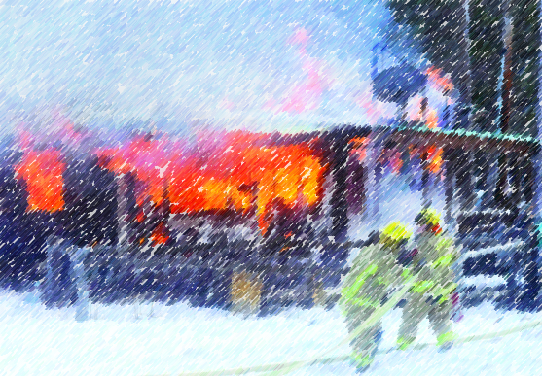
Big Prevention Small Department
DC Haas,
Fire Chief, Smith Valley Fire District

Slide 2
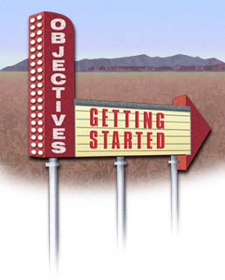
Objectives:
Introduction
Prevention, overview
Budget & Funding
Marketing
Failures
Successes

Slide 3
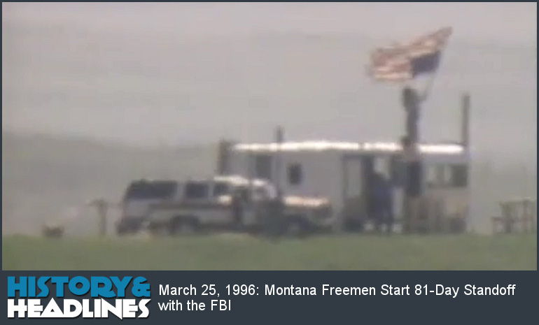
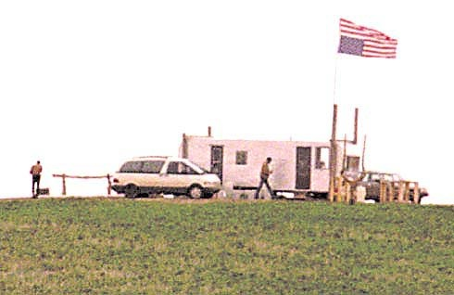
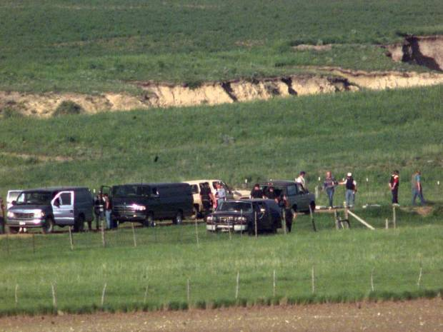
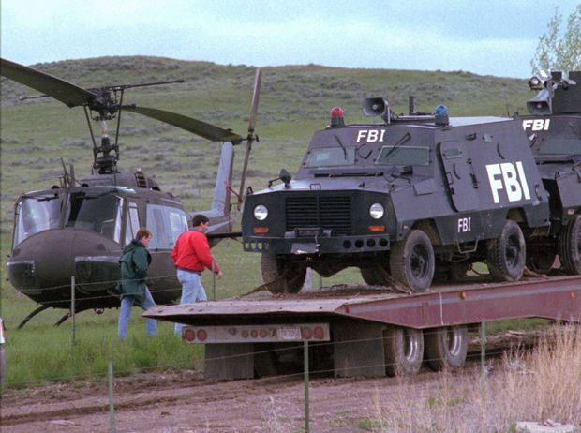

Slide 4
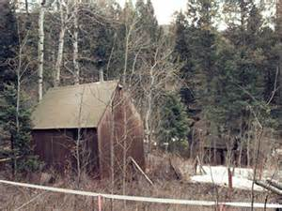
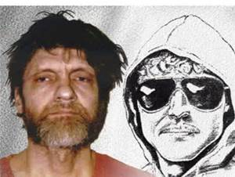

Slide 5
Introduction:
Missoula Rural Fire District
Montana DSL, later Montana DNRC
Keep Oregon Green
Montana DNRC
Kalispell Fire Department
Glacier National Park
Smith Valley Fire District

Slide 8
Flathead County population, 94,000
Kalispell city population 21,500
Smith Valley Fire District Population 6,500
Smith Valley Fire District Area, 69 square miles (300 sq. mi. responce area).
Flathead County average income $46,500

Slide 9
Foy’s Lake

Slide 10
East area facing Kalispell city limits

Slide 11
Interface

Slide 13
Smith Lake,
Highest fishing use in Northwest Montana

Slide 14
$824,000

Slide 15
Average Smith valley area home $282,650

Slide 16
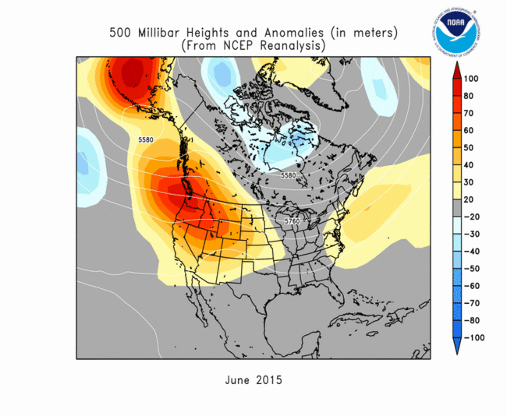
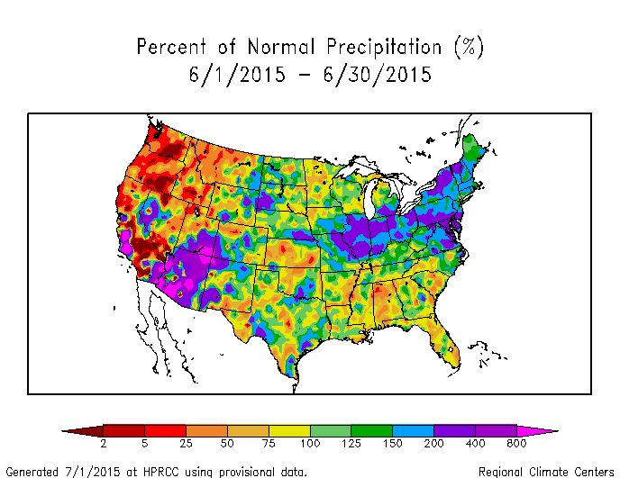
Remember last June?

Slide 17
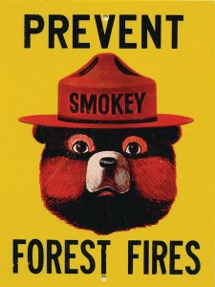
Fire Prevention Overview

Slide 18
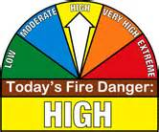
THREE E’S of FIRE PREVENTION

Slide 19
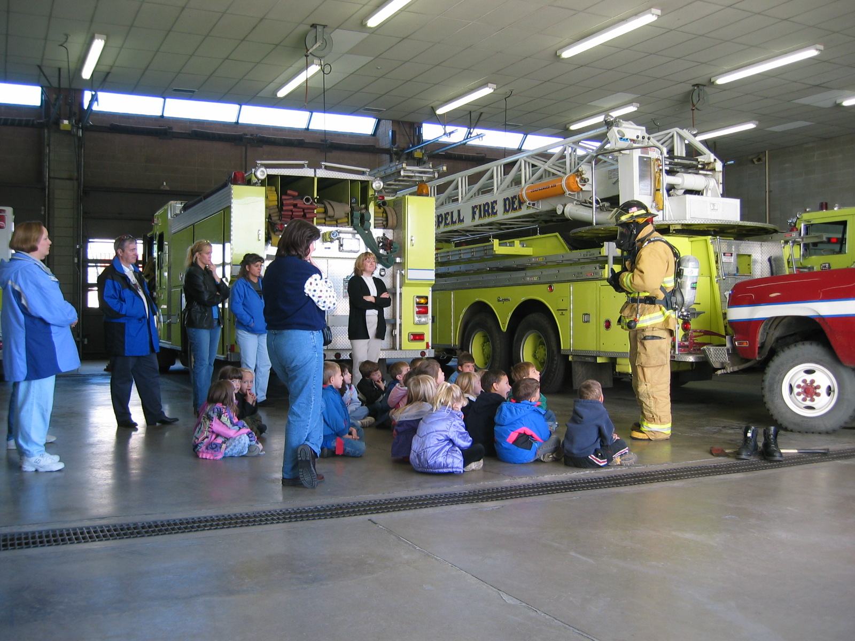
education

Slide 20
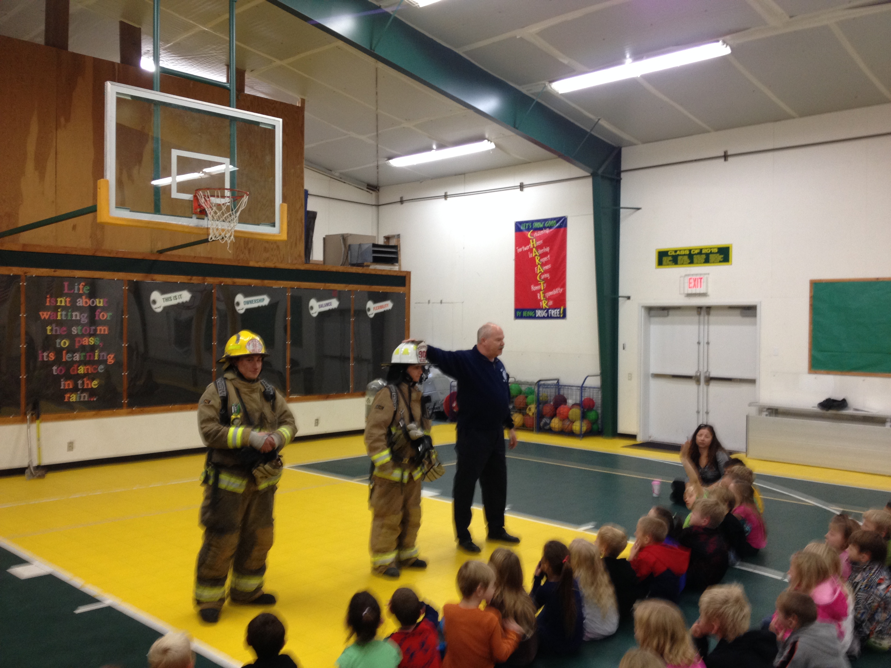

Slide 21
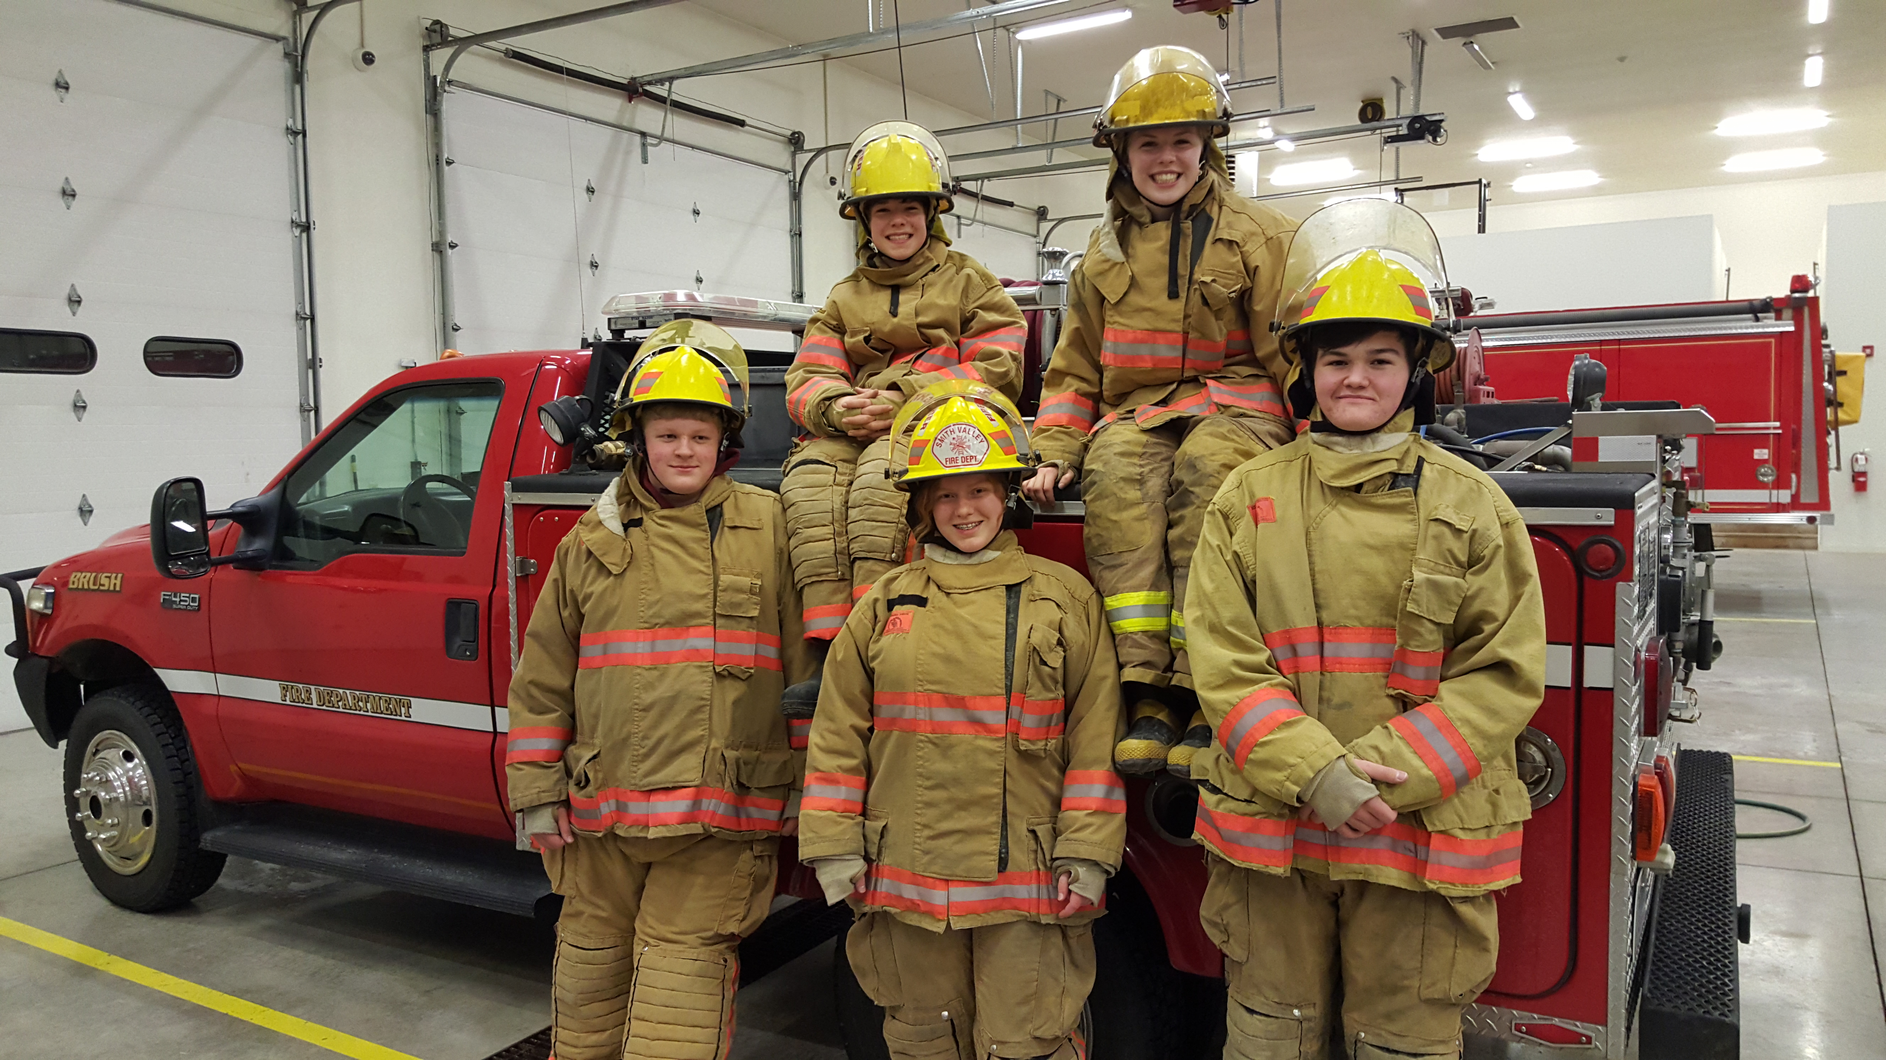

Slide 22
Education

Slide 23
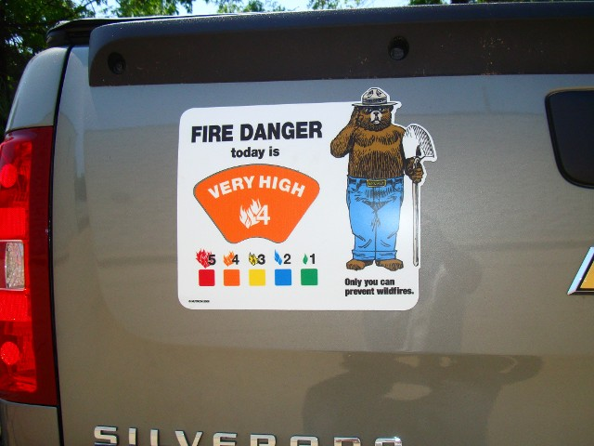

Slide 24
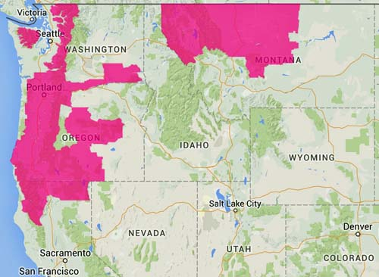
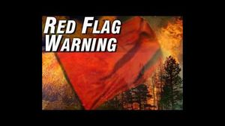

Slide 25
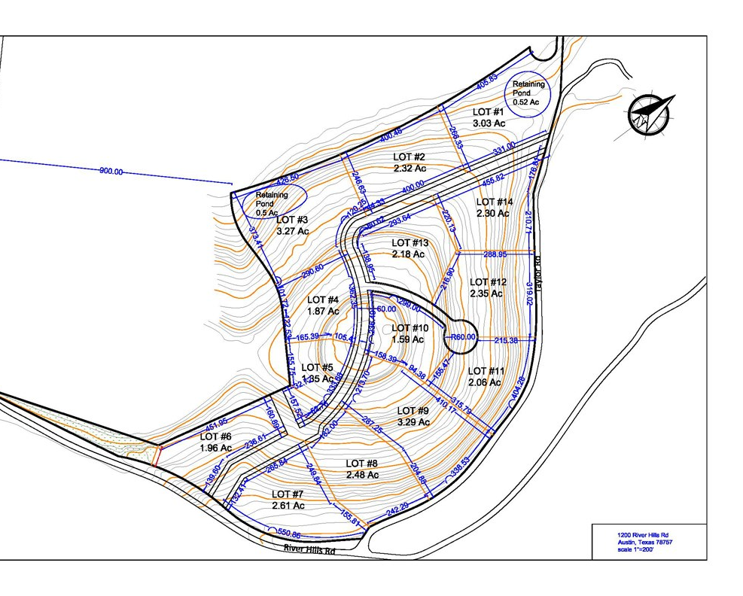
engineering

Slide 27
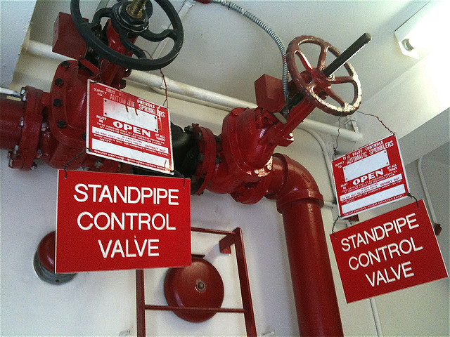
Plan review

Slide 28
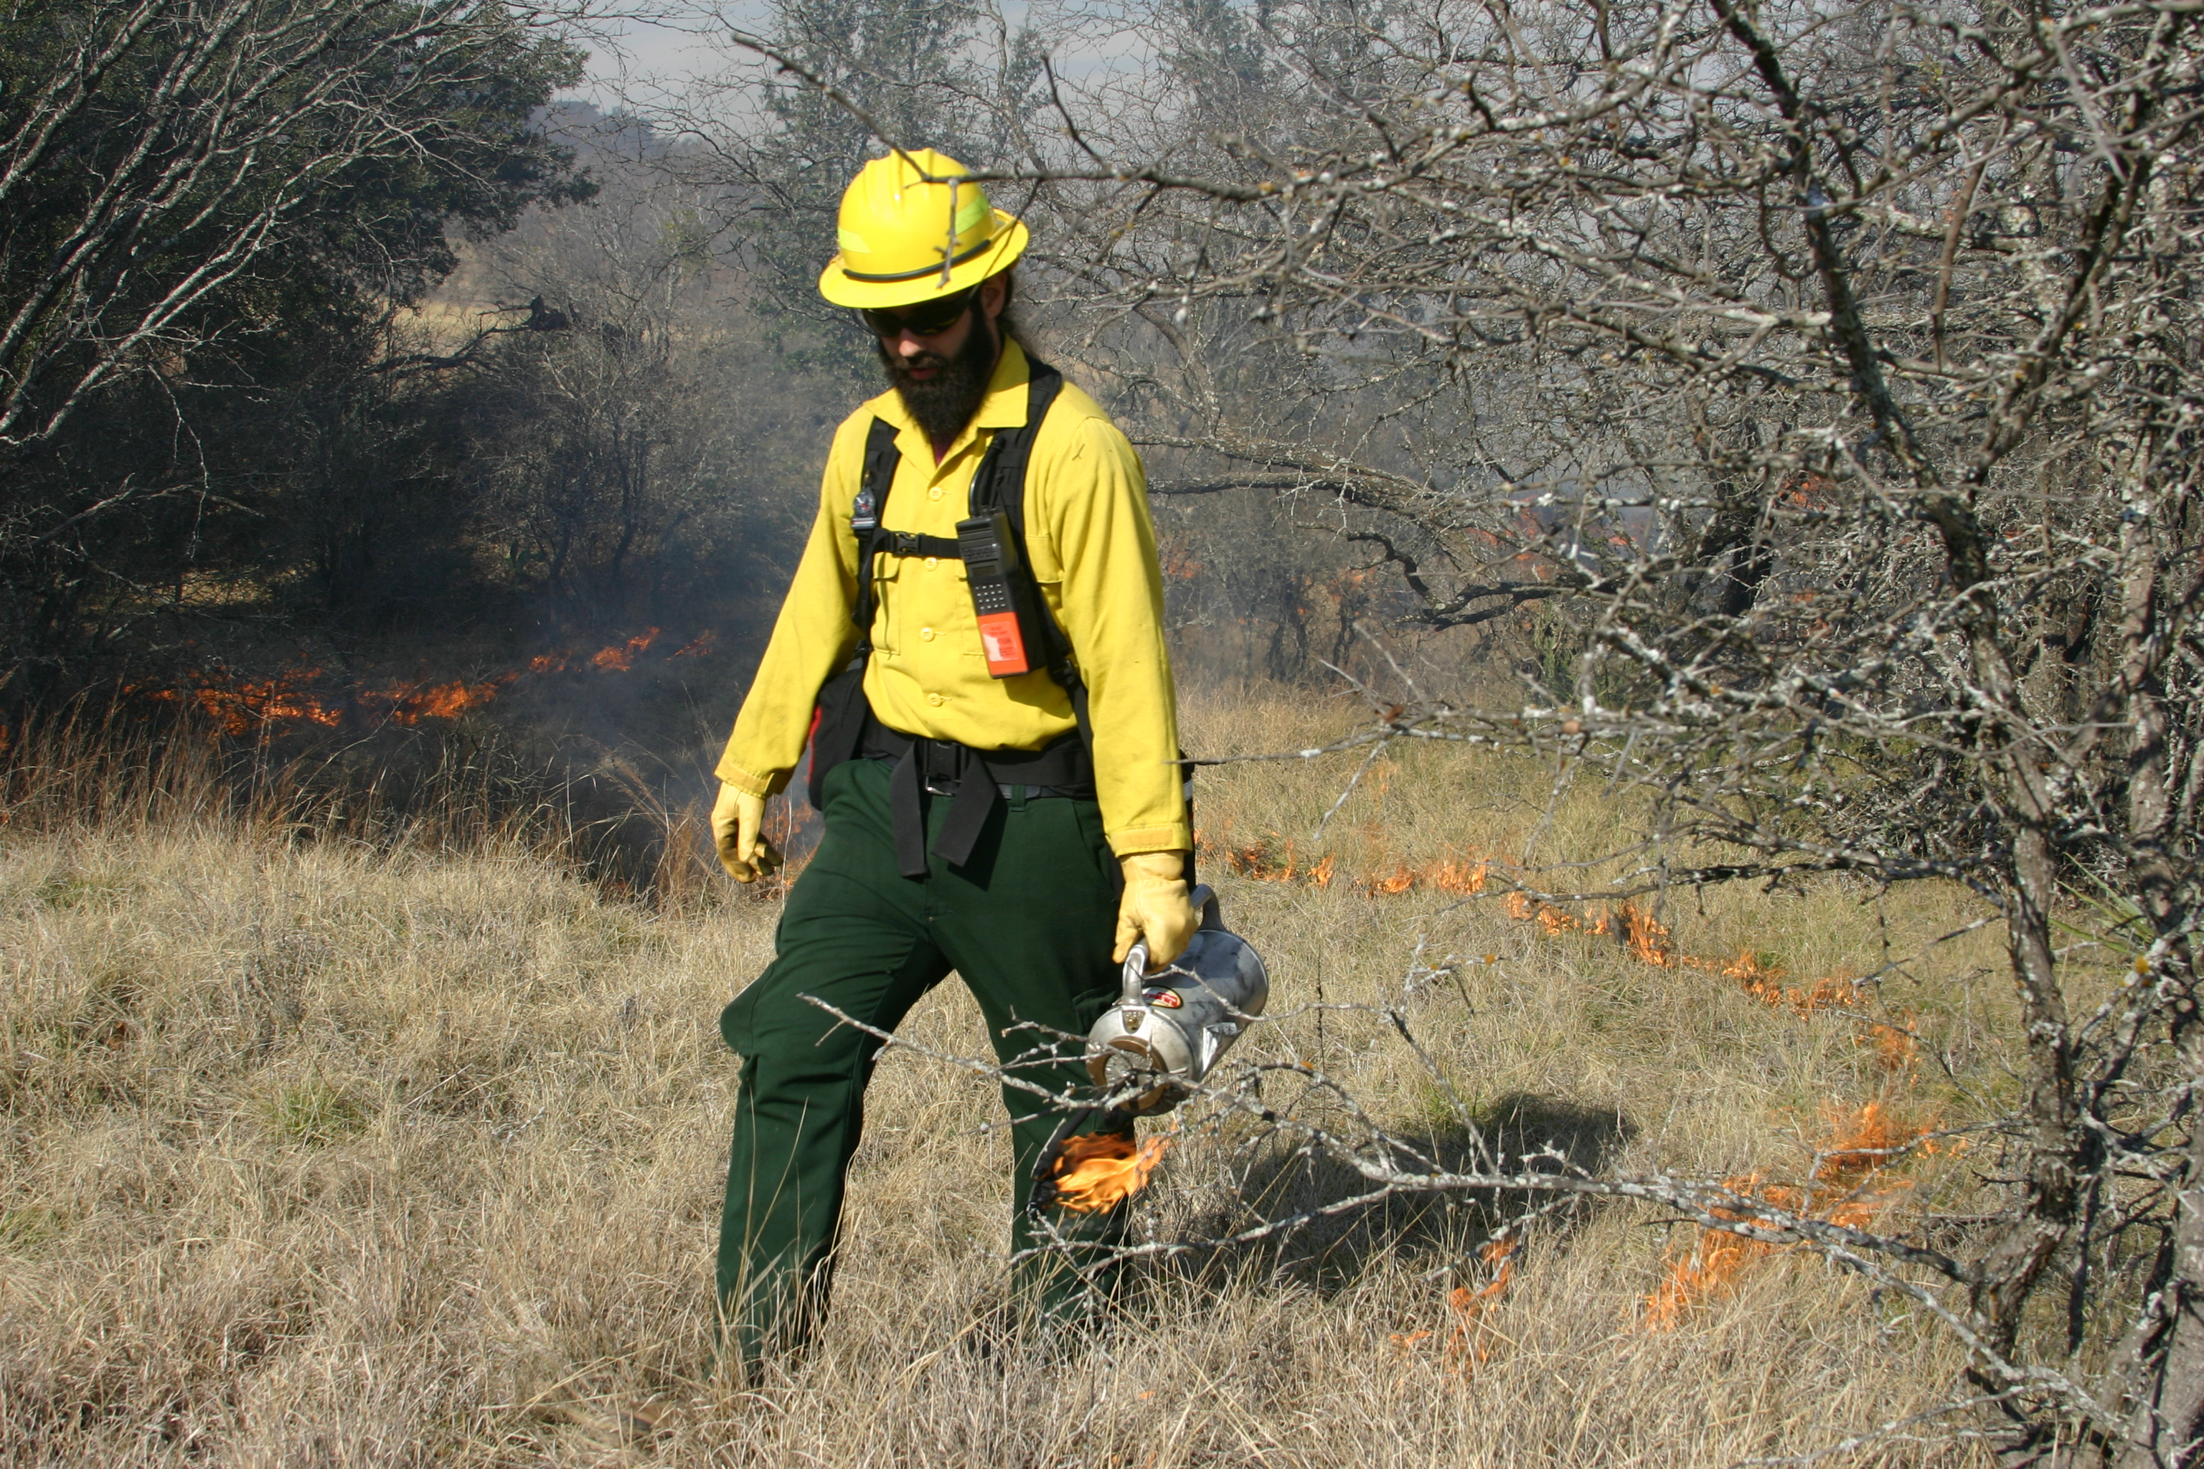

Slide 29
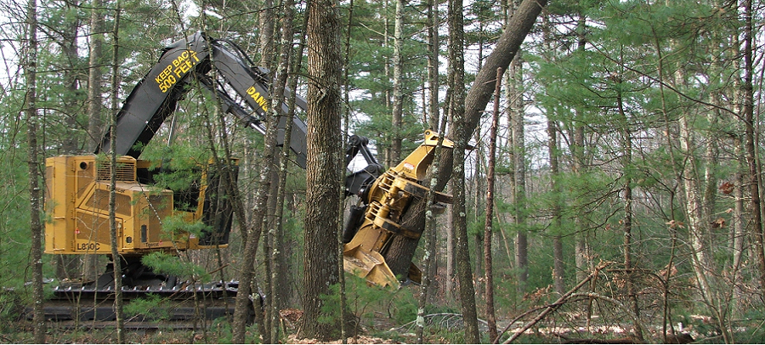
Engineering Partnerships

Slide 30
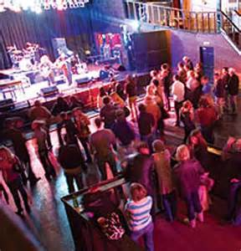
enforcement

Slide 31
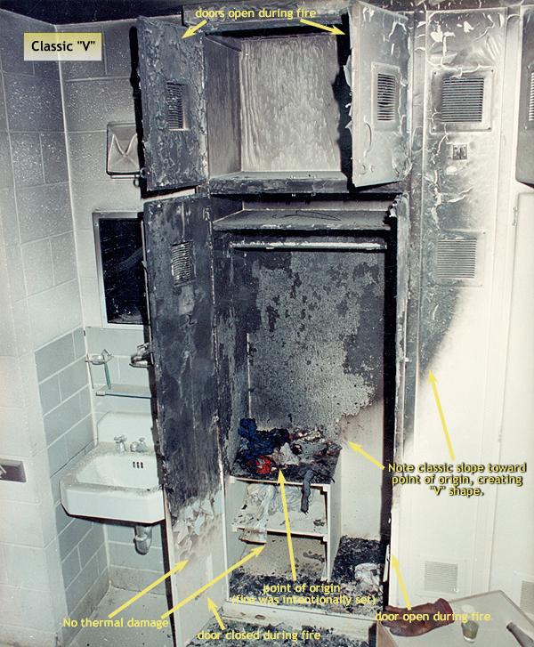
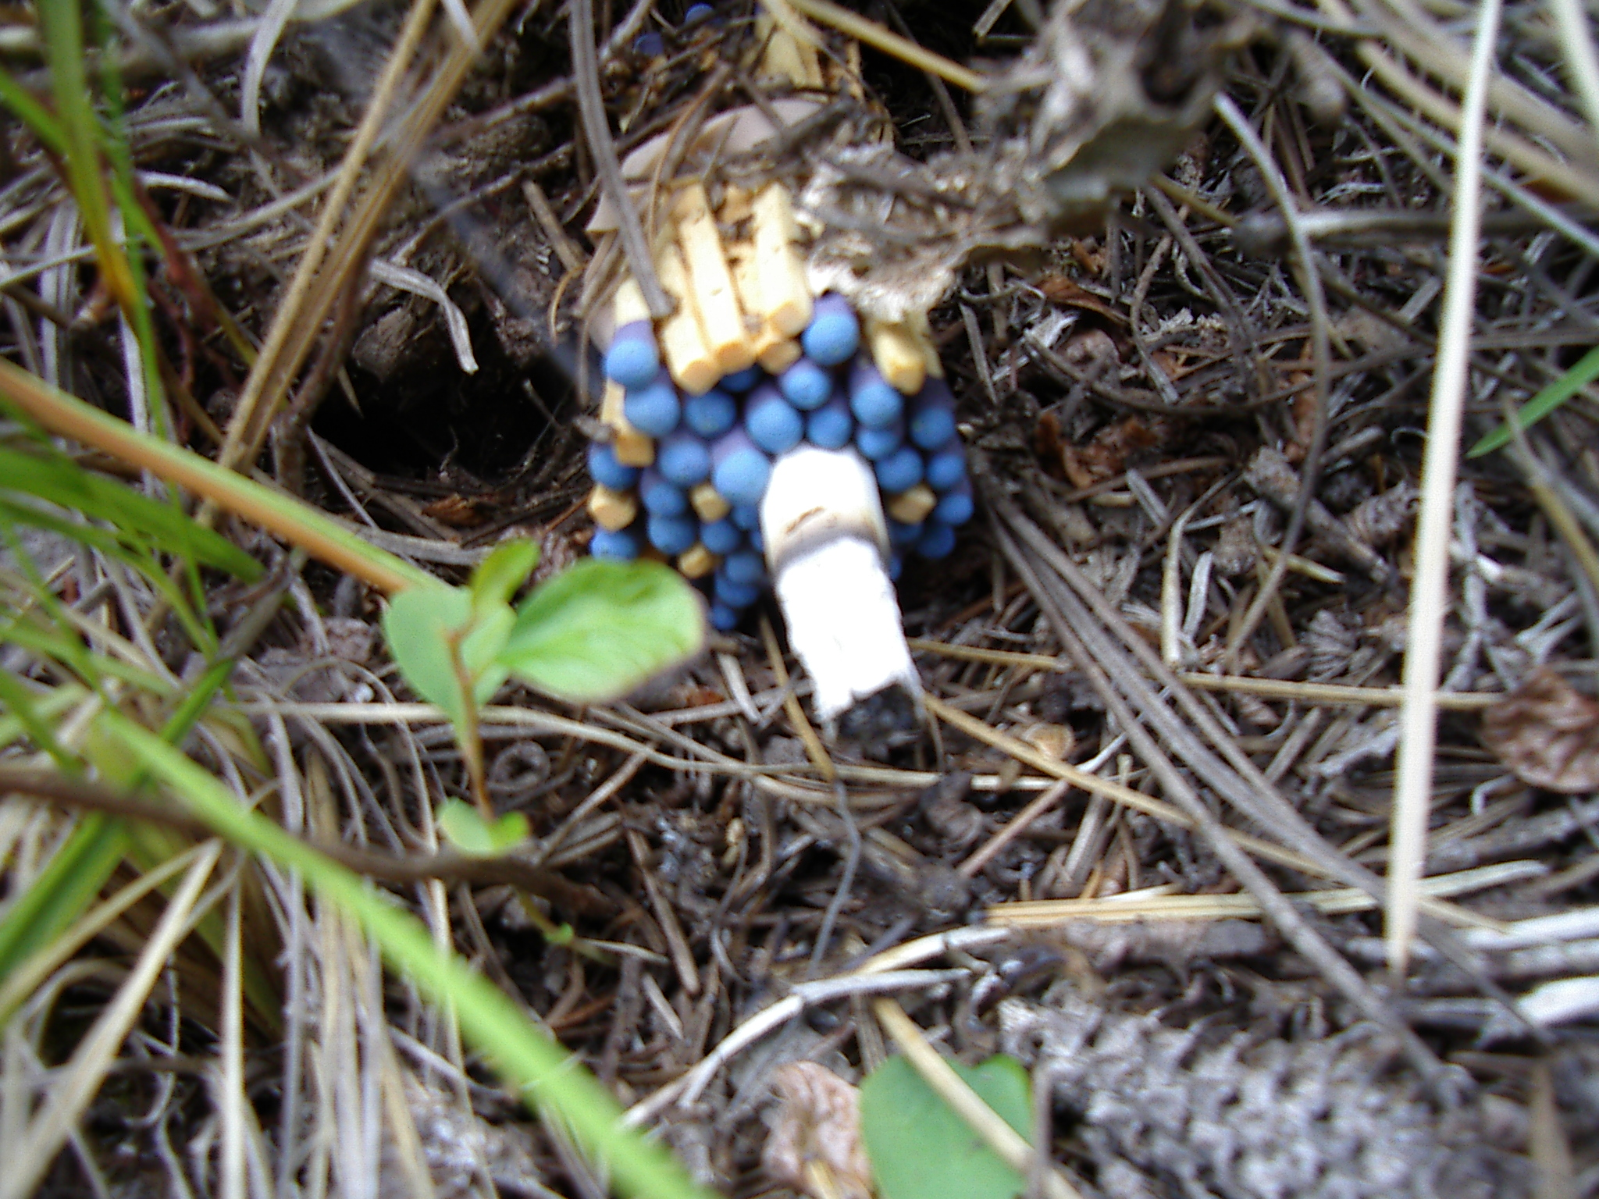
Cause and origin

Slide 32
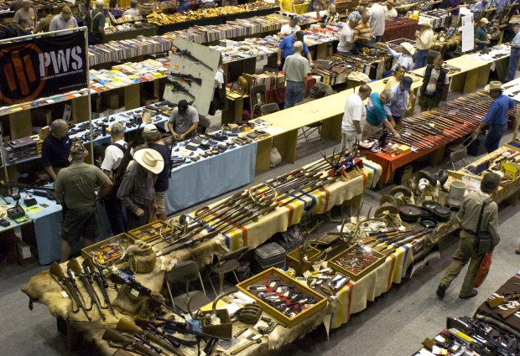
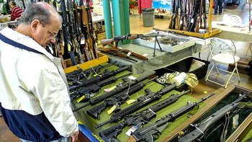
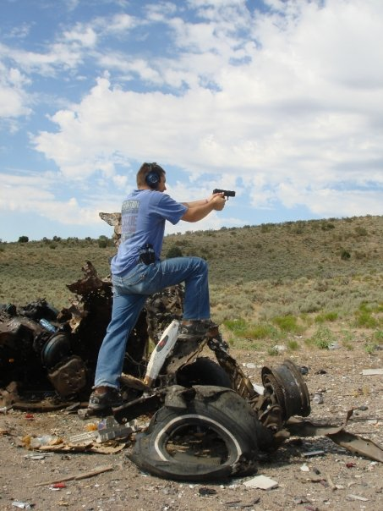
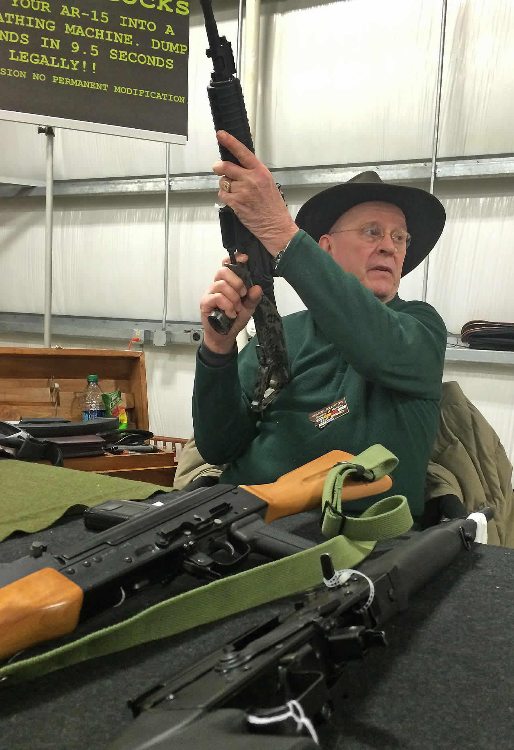
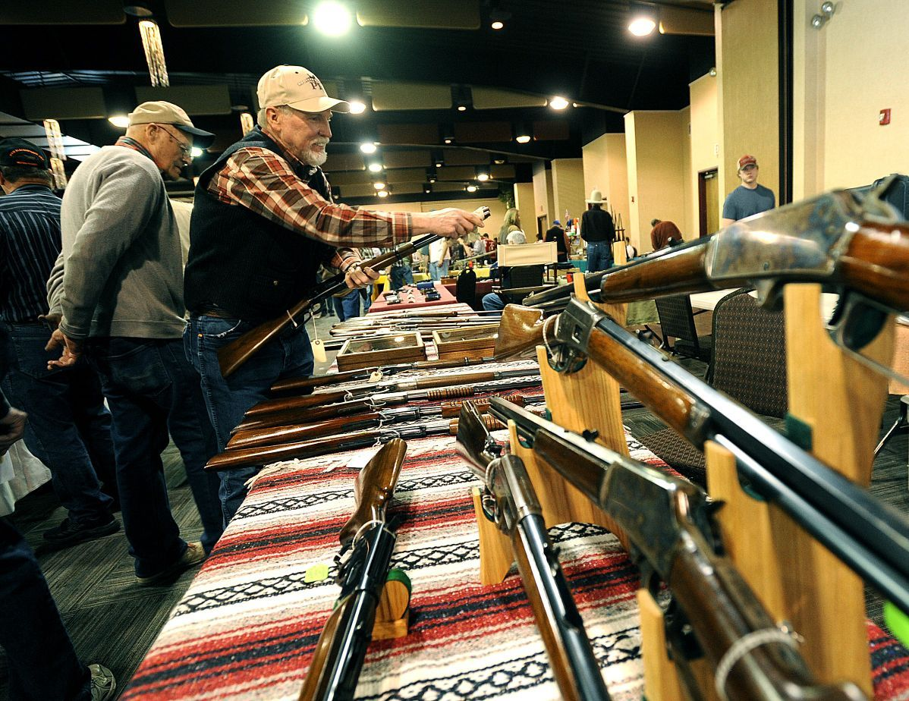

Slide 33
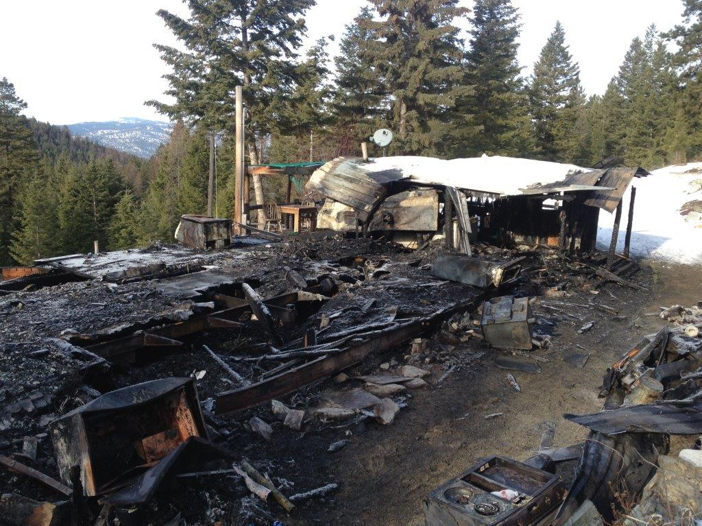

Slide 37
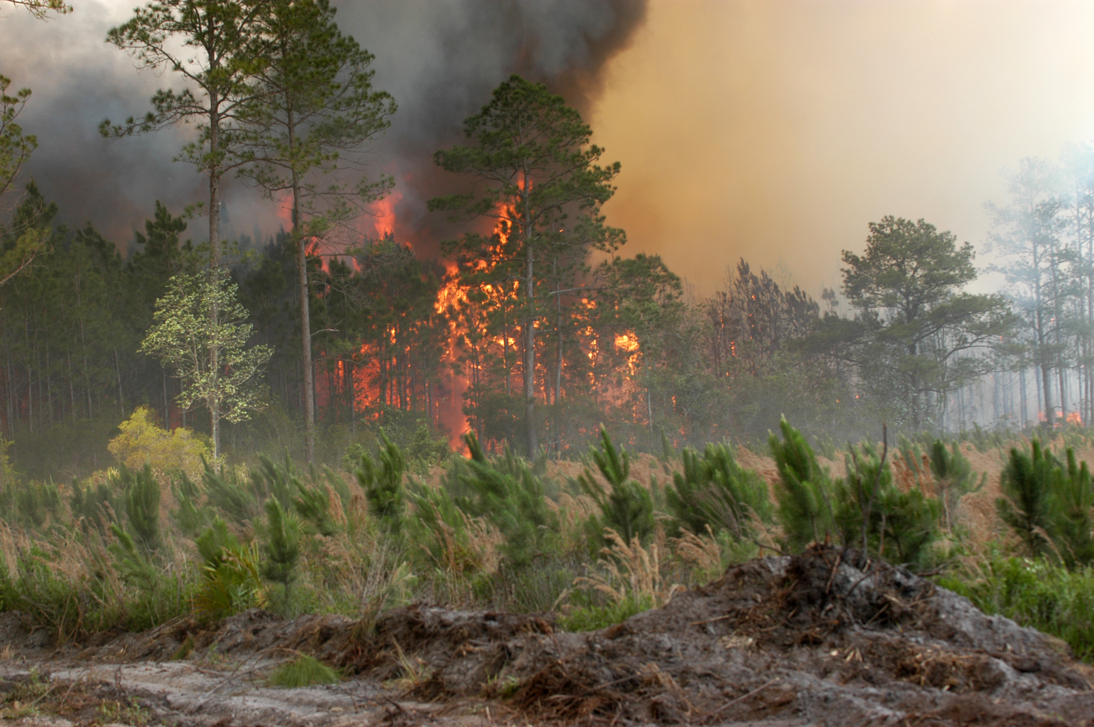
EDUCATION
ENGINEERING
ENFORCEMENT

Slide 38
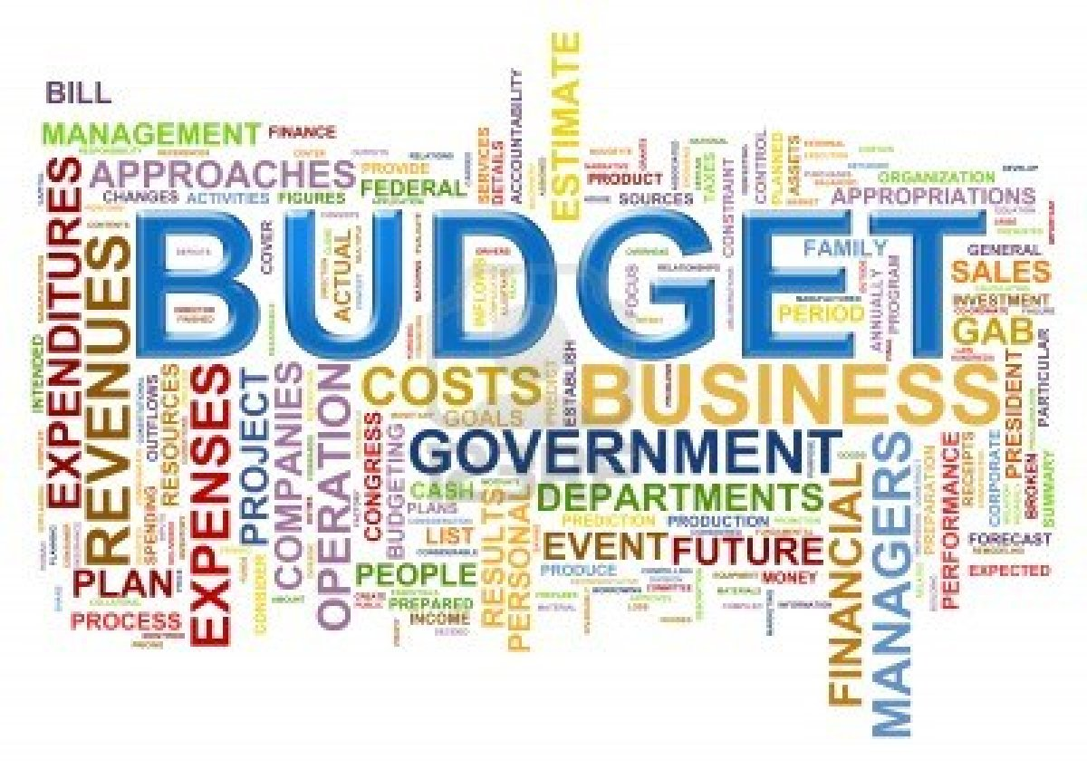
how do I pay for it?
Line item approved though tax base
Grants
FEMA
State
Insurance
DOT
Cost share partnerships:
Local, State, Federal
Donations
Fund raising
Auxiliary

Slide 39
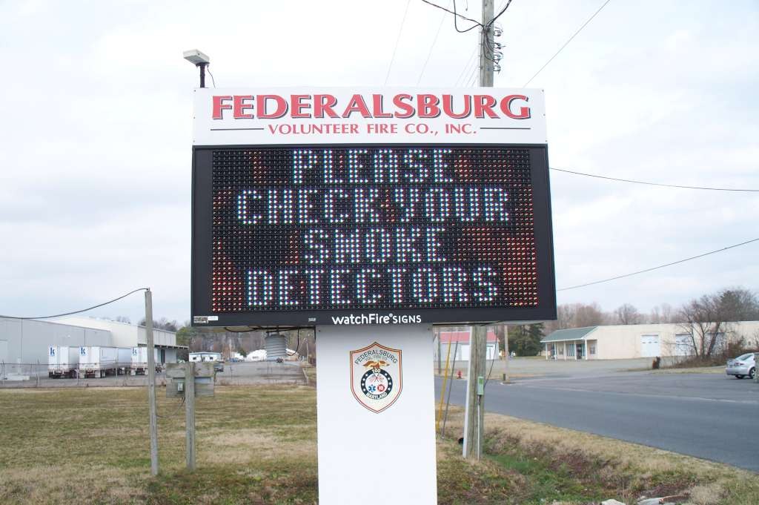
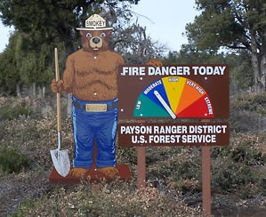
More on Grants,
FEMA Fire Prevention & Safety Grants
Become a Peer reviewer
Workshops for dummies

Slide 40
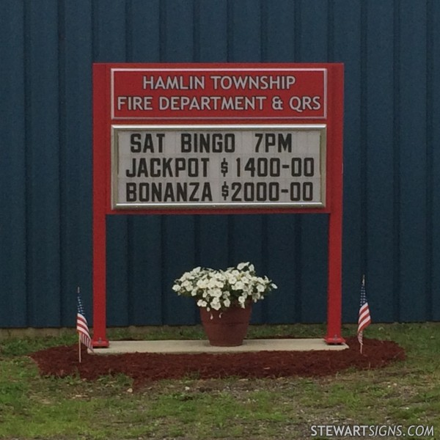
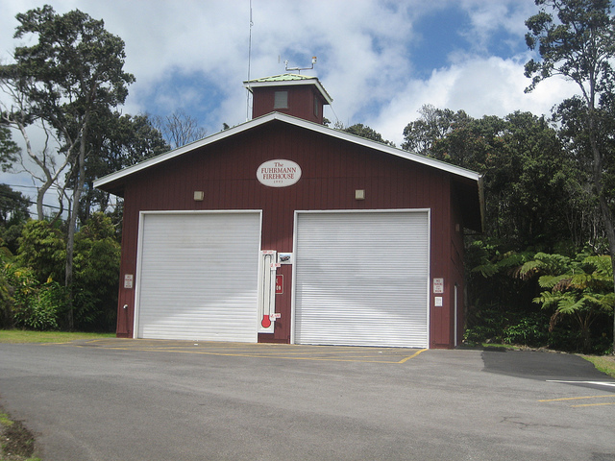
Pay Cash for your next ambulance

Slide 41
Marketing & Sales
Sell for success

Slide 42
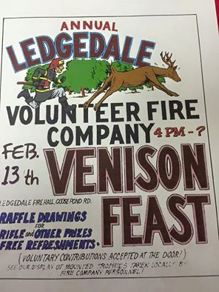

Slide 43
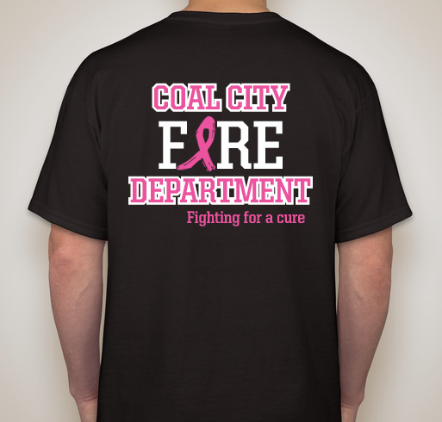
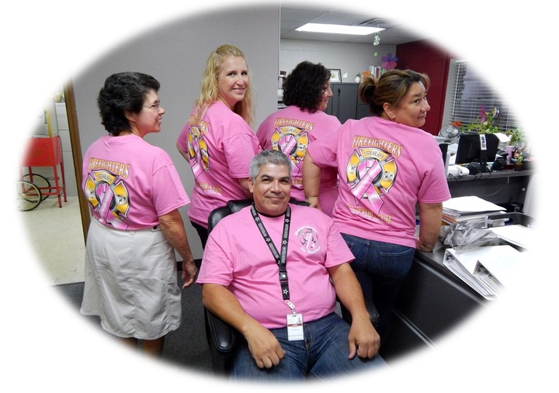
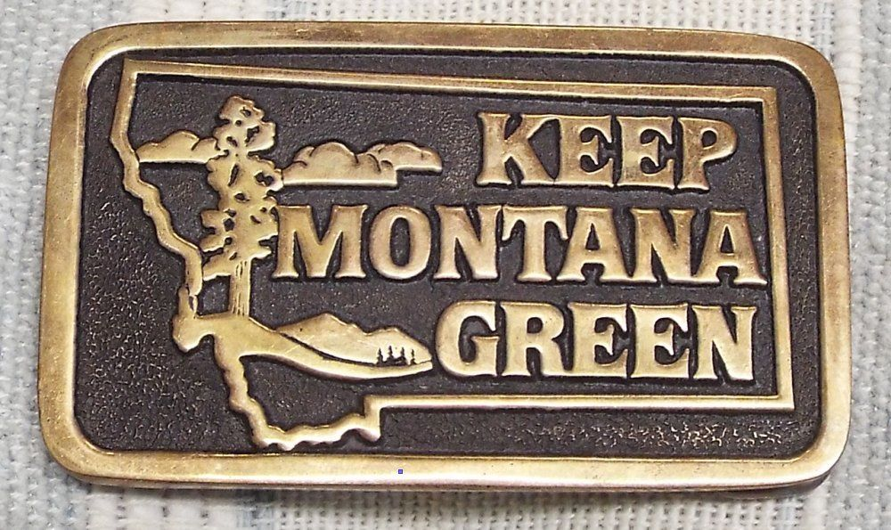
MARKETING THE DEPARTMENT

Slide 44
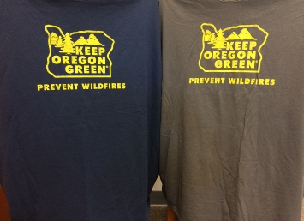
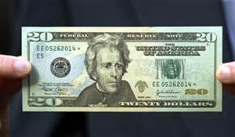
KOG

Slide 45
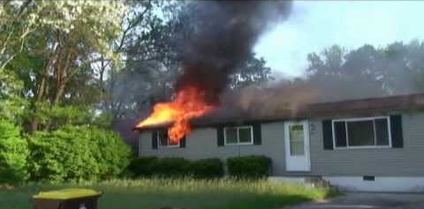
Your department sells Prevention
Prevention
sells Your department

Slide 46
Your Prevention Message is only as good as your Department

Slide 47
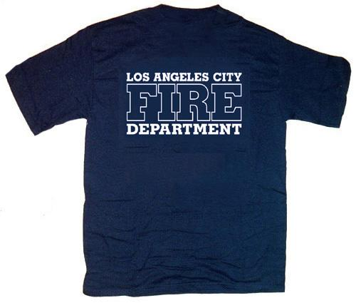
Everyone is your customer

Slide 48
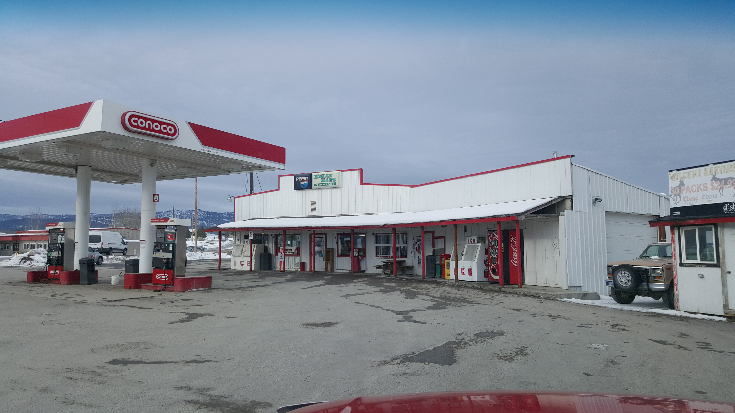

Slide 49
Remember last June?

Slide 50
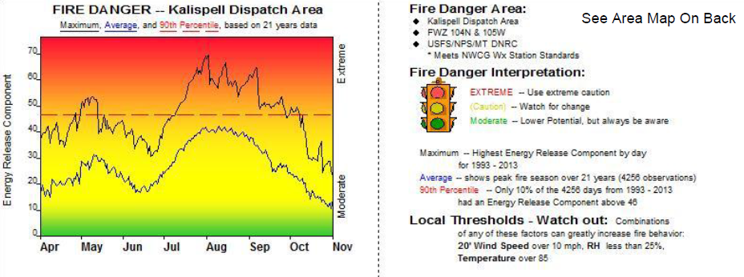
late June erc’s in the 97th percentile

Slide 51
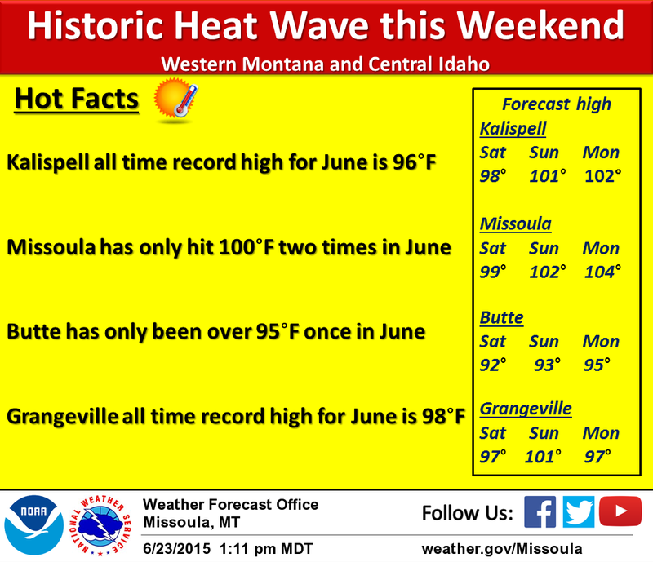
MARKETING WITH THE MEDIA

Slide 52
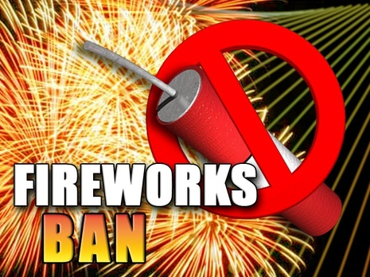
“Our god given right…”

Slide 53
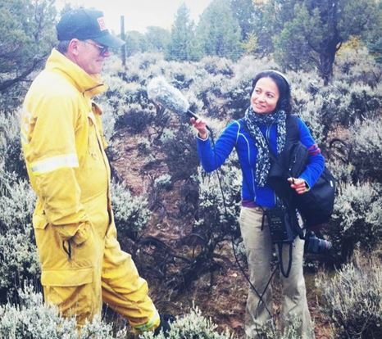

Slide 54
Outreach

Slide 55
MARKETING ON LINE

Slide 56
How can a car seat be a fire Prevention message?

Slide 58
Fire Prevention?

Slide 59
Public information officer

Slide 61
Service Groups want to hear you

Slide 62
So what didn't work

Slide 63
BURN PERMITS
On line permits

Slide 64
when can we burn vs. air quality concerns.

Slide 65
Restrictions and the lay person
Hoot owl
Closure
Restricted use
Regulated Use
Preparedness levels
Red flag
Fire weather watch
No open flames

Slide 67
NWCG Preparedness Levels

Slide 68
Summary
Follow the basics
Three E’s
Sell your Department and message
Everyone is your customer
Partnership at every opportunity
Budget for sales
Learn from failures and move on

