Slide 1
Social Media
engage * inspire * educate
Presented by Cassandra Ulven
Public Affairs Chief, Tualatin Valley Fire & Rescue
Oregon State Fire Marshal’s Conference February, 2016

Slide 2
about me………………
Notes:
Been with TVF&R since 1998.
Now serve as Public Affairs Chief overseeing internal and external communications, marketing and public information program. I also have the opportunity to partner with Joanne Hatch to share content she develops.
Haven’t always been a social media maven. I’m still not. Frankly, I was a very late adopter and I’ve never even had my own published FaceBook page. Now, I’m somewhere between competently tweeting and avidly consuming digital strategy blogs, but we have improved the dialogue with our community and partners thanks to social media.

Slide 3
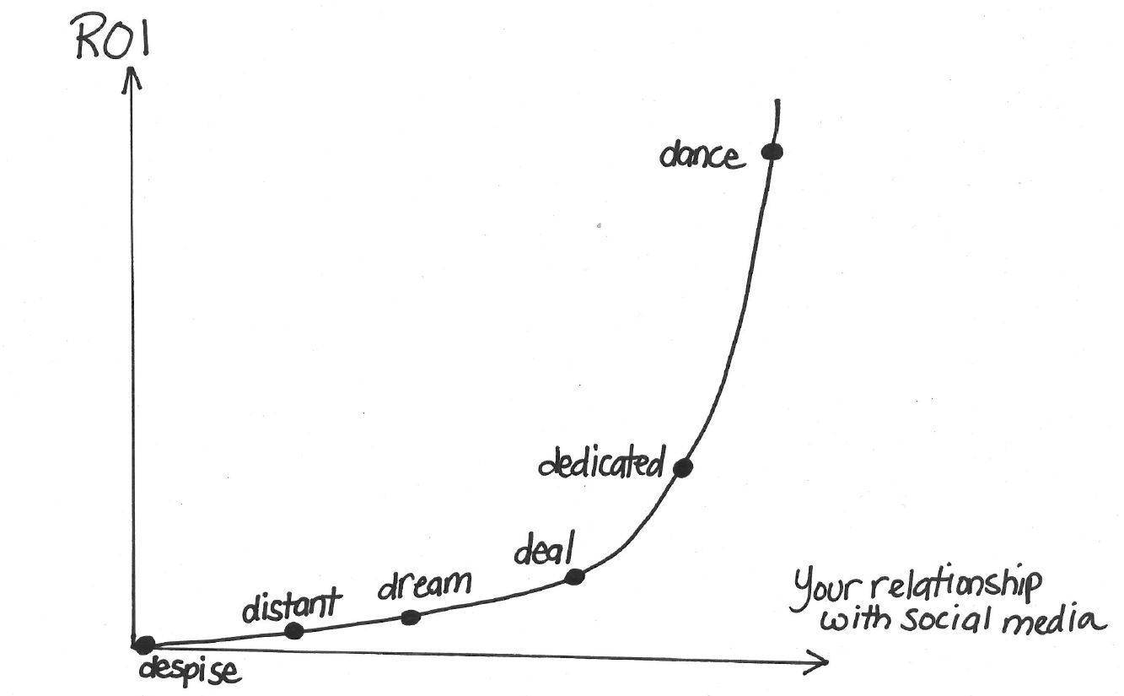
where are you on the spectrum?
Blogger Rajesh Setty: ACTIVE GARAGE
Notes:
ACTIVE GARAGE http://www.activegarage.com/7-kinds-of-relationship-to-social-media
1. Despise: You hate social media and social networking. You might even think it’s a nuisance. You think it’s artificial and you just keep thinking about the old days when people could really meet and talk. This new kind of building relationships seems so fake to you. Some of you may think that this is a fad that’s going to go away sooner than later. So why bother?
2. Distant: You don’t hate social media but you don’t love it either. You are standing at a distance and watching all the action. You are sometimes amused, sometimes surprised and sometimes shocked with what’s happening there. When you read a success story you are encouraged to begin your journey but you stop yourself saying that you may not be ready to make that BIG commitment of time, energy and mindshare into this without being fully clear about the return on that investment.
3. Dream: You are more open to participating in social media but the right time has not come in yet. You know what you will do when you finally start engaging in social media. In your mind, you have a grand plan but the time to execute has not come yet. Even here, your ROI from social media is not much for you as the marketplace rarely places a premium on people’s dreams. Dreams are important but action is even more important.
4. Deal: You are someone that had no choice but to jump into social media. Someone posted about you or your company on a blog. Someone tweeted about you or your company on Twitter. You are now forced to respond, especially if you feel the article or tweet was not backed with facts. You jump into the social media to set the record straight. This is a reactive approach rather than a proactive approach.
5. Dabble: You are definitely on the social media side of the fence. You experiment with various tools, techniques and tactics albeit without a clear strategy. You act as if the latest tools that surfaced were the missing piece in the puzzle.
6. Dedicated: You are committed to participate and engage in social media. You are active on various networks, ask and answer questions and do everything to engage with community. People know you as not only competent in your domain but also as a “nice and helpful” person and probably will reciprocate back when you are in need. You are on the path to building long term relationships that matter.
This is where you start seeing serious returns from social media.
7. Dance
This is social media mastery at display. You know what it takes to “dance” in the social media. You not only help – you ensure that your help is “valuable.” You not only give away stuff but you ensure that what you are giving away is “SIGNFICANT.” Whether it is an article, eBook or a tweet, when you talk people listen and they are thankful that you are there in social media and you are accessible. You change lives via social media and make things happen.
http://www.activegarage.com/7-kinds-of-relationship-to-social-media

Slide 4
Notes:
Regardless of where you are on the social media spectrum, as members of the fire service we share the responsibility of creating safer communities and we can use our social networks toward that aim.
Today we’ll talk about:
The landscape of social media
Grabbing our share of attention and using it for good
Strategies for effective content and identifying key influencers
Brand management
Social media and incident/disaster response
Monitoring tools

Slide 5
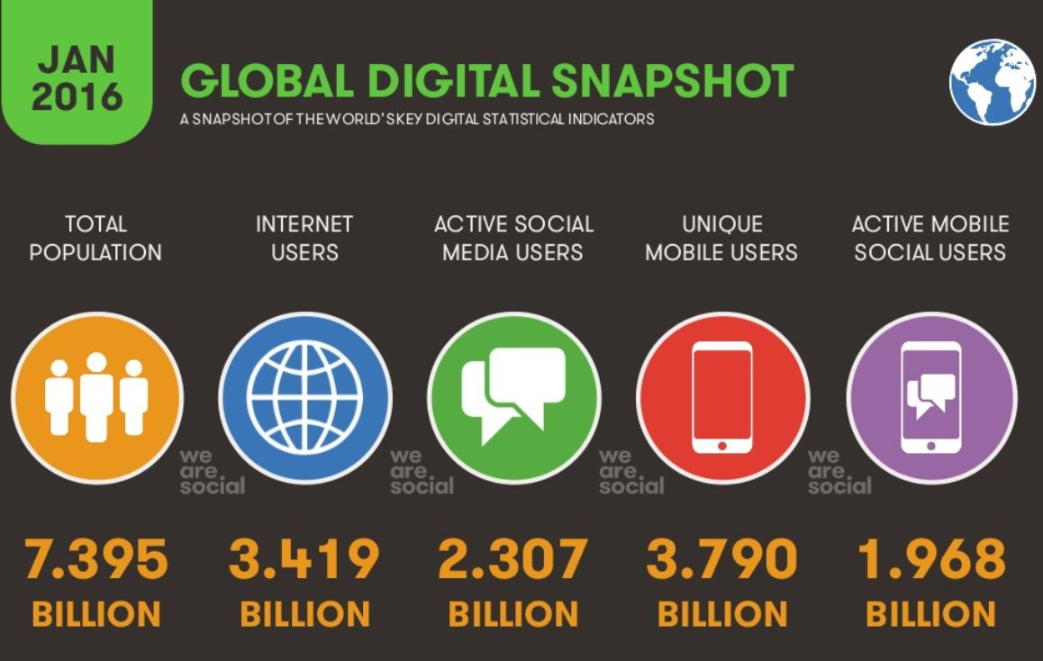
Source: We are Social
Notes:
A little bit about today’s social media and digital landscape.
Source for slides 5-7 : we are social, digital strategy firm, http://wearesocial.com/uk/special-reports/digital-social-mobile-worldwide-2015

Slide 6
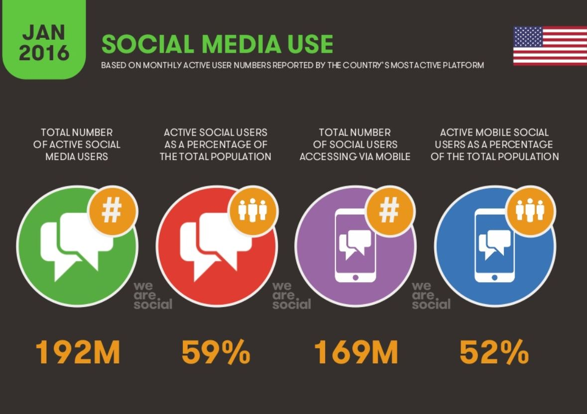
Social media use is up by 10% in the US since 2015
Notes:
Source for slides 5-7 : we are social, digital strategy firm, http://wearesocial.com/uk/special-reports/digital-social-mobile-worldwide-2015

Slide 7
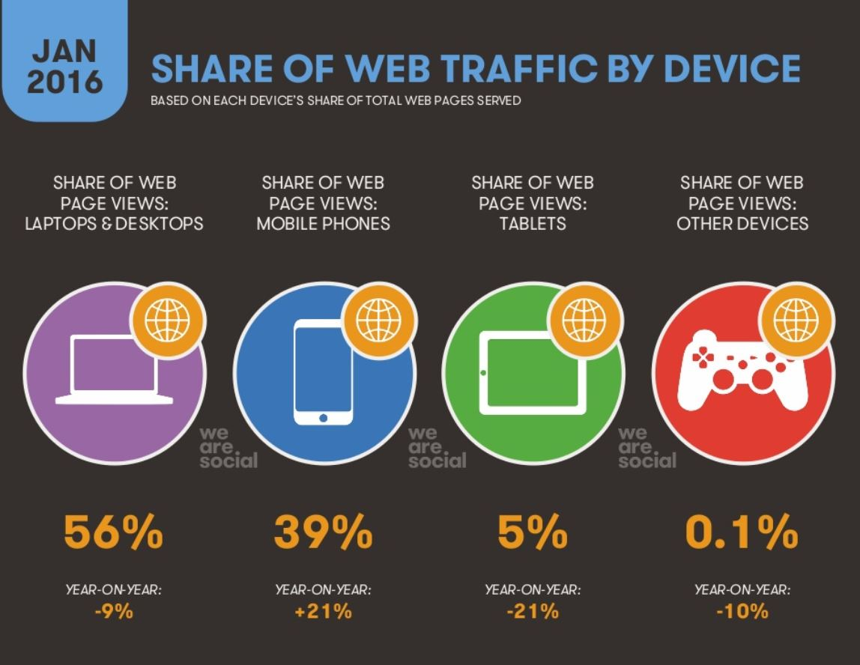
Source: We are Social
Notes:
So when it’s time to update your web sites, make sure they’re configured for mobile viewing.

Slide 8
91%
turn to devices while completing tasks
micro moments
Notes:
91% of smart phone users turn to their devices for ideas while completing a task

Slide 10
Notes:
So with all the competition for attention and noise, we have to make sure we’re strategic about our content development.
Is it educational?
Does it relate to a common interest of your audience?
Is it funny?
Think about what your audience wants. It’s not all about you.
Be timely and current
Tie to trends, hashtags, current events and news

Slide 11
Notes:
Using photos and videos significantly increases engagement and audience

Slide 13
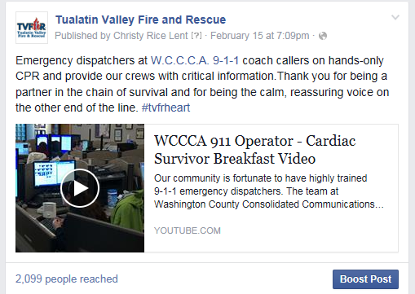
leverage video + partners
https://www.facebook.com/TualatinValleyFireandRescue/
Notes:
You don’t have to have expensive equipment. One of our highest viewed posts was a 30-second clip of a controlled grass fire started by fireworks. It got nearly 1 million views.

Slide 14
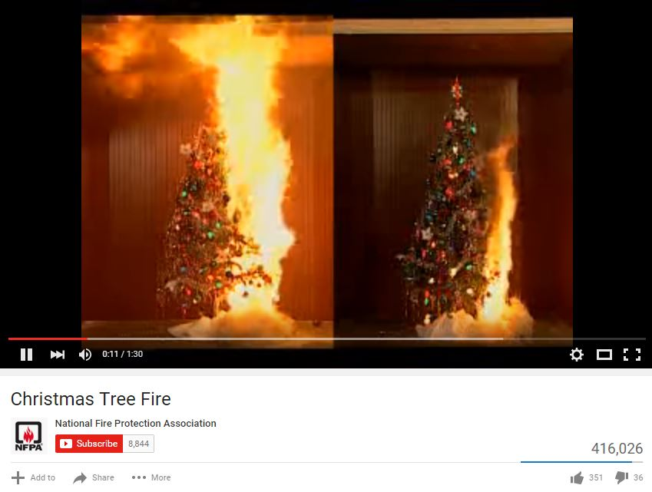
leverage free content
https://www.youtube.com/watch?v=RNjO3wZDVlA

Slide 15
leverage online communities

Slide 16
when to post
Source: StatisticBrain

Slide 17
how often to post
Source: StatisticBrain

Slide 18
best day to post
Source: StatisticBrain

Slide 19
ask for the retweet or share
Source: Mashable, Twitter Timeline
Notes:
Ask for the retweet or share
Applies to all social platforms
Asking increases success and results
Shares=more views
Tweets that contain the call to action, please retweet are four times more likely to get retweeted at lease once compare to those without an ask.
But don’t use tragedies as a way to tie into a trend or get attention

Slide 20
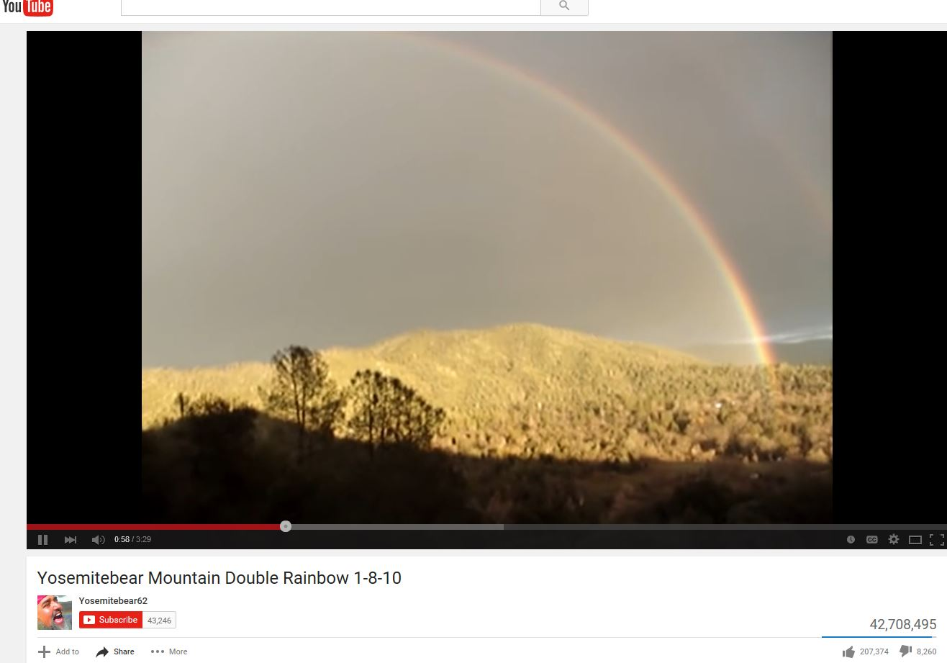
what goes viral?
https://www.youtube.com/watch?v=OQSNhk5ICTI
Notes:
Kevin Allocca is YouTube's trends manager, and he has deep thoughts about silly web video. In this talk from TEDYouth, he shares the 4 reasons a video goes viral.
Tastemakers, creative participating communities, complete unexpectedness, these are characteristics of a new kind of media and a new kind of culture where anyone has access and the audience defines the popularity. I mean, as mentioned earlier, one of the biggest stars in the world right now, Justin Bieber, got his start on YouTube. No one has to green-light your idea. And we all now feel some ownership in our own pop culture. And these are not characteristics of old media, and they're barely true of the media of today, but they will define the entertainment of the future.
https://www.ted.com/talks/kevin_allocca_why_videos_go_viral?language=en#t-33522
YouTube Company Statistics
Total number of people who use YouTube 1,300,000,000
Hours of video uploaded to YouTube every minute 300 hours
Number of videos viewed on YouTube everyday nearly 5 billion
Total number of hours of video watched on YouTube each month 3.25 billion hours
Number of YouTube videos that have generated over 1 billion views 10,113
Percent of YouTube visitors that come from outside the U.S. 70 %
Number of countries with localized versions of YouTube 42
Total number of languages YouTube is broadcast in 54
User submitted video with the most views – "Charlie bit my finger" 829,000,000
Average number of mobile YouTube video views per day 1,000,000,000
Average time spent on YouTube per mobile session 40 minutes

Slide 21
Notes:
Respond to people on your platforms: web, social media, etc.
Fewer than 30% of questions to brands on Twitter get answered.
Consumers, and in our case customers, are expecting immediate answers and want a conversation,
Twitter actually has a customer service playbook for brands with best practices from Fortune 500 companies
https://twitter.app.box.com/customer-service-on-twiter

Slide 22
Notes:
Measure success
Define clear goals
Gauge a baseline
Use metrics tools…many are free. Others like Twittercounter are cheap.
We use Hootsuite which allows you to manage all your networks and schedule messages for future publishing.
Hootsuite and other programs offer analytics and let’s you monitor others’ conversations about you.

Slide 23
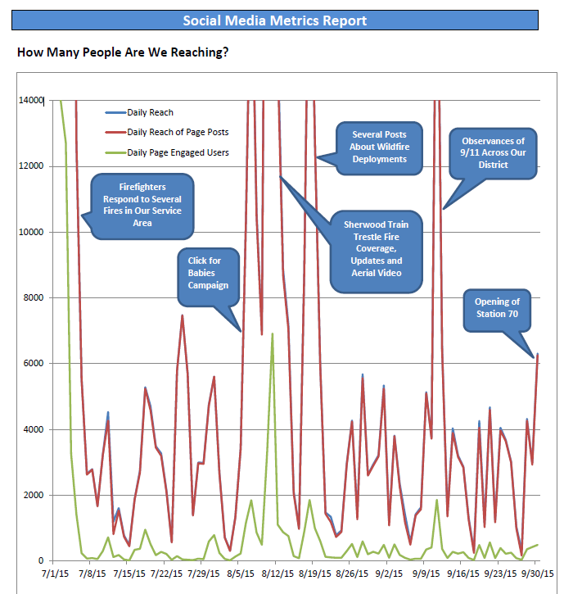

Slide 24
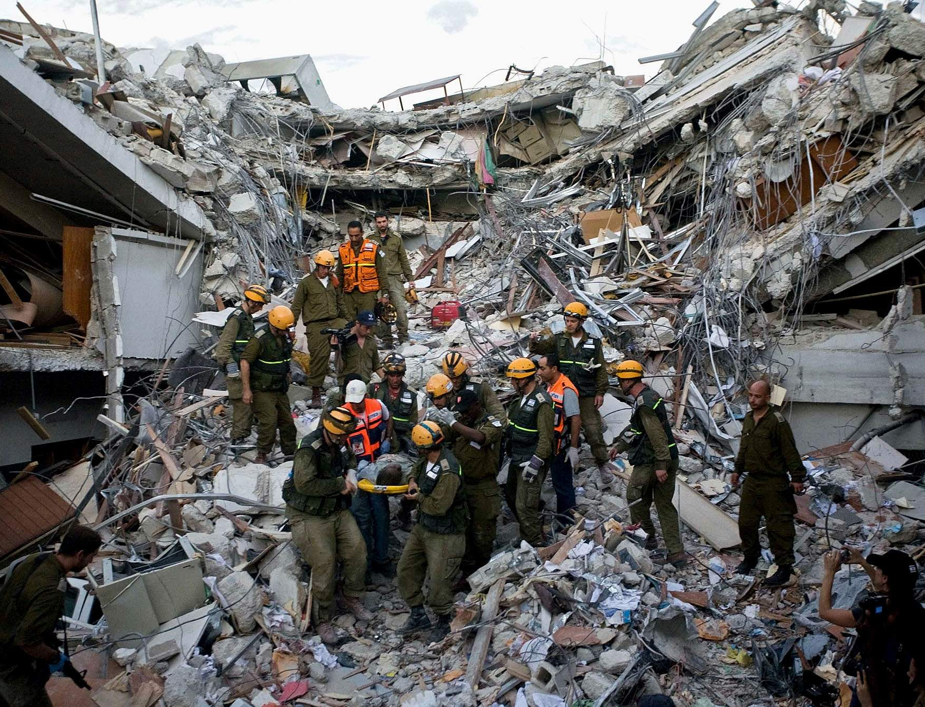
Notes:
It is estimated by FEMA that 37% of crisis survivors use information on social media to buy supplies and find shelter.
25% download disaster apps in preparation for support
76% use social media to contact friends and family to see if they’re safe
During Haiti earthquake in 2010, there were 320k deaths and 1.2 million homeless. The government was in ruins. But 80% of the Haitian population had mobile phones. Thousands of online volunteers converted texts to tweets and aggregated data, relocated data and helped connect aid workers to those in need.
Over 6 million SMS messages were sent.

Slide 25
#InACrisis
Notes:
use a single #hashtag to unify posts
keep them short and easy to spell
create a #hashtag that’s incident related and avoid marketing campaign #hashtags
capitalize each word in a multi-word #hashtag
monitor trending topics
During the Boston Marathon Bombings, the Boston Police Department made terrific use of hashtags. They likely had a strategic crisis plan in place and used social media for news conferences, as well as information requests from the community.

Slide 26
Notes:
Oregon Virtual Operations Support Team

Slide 27
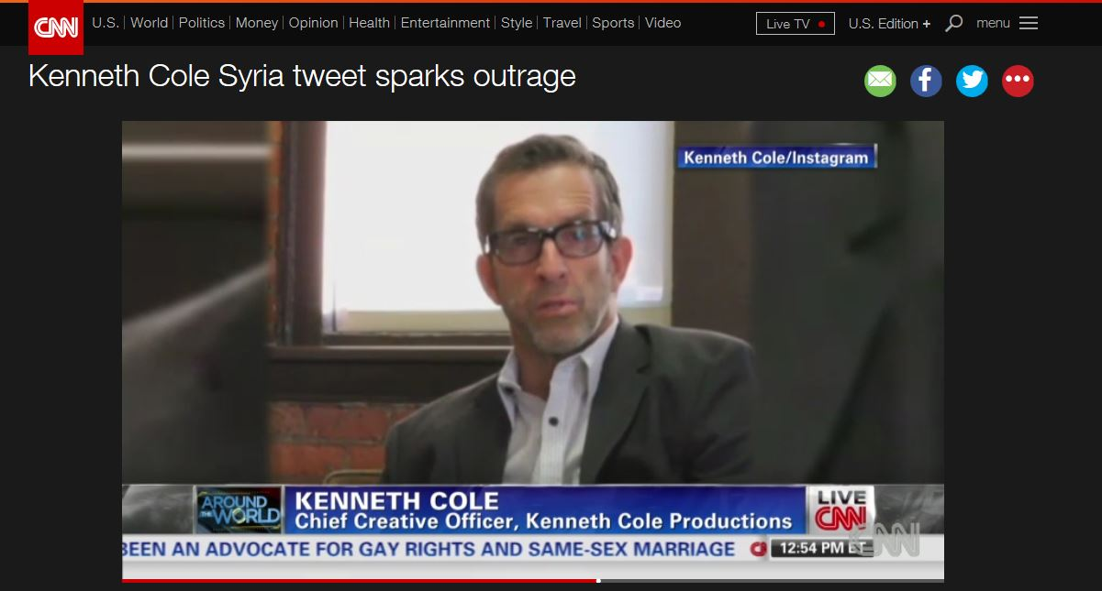
how not to use a #hashtag
http://www.cnn.com/videos/us/2013/09/06/atw-asher-kenneth-cole-tweet.cnn

Slide 28
Your online life can be as permanent as a tattoo. –Juan Enriquez, Futurist

Slide 29
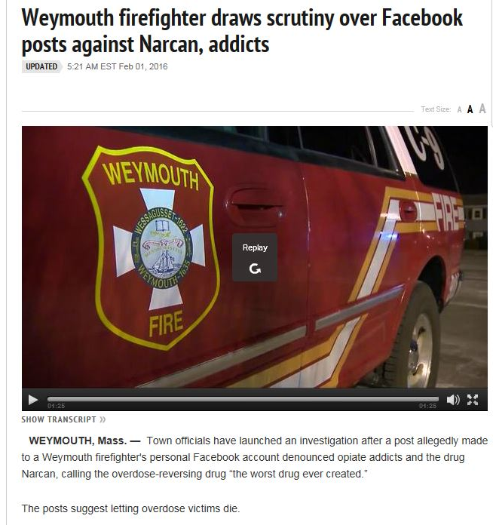
social media policies
http://www.wcvb.com/news/weymouth-firefighter-draws-scrutiny-over-facebook-posts-against-narcan-addicts/37744126
Notes:
Social media policies are a must (both for social media programs and personal use)
It’s illegal to limit free speech, but as soon as employees identify themselves or are in uniform on their personal pages, they can be considered agency spokespeople
Your policies should be publicized and it takes ongoing education to help employees engage in the use of social media consistent with your organization’s values.

Slide 30
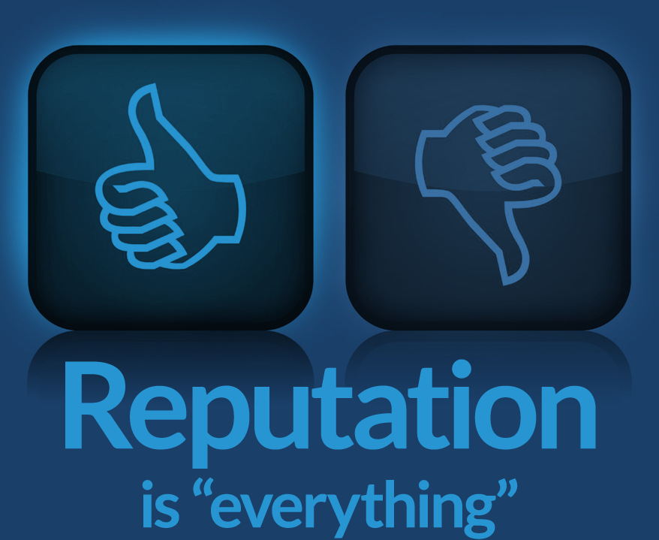
Notes:
Establishing and guarding your brand takes time and attention.
Use brand consistency
Consider securing domain names that can be used against you: like tvfrsucks.com
Simply setting up Google alerts or talkwalker alerts
There are also several reputation reporting programs:
Klout
Kred
Naymz
PeerIndex
TrustCloud
Trackur
Thinkup
TweetReach
Sumall
Mentionmapp
Social Mention
Xefer
Unfollowers

Slide 31
Contact
Cassandra Ulven
Public Affairs Chief, Tualatin Valley Fire & Rescue
cassandra.ulven@tvfr.com
503.259.1513

