Slide 1
Welcome to the
2016
Oregon Fire Prevention Workshop

Slide 2
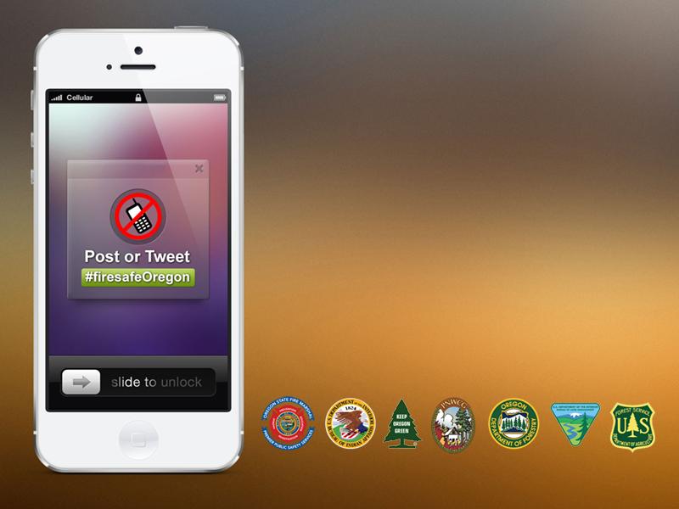
Please silence your phones, but feel free to post or tweet to
#firesafeOregon

