Slide 1
Industrial fire prevention
Fire Safe Operations
Tom Fields
Fire Prevention Coordinator
Oregon Department of Forestry

Slide 2
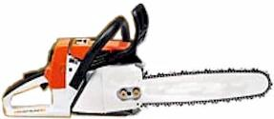
Objectives
Review Oregon’s fire prevention laws and rules (and how we interpret them) for industrial operations.
Provide consistent interpretation (guidance manual development)
Review proposed rule updates from statewide committee
Share Information

Slide 3
Why?
Mission: To serve the people of Oregon by protecting, managing, and promoting stewardship of Oregon's forests to enhance environmental, economic, and community sustainability.

Slide 4
What is our goal?
To PREVENT human-caused fires……
Through Education, Engineering and/or Enforcement.
Don’t forget Evaluation

Slide 5
How do we achieve this?
Oregon Revised Statutes (ORS)
Oregon Administrative Rules (OAR)
Policies and Procedures
Professional Judgement

Slide 6
statistics
Providing a Starting Point

Slide 7
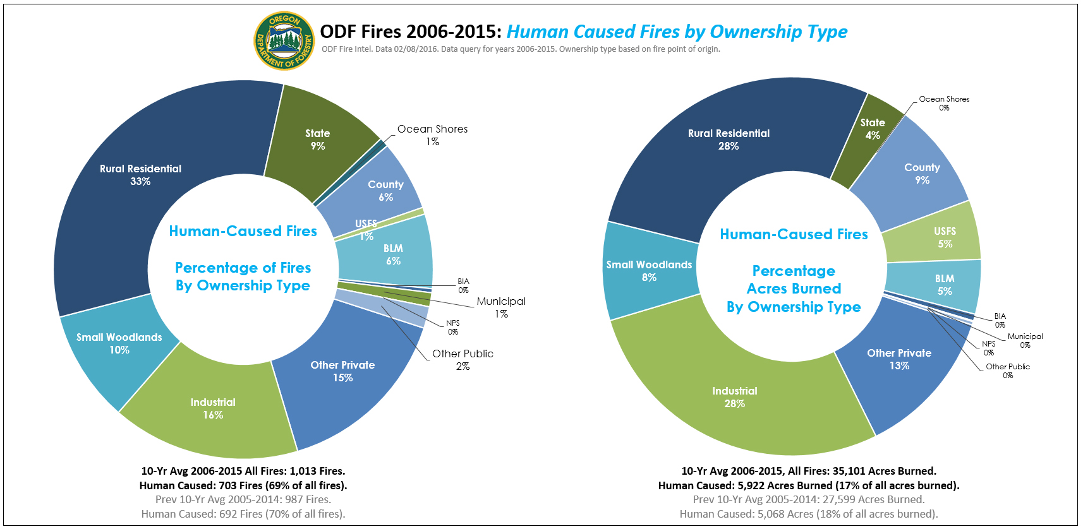

Slide 8
Operation fire statistics
Leading fire causes over the past 10 Years (2006-2015)
Cause | Fires | Acres | Costs

Slide 9
Clean data starts with you
Uploading the information (review the FIRES manual).
Did the fire result from an operation?
(1) No
(2) Yes
(3) Operation in progress, but not result
(4) Additional Hazard
General Cause
Specific Cause
Cause Comments

Slide 10
Did the fire involve an operation? Fires manual #38
No operation involved. This includes long-term holdovers when the operator was not negligent.
Fire originated as a RESULT OF THE OPERATION (includes slash burn).
Fire originated in an operation area while the operation is in progress, but NOT THE RESULT OF THE OPERATION (including Firewatch period).
Slash responsibility (failed to comply with options). This refers to rating additional hazard, not typical slash burning fires.

Slide 11
Operation fire statistics
Operation Fires from 2006-2015
Involved Operation | Within but not result of Operation | Additional Hazard (Slash)
390 | 55 | 35

Slide 12
Operation fire statistics
Operation Fires from 2006-2015
Involved Operation | Within but not result of Operation | Additional Hazard (Slash)
390 | 55 13 | 35

Slide 13
Operation fire statistics
Operation Fires from 2006-2015
Involved Operation | Within but not result of Operation | Additional Hazard (Slash)
390 432 | 55 13 | 35

Slide 14
Operation fire statistics
Operation Fires from 2006-2015
Involved Operation | Within but not result of Operation | Additional Hazard (Slash)
390 432 | 55 13 | 35 0

Slide 15
Operation fire statistics
Operation Fires from 2006-2015
Involved Operation | Within but not result of Operation | Additional Hazard (Slash)
390 432 467 | 55 13 | 35 0

Slide 16
Operation fire statistics
Leading fire causes over the past 10 Years (2006-2015)
Cause | Fires | Acres | Costs
Slash Burning | 257 | 4346 | $ 1,964,823
Other Logging Equipment | 45 | 159 | 614,857
Rotary Saw | 42 | 2735 | 7,240,314
Exhaust | 26 | 2 | 28,503
Electrical Wiring | 23 | 48 | 206,361

Slide 17
Industrial fire prevention rules
Making Sense of it All

Slide 18
Fire tools and extinguishers
ORS 477.655 Fire-fighting tools and equipment at operation area and on trucks; rules. During a fire season inside or within one-eighth of one mile of a forest protection district:
(1) Every person conducting an operation shall provide and maintain, at the operation area or at a location designated by the forester, fire-fighting tools that are in conformity with rules promulgated by the State Forester. The tools shall be used only for fighting fire and for no other purpose.
(2) Each internal combustion engine used in an operation area shall be equipped with fire-fighting tools and equipment that are in conformity with rules promulgated by the State Forester.

Slide 19
Fire tools and extinguishers
ORS 477.655 (3) All trucks driven over roads through forestland, excepting county roads and state highways, shall be equipped with fire-fighting tools and equipment that are in conformity with rules promulgated by the State Forester.
OAR 629-041-0005 (y) "Truck" means a motor vehicle designed primarily for carrying loads other than passengers and which is used to conduct an operation. Note: Pick-ups meet the definition of trucks.
Crummies and crew vans used for transporting passengers are not required to carry fire-fighting tools. Fire extinguishers are required for all internal combustion engines.

Slide 20
Fire tools and extinguishers
OPERATION AREA
Fire tool box with mix of tools according to chart.
Rules Review looking at small operation requirements
Each internal combustion engine, except power saws, requires one 2 ½ lb ABC Fire Extinguisher.
Contradicts statute (in use), but statute overrules OAR.
OR-OSHA requires 2A: 10BC (5 lb) or equivalent
Proposed rule change to align with OR-OSHA.
TRUCKS (not transport vehicles)
Shovel
Axe or Pulaski
2 ½ lb ABC Fire Extinguisher (all internal combustion engines)

Slide 21
Water supply and delivery
Stationary Equipment Requirement
ORS 477 650 (2) Requires an additional water supply if additional stationary equipment is further than 150 feet from the main water supply.
Not too common.
Extra water supply specifically refers to ORS 477.615 and what is required by the OAR.
The forester/warden can also require additional protection under ORS 477.660.
The 2-Day Rule.
This is how stationary internal combustion engines are defined in this statute.
It has no bearing on when a water supply is required. A water supply is required from day one if the “stationary internal combustion engine” is scheduled to be on site for more than two days…not starting on day 2 or 3.

Slide 22
Water supply and delivery
Mobile Equipment Requirement
Treated like stationary equipment.
Defined in rule rather than statute.
Requirements can be found in OAR 629-043-0026 (2) Operation Area.
Capacity
20 GPM through 50 feet of hose and ¼ inch nozzle.
Bottom line…does it have the pressure and consistency to initial attack a fire.
Rules review is working on including psi at the pump head for clarification.

Slide 23
firewatch
MOST COMMON LIABILITY VIOLATIONS
9 OUT OF 10 FIRES THAT REACH THE SALEM OFFICE HAVE AN ISSUE WITH THE FIREWATCH SERVICE
REQUIREMENTS
Competent person.
Must be at least 18 (US Dept. of Labor)
Must be physically able to safely attack a fire start.
Must take annual refresher training.
Constantly on duty for 3 hours (unless waived)
Visually observe all areas of the operation where work was being conducted that day.
Adequate facilities for communication and transportation.

Slide 24
firewatch
PROPOSED RULES CLARIFICATION
Notice the title? Change from Watchman to Firewatch
Align with OR-OSHA safe firefighting for single resources.
Current: Have the physical and mental faculties and be trained to a necessary to make decisions, communicate needs and take appropriate action when a fire is detected.
Proposed: Be qualified in the use and operation of assigned firefighting equipment and tools; be physically capable of performing assigned fire suppression activities; and be advised of single employee assignment responsibilities (OAR 437-007-1315), when working alone.

Slide 25
Questions on rules?
Coming up…closures.

Slide 26
IFPL and closures
Common Questions

Slide 27
Power driven machinery and closures
ORS 477.625 Permit to use fire or power-driven machinery (1) Every person conducting an operation…that uses fire in any form or power-driven machinery shall first obtain from the forester a written permit.

Slide 28
Power driven machinery and closures
ORS 477.625 Permit to use fire or power-driven machinery (1) (a) Take reasonable precautions that in the judgment of the forester are necessary in the use of fire and power-driven machinery to prevent the spread of fire on or from an operation area.

Slide 29
Power driven machinery and closures
ORS 477.625 Permit to use fire or power-driven machinery (1)(c) If operating west of the summit of the Cascade Mountains, close down any part or all of the operation during any period of time when notified that, in the judgment of the forester, conditions exist as described in ORS 477.670.

Slide 30
Power driven machinery and closures
IFPL
ORS 477.670 When use of fire or power-driven machinery prohibited.
During a fire season…west of the summit of the Cascade Mountains, if the forestland in such district…is susceptible in the judgment of the forester to damage by fire, the forester shall issue notice to that effect.
Thereafter the use of fire…or…power-driven machinery for any operation, is unlawful unless approved by the forester. Approval shall be granted only when in the judgment of the forester the activity will not constitute a fire hazard sufficient to justify the requirement.

Slide 31
Power driven machinery and closures
Eastside ODF

Slide 32
Power driven machinery and closures
OAR 629-043-0026 Operation Area
Pursuant to ORS 477.625(1)(a), operators shall comply with the following reasonable precautions that, in the judgement of the forester, are necessary to prevent the spread of fire on or from an operation area:
(5) When conducting an operation during fire season which uses mobile equipment east of the summit of the Cascade Mountains and when directed by the forester in written order, comply with limitations on when mobile equipment may be used. The forester shall base such limitations on the fire danger in the operation area, on the risk of fire beginning in the operation area, or due to a combination of any such conditions.

Slide 33
closures
IFPL (ODF Westside and all Federal)
I Closed Season
II Partial Hoot Owl
III Partial Shutdown
IV General Shutdown
ODF Eastside
OAR 629-043-0026 (5)

Slide 34
Common closure questions
IFPL 3: WHERE SHOULD THE LOG TRUCK BE AT 1:00?
The log truck, and all personnel other than the Firewatch should be leaving the operation site at 1:00 or shortly thereafter. The operation shuts down at 1:00 so all personnel should be headed off site.
If a fire results from activities associated with the log truck or operator within the operation area after 1:00, the investigation will determine if negligence occurred.

Slide 35
Common closure questions
CAN WORKERS AND EQUIPMENT SHUTDOWN AND LEAVE ONE OPERATION TO HELP FIGHT FIRE ON AN OPERATION NEARBY?
Technically, the Firewatch and water supply must stay, unless waived by the forester.
In most cases, the landowner may accept the risk and allow personnel and equipment leave to assist with fire suppression efforts.
Should we cite? Consult with your District Forester on how to proceed.
Rule revision will allow water supply to go, leaving Firewatch behind to observe and report.

Slide 36
Common closure questions
DOES A LOADER WITH A HEAL BOOM AND GOOD OPERATOR CAPABLE OF CONSTRUCTING FIRELINE MEET THE IFPL 3 REQUIREMENT OF EQUIPMENT “WITH A BLADE”…?
No. But you can write a waiver that allows this equipment to construct fireline.
Proposed revision to IFPL includes taking “WITH A BLADE” out of the requirement. It would just read equipment capable of constructing fireline….

Slide 37
Common closure questions
REGULATING GOVERNMENT AGENCIES (BPA, ODOT, etc).
Currently: Government agencies doing government work with government employees are not required to have a PDM.
This does not relieve them of liability in the event of a fire. So if they don’t have fire tools or a water supply or don’t follow fire prevention requirements and they have a fire, they would most likely be liable for fire suppression costs.
Discussions are under way regarding this unwritten policy.

Slide 38
Common closure questions
Sky Lanterns, Tracer Ammo, Exploding Targets
These activities are now prohibited from the start of fire season.
Do not include in Regulated Use Closure.
First offense is a Class “A” violation with a presumptive fine of $435.

Slide 39
Common closure questions
WAIVERS FOR FIRE SAFE OPERATIONS
A fire safe operation is defined as an operation where ignition likelihood has been reduced or where provisions are made for early discovery and suppression of a fire which may start.
Operators must preplan such fire safe operations with the district.
Inspection of each fire safe operation must be made prior to writing a waiver.
Fire prevention or reduction of ignition sources are primary considerations.

Slide 40
Common closure questions
WAIVERS FOR FIRE SAFE OPERATIONS
Increased detection and suppression capability is a secondary consideration, but an important concern.
Operations working during closedown periods will receive more frequent and more comprehensive inspections.

Slide 41
Common closure questions
WAIVERS FOR FIRE SAFE OPERATIONS
Some districts have specific guidelines for issuing waivers.
Here are a few other considerations.
Landowner Approval
Differing site conditions (fog belt, aspect, site specific)
History of compliance, violations, ignitions

Slide 42
Common closure questions
WAIVERS FOR FIRE SAFE OPERATIONS
Additional Measures
Exceeding requirements
Additional Firewatch
Weather considerations
Extra suppression (prepositioning people and equipment)
Availability of resources and number of fires in the Area and State
Political

