Slide 1
2016 Oregon Fire Prevention Conference
Target Shooting Fires: Examples, Educational Efforts, and the Future for ODF in the Tillamook State Forest
Mike Cafferata, ODF
February 17, 2016
Goal: Share understanding of target shooting as a cause – for prevention… and to better identify it in fire investigation and reporting efforts
Notes:
90 minutes

Slide 2
Tillamook State Forest
Easy Access from Portland
History of target shooting use
Recreation Management for other uses – hiking, ATV, horses, etc.
Surrounded and interspersed by private and lands and roads

Slide 3
Private Lands
Diverse private lands
Rural interface
Agricultural operations

Slide 4
Summer of 2015
1. Sunset Grade Fire – June 12
4.5 miles from pavement
Started when – June 12, pm?
Conditions at ignition – 1000 hour fuels at 20%, 1 hour fuel at 8% moisture content
Exploding targets present, unknown spark
Notes:
Point I want to make here – exploding targets were present, but we really don’t know the spark that started the fire… a fire started at the target area – exploding target, bullet impacts, likely the shooter walking there, possibly another person driving up o the site… really don’t know…

Slide 5
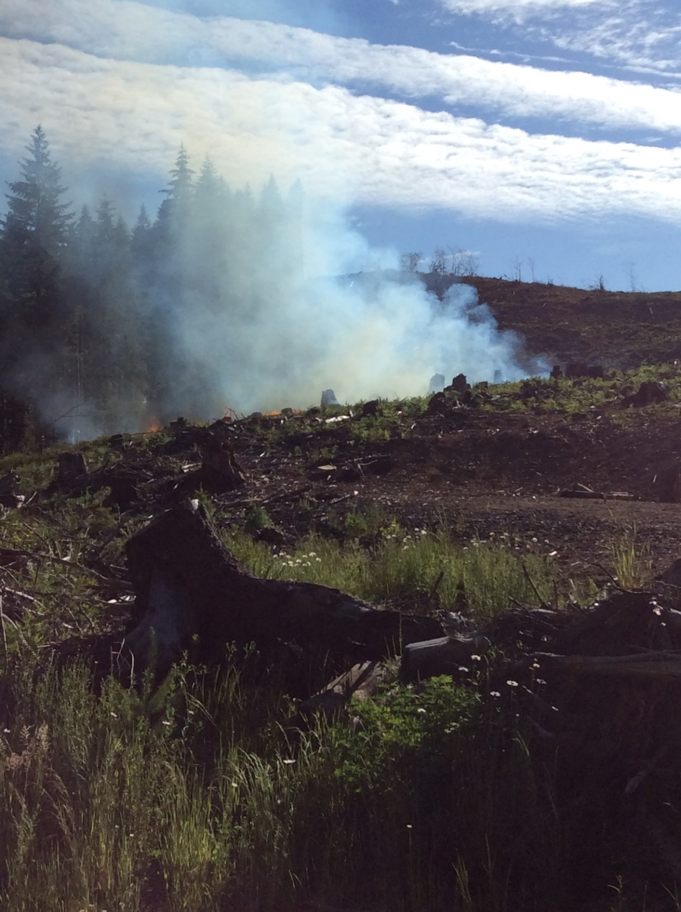
Summer of 2015
2. Beaverdam Road - June 17
History of target shooting use
5 miles off pavement
Started late afternoon
Conditions at ignition – 1000 hour fuels at 20%, 1 hour fuel at 8% moisture content
Exploding targets present..
Notes:
Lots of public use – good access. Point here – 2 fires, early in the season, that were substantial – most years – just be 10 by 10…

Slide 6
Summer of 2015
3. Wolf Creek Call - June 21
History of high target shooting use
2.5 miles off pavement
Started late afternoon
Conditions at ignition – 1000 hour fuels at 16%, 1 hour fuel at 6% moisture content
Reporting party describes incident – no exploding targets – just friends shooting a variety of guns
Notes:
Difficulty of patrol
Difficulty of discerning exploding targets from regular shooting.
The third one – I called him… shooters – private group – responsible, did not want to cause damage… site of a previous fire the year before…

Slide 7
Summer of 2015
4. Salmonberry Fire – July 11
History of target shooting use
7 miles off pavement
Late afternoon
Conditions at ignition – 1000 hour fuels at 14%, 1 hour fuel at 5% moisture content
30-06, shooter reported it, described the incident

Slide 8
Notes:
Don’t think this was the target, but this picture says a thousand words.

Slide 9
Summer of 2015
5. Old Bald Mountain Fire – July 31
History of target shooting use – BLM lands
0.5 miles off pavement
Started afternoon of July 31
Conditions at ignition – 1000 hour fuels at 14%, 1 hour fuel at 5% moisture content
30-06 through paper into a stump

Slide 10
Summer of 2015
Long range – 100 yards +
High use
No exploding targets

Slide 11
Summer of 2015
6. Helter Shelter – August 1
History of target shooting use – ODF lands
2 miles off pavement
Started early afternoon of Aug 1st
Conditions at ignition – 1000 hour fuels at 13%, 1 hour fuel at 4% moisture content
Recreation, shooting?

Slide 12
Summer of 2015
7. August Fire – August 22
History of target shooting use – private lands (trespassing)
Just off pavement
Conditions at ignition – 1000 hour fuels at 13%, 1 hour fuel at 8% moisture content
Target shooting – no sign of exploding targets

Slide 13
Summer of 2015
8. Rock Creek – August 8/26
Private land – rural residential
Back yard
Started mid afternoon
Conditions at ignition – 1000 hour fuels at 13%, 1 hour fuel at 8% moisture content
50 caliber at 425 yards. Steel target

Slide 14
Summer of 2015

Slide 15
Summer of 2015

Slide 16
36 Pit Fire
Federal investigators have determined that the persistent 36 Pit Fire was started by target shooters' hot bullet fragments igniting dry tinder nearby.
Notes:
Pause here –
Here is what I think- and talking with Mark –
Low fuel moisture – south aspect on dry day, late in the day, good fuel bed – that is the risk period. North slopes, riparian areas… none of our fires were in those spots.
Anyone here share this opinion – different opinion? Learn something new?

Slide 17
Your stories?

Slide 22
Education Efforts
Fliers at ammunition counters
Email to our many recreation contacts – soliciting feedback
On local news stations
Web presence at FGDFire.com
Patrols after hours when humidity was below 20%.
People want the data!

Slide 23
Mark Finney has just explained the science to us
The recreation community wants the facts, not our opinions. The science papers help.
Rocky Mountain Research Station
Research Paper RMRS-RP-104
August 2013
A Study of Ignition by Rifle Bullets
Mark A. Finney, Trevor B. Maynard, Sara S. McAllister, Ian J. Grob
http://www.fs.fed.us/rm/pubs/rmrs_rp104.pdf

Slide 24
Science messages:
Bullets reflected off steel plates started fires
Especially steel core and steel jacket and copper.
Lead core, copper jackets were least likely to cause starts.
Bullet Fragments were 800 degrees C.
Research Paper RMRS-RP-104
Kinetic energy transformed to thermal energy on impact
http://www.fs.fed.us/rm/pubs/rmrs_rp104.pdf

Slide 25
Feedback from recreation community about shooting:
Supportive of efforts to find solutions
Care for forests first, recreation second
Confusion why we regulate woods professionals with equipment, but not target shooting
Most private lands are closed to recreational shooting
Desire to understand the mechanism of fire starts… disbelief – even from our own staff.

Slide 26
From our public contacts
Target shootings are a diverse group
Mixed understanding of requirements for shovel and water
Mixed range of guns and desired shooting experience
Mixed reactions to approach from government
Range of targets
Lesson – this is a diverse set of forest users. Most open to better information, most willing to contribute to problem solving.
Most were willing to share contact emails – so we are establishing a communication link

Slide 27
ORS 166.170 State preemption
The Legislative Assembly has sole authority to regulate use of firearms and any element related to fire arms.
Counties may regulate some discharges of firearms, but not,
“A person discharging a firearm in the course of target shooting on public land that is not inside an urban growth boundary or the boundary of a city, if the discharge will not endanger persons or property.”

Slide 28
Our understanding – much better about this – perhaps fires that were unknown before, we now surmise what is the actual start.

Slide 29
Bullet Fragments

Slide 32
How are these reported in Fires?
Fire Caused By Factors:
Landowner Related: Ruralist or “Other”
Public Related: recreationist or “other public.”
General Cause: Miscellaneous
Specific Causes:
901 exploding device
950 firearms - general
951 firearms - target
952 firearms - ammunition
Cause Comments can be very helpful: “bullet ricochet into dry grass” or not so much, “See investigation report.”

Slide 33
Statewide – 26 fires in specific causes of 901, 950, 951, 952 and where specific description indicates shooting. About $500,000, 120 acres
Example descriptions:
“Super heated bullet in dry grass.”
Exploding target (evidence of?)
Target shooting
This information is important if we want to recognize this issue and search for solutions.

Slide 34
Next Year – More Education
Better web presence – we are building this now…
More patrols
Better communications with our shooting public – direct via email
We are starting to reach out to our shooting public to work on solutions – fire safe locations, supported by user groups. Education for all about the risks of fire and public safety.
Wild card – learning about the environmental aspects of target shooting.

Slide 35
Engineering? 1. Stump removal 2. Remove fine woody material 3. add soil backstops

Slide 36
End
You can help share these messages…

