Slide 1

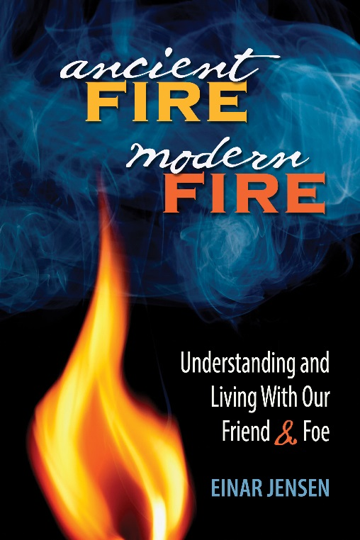
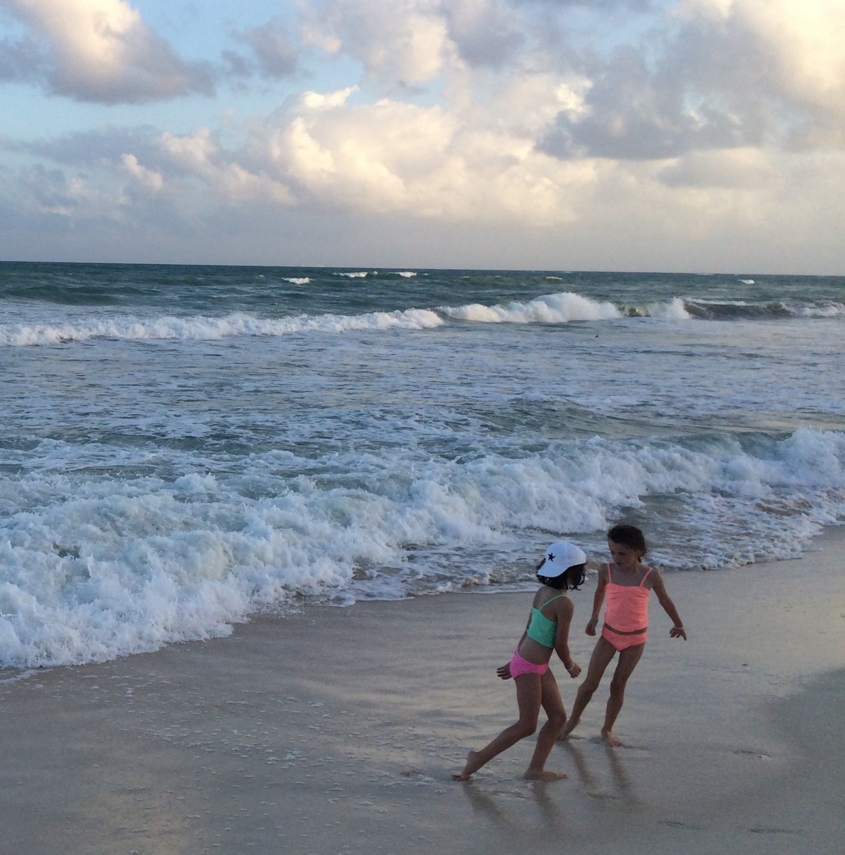
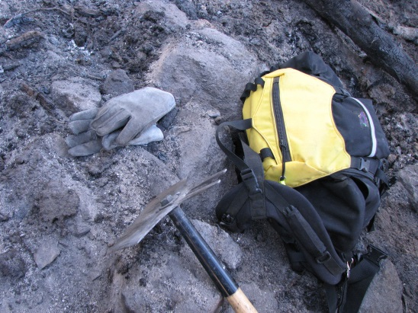

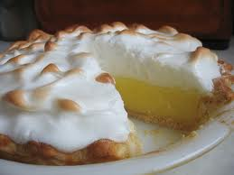

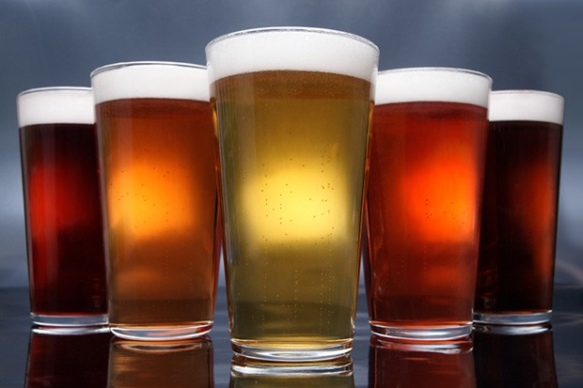
Notes:
Photos of our lives and favorite pies

Slide 2

Wildfire Matters
Teaching Kids about the Wildland Urban Interface

Slide 3
How Do We Change a Culture?
“We are continually faced with great opportunities which are brilliantly disguised as unsolvable problems.”
--Margaret Mead
How? We Teach…
  Change Attitudes (regarding risk, responsibility)
  Change Behavior
  Change Conditions

Slide 4
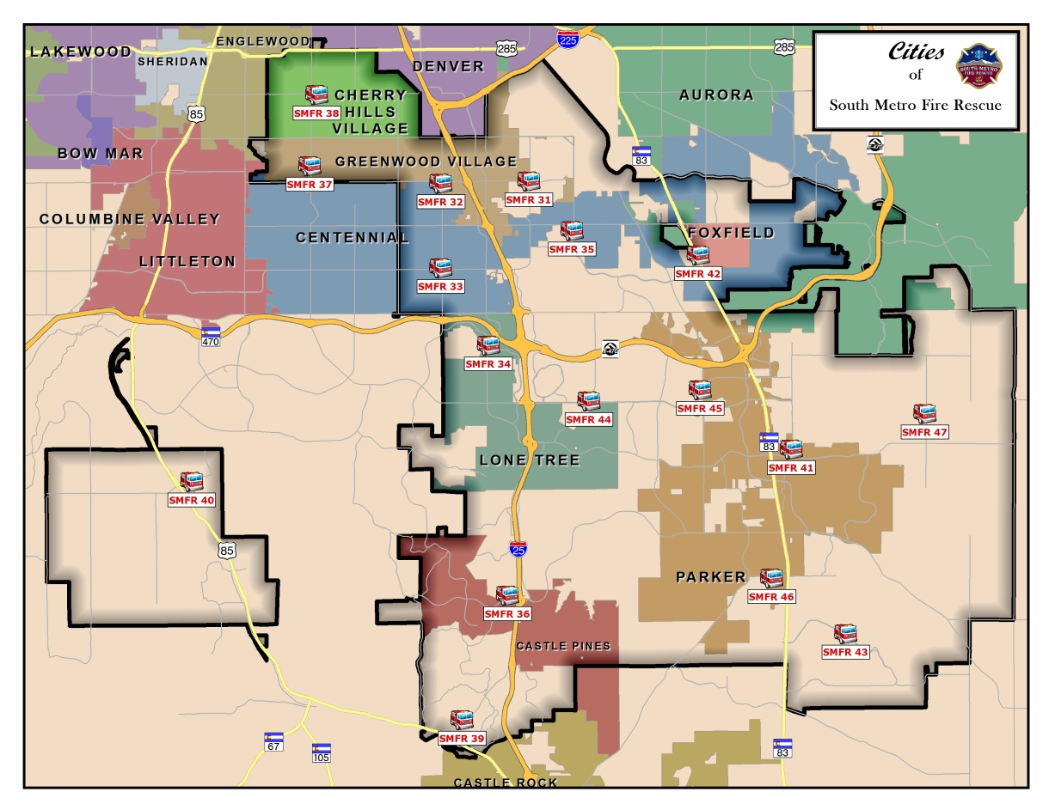
South Metro Fire Rescue
176 Square Miles
198,000 residents
6,200 businesses
69,200 homes (867 apts)
Median age of 29.9
8% aged 65+
373 personnel
3 Divisions
17 stations (+2 facilities)
18,000 calls in 2015
2 Risk Reduction Spec.

Slide 5
Why Wildfire?
It’s my passion
South Metro Fire Rescue is all WUI
Wildland Urban Interface fires are the new norm
Most damage, injuries, deaths are preventable
Still an Underdog of the Fire Service
Avenue for Environmental History, Environmental Literacy

Slide 6
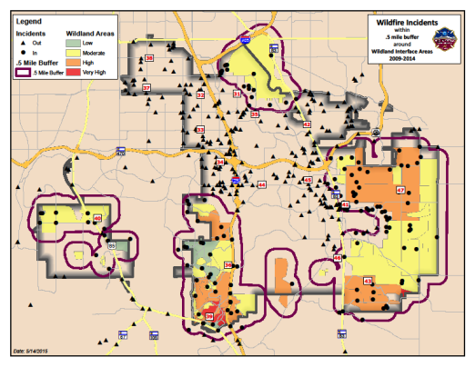
Know your Wildland Urban Interface
Assess your Risk
  2008 CWPP
  2012 Douglas County CWPP
  Annual data
Ask some questions
  Are the data sound?
  Do all fires count?

Slide 7
Massage the Data

Slide 8
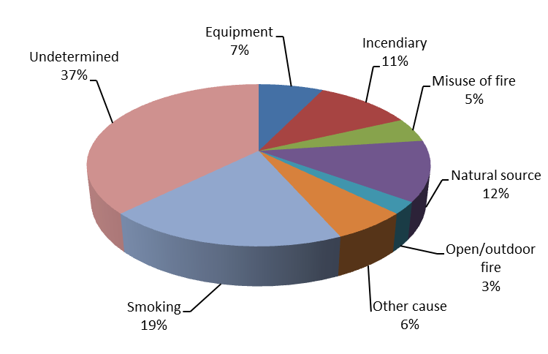
Massage the Data

Slide 9
Two Audiences Addressing WUI Risks
Teaching old dogs new tricks
  Ready Set Go, FireWise
  HOA Meetings
  Home Ignition Zone Assessments
  Interface Drills
Teaching new tricks to puppies
Shape the next generation’s culture
Children bring messaging home to parents
Prime them to make a difference (teens love to make a difference)
Empower the next generation of adults

Slide 10
Building a Program
(1998 – Master’s degree in Environmental History)
2007-ish: Chat with Kim Scott
2010 – Project Learning Tree workshop
2011 – Read Last Child in the Woods
2011 – Piloted the Class
2012 – FireWorks Master Class
2012 – Join Colorado Alliance for Environmental Educators
2012 – Adopt Ready Set Go and Fire-Adapted Community themes for SMFRA
2015 – Published Ancient Fire, Modern Fire

Slide 11
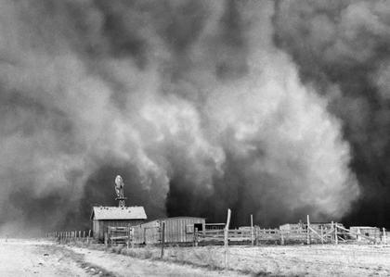
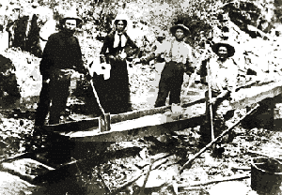
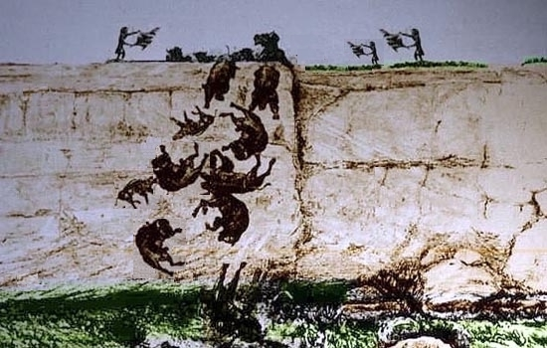
Environmental History
The study of human interactions with our ecological context
Courtesy: AP

Slide 12

Project Learning Tree - 2010
Evidence-based environmental education curriculum
Developed by the American Forest Foundation
How to think, not what to think
PreK-12 lesson plans
Differentiated learning
Only 2 actual fire ecology lessons, but hundreds of ideas

Slide 13
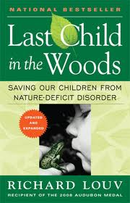
Last Child in the Woods - 2011
Nature-deficit disorder
Links lack of “Nature” with ADD, ADHD
Suggested connections to juvenile firesetting, inept WUI living

Slide 14
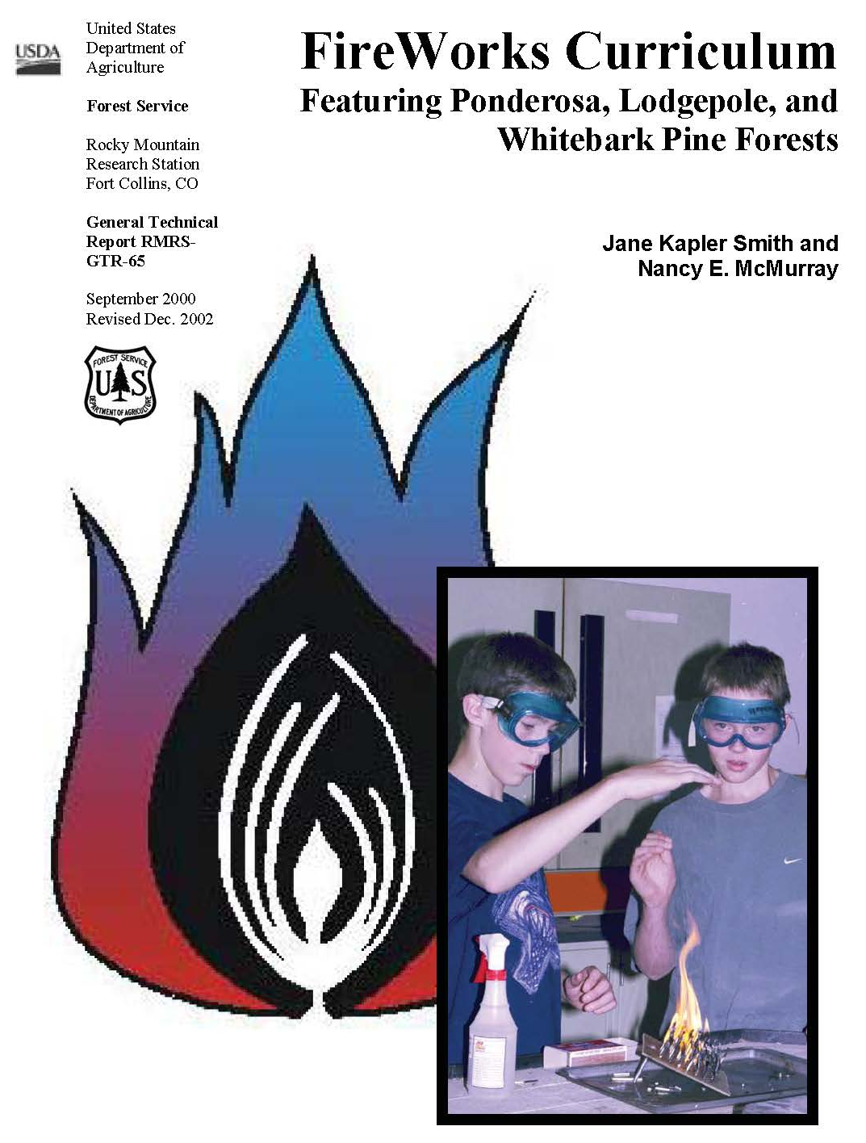
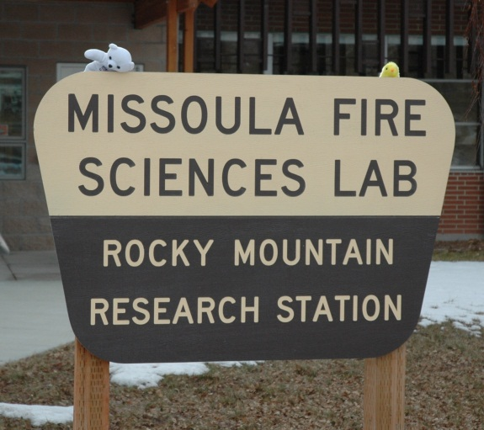
FireWorks - 2012
Interactive, hands-on activities
Fire ecology, fire behavior, human impacts
Grades 1-10
Designed for ponderosa, lodgepole and whitebark pine ecosystems
Jane Kapler Smith and Nancy McMurray, USFS

Slide 15
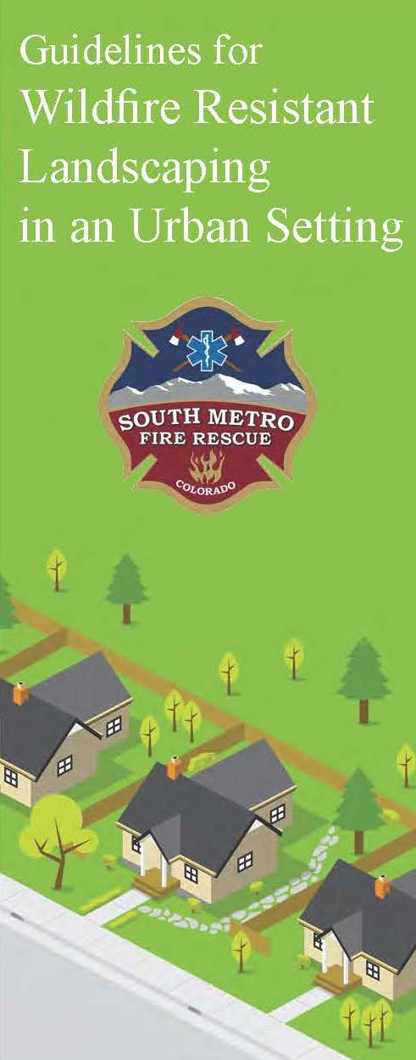
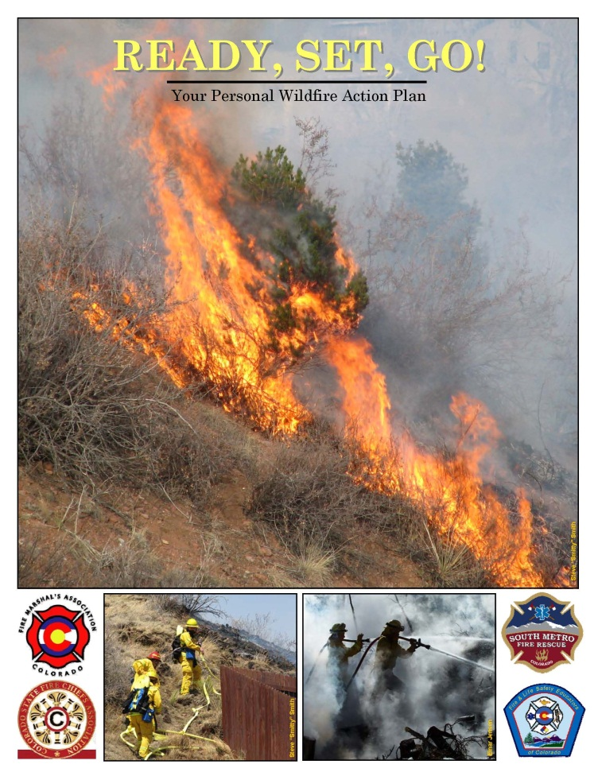
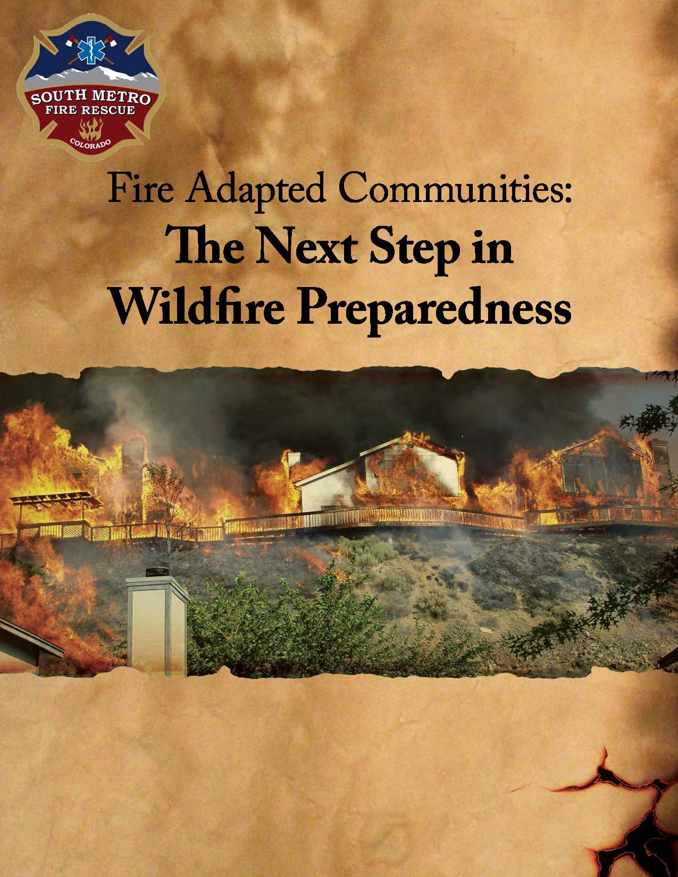
SMFR Campaigns

Slide 16
Ancient Fire, Modern Fire
Shelved the program in 2012, but couldn’t let go
Addresses cultural gaps
Targets educators, firefighters (adults)
Fire origin stories
Youth firesetting
Striving for harmony with fire

Slide 17
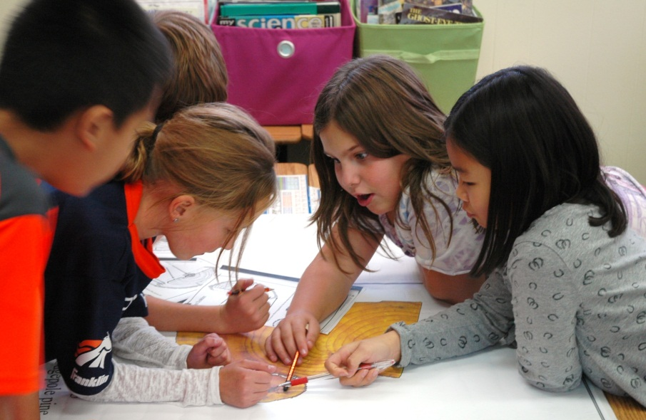
Why 4th Graders?
9-10 years old
Able to distinguish fantasy from reality
Developing ability to conceptualize
Developing “self” attitudes
Learning social rules
Social, physical and intellectual thrusts

Slide 18
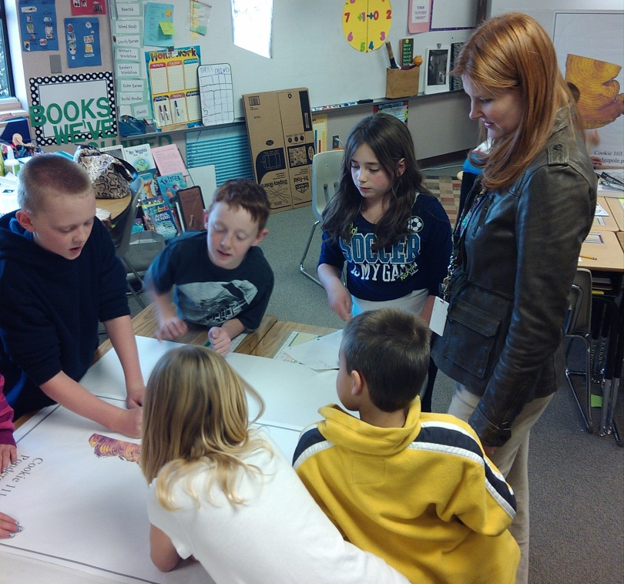
Why 4th Graders?
Eager to learn
Ready for personal, community responsibility
Understand that positive and negative incentives influence behavior

Slide 19
Still Needed a Venue…
Teachers were interested, but teachers have huge responsibilities and little time for extras
What if our programs weren’t extras?
Work with classroom teachers
  Meet with them
  Learn from them
  Seek their advice
  Follow their advice
State Academic Standards

Slide 20
Make It Easy to Say Yes
Life Science: Living things have characteristics that can be described and classified. There is interaction and interdependence between and among living and nonliving components of systems.
Physical Science: Energy exists in many forms such as light, heat, sound, magnetic, chemical and electrical.
History: Organize a sequence of events to understand the concepts of chronology and cause/effect in the history of CO. Themes in Colorado history are related to key events in the US.
Geography: Use geographic tools to develop connections within and across human and physical systems.
Reading, Writing, and Communicating: Comprehending new information for research is a process undertaken alone and within groups. Identifying implications enriches reasoning skills.
Economics: Positive and negative incentives influence decisions.
Civics: Analyze and debate multiple perspectives on an issue.

Slide 21
Addresses CO EE Plan
Prepare students to understand, analyze and address the major environmental challenges facing Colorado, the United States and the world.
Connect teachers and students to standards-based, relevant, environmental education experiences in an effort to develop life-long health, wellness and civic-minded behaviors.
Connect school districts and teachers to professional development opportunities in environmental education.

Slide 22
Wildfire Matters is Born
Four 1-hour Sessions (per Classroom)
Lecture
Active, Hands-on Lessons
Multi-media
Group Work
Respect the child
Include relevant information
Lesson should build confidence
Involve affective and cognitive domains
20 hours per school = 6 schools per year

Slide 23
Unit 1: The Local Ecosystem
Pre-test
Introduce the class
Define terms (wildfire, wildland urban interface, ecosystem)
Discuss recent WUI fires
Discuss the role fire plays in ecosystems
Distinguish between built and growing fuels
Mystery Bag Activity
Letter for Parents
Notes:
Hand-out the pretest….

Slide 24
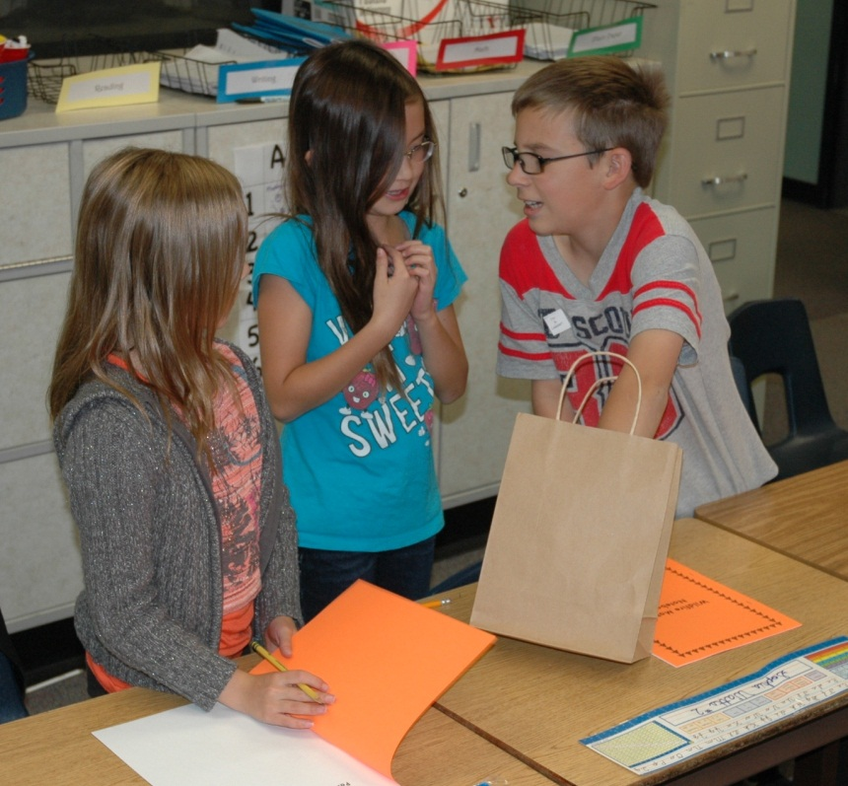
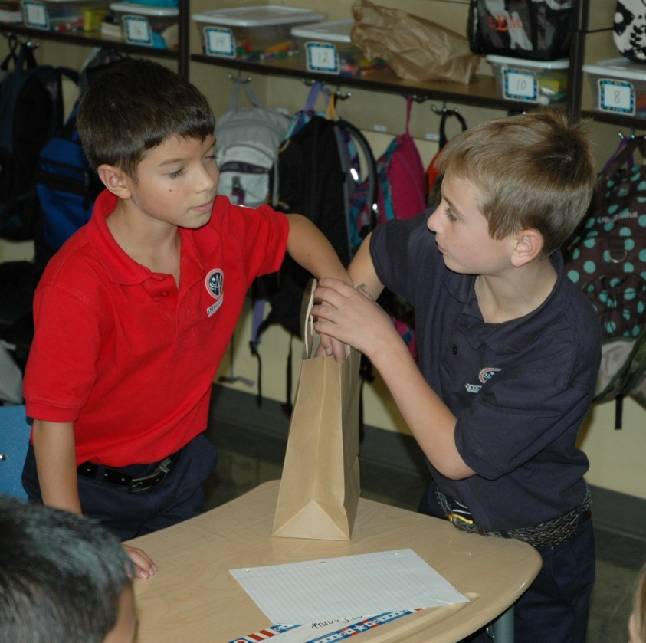
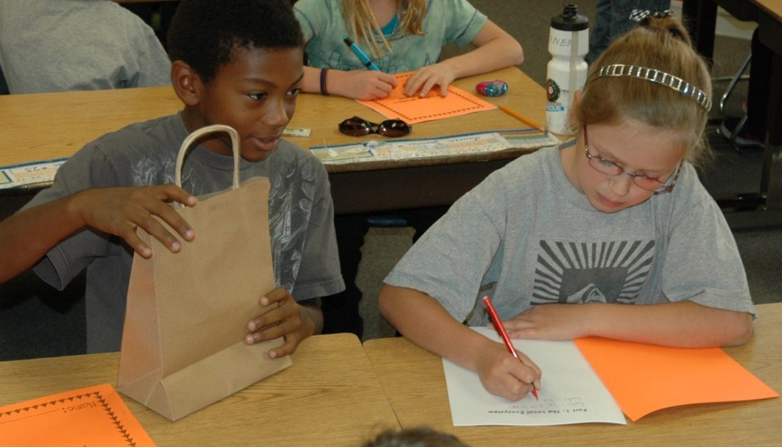

Slide 25

Unit 2: The Science of Fire
Juvenile Firesetting
Fire Triangle
Forms of Heat Transfer
Role of Topography
Role of Weather
Lesson Quiz

Slide 26
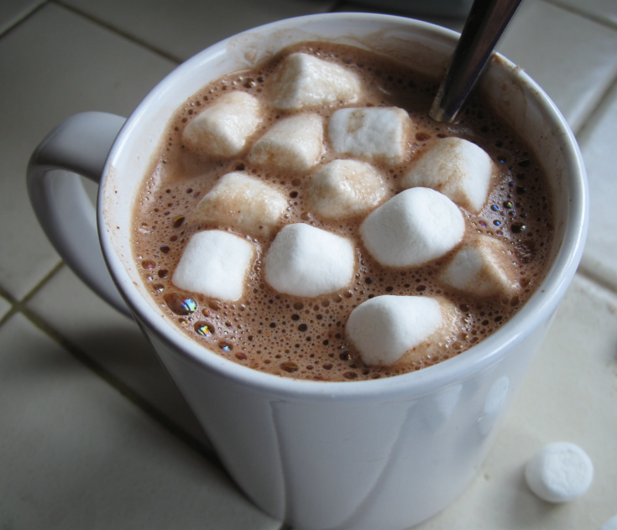
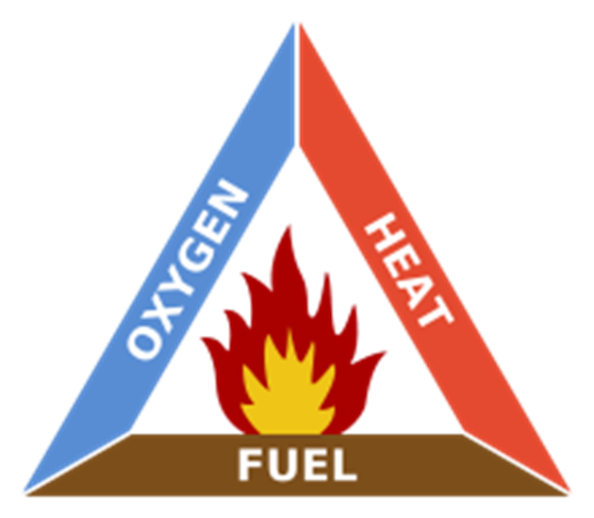

Slide 27
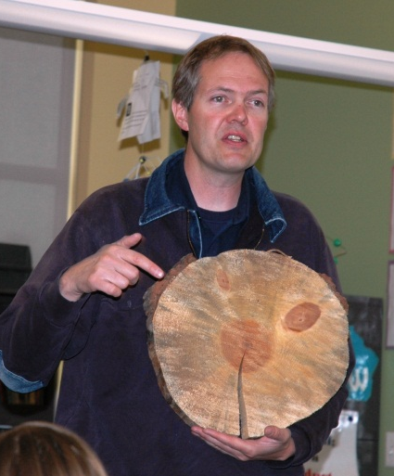
Unit 3: Trees and Fire
Tree anatomy
Living tree model (let’s do it)
Identify resources for trees and how they influence growth
Identify impact of fire on resources
Read tree rings
Worksheet
Quiz

Slide 28
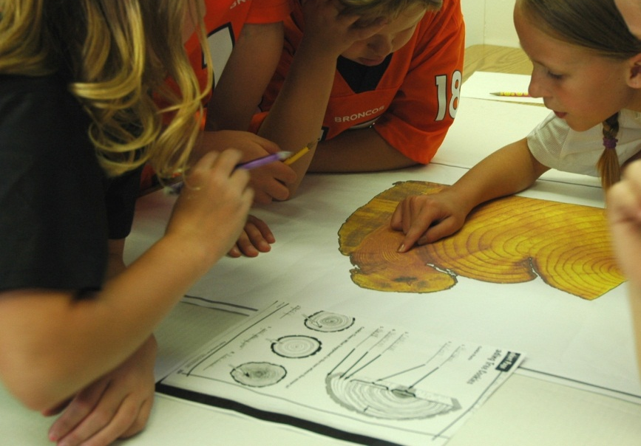
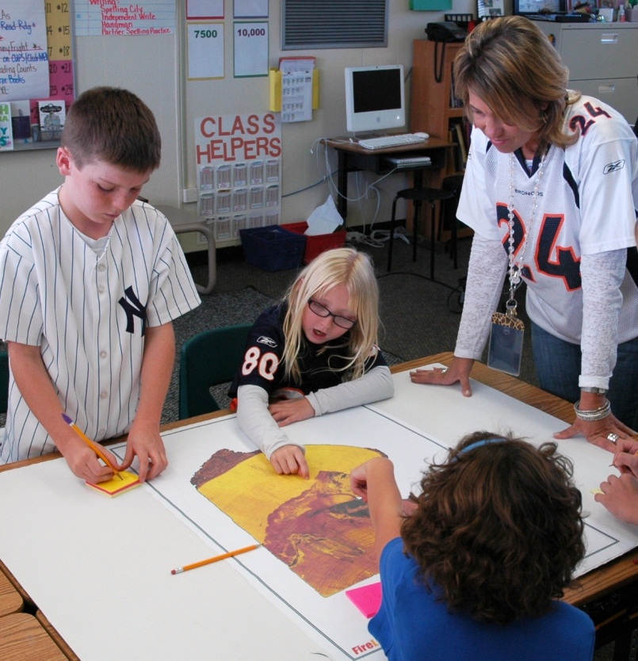
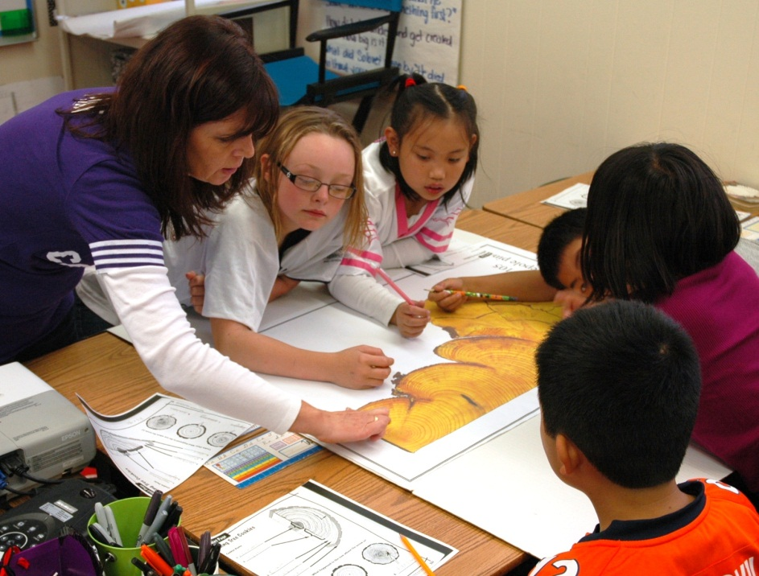

Slide 29
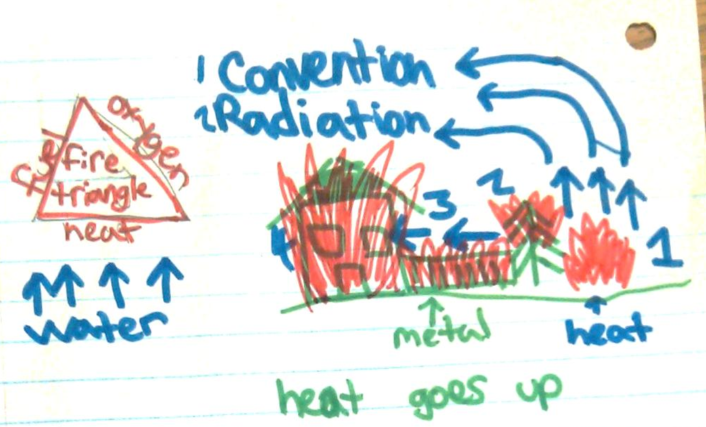
Unit 4: WUI Fire Mitigation
Discuss why people live in WUI neighborhoods
Create a spectrum of flammability (trees, siding, roofing, decking)
Review heat transfer, embers
Use the NFPA 1144 form to rate a house

Slide 30
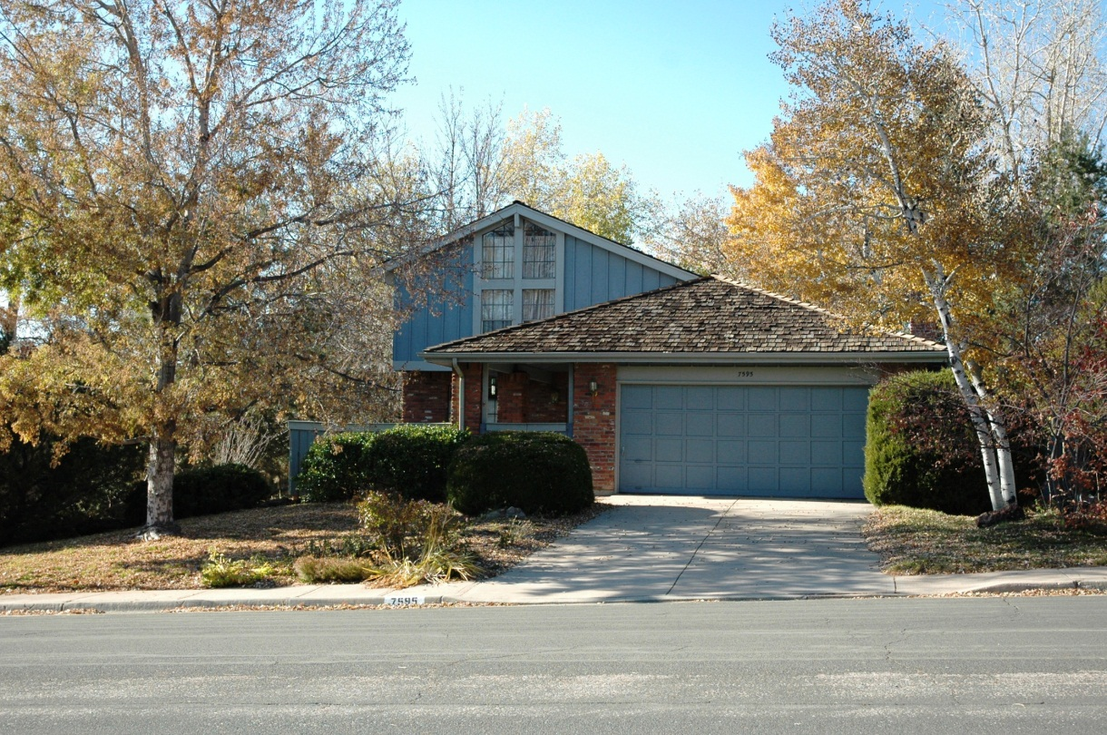
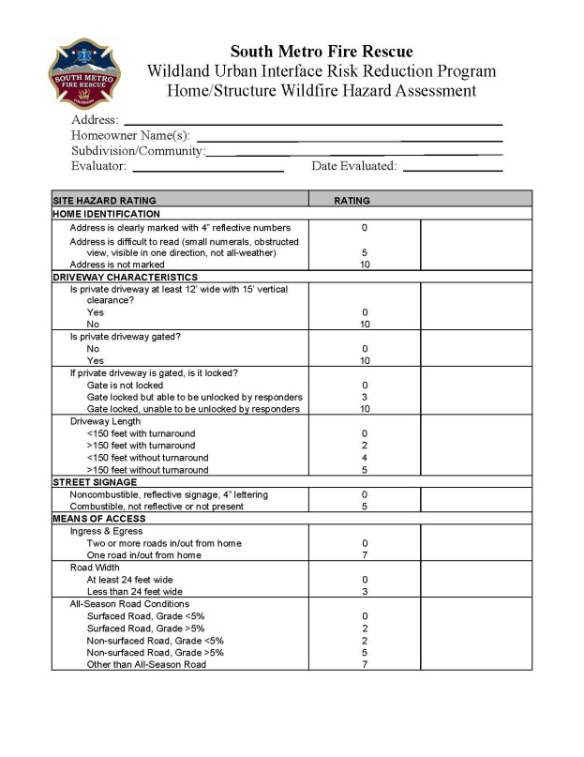
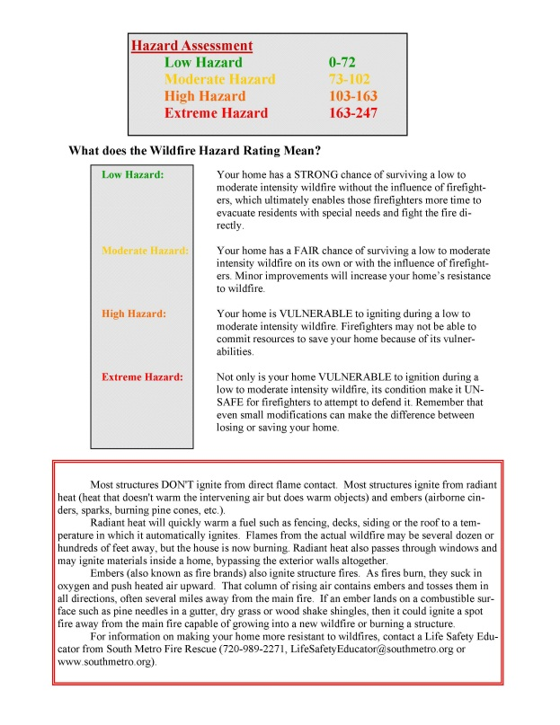

Slide 31
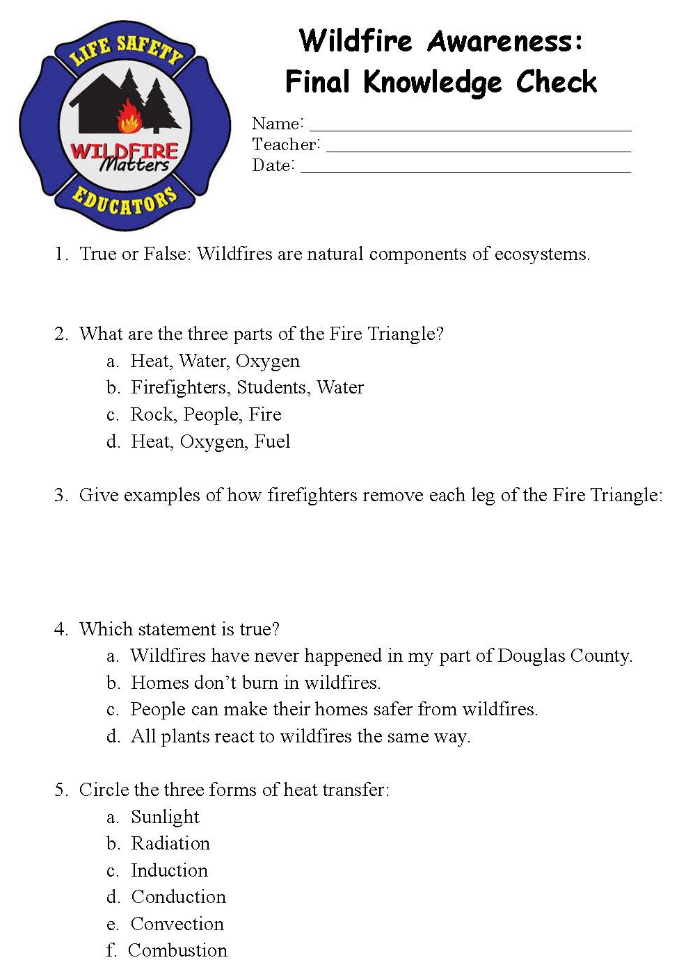
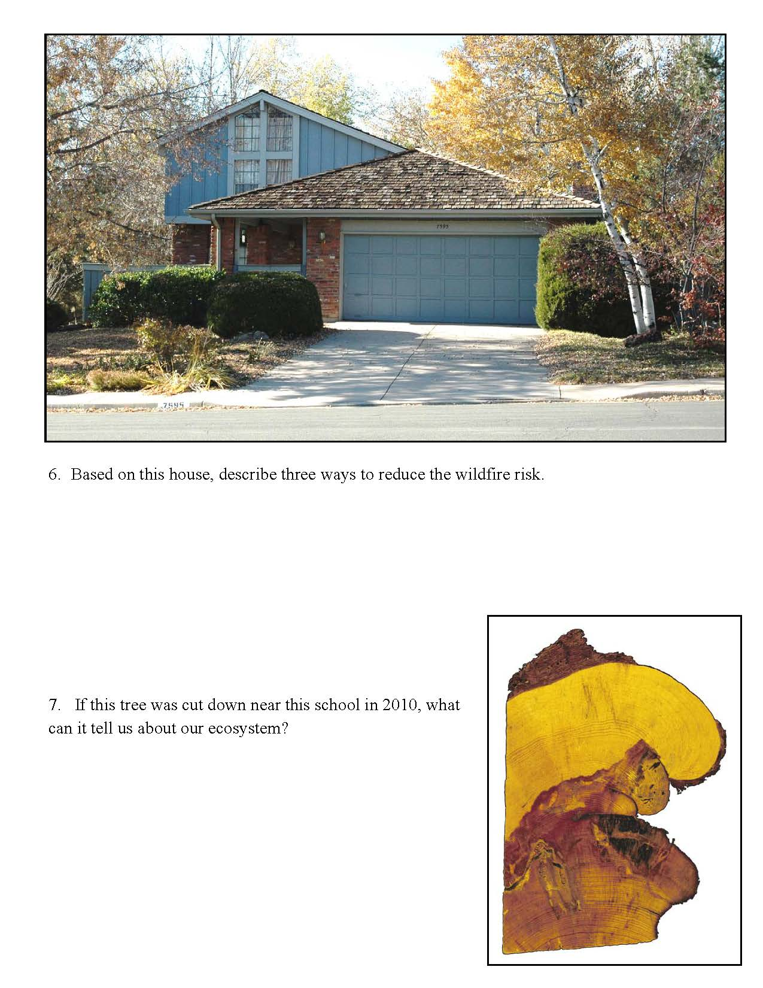
Evaluation
Students complete a post-test one week after the final session

Slide 32
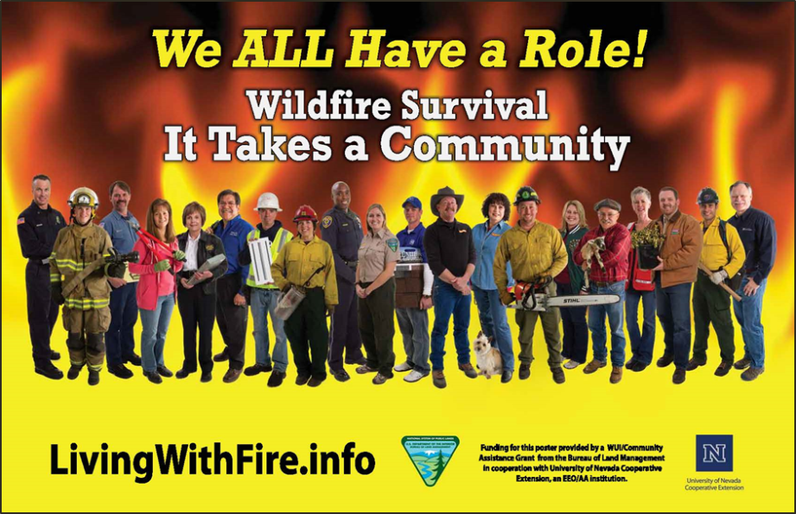
Other Components
Jeopardy Game
Debates

Slide 33
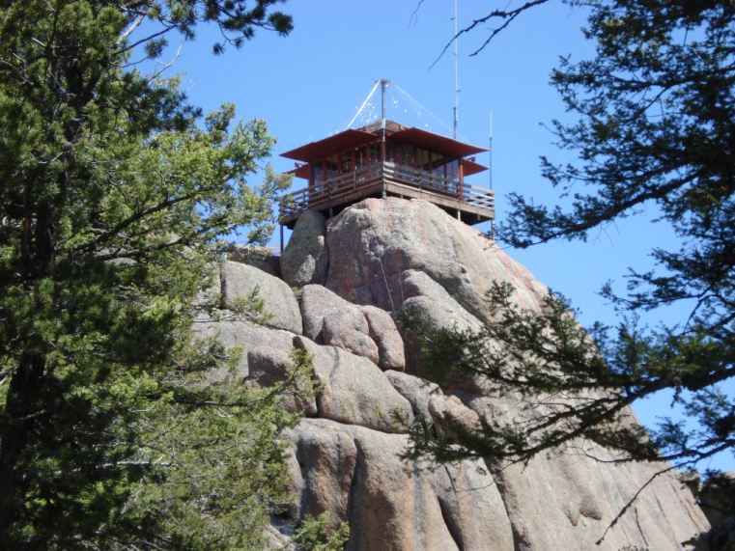

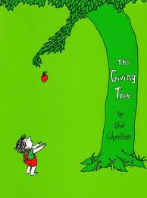

Other Components
Notes:
www.everytrail.com

Slide 34
But are They Learning?
Anecdotal
Teacher feedback
Student art/letters
Test Scores

Slide 35
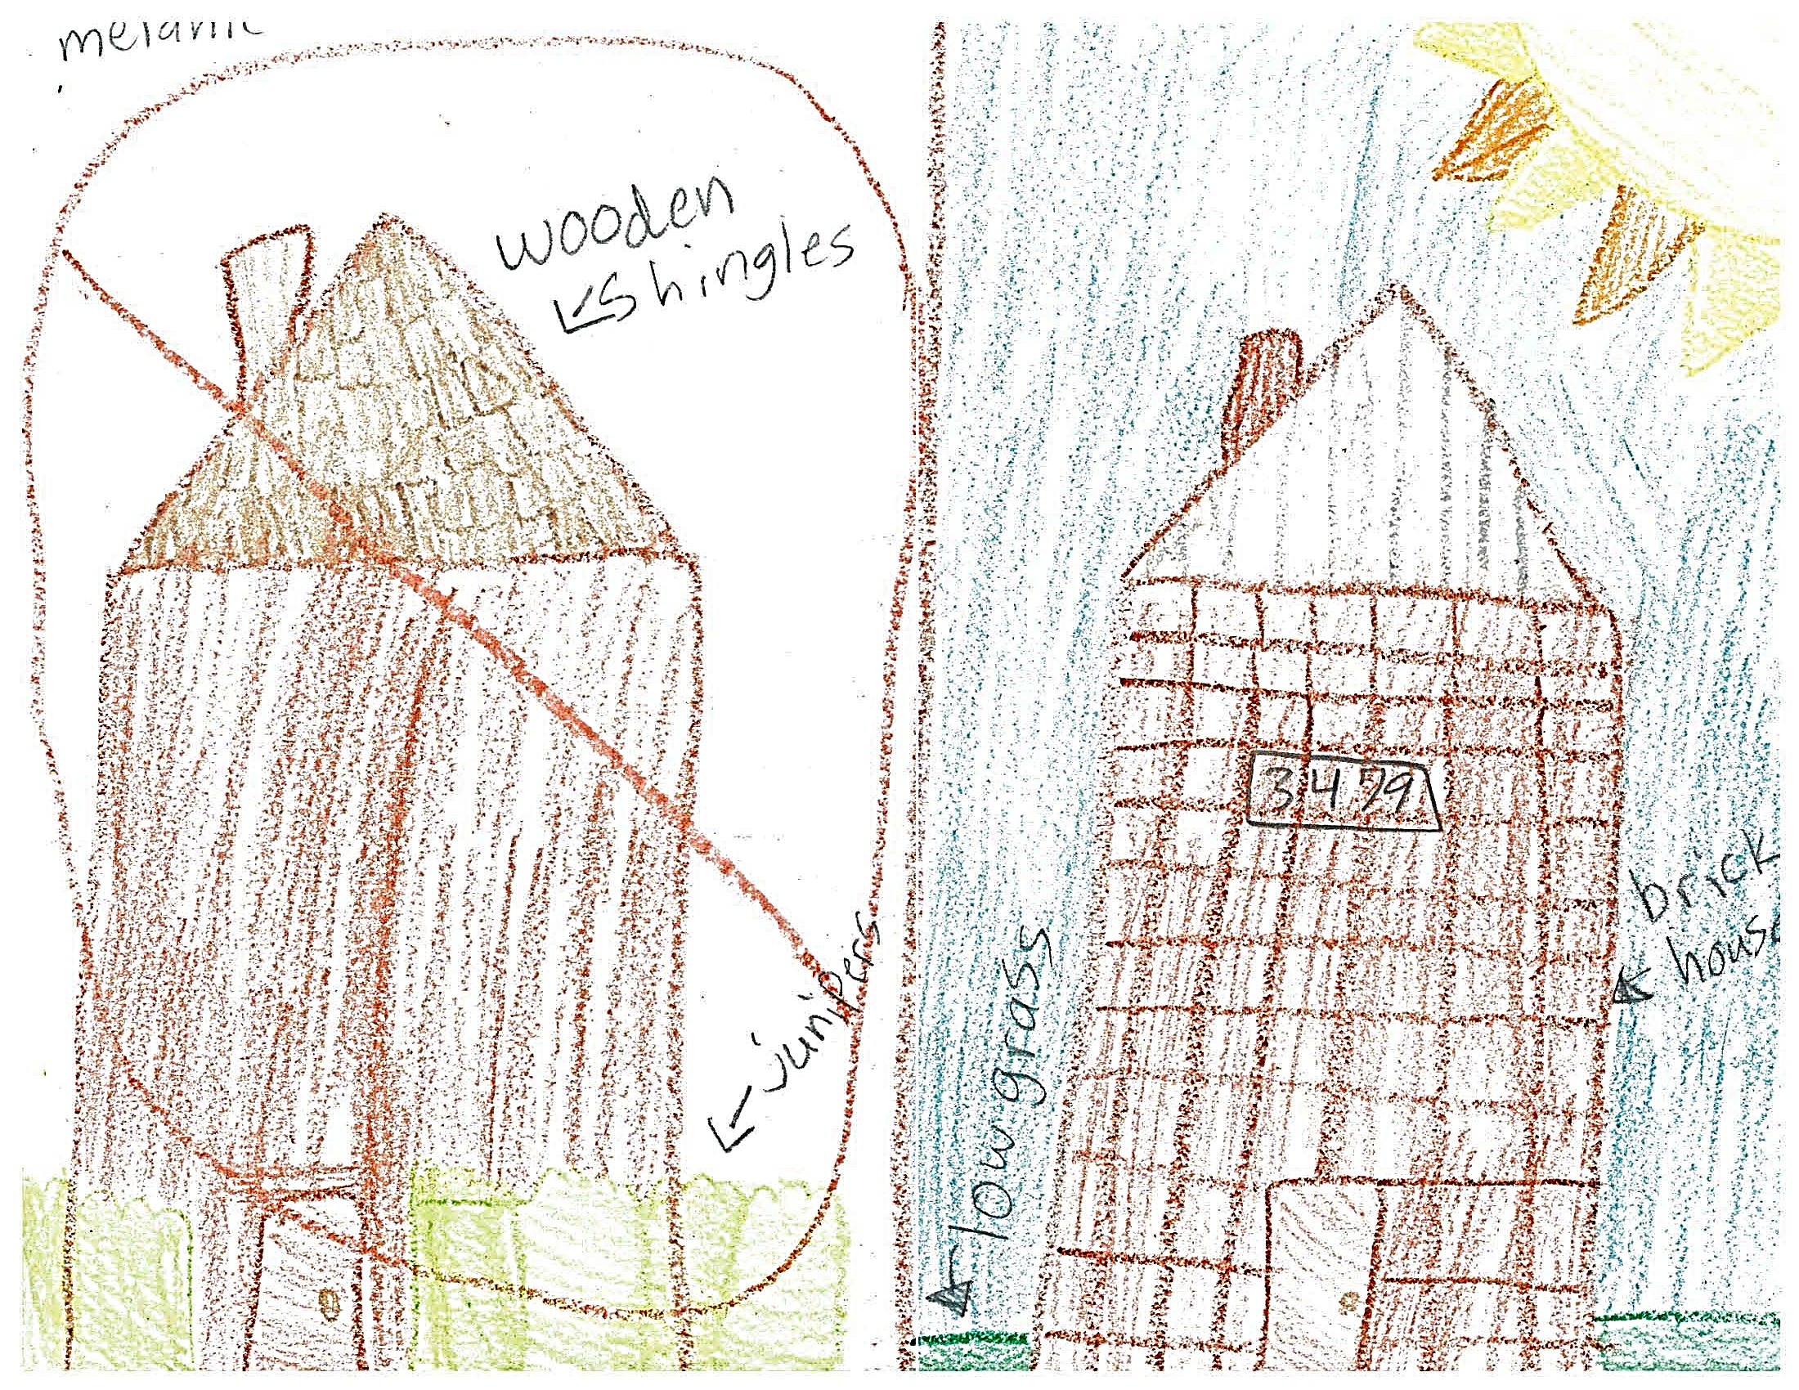

Slide 36
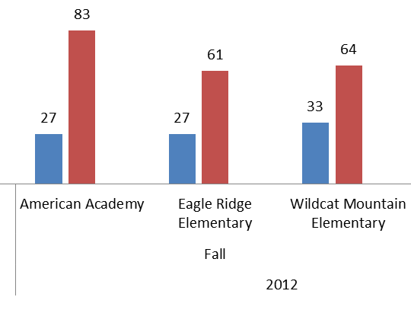
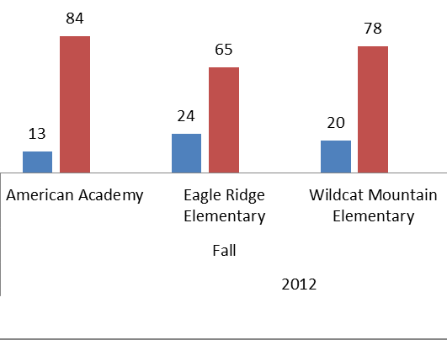
Wildfires are Natural: Pretest vs. Post-test

Slide 37
New Evaluation Model
Fire Safety Matters 4.1
  Pre-test
  Exit Ticket
  Post-test
  Retention test at end of school year
  Retention test next fall in next grade

Slide 38
Changed Knowledge
But what about Behaviors?
But what about Conditions?

Slide 39
A Raging Success… right?
Positive knowledge gain
Positive relationships with teachers
Positive relationships with students
Positive relationships with parents
I love teaching Wildfire Matters!
But…
  Anecdotal behavior change
  6 out of 41 elementary schools (Time Intense)
  Juvenile firesetting more common than wildfires

Slide 40
So I Shelved It… and Adapted
Change is OK
If a program isn’t delivering, don’t keep doing it
Agency buy-in should increase
Community buy-in should increase
Wildfire Matters for Adults
Fire Safety Matters 4.0, 4.1
By special request…

Slide 41
Lessons Learned
Collaborate with your teachers
Review terms, vocabulary
Review evaluation questions
Classroom, speaker expectations
Create and innovate with them

Slide 42
Lessons Learned
Change is OK
Try it, then try something else
Evaluate your program(s)
  Attitudes, Knowledge, Behaviors
Learn more
Share more

Slide 43
If you want to go fast, go alone…
If you want to go far, go together
Fire & Life Safety Educators of Colorado
Environmental Education Assoc. of Oregon
Project Learning Tree
Conference Partners
NFPA
Ready-Set-Go, Fire-Adapted Communities
All of my lesson plans, tests

Slide 44
Einar Jensen
einar.jensen@southmetro.org
720-989-2273

