Slide 1
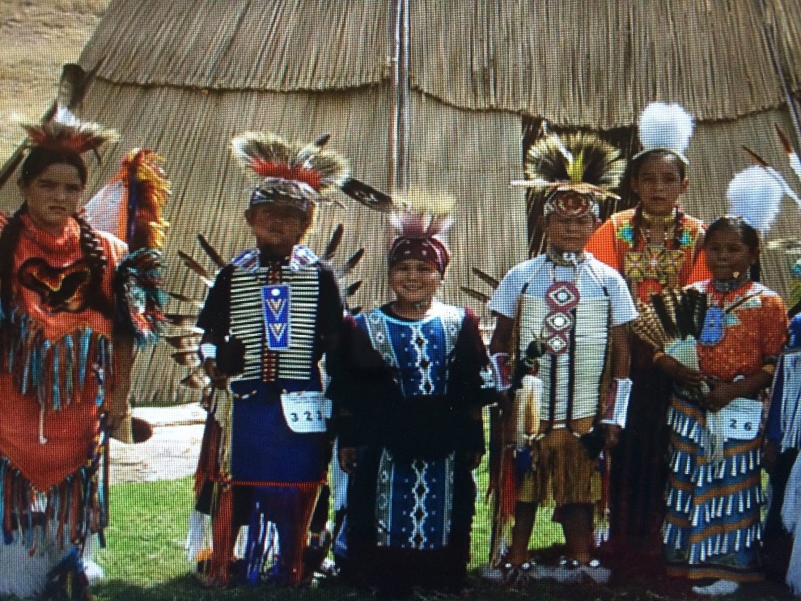
Investing in Indian Youth
February, 2016
Oregon Fire Prevention Conference

Slide 2
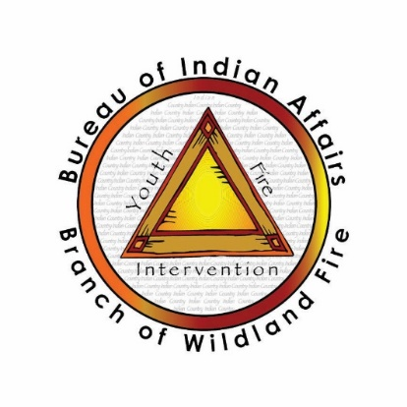
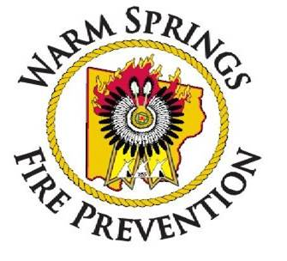
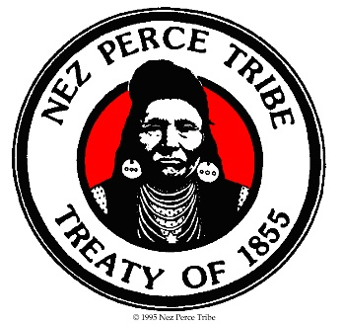
Judith S. Okulitch
BIA Consultant
Youth Fire Intervention Program
Kip Kemak
Nez Perce Tribe
Wm. Wilson
Warm Springs Indian Reservation
Notes:
Current National and Regional Staff

Slide 3
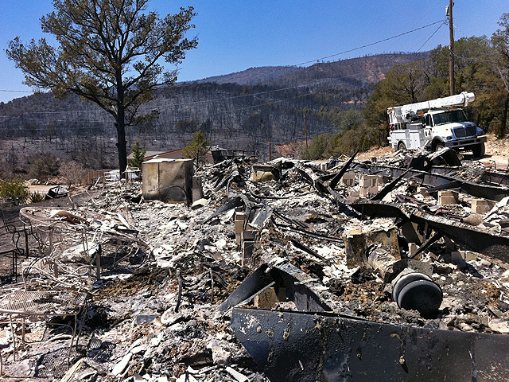
Youth Fire Setting
Do we have a youth-set fire problem in Indian Country?
Indian Country
FY 2001 – 2009 14% of all fires children caused
7191 fires
Over 100K in acres
Approximately $25 Million in suppression costs
720 structure fires set in Tribal Communities
Do we have a youth-set fire
problem in Indian Country?
Two teens accused of setting off fireworks. The wind-driven blaze burned more than 10,000 acres and five homes.
Notes:
Amerind Risk Management Corp reports that over the past 24 years youth have set 720 structure fires in Tribal Communities.

Slide 4
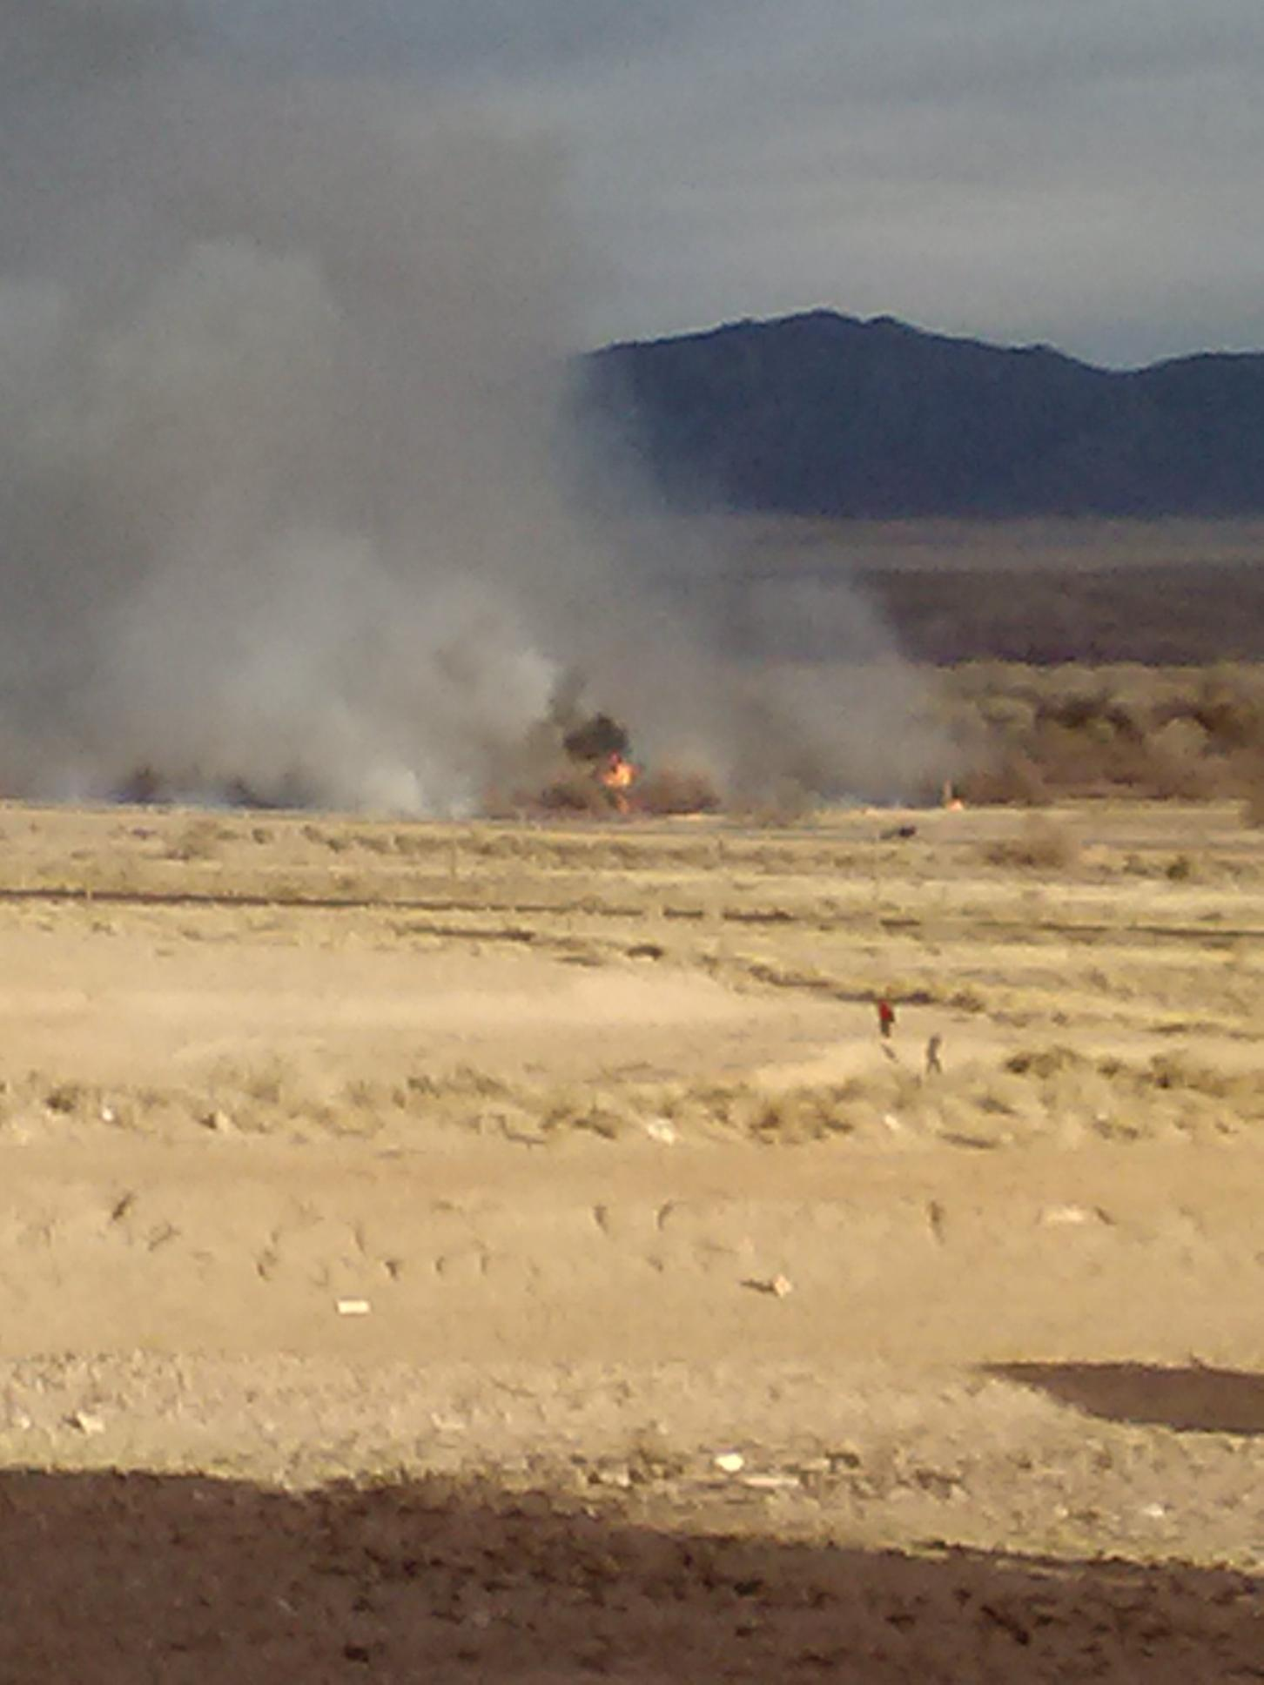
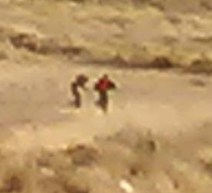
New Mexico Fire
New Mexico Fire
Fires scorched 449 acres
Cost: over $350,000
Type 3 resources
Grass field
Ignition Source: Lighter
Remains of a campfire
Two boys—ages 11 and 12 were hunting and wanted to heat up some beef jerky
Citation: Unlawful burning

Slide 5
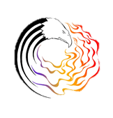
Wildfire Occurrence
Major Causes
Arson = 31%
Natural = 15%
Misc = 14%
Juveniles = 12%
Fire Use = 11%
Nat’l Ave Cost/Ignition
$8,200
Notes:
The Major causes in Indian Country are Arson, Misc (unknown the largest in that category), Fire Use and Juveniles
Fire occurrence data is for all of the BIA (all regions) from 2005 – 2014
In RM Region Incendiary is the leading cause of wildfires over the same time period. You are at 25% incendiary, 17% for Juveniles, 16% Natural

Slide 6
Cost of Youth-set Fires
$0-$350,000-$1,000,000.00
Trash pile to 10,000 + acres of forest land, agriculture, natural resources
Burn injury to fatality
Patch of burned grass to loss of housing units, community structures or sacred or ceremonial grounds

Slide 7
What makes this a challenging issue?
Difficult to find enough evidence or find witnesses willing to identify youth
Variation in age of youth setting the fires---5 - 17 years old
Defining juvenile firesetter and labeling kids
Tribal Codes
Tribal resources to help youth
Communities don’t want to identify kids because they don’t want to give youth a record or in trouble or sent to jail

Slide 8
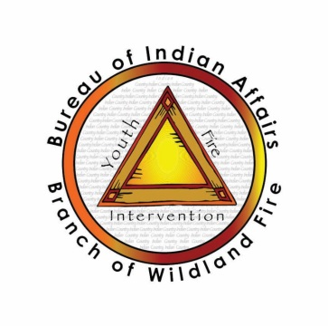
How did we address this fire problem?
Researched “Best Practices” in working with Tribal Youth
Designed new educational materials
Developed a culturally appropriate youth fire intervention program ( FEMA adaptation)

Slide 9
Youth Fire Intervention Program
Goals
Stop the Fires
Educate youth to:
Respect cultural use of fire
Understand the consequences of misuse
Earn trust of community by completing service projects
3) Fulfills Court or Tribal Council Mandates
Notes:
An investment in native youth is an investment in the future of Indian Country

Slide 10
Community based Youth Fire Program does not:
Label kids as firesetters or juvenile arsonists
Does not encourage putting youth in detention center but relies on the juvenile court judge to mandate program
Does not shame or punish youth or use scare tactics
Does not solve all the problems

Slide 11
Youth Fire Intervention Program is “best practice”
Has Tribal Council or Court Support
Is coalition based
Is strength based and promotes positive youth development
Has a “spark plug” leader
Community based-reflects values and resources on the Reservation
Stops the fires
Notes:
What we learned fom the Tule River program and is supported by the OJJDP Tribal Youth Technical Assistance programs is
Must be community based…. This is different from a public education program in that there isn’t a video or pamplets to hand out….we have to deal with the kids on a one to one level and any program must address their needs.
Tule had Tribal Council Support. The Pueblo Tribe in New Mexico had court support and we were able to work with 2 kids who set a grassland fire.
Is Coalition based and why is this so important. Well. Wildland and structural fire are experts at fighting fires, doing logistics, and even fire prevention but working with kids on an individual basis and/ or with kids who have other issues on a daily basis is not their expertise…that’s why we reach out to the agency who’s job it is to work with youth and families for assistance.
Must be strength based….we do not shame kids, scare kids or want to punish kids but to build on their strengths.
Must have someone to keep this going and cares about it

Slide 12
Program Elements
Multi-session
education program
Community Service Learning
Warm Springs
Nez Perce
Southern Pueblo Agency
Tule River Reservation

Slide 13
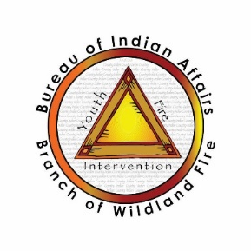
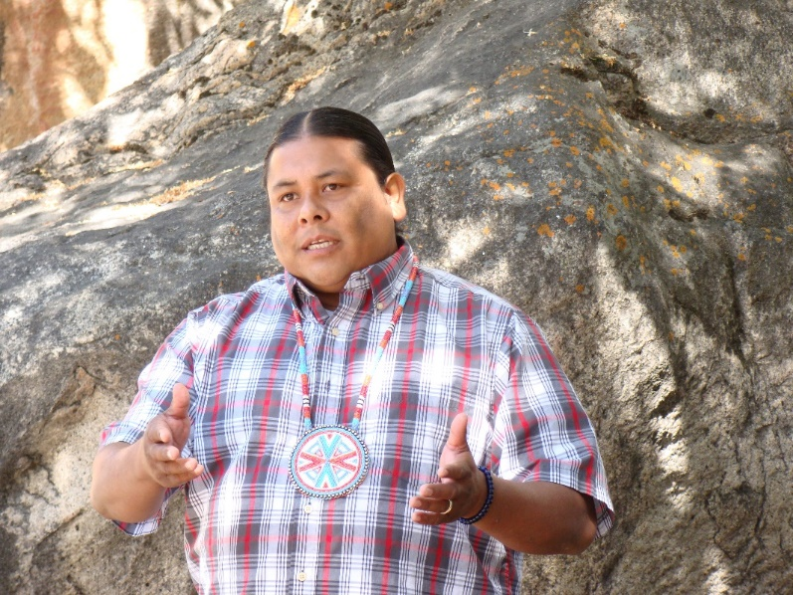
Tule River Program
http://www.bia.gov/nifc/prevention/yfip

Slide 14
Program Components
Community Service Learning
Helps youth accept responsibility
Helps youth develop leadership skills
Helps youth earn back the trust of the community
Has elements from the Restorative Justice Model

Slide 15
Nez Perce Tribe
Program Background:
Since 2012 in reaction to a 2011 youth-set fire.
Mission Statement:
Reduce the incidence of youth-set fires on Tribal lands by establishing a continuum of care to help youth learn their responsibility to protect their families, communities and natural resources from fire.

Slide 16
Nez Perce Tribe
Goals:
Establish and maintain a community coalition of Tribal agencies to address the needs of the youth.
Offer diversion programs that require youth to complete community service projects to earn back the trust of the Tribal community.
Educate youth about fire safety, fire survival and the serious legal, financial and social costs of setting fires in Indian Country.

Slide 17
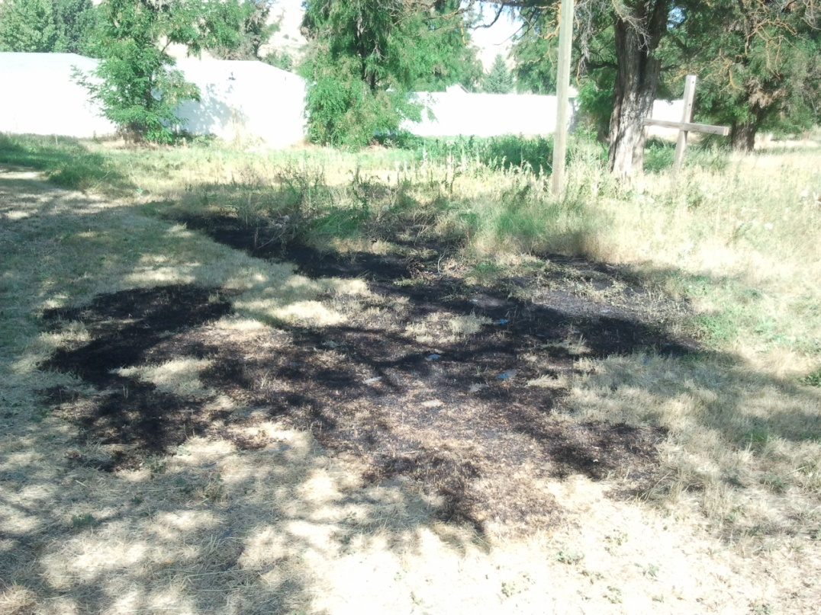
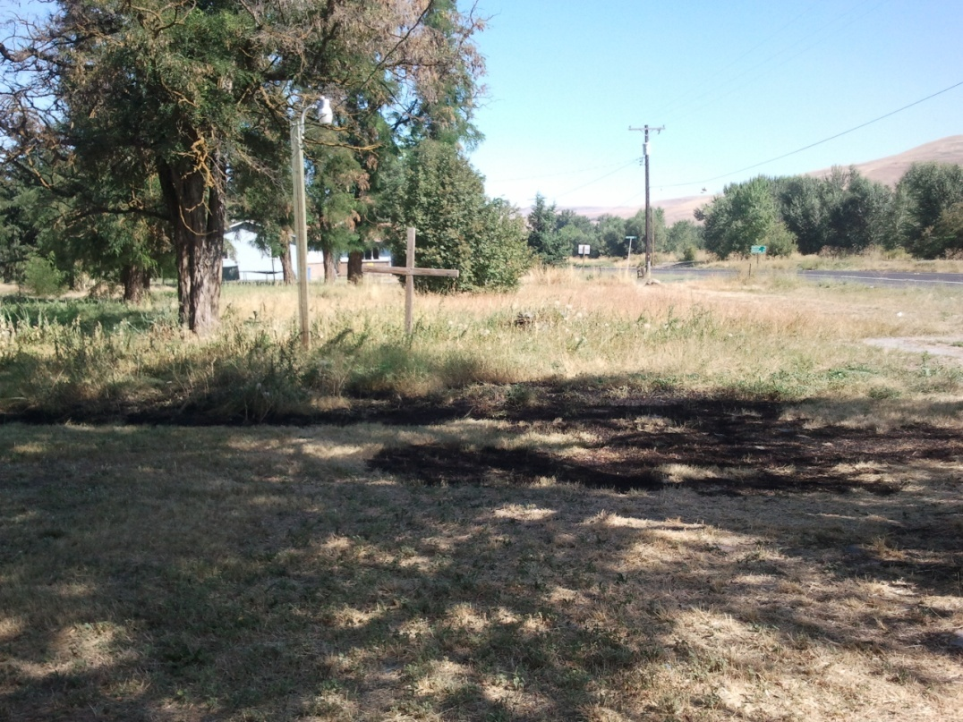
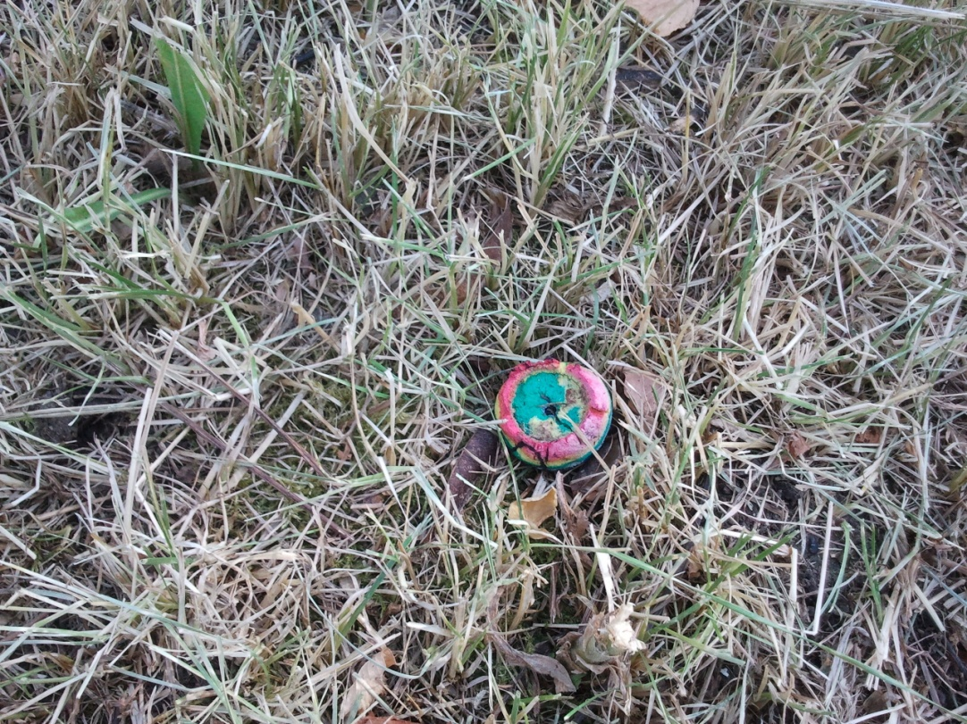
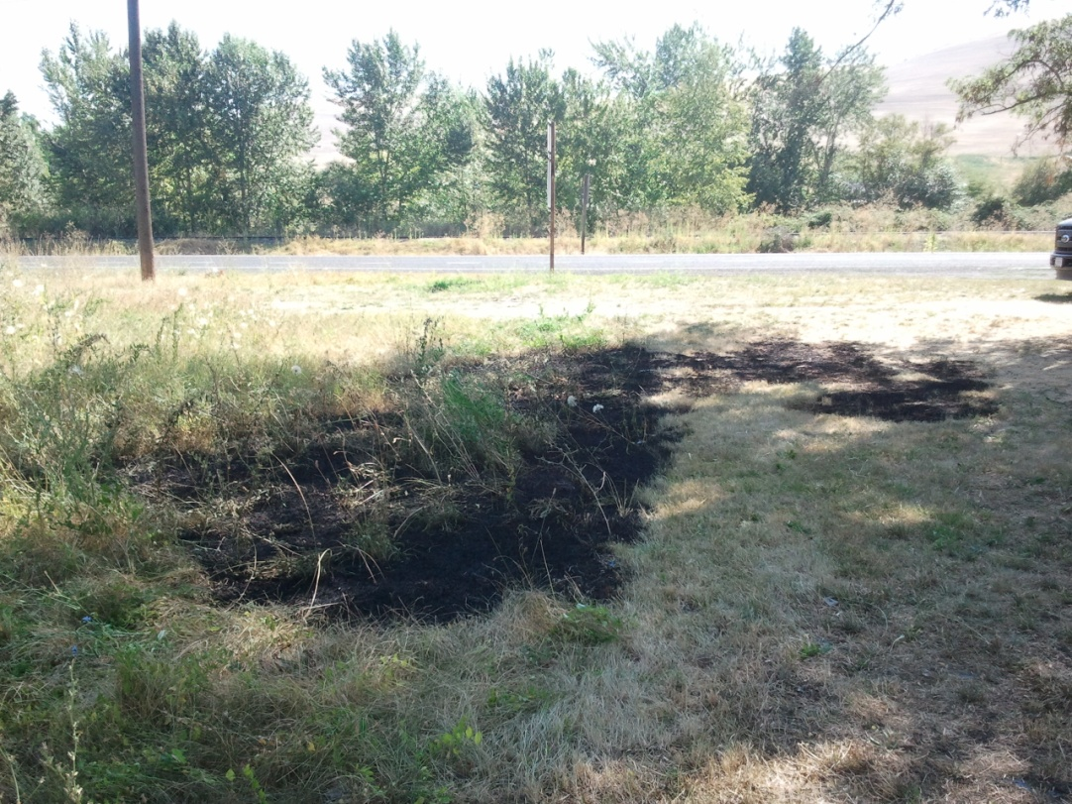

Slide 18
Nez Perce Tribe
In Summary:
Have program in place before you need it.
Solid investigations to identify issues.
Maintain coalition relationships.

Slide 19
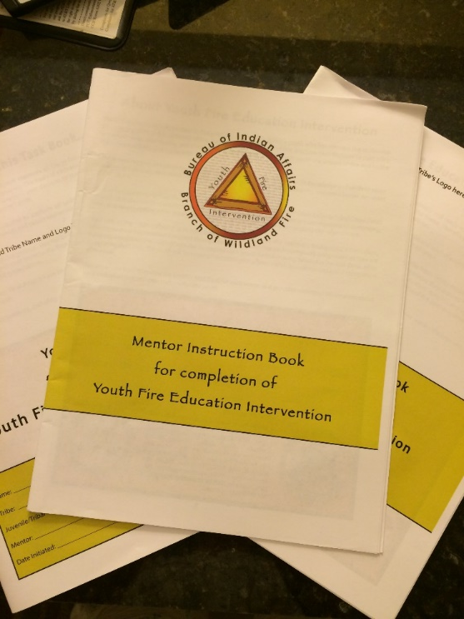
Southern Pueblos Agency Youth Fire Education Program
Defining the Basics
The Science of Fire and Campfire Safety
Historic and Cultural Uses of Fire
The Cost of Firefighting
The Community Ripple Project
Completing the Circle
Giving Back to the Community
Curriculum includes:
Task Book for Youth
Mentoring Book for Instructors

Slide 20
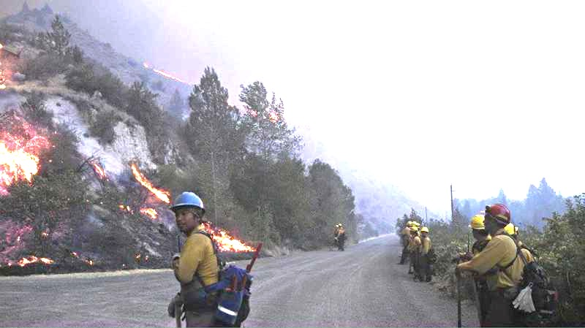
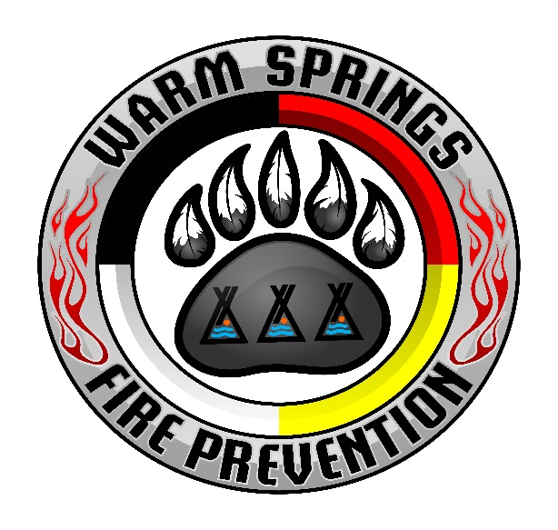
Warm springs wildfire prevention
2015 county line 2 fire

Slide 21
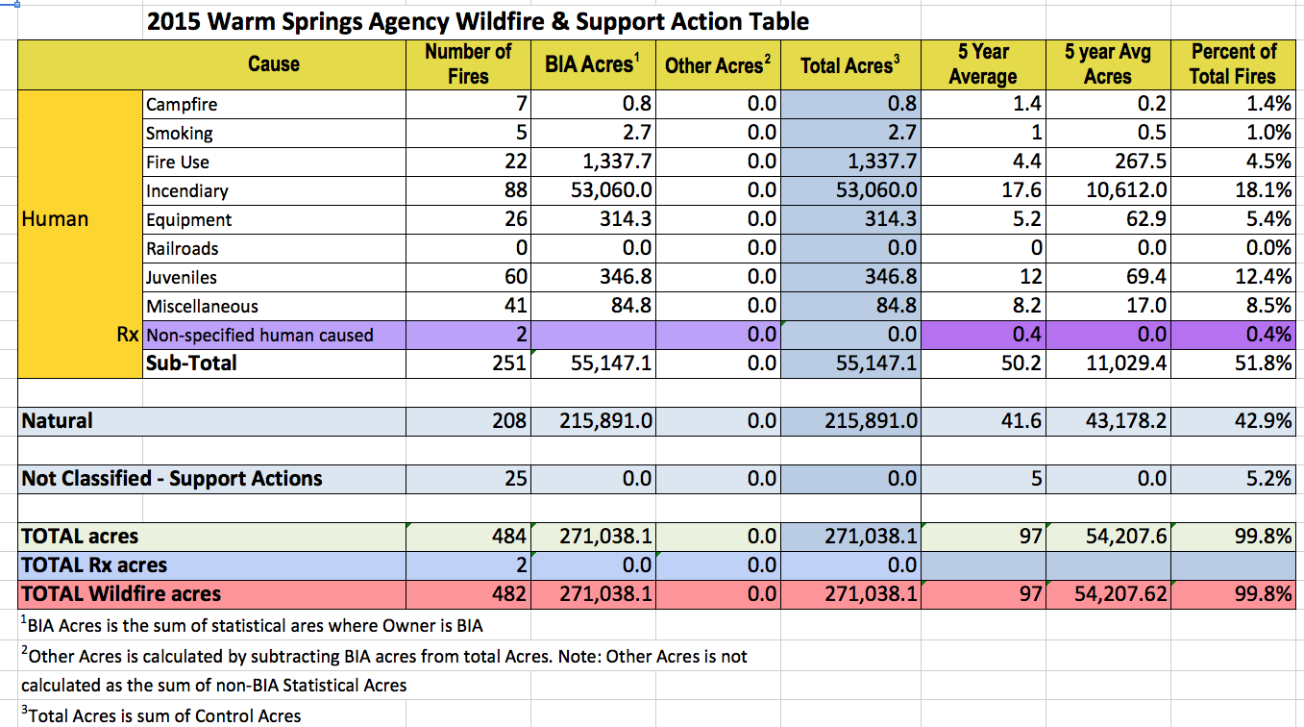
Wildfire Prevention: Prevent unwanted human caused wildfires
Determine the Workload – How?
Statistics !

Slide 22
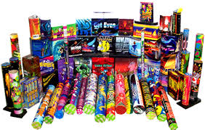
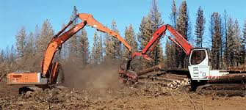
Wildfire Prevention: Workload analysis
Determine the priorities to target limited prevention funding towards
From fire history identify the top THREE human caused fire incidents
Incendiary 18/yr – primarily fireworks, also lighters matches etc.
Juveniles 12/yr – Children with multiple ignition types
Equipment 5/yr – Exhaust, sparks, friction on vegetation etc.

Slide 23
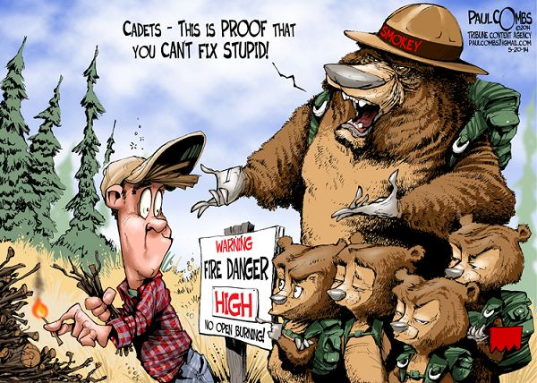
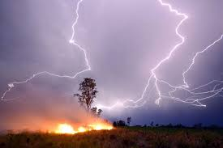
Wildfire Prevention: trends 5 year & ten year
Ten Year Trends – 916 total wildfires
550 human caused wildfires
189 incendiary for 18.9 or 19 per year
119 juvenile caused for 11.9 or 12 per year
62 equipment fires for 6.2 or 6 per year
366 natural wildfires for 36.6 or 37 per year
Five Year Trends – 459 total wildfires
251 human caused wildfires
88 incendiary for 17.6 or 18 per year
60 juvenile caused for 12.0 or 12 per year
26 equipment fires for 5.1 or 5 per year
Note: An increase in intentional arson fires by at least 100% to 22 per year
208 natural wildfires for 40.8 or 41 per year

Slide 24
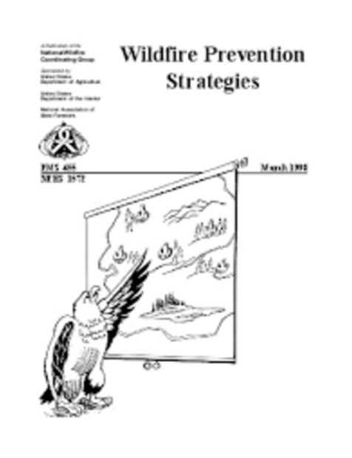
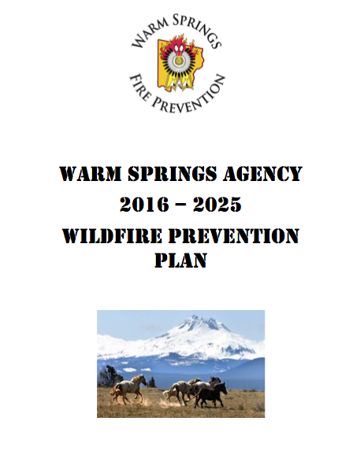
Wildfire Prevention: The response or strategy
Warm Springs Wildfire Prevention Plan
Developed from the top 3 human caused fires
Incendiary
Juvenile
Equipment
Strategies from publication PMS455
Education
Information dissemination
Investigation of all human caused fires

Slide 25
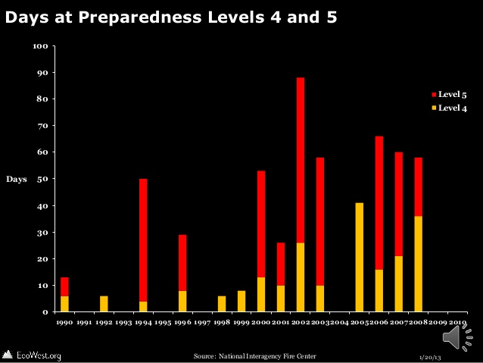
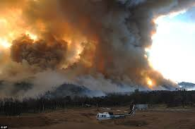
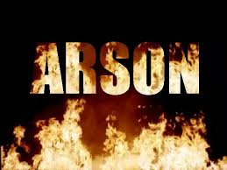
Wildfire Prevention: The response or strategy in an emergency
Seasonal condition variations create Extreme Fire Danger…..
Multiple Ignitions human and natural
Multiple fire ignition days
Large fire incidents occur
An increase in human activity and suspicious ignitions
An order is placed for a Prevention Team (Avoid using Education Teams
or Arson Task Forces to use trainees and different variations of prevention
Personnel) to respond to increased instances of suspicious human caused
Fires.

Slide 26
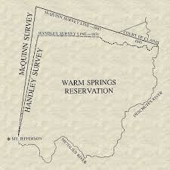
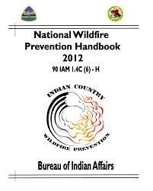
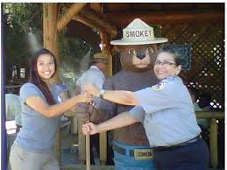
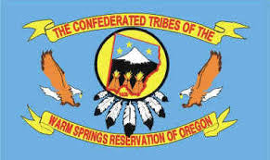
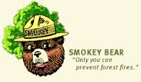
Warm Springs Wildfire Prevention

Slide 27
Warm Springs
Mentor Book for Younger Aged youth
Lessons include:
Tools and Toys
Safe and Unsafe Fires
Cultural Stories about the Origin of Fire

Slide 28
Panel Discussion on Program Development in Indian Country
Lessons Learned:
Tribal Council Resolution
Coalition
Educational Materials

Slide 29
Tribal Council Resolution Challenges and Support?
Warm Springs
Nez Perce
Lesson Learned:

Slide 30
Coalition Based Who is in the coalition? How was it developed? What is the benefit?
Warm Springs
Nez Perce
Lessons Learned

Slide 31
Value of Coalition Participation
1) Improvement of agency efficiency through sharing of resources, less duplication of effort and a reduction in gaps in service.
2) Better understanding among agencies of their roles and responsibilities leading to a greater appreciation of each others’ fields.

Slide 32
Value of Coalition Participation
3) Better decisions by all participants due to greater access to legal, investigative, social service, mental health, education and family issues related to youth.
4) Development of protocols which increase consistency and quality of intervention.
5) Provide opportunities for cross training.

Slide 33
Educational materials What are you using? How is it working?
Nez Perce
Lessons Learned
Warm Springs

Slide 34
Program Components
1)Educational Curriculum—multi sessions
Fire incident focus
Framework for exploring culture and tradition
Promotes dialogue with Elders and Tribal Leaders
Helps youth understand consequences
Helps develop better decision making skills
Notes:
Coalition partners…many of whom are here today.

Slide 35
Questions and Comments
Nez Perce
Warm Springs

Slide 36
Website
http://www.bia.gov/nifc/prevention/yfip

