Slide 1






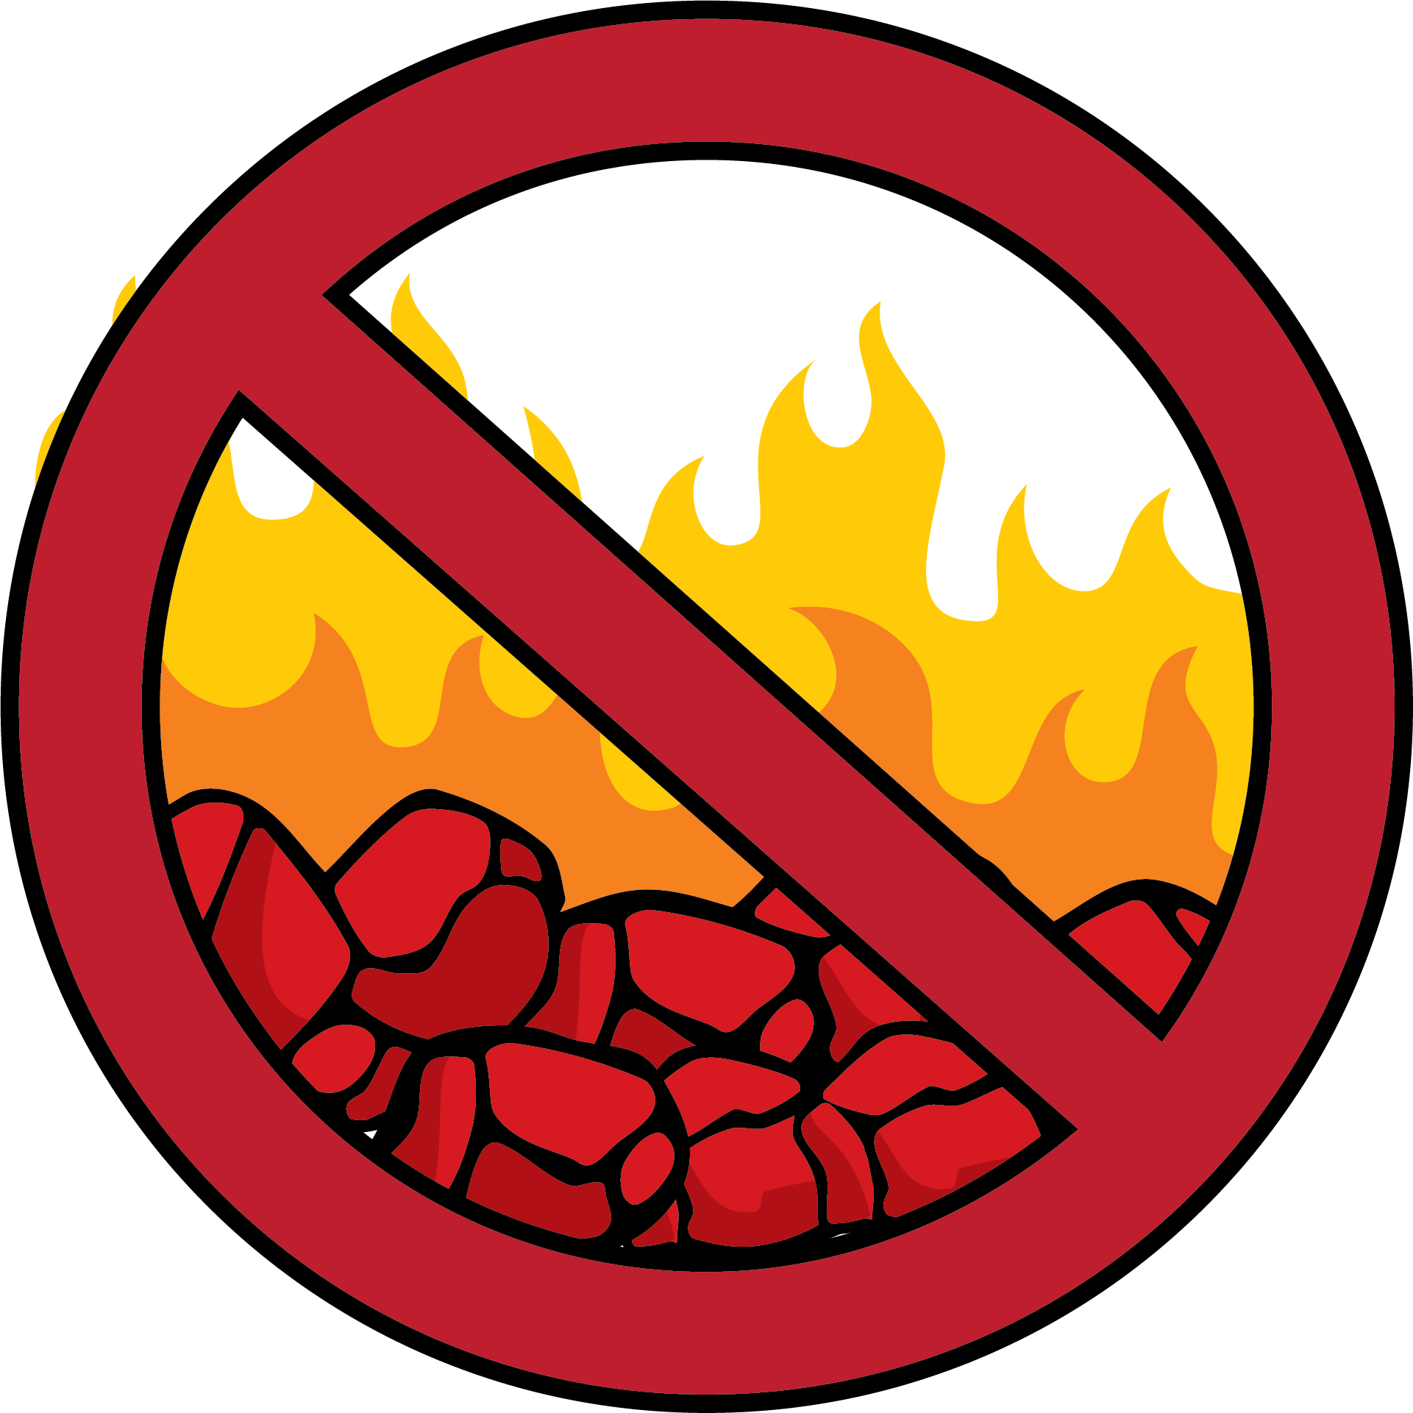
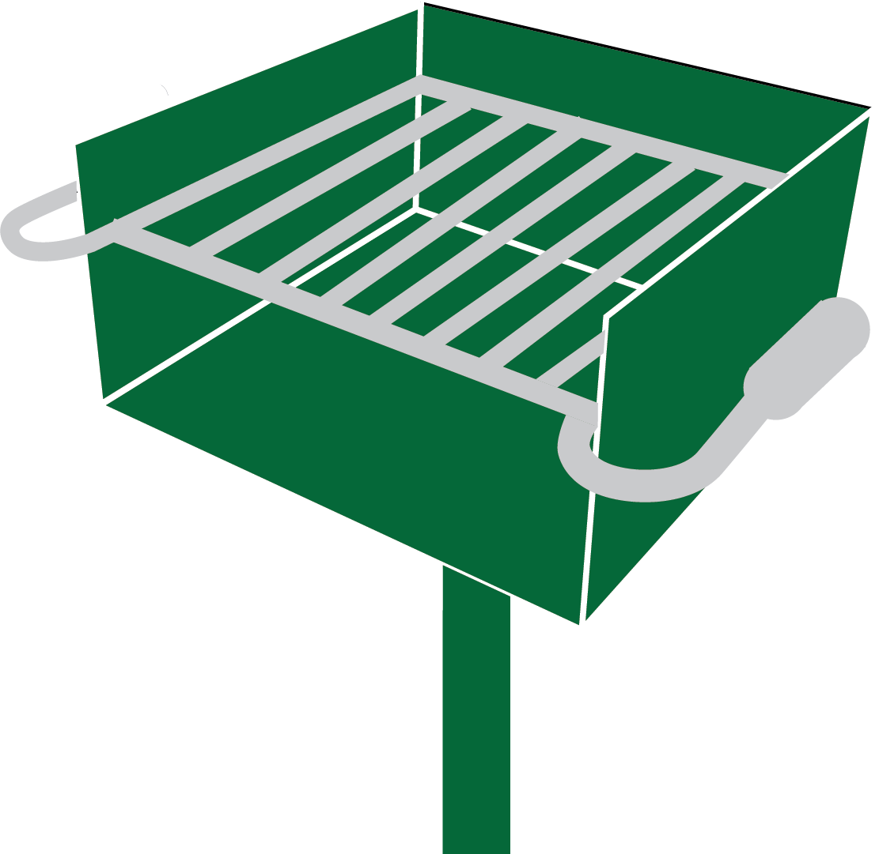
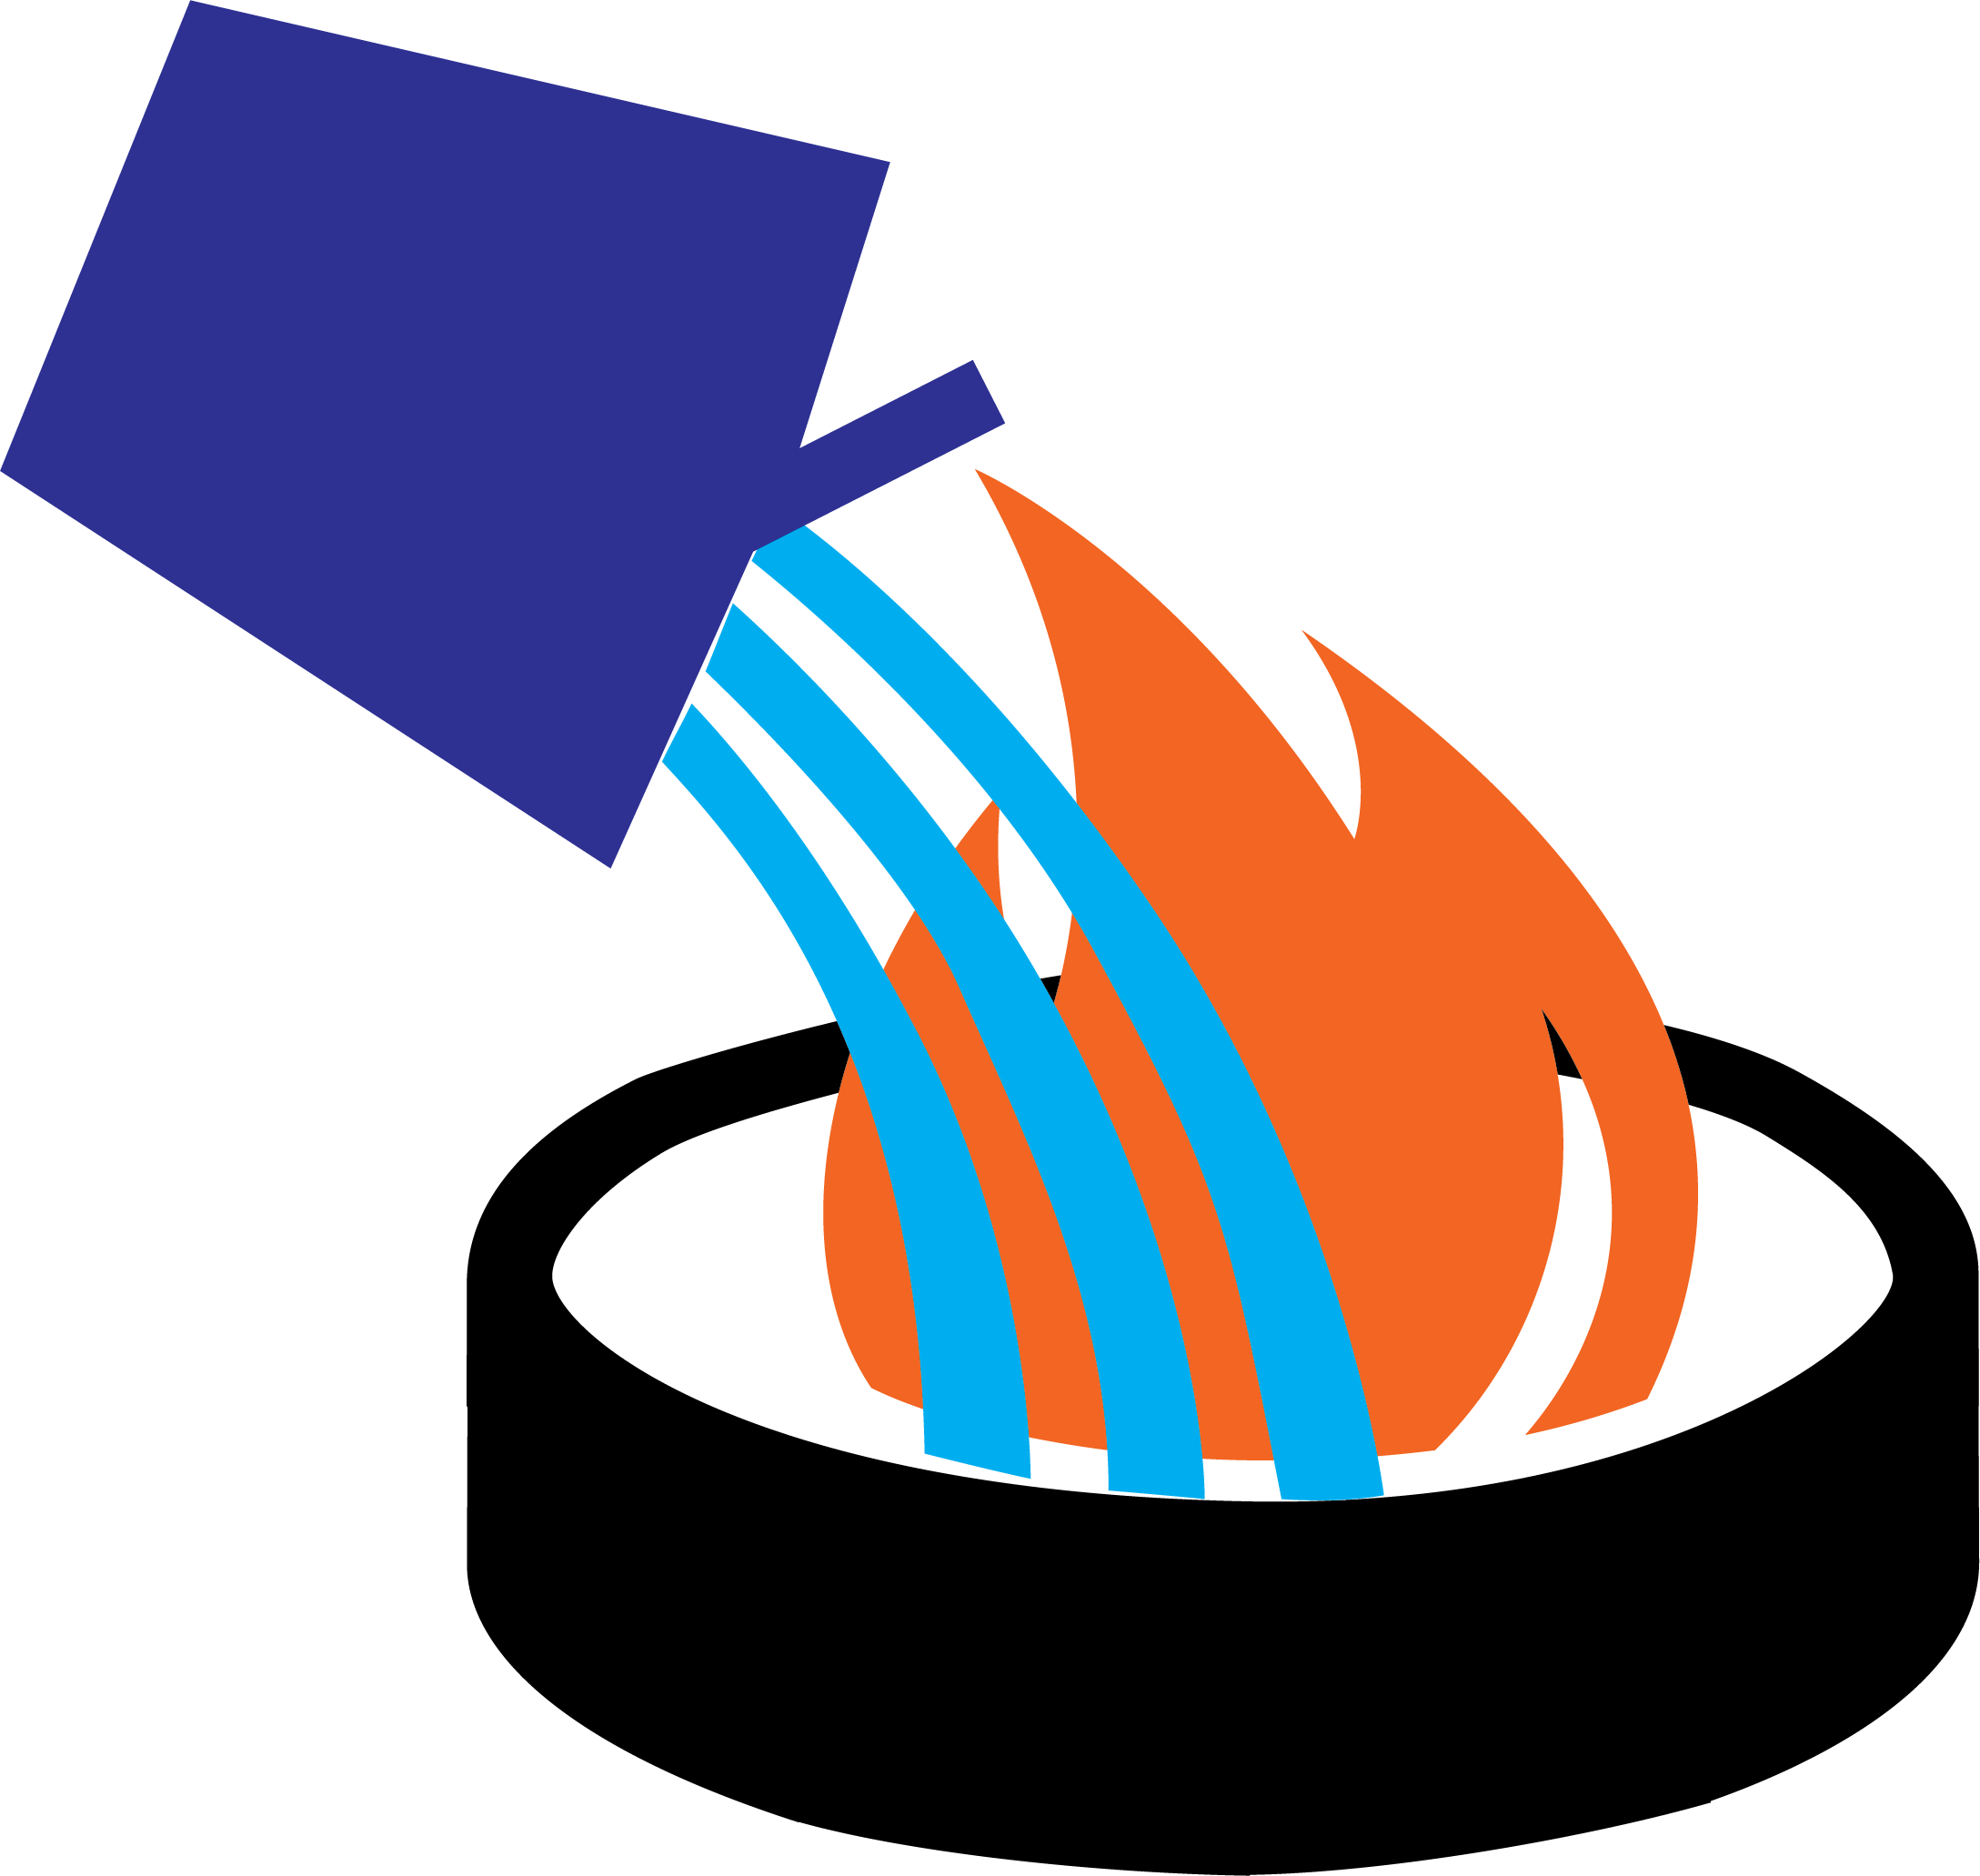
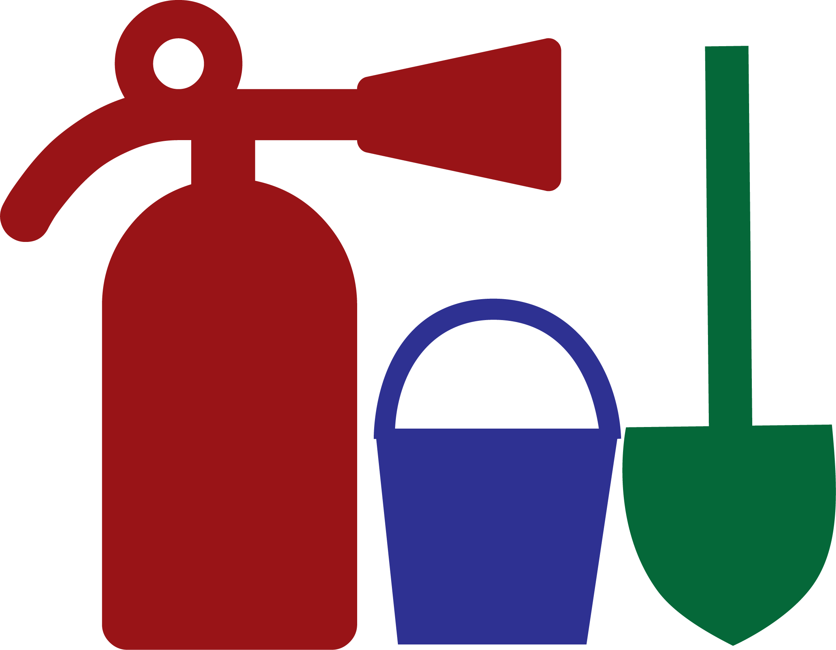



You can use this text block to describe the fire restriction order.
This page prints on 36x48 paper size on a plotter and fits on a 4x4 piece of plywood, placed in an area where people can walk up and read it. It is not a road sign, flyer or facebook graphic. Additional information can occupy the 12’ space left on the side. Messages, restriction graphics and maps can be changed based on location. The second page contains art that can be switched out depending on restrictions.
No Sky Lanterns
No Parking on Dry Grass
No Fireworks
No Explosives
No Dumping Coals
Consider campfire alternatives, such as gas stoves, grills and lanterns.
If you have a fire in an approved ring at a developed site, drown, stir and feel to make sure it is dead out.
Be prepared to put out a fire. In some areas, you are required to carry a shovel, water and a fire extinguisher.
4x4aframeportal1.pptx
Notes:
This page is designed to be printed on 36x48 paper size on a plotter, but it fits on a 4x4 piece of plywood. Additional information can occupy the 12’ space left on the side. Messages, restrictions and maps can be changed based on location. The second page contains art that can be switched out depending on restrictions. This is meant to be used where people walk up to it and read. It is not a roadside sign, because there is too much content. It is not meant to be a facebook or social media graphic, either.

Slide 2







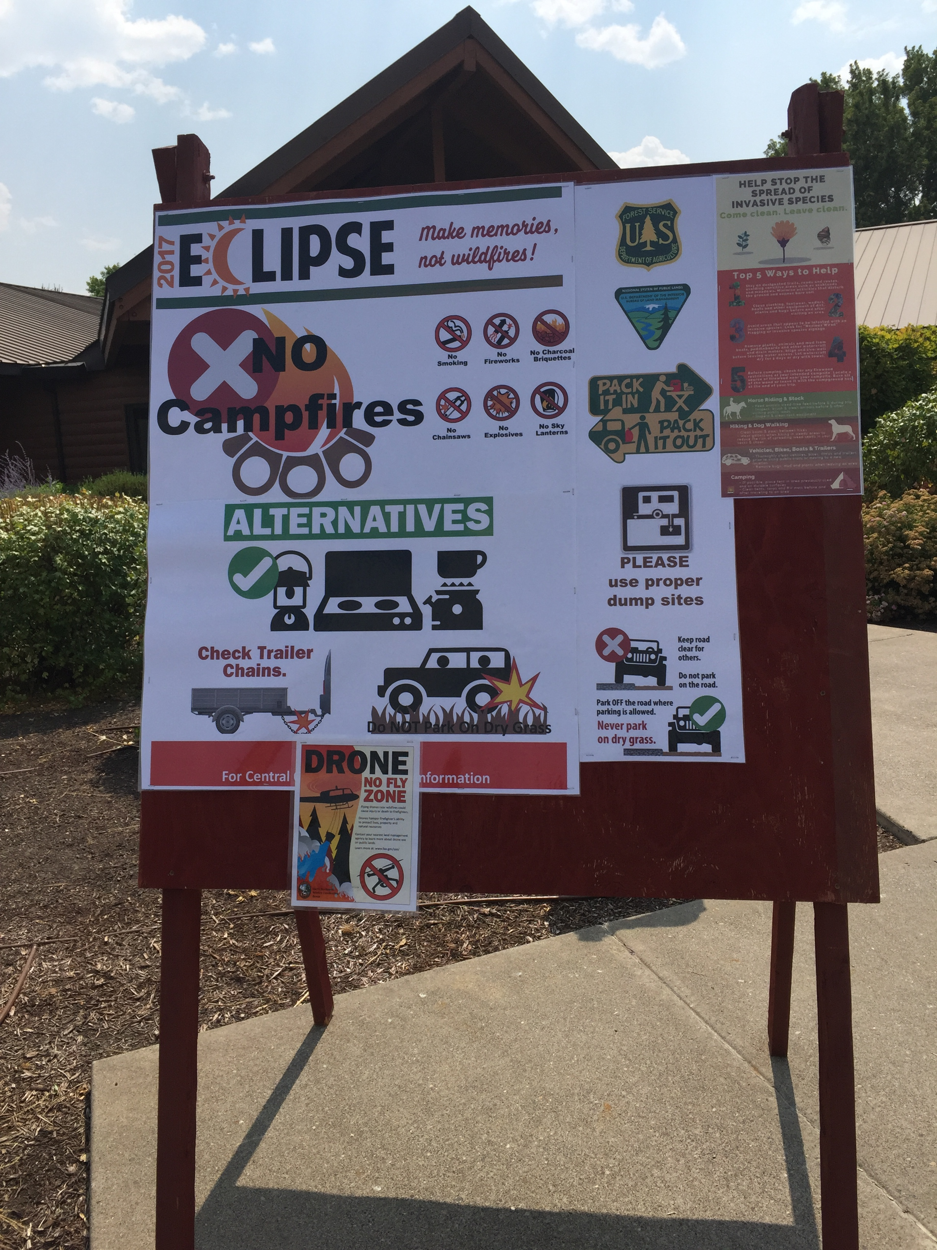







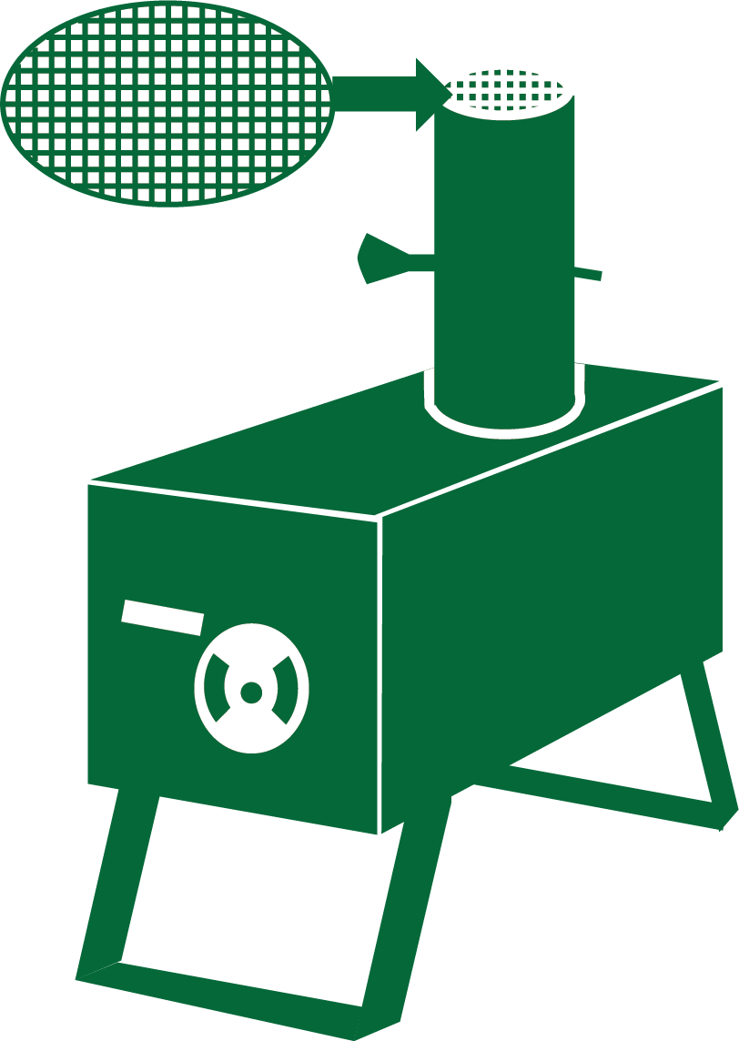




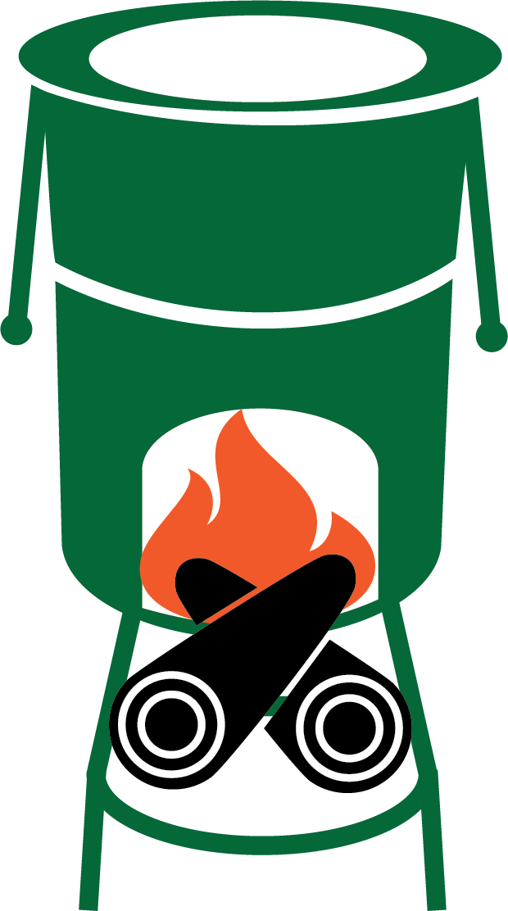


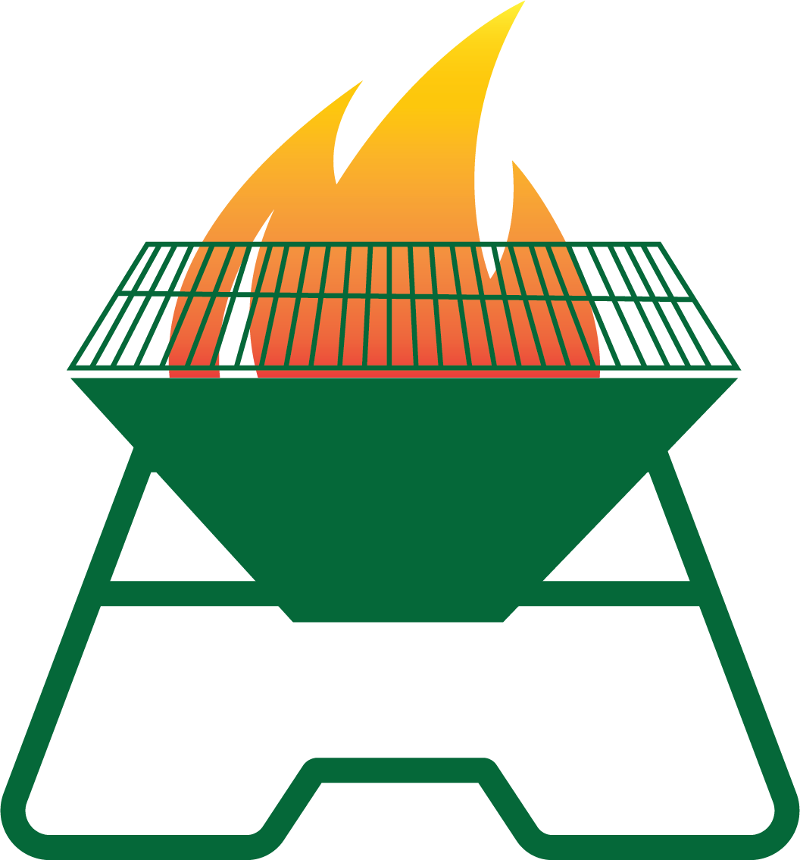



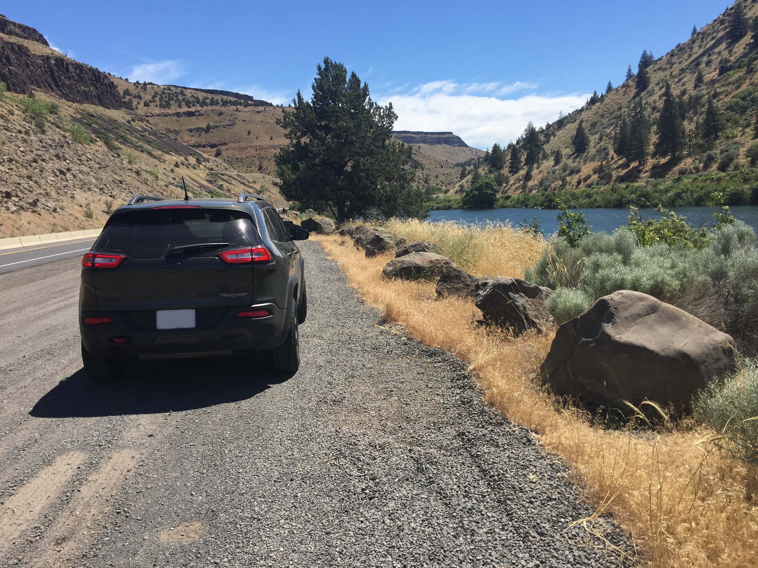

These are the different prohibited symbols, depending on the level or stage of restriction in the order. You can switch them out with the ones on the first page.
At right is an example of a 4x4 board. Keep your design simple and uncluttered. Avoid putting text over graphics, as it decreases readability.
Keep it very simple. Avoid adding more graphics just because you can. The more stuff you add, the more it detracts from the central message.
These are the different campfire alternatives that can be used, depending on the wording of the restriction, fire prevention or closure order. Check with law enforcement on which specific graphics will be allowed. You can use the red X next to or overlapping part of the graphic to show prohibited, green check to show permitted.
Park on gravel shoulder, not dry grass.
Notes:
This page contains art that you can use on the previous page. Be sure to delete this page when printing on the plotter.

