Slide 1
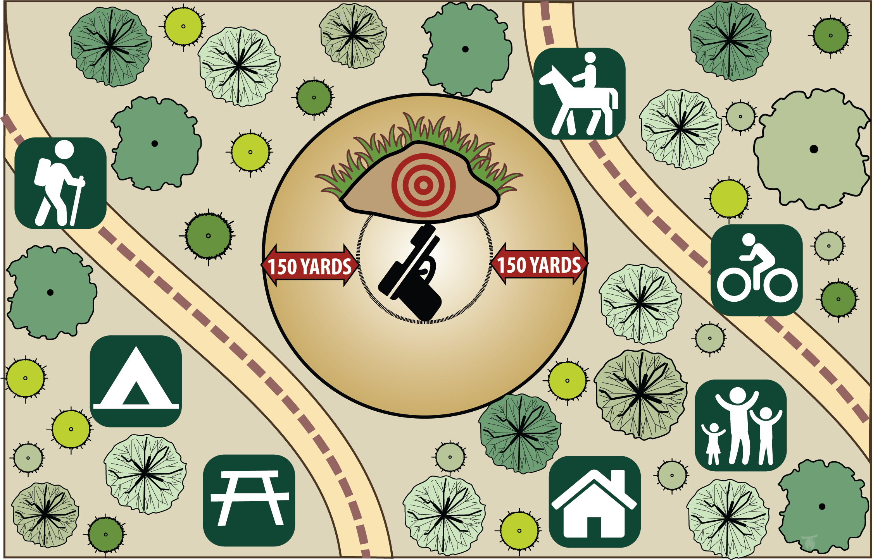
ON PUBLIC LANDS IN WASHINGTON & OREGON
Know before you go
Know the rules
Check the rules and regulations in the area you are visiting.
Pack out all target trash including shotgun shells, fragmented clay pigeons, or any targets. Trash gives a negative impression of shooters.
Know what activities you might encounter.
Respect the rights of others, including private property owners, trail users, campers and others so they can enjoy their activities undisturbed.
Know the potential of your firearm.
Keep in mind your firearm’s maximum range, and be sure you have a safe backstop to contain the bullet. A dirt bank is best.
.22 bullet travels up to one mile
30.06 bullet travels up to 2.5 miles
12 gauge shot travels up to 200 yards
Where NOT to Shoot
Improve the reputation of shooters by only shooting at legitimate targets.
Property such as signs, kiosks, and buildings are not targets.
Do not shoot across roads, waterways or into caves.
Do not use trees or other natural objects as targets.
Do not shoot in recreation sites such as campgrounds, trailheads, parking areas or boat launches.
Do not disturb or shoot historical or archeological sites.
Do not shoot household appliances and other objects dumped in shooting areas. It is misconstrued that shooters are the dumpers.
Notes:
Review with law enforcement, since regulations and language used may be different in your area.

Slide 2
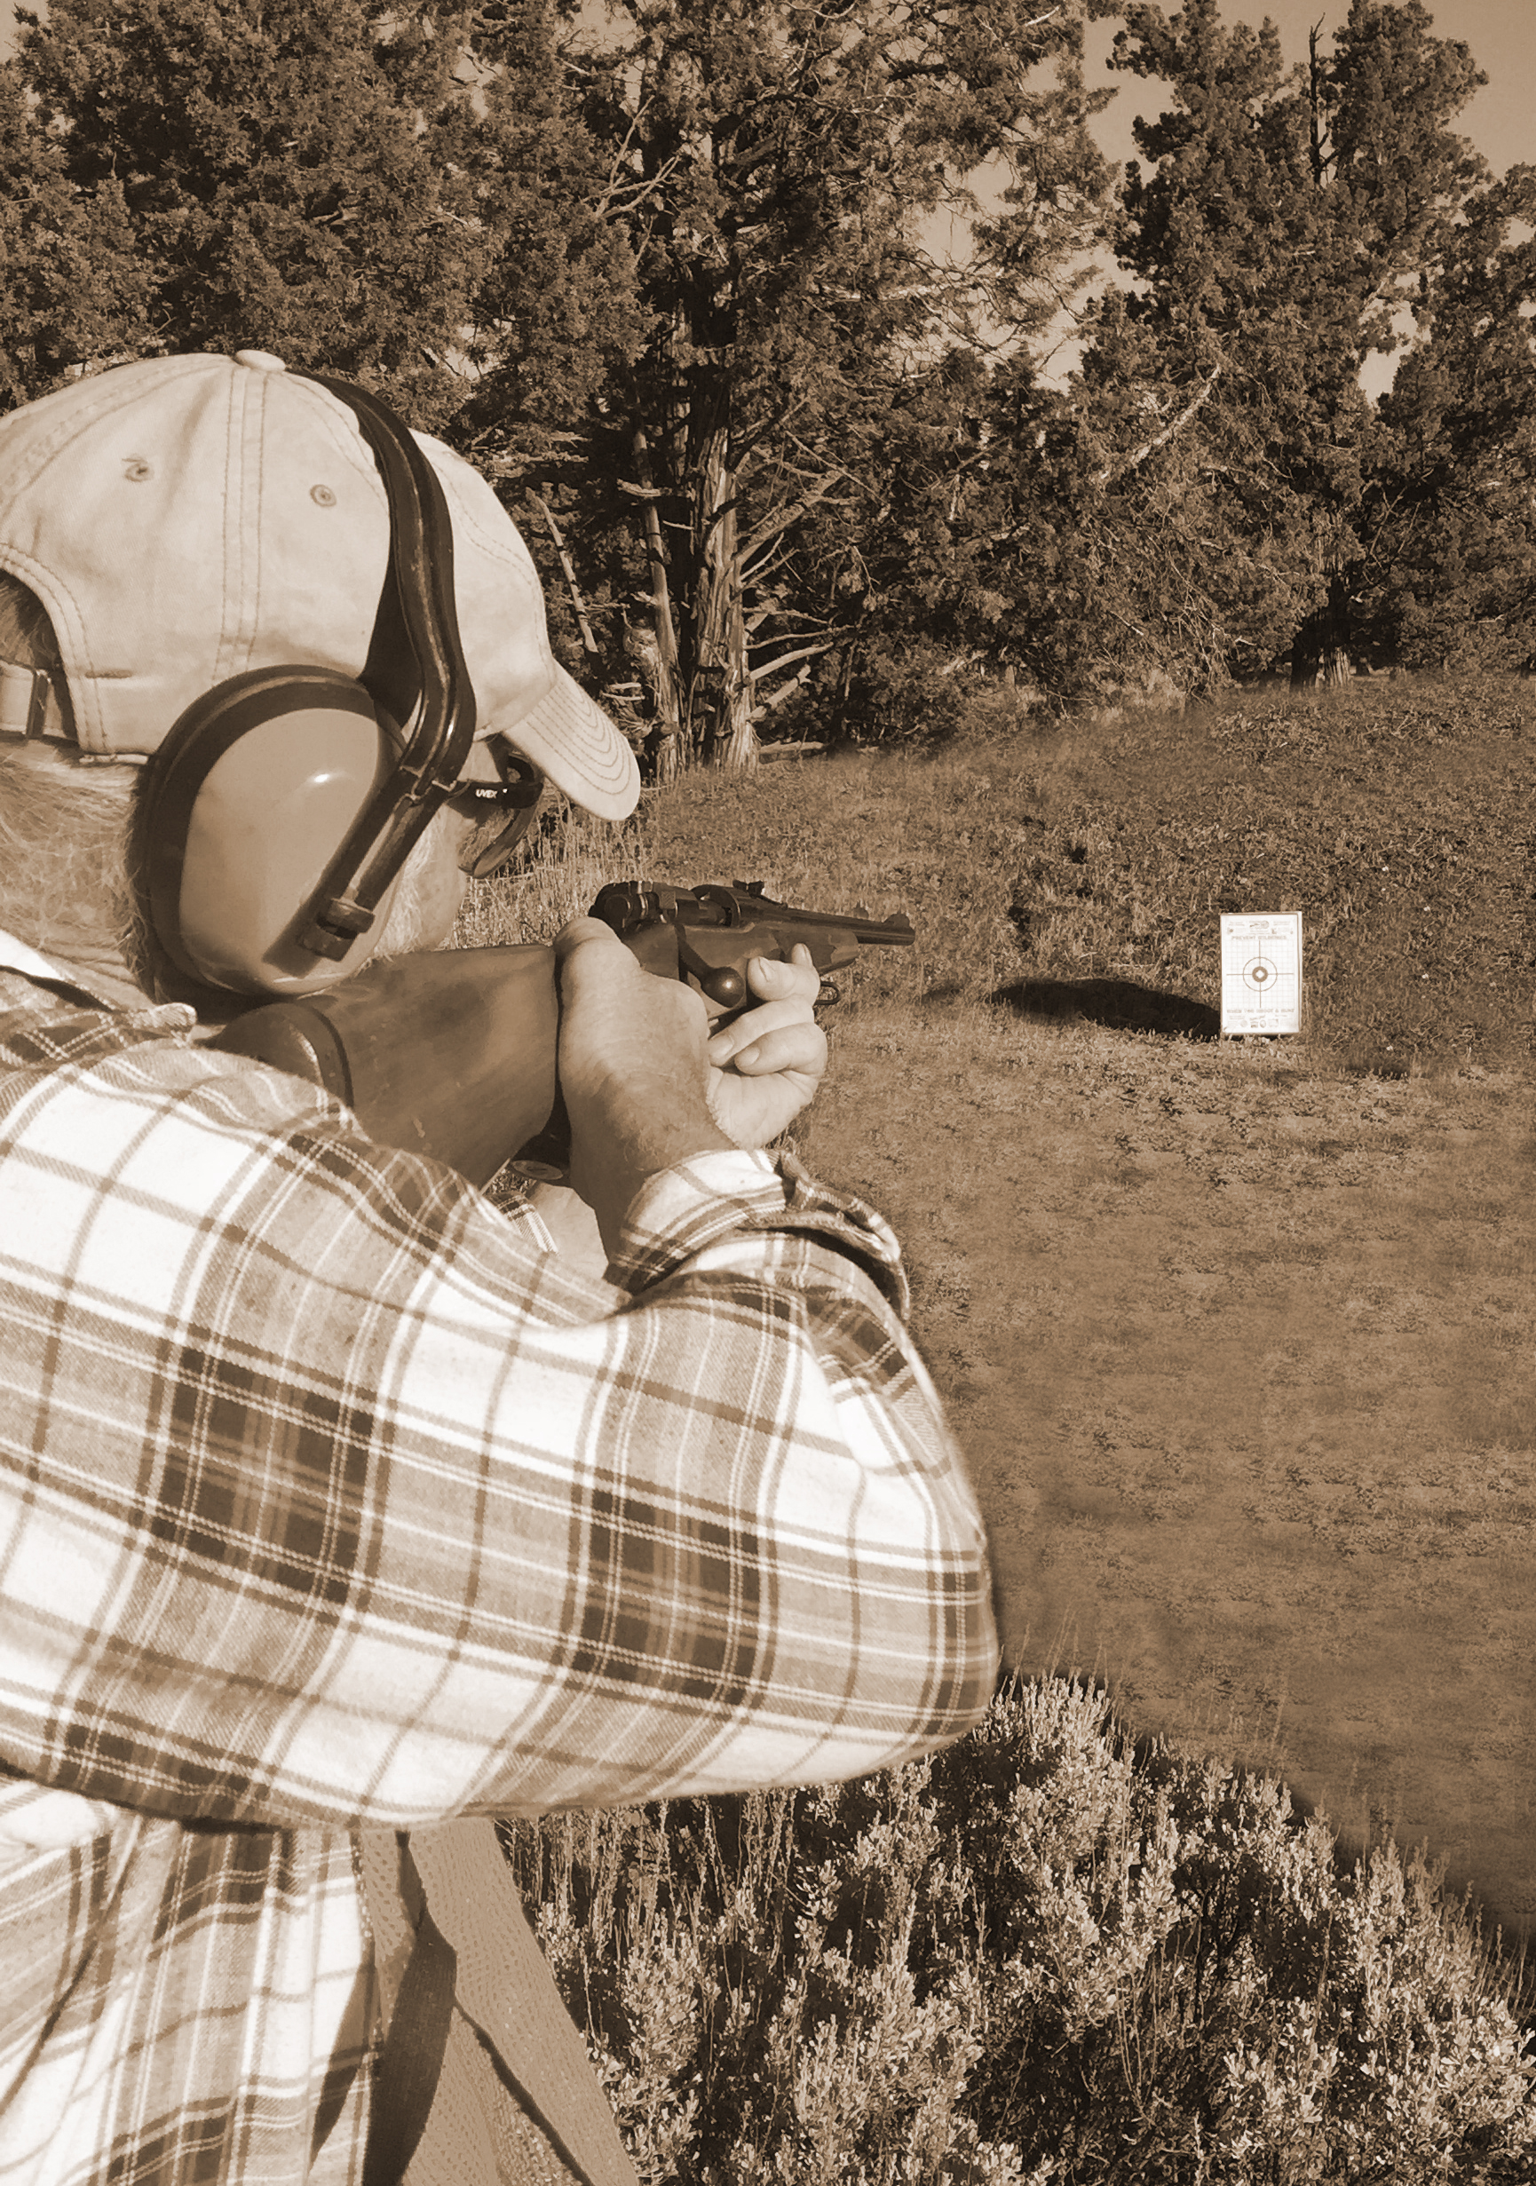
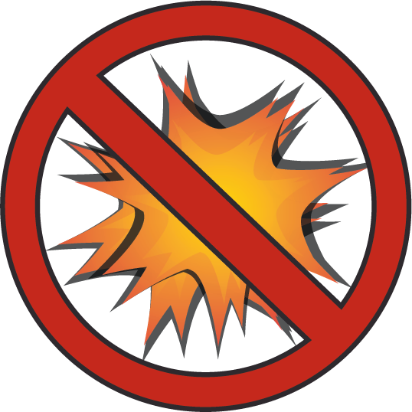
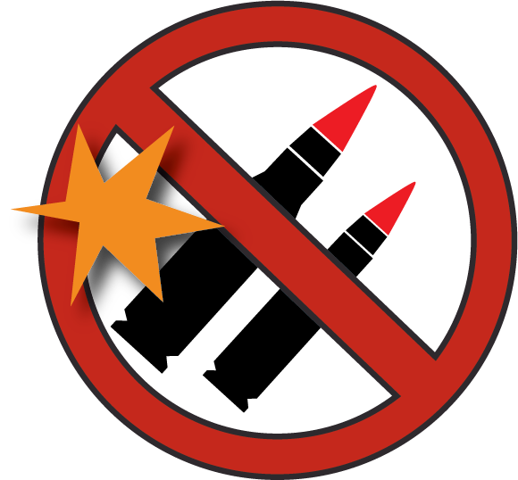


When target shooting is done in the right way, it poses little threat to our safety or natural resources. However, careless, unsafe shooting can cause great resource damage and pose serious threats to human life: both to staff and visitors.
FIRE DANGER IS HIGH!
Please avoid shooting after 1:00 p.m. on extremely hot days and follow these guidelines:
Bring water and a shovel or fire extinguisher and place them near target areas to help immediately extinguish any fires.
Place targets against an earthen backstop and away from all vegetation; especially avoid rocks, dry grasses or other flammable materials.
Never use incendiary ammunition or exploding targets, which are prohibited on federal and many other lands.
After shooting, check the target area for any signs of fire or heat. Stay for an hour after shooting to make sure.
Avoid jacketed bullets and high velocity ammunition when fire danger is high.
Some activities may be prohibited on public lands, including explosives, fireworks, tracer rounds, incendiary ammunition and exploding targets. Know before you go by checking with your land management agency.
Exploding targets
prohibited
Tracer rounds
prohibited
Fireworks
prohibited
Enjoy shooting and hunting on public lands.

