Slide 1
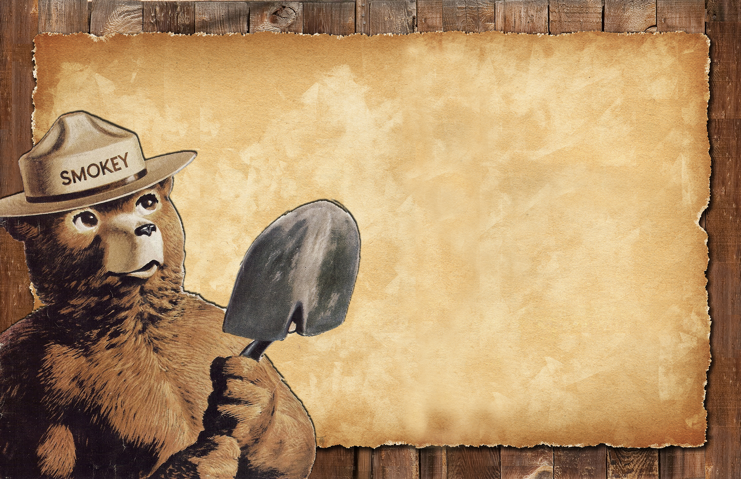
Make sure your campfire is DEAD out.
Obey all fire restrictions.
Do not park on dry grass.
Olympic National Forest
Supervisor's Office
1835 Black Lk Blvd SW
Olympia, WA 98512
(360) 956-2402
www.pnwfac.org
2015_08_21smokey11x17.pptx
Notes:
The text is editable, so you can change the wording based on fire causes and restrictions. You can also switch out logos and contact information. Logos are in the art_boards folder, in the agencylogos.pptx file. Always clear products you make with Public Affairs, Fire, Resource Specialists, Law Enforcement, Forest Supervisor etc. to make sure they are correct.
The dimensions are 36x18; export as a pdf to print, then print at 200% for a 72x36 banner.

