Slide 1
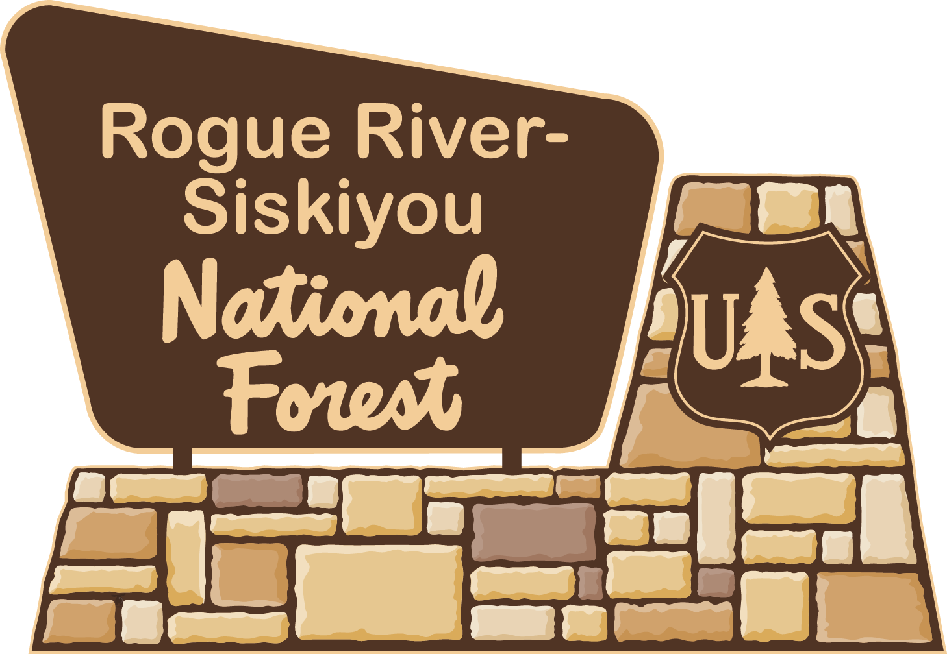
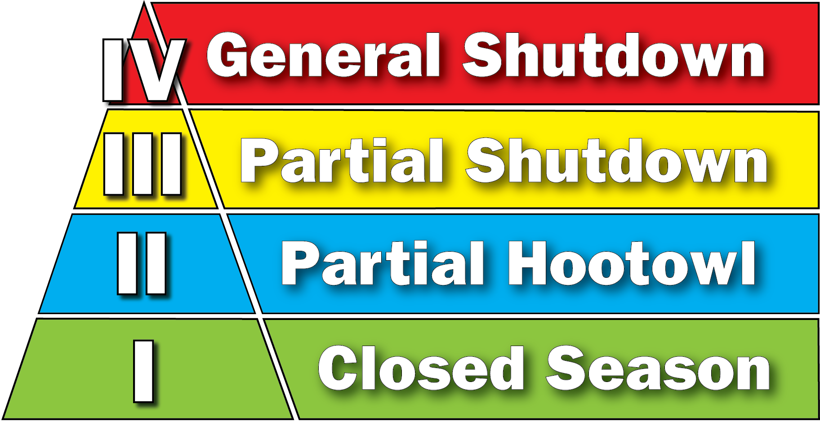
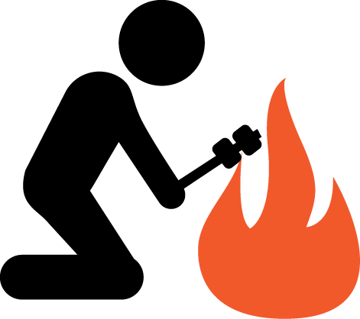
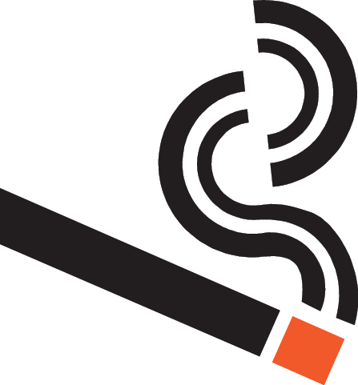
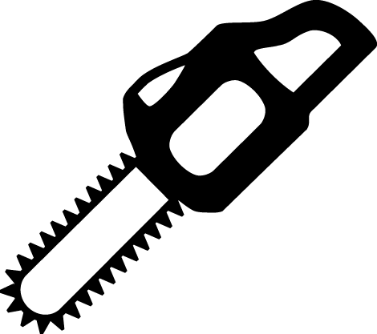
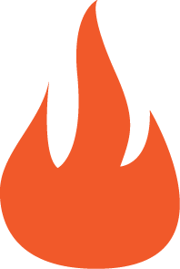
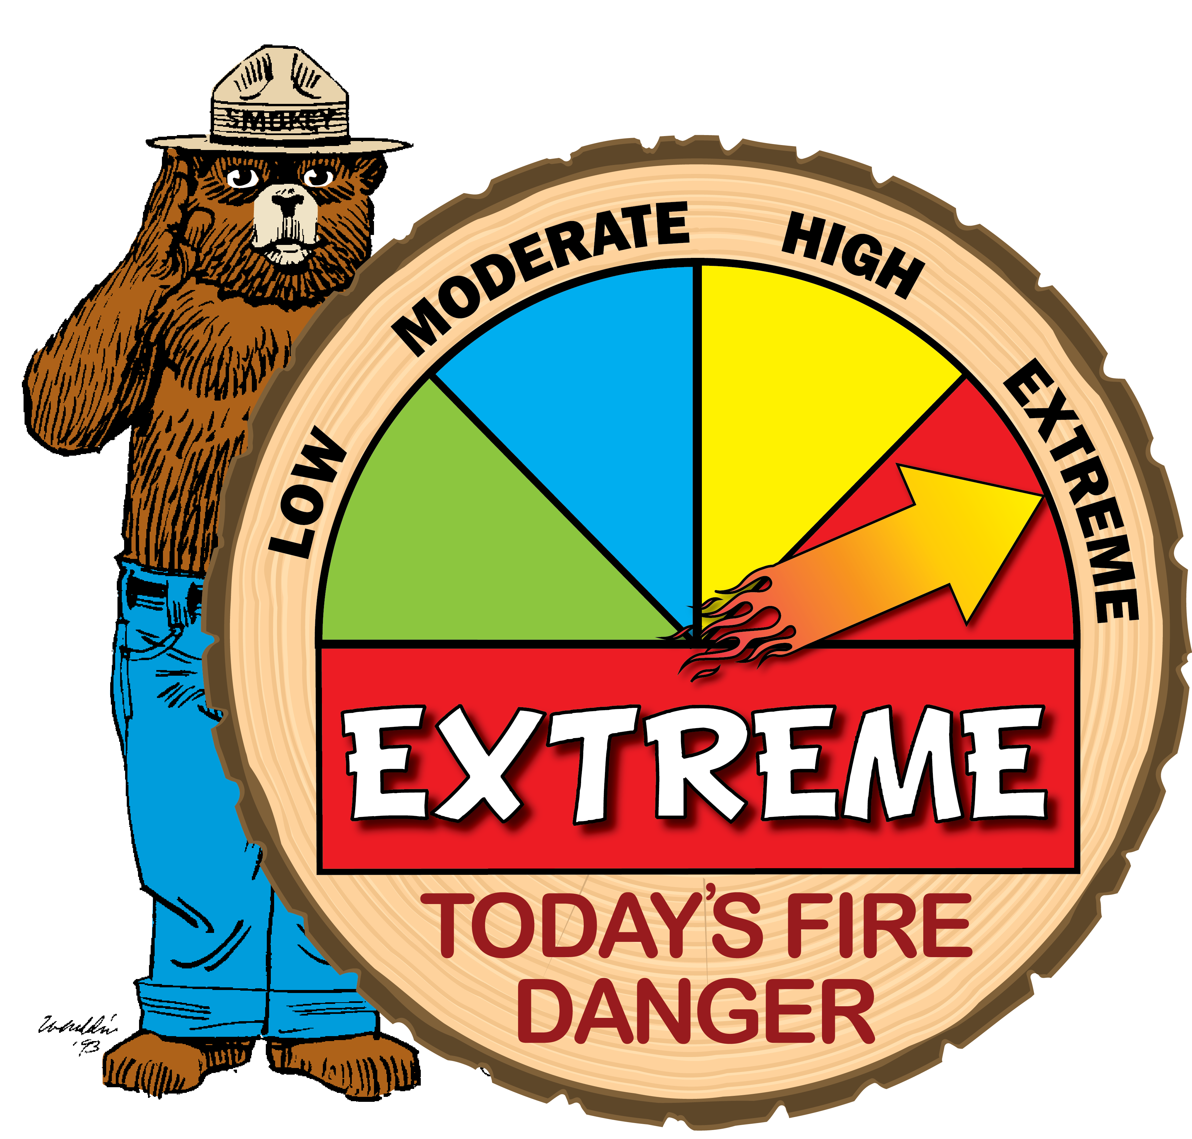
What You Need To Know
When Using Spark-Emitting
Equipment on Forest Land
Industrial Fire Precaution Levels (IFPLs)
Southwest Oregon uses two systems to reduce wildfire risk on forested lands. From April 1 to October 31, one system applies to woods workers and other industrial forest users. The IFPL
system regulates spark-emitting
devices on timber sales, service
contracts and special use permits.
Closed Season. Fire equipment and fire watch service is required.
Partial Hootowl. Limits certain activities to between 8 p.m. and 1 p.m.
Partial Shutdown. Prohibits some activities; limits others to between 8 p.m. and 1 p.m.
General Shutdown. All operations are prohibited.
Public Use Restrictions
These restrictions, enacted for public health and safety, are aimed at the general public, recreationists and forest visitors. These restrictions limit activities in order to reduce human-caused fires, especially in more hazardous areas. Activities limited can include campfires, shooting, smoking, atv use, and others. In extreme cases, road or area closures may occur.
Learn more at: www.fs.usda.gov/rogue-siskiyou
2015_08_23ifplfactsheeet.pptx

