Slide 1

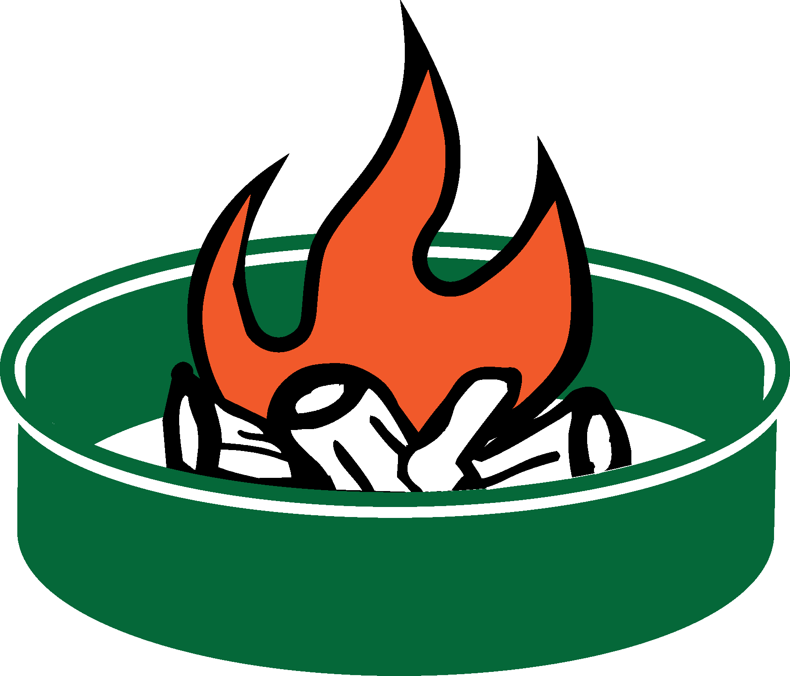







OLYMPIC
NATIONAL FOREST
Open Fire Prohibition on Olympic National Forest
Supervisor Order #06-09-15-03, June 25, 2015
Campfires are only allowed in established metal fire rings within developed areas such as campgrounds. You may have wood and charcoal fires, charcoal grills, and portable braziers, but they must be placed in an established metal fire ring before use.
Campfires are NOT ALLOWED in the following developed sites due to the extreme fire potential:
Lena Lake and Elkhorn Campgrounds on the Hood Canal Ranger District
Campbell Tree Grove and Littleton Horse Camp Campgrounds on the Pacific Ranger District
No open fires are allowed in dispersed, nondeveloped, backcounty areas. Wood and charcoal fires, charcoal grills, and portable braziers are prohibited in these areas. Fires are likewise prohibited in rock fire pits. Only pressurized gas stoves and space heating devices that can be quickly turned off are allowed in these areas.
Olympic National Forest
Supervisor's Office
1835 Black Lk Blvd SW
Olympia, WA 98512
(360) 956-2402
TTD (360) 956-2401
Fire ring at a developed recreation site
Fire ring at a dispersed camping site
United States Department of Agriculture
Forest Service
USDA is an equal opportunity provider,
employer, and lender.
Notes:
This flyer is designed for posting on recreation area bulletin boards, agency offices and visitor centers and other locations forest visitors will see it. It can also be used as a handout when on patrol. You can select the text and change the wording. You can add the recreation sites where fires are allowed/prohibited. You can cahnge the forest name.You can also insert different agency logos; copy and paste them from the agencylogos.pptx file in the art_firestrictions folder. Always be sure to get permission when using a cooperator logo.

