Slide 1





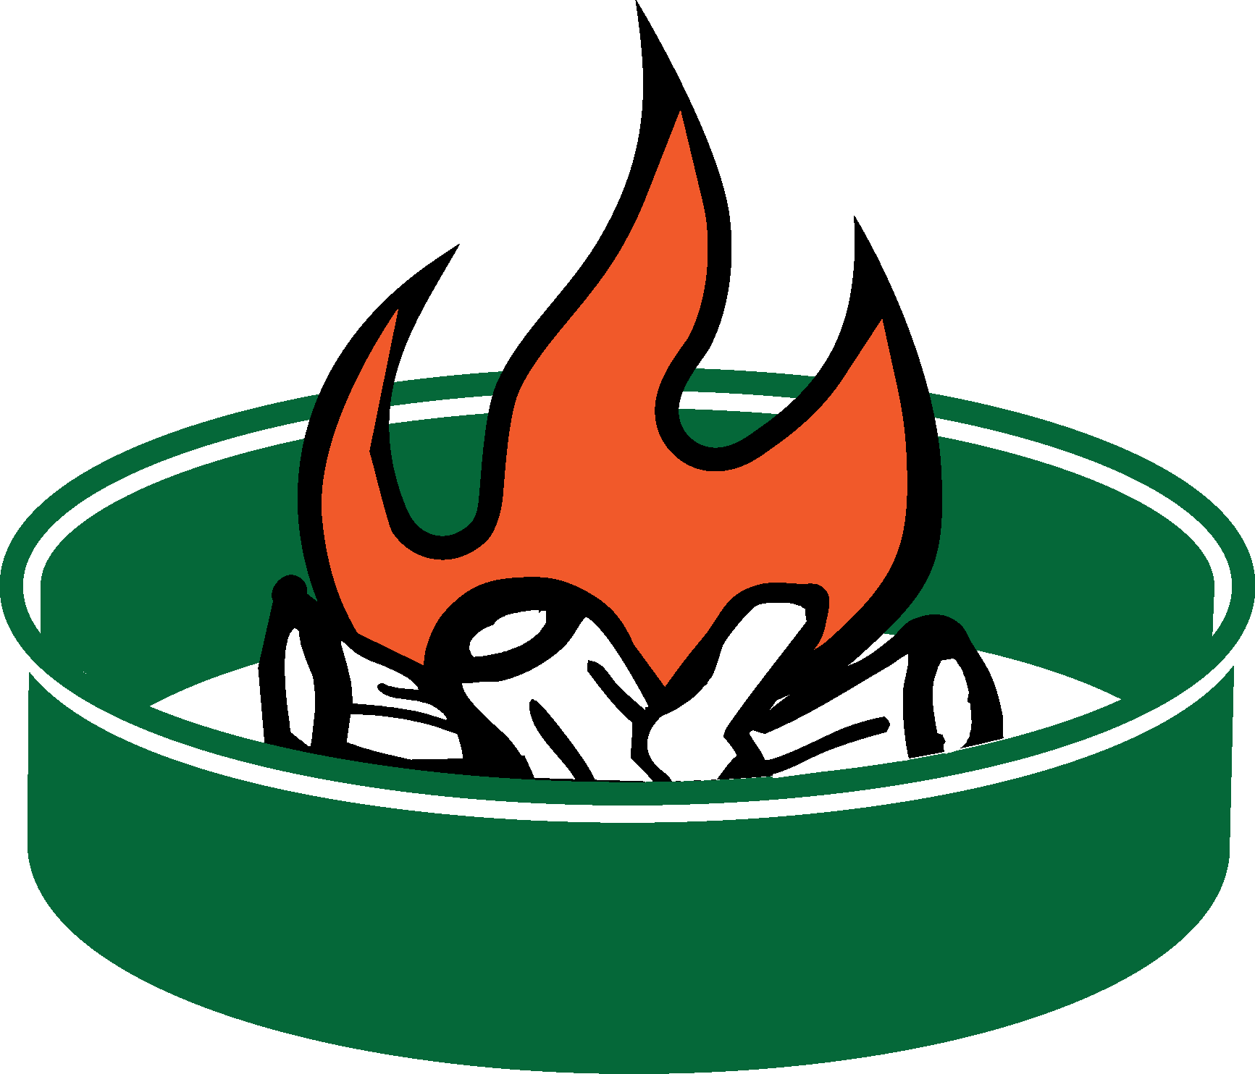


Open Fire Prohibition on Olympic National Forest
Campfires are only allowed in established metal fire rings within developed areas such as campgrounds. You may have wood and charcoal fires, charcoal grills, and portable braziers, but they must be placed in an established metal fire ring before use.
Campfires are NOT ALLOWED in the following developed sites due to the extreme fire potential:
Lena Lake and Elkhorn Campgrounds on the Hood Canal Ranger District
Campbell Tree Grove and Littleton Horse Camp Campgrounds on the Pacific Ranger District
No open fires are allowed in dispersed, nondeveloped, backcounty areas. Wood and charcoal fires, charcoal grills, and portable braziers are prohibited in these areas. Fires are likewise prohibited in rock fire pits. Only pressurized gas stoves and space heating devices that can be quickly turned off are allowed in these areas.
Supervisor Order #06-09-15-03, June 25, 2015
Olympic National Forest Supervisor's Office
1835 Black Lk Blvd SW (360) 956-2402
Olympia, WA 98512 TTD (360) 956-2401
United States Department of Agriculture
Forest Service
USDA is an equal opportunity provider, employer, and lender.
Fire ring at a developed recreation site
Fire ring at a dispersed camping site
Notes:
This 11x17 poster is designed for posting on recreation area bulletin boards, agency offices and visitor centers and other locations forest visitors will see it. You can select the text and change the wording and artwork. You can add the recreation sites where fires are allowed/prohibited. You can also insert different agency logos. (Insert>Photo>Picture from File), or move one of the logos on the pasteboard at left.

