Slide 1





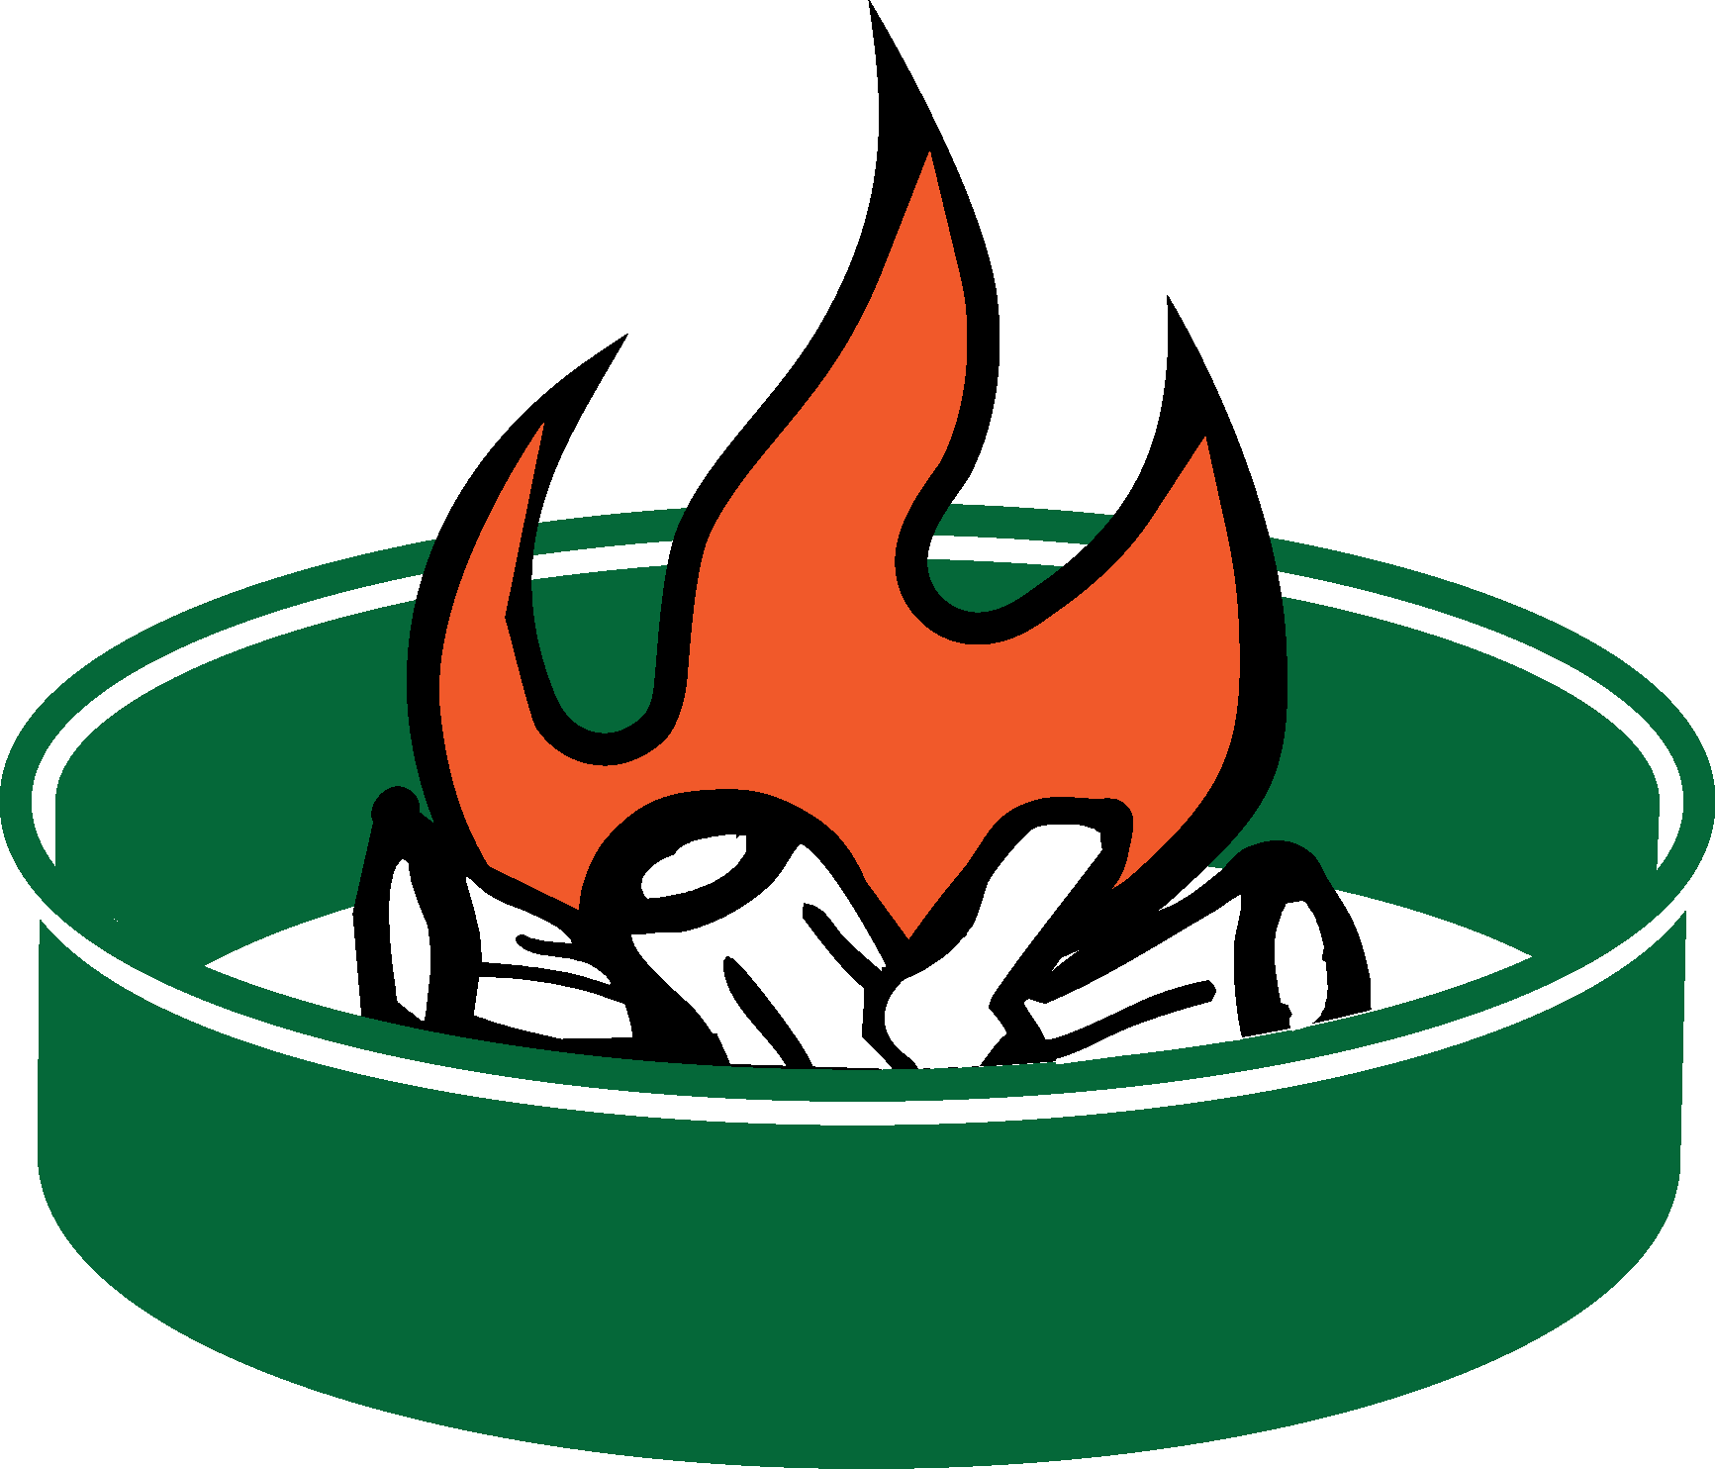


NAME OF
NATIONAL FOREST
Open Fire Prohibition on (Name) National Forest
Campfires are only allowed in established metal fire rings within developed areas such as campgrounds. You may have wood and charcoal fires, charcoal grills, and portable braziers, but they must be placed in an established metal fire ring before use.
Campfires are NOT ALLOWED in the following developed sites due to the extreme fire potential:
Name Recreation area
Name Recreation Area
Name Recreation Area
No open fires are allowed in dispersed, nondeveloped, backcounty areas. Wood and charcoal fires, charcoal grills, and portable braziers are prohibited in these areas. Fires are likewise prohibited in rock fire pits. Only pressurized gas stoves and space heating devices that can be quickly turned off are allowed in these areas.
Supervisor Order #0000000, (insert Date)
(Insert Name) National Forest
Street 555-555-5555
City/State/Zip TTD 555-555-5555
United States Department of Agriculture
Forest Service
USDA is an equal opportunity provider, employer, and lender.
2015_08_21nf_restrict11x17.pptx
Fire ring at a developed recreation site
Fire ring at a dispersed camping site
Notes:
This 11x17 poster is designed for posting on recreation area bulletin boards, agency offices and visitor centers and other locations forest visitors will see it. You can select the text and change the wording and artwork; open the restrictart.pptx file and copy/paste/resize what you need. You can add the recreation sites where fires are allowed/prohibited.

