Slide 1
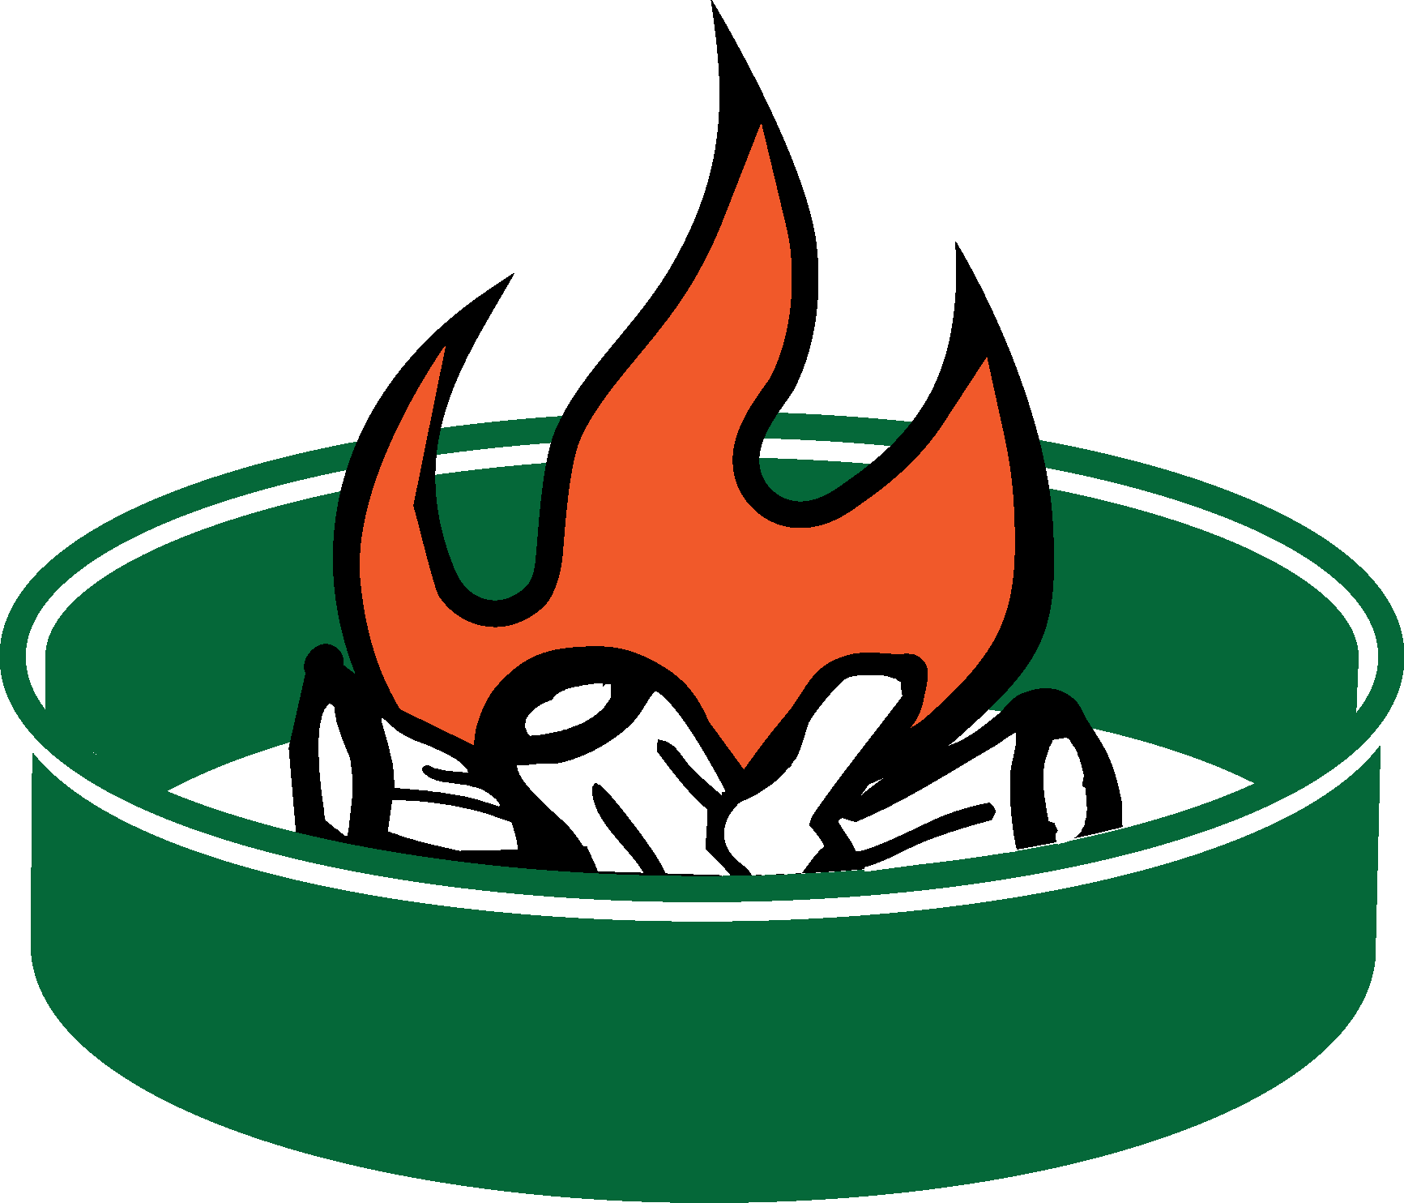



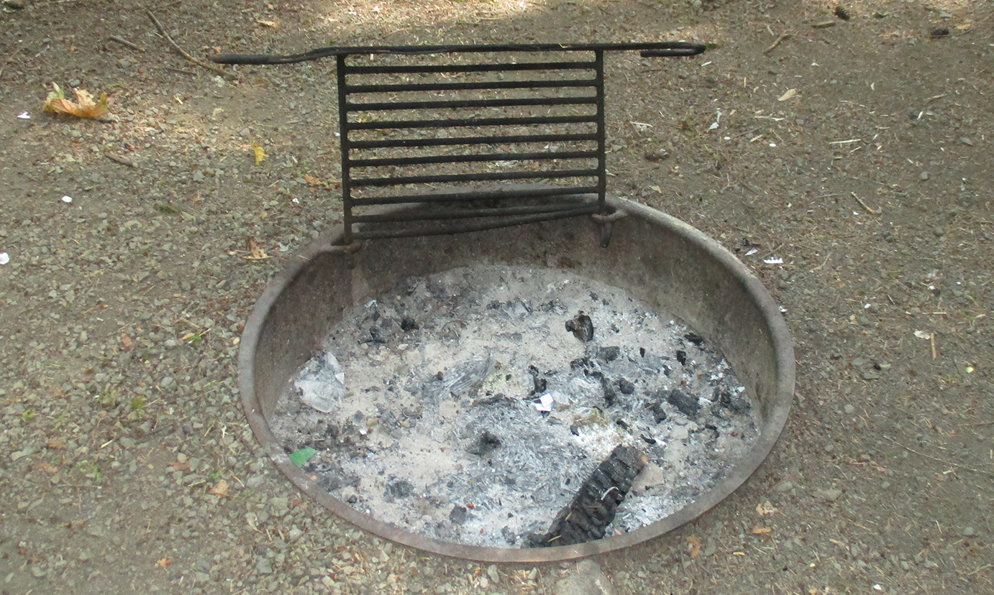
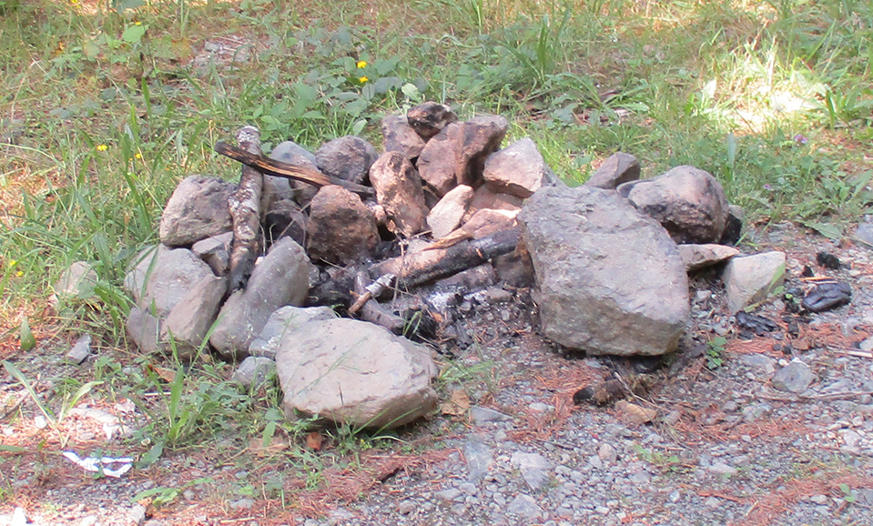



Fire ring at a developed recreation site
Fire ring at a dispersed camping site
2015_07_23frontlinerbanfacts.pptx
Olympic National Forest Fire Restrictions
Fire rings at developed recreation sites are designed by the Forest Service to keep fires from spreading.
The concrete base with a heavy steel ring keeps fire contained.
The area around the ring is cleared of vegetation.
Rings are located away from overhanging limbs where embers may spread.
Rings are located in frequently patrolled areas that are easily accessible by firefighters.
If you camp in a nondeveloped, backcountry site, you might find a rock or metal fire ring that others have brought in. During fire restrictions, you cannot have a fire in these “dispersed” areas since the fire cannot be effectively contained.
Embers can easily escape rock rings when the wind picks up.
Embers can easily drift over to nearby vegetation and start a fire.
Coals can smolder for days and re-ignite later.
Dispersed sites are typically in less travelled areas that are harder for firefighters to detect and access quickly.
CAMPFIRE ALTERNATIVES
Consider alternatives to campfires, such as pressurized gas stoves and lanterns.
Check with your local land
management agency or visit
firerestrictions.us
Notes:
You can select the text and change the wording. You can add the recreation sites where fires are allowed. You can change the office names and phone numbers. You can also insert different agency logos. (Insert>Photo>Picture from File). You can also add a map highlighting areas where fires are allowed or prohibited.

Slide 2
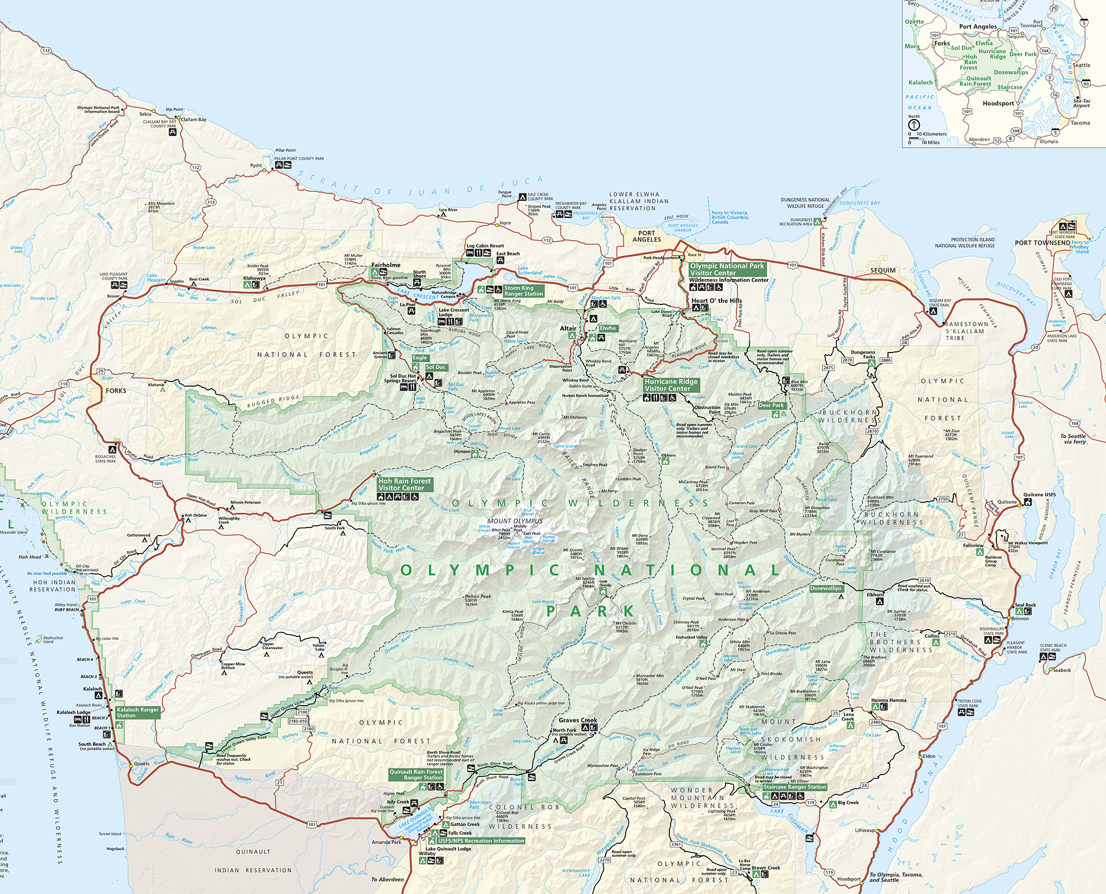
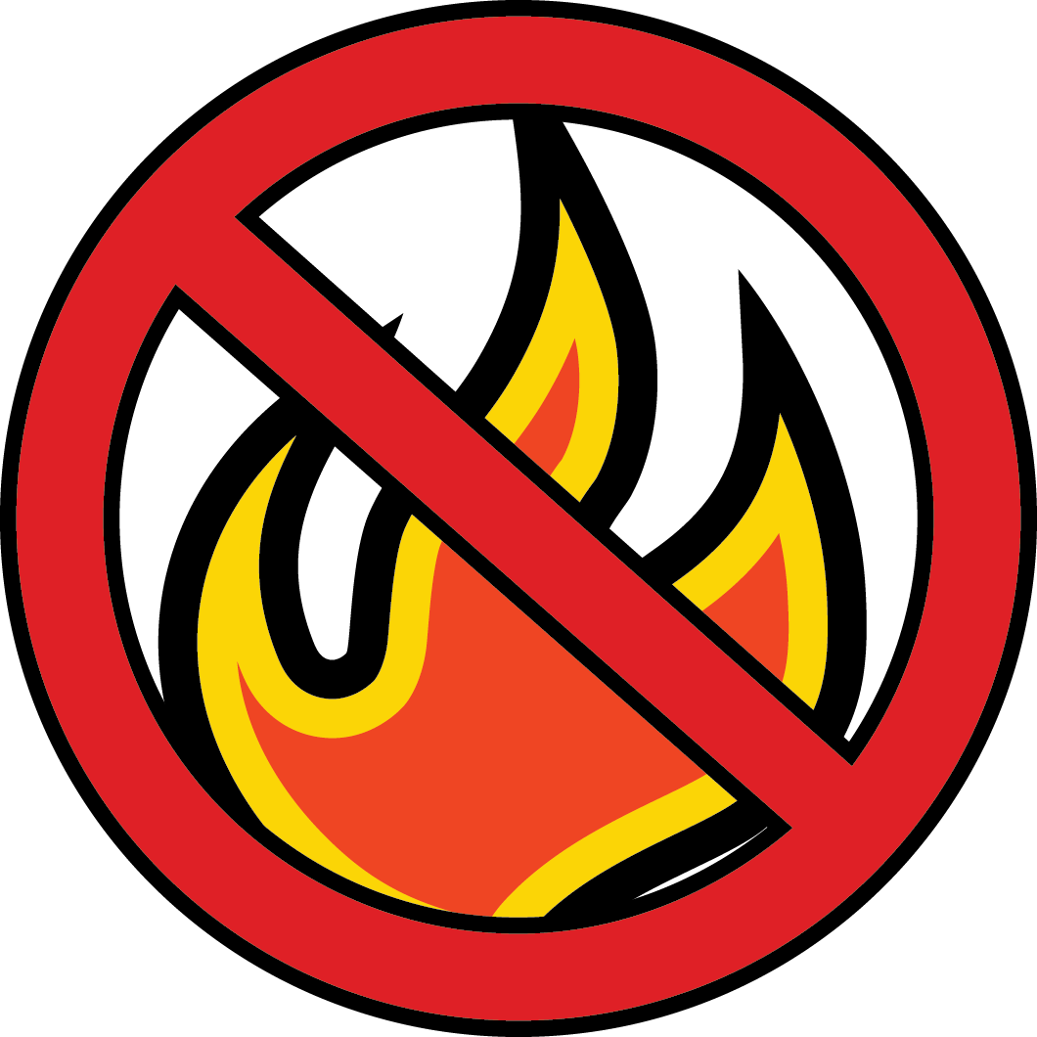

Olympic National Forest
Fire Restrictions
Littleton
Horse Camp
Elkhorn
Campground
Lena Lake
Campground
Campbell Tree
Grove Campground
Fire Restrictions on Olympic National Forest
Campfires are only allowed in established metal fire rings within developed areas such as campgrounds. You may have wood and charcoal fires, charcoal grills, and portable braziers, but they must be placed in an established metal fire ring before use.
Campfires are not allowed in the following developed sites (see map above), due to the extreme fire potential:
Lena Lake and Elkhorn Campgrounds on the Hood Canal Ranger District
Campbell Tree Grove and Littleton Horse Camp Campgrounds on the Pacific Ranger District
No open fires are allowed in dispersed, nondeveloped, backcounty areas. Wood and charcoal fires, charcoal grills, and portable braziers are prohibited in these areas. Fires are likewise prohibited in rock fire pits. Only pressurized gas stoves and space heating devices that can be quickly turned off are allowed in these areas.
For information contact: www.fs.usda.gov/olympic
Olympic National Forest Supervisor's Office
1835 Black Lk Blvd SW (360) 956-2402
Olympia, WA 98512 TTD (360) 956-2401
Hood Canal Ranger District - Quilcene
295142 Highway 101 S. (360) 765 2200
Quilcene, WA 98376 (TDD (360) 765 2200
Pacific Ranger District - Forks
437 Tillicum Lane (360) 374 6522
Forks , WA 98331 TDD (360) 374 6522
Pacific Ranger District - Quinault
353 South Shore Road (360) 288 2525
Quinault, WA 98575 TDD (360) 288 2525
United States Department of Agriculture
Forest Service
USDA is an equal opportunity provider, employer, and lender.
Notes:
You can select the text and change the wording. You can add the recreation sites where fires are allowed. You can change the office names and phone numbers. You can also insert different agency logos; open the agencylogos.pptx in the art_restrict folder and copy, paste and size the logo to fit. You can also add another map highlighting areas where fires are not allowed.
Aways check with Public Affairs before making significant changes.

