Slide 1
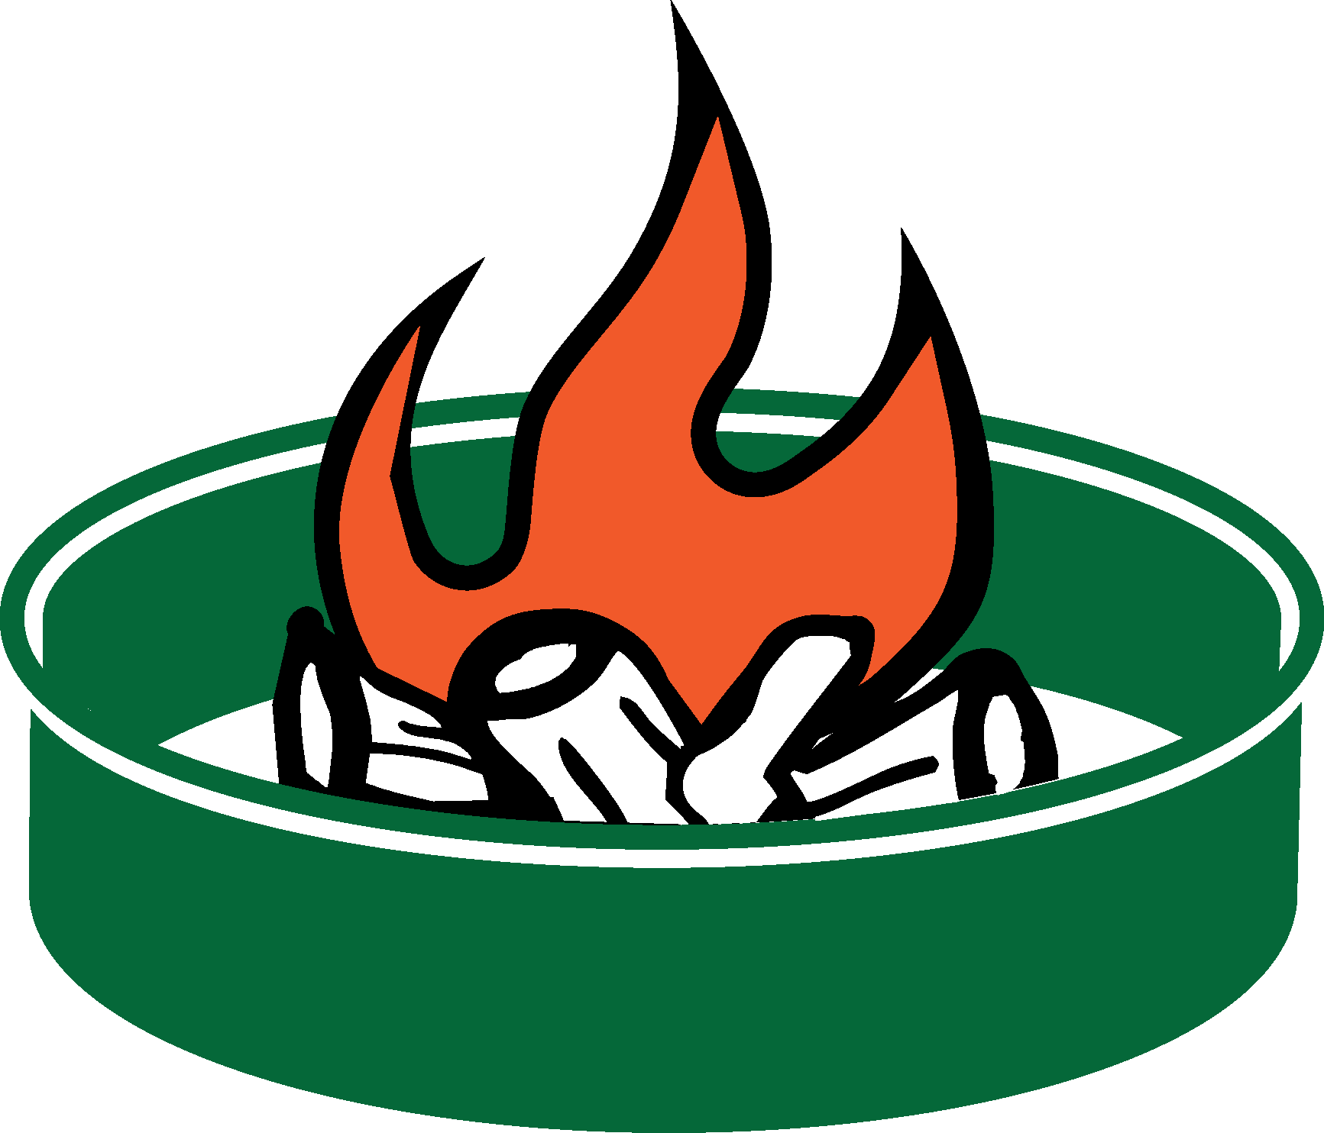
Fire ring at a developed recreation site
Fire ring at a dispersed camping site
(Name) National Forest Fire Restrictions
Fire rings at developed recreation sites are designed by the Forest Service to keep fires from spreading.
The concrete base with a heavy steel ring keeps fire contained.
The area around the ring is cleared of vegetation.
Rings are located away from overhanging limbs where embers may spread.
Rings are located in frequently patrolled areas that are easily accessible by firefighters.
If you camp in a nondeveloped, backcountry site, you might find a rock or metal fire ring that others have brought in. During fire restrictions, you cannot have a fire in these “dispersed” areas since the fire cannot be effectively contained.
Embers can easily escape rock rings when the wind picks up.
Embers can easily drift over to nearby vegetation and start a fire.
Coals can smolder for days and re-ignite later.
Dispersed sites are typically in less travelled areas that are harder for firefighters to detect and access quickly.
CAMPFIRE ALTERNATIVES
Consider alternatives to campfires, such as pressurized gas stoves and lanterns.
Check with your local land
management agency or visit
firerestrictions.us
2015_07_23nf_frontlinerbanfacts.pptx
Notes:
You can select the text and change the wording. You can add the recreation sites where fires are allowed. You can change the office names and phone numbers. You can also insert different agency logos and art by opening restrictart.pptx, then copy/paste and resize into your document. You can also add a map highlighting areas where fires are allowed or prohibited.

Slide 2
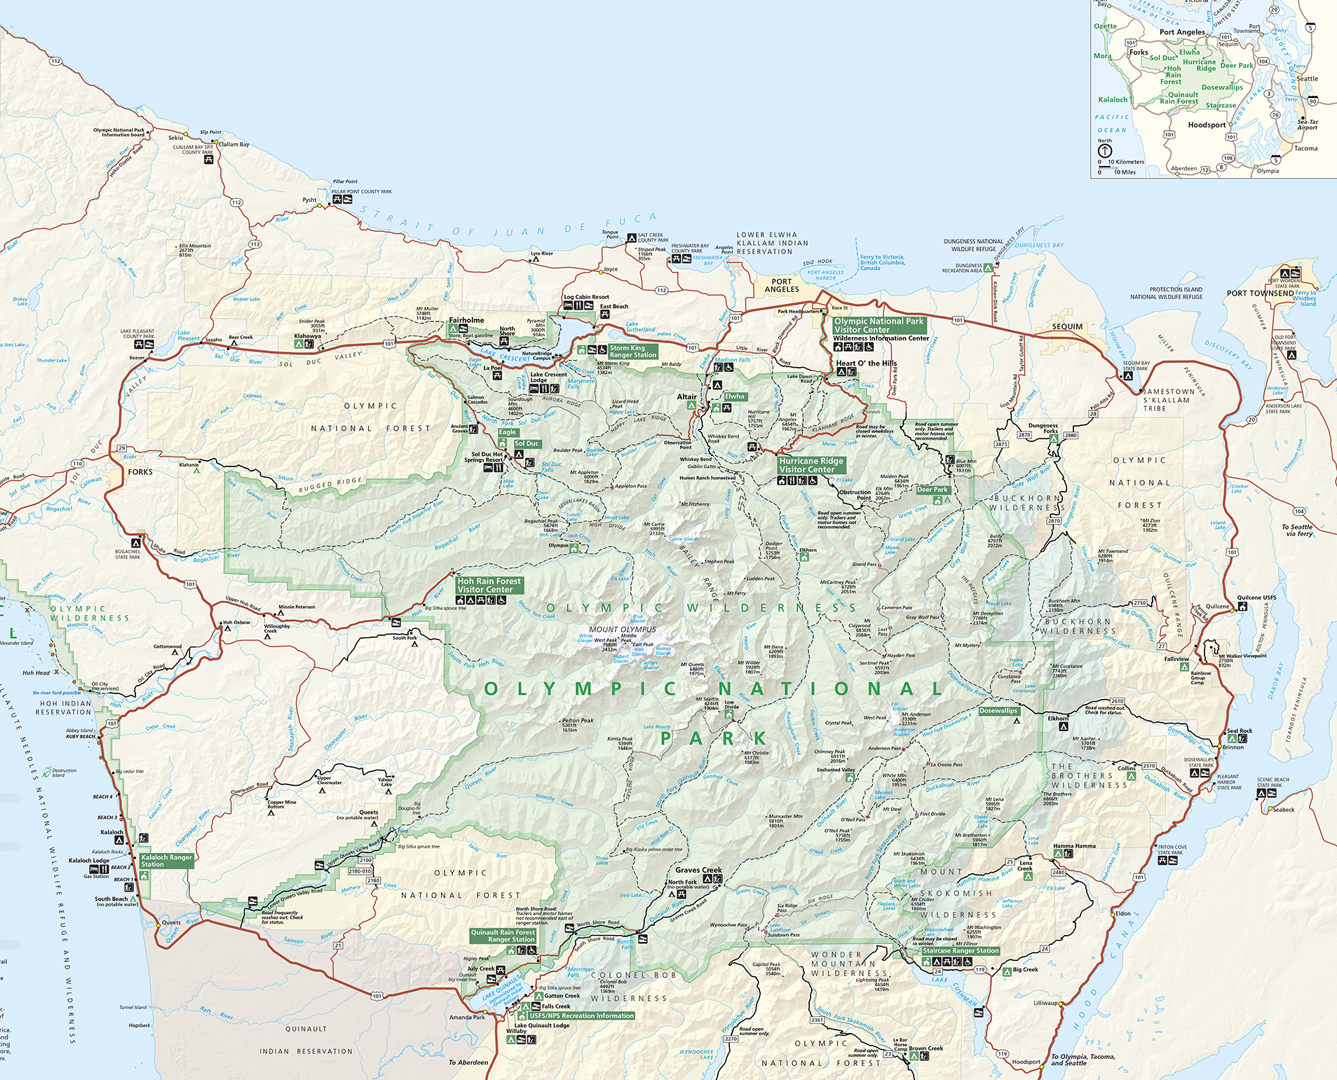
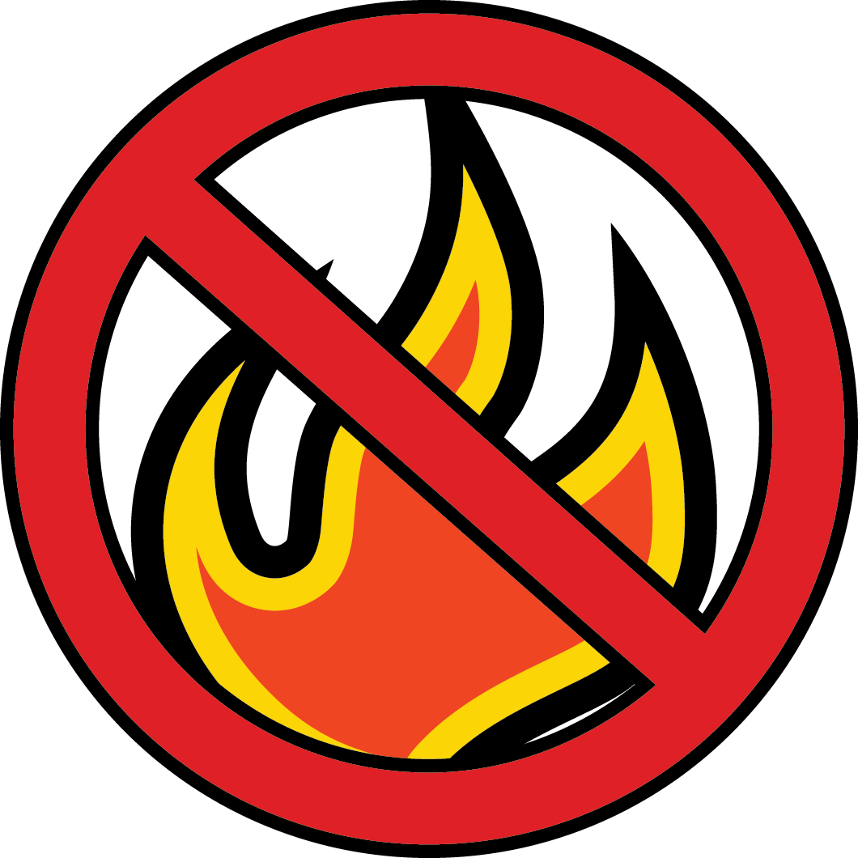
(Name) National Forest
Fire Restrictions
Littleton
Horse Camp
Elkhorn
Campground
Lena Lake
Campground
Campbell Tree
Grove Campground
Fire Restrictions on (name) National Forest
Campfires are only allowed in established metal fire rings within developed areas such as campgrounds. You may have wood and charcoal fires, charcoal grills, and portable braziers, but they must be placed in an established metal fire ring before use.
Campfires are not allowed in the following developed sites (see map above), due to the extreme fire potential:
Insert the name of recreation areas that have exceptions to the restrictions
Insert the name of recreation areas that have exceptions to the restrictions
No open fires are allowed in dispersed, nondeveloped, backcounty areas. Wood and charcoal fires, charcoal grills, and portable braziers are prohibited in these areas. Fires are likewise prohibited in rock fire pits. Only pressurized gas stoves and space heating devices that can be quickly turned off are allowed in these areas.
For information contact: www.fs.usda.gov/nameforest
Name National Forest Supervisor's Office
Street 555-555-5555
City/State/Zip TTD 555-555-5555
Name Ranger District
Street 555-555-5555
City/State/Zip TTD 555-555-5555
Name Ranger District
Street 555-555-5555
City/State/Zip TTD 555-555-5555
Name Ranger District
Street 555-555-5555
City/State/Zip TTD 555-555-5555
United States Department of Agriculture
Forest Service
USDA is an equal opportunity provider, employer, and lender.
Notes:
You can select the text and change the wording based on forest orders. You can add the recreation sites where fires are allowed. You can change the office names and phone numbers. You can also insert different agency logos. (Insert>Photo>Picture from File). You can also add another map highlighting areas where fires are not allowed.
Aways check with Public Affairs and Law Enforcement before making significant changes.

