Slide 1
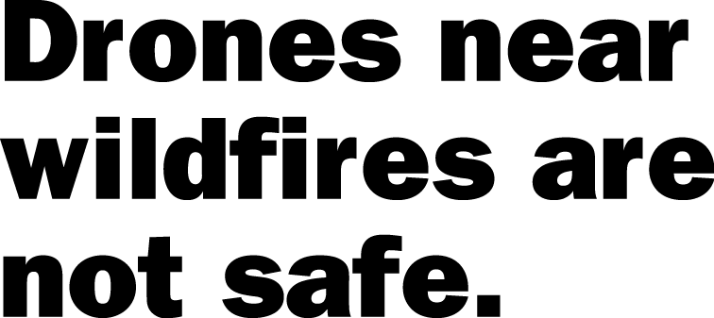
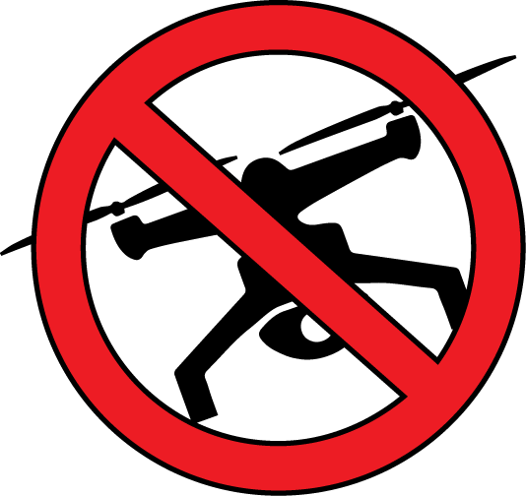
Flying hobby drones near wildfires could cause injury or death to firefighters.
Drones hamper firefighters’ ability to protect lives, property and natural resources.
Aerial firefighting may be suspended until unauthorized drones leave the area. This could result in a larger wildfire.
Contact your nearest land management agency to learn more about drone use on public lands.
Learn more at: knowbeforeyoufly.org
Pacific Northwest
Wildfire Coordinating Group
2015_08_23drones.pptx
Notes:
This 8.x11 flyer can be edited, so you can change the text if needed, or change the logo and contact information.

Slide 2
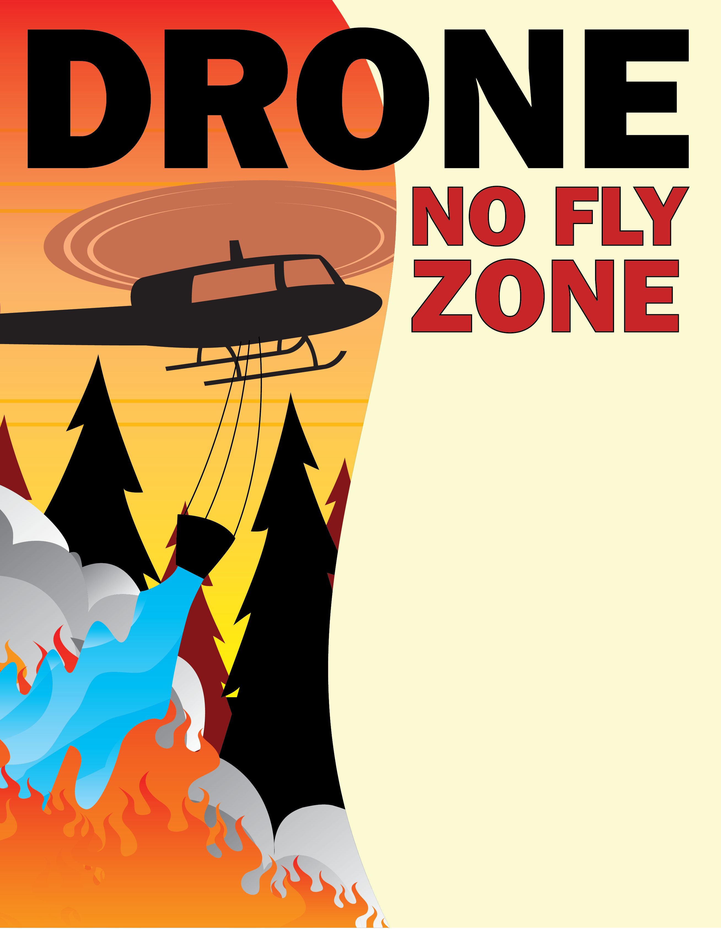
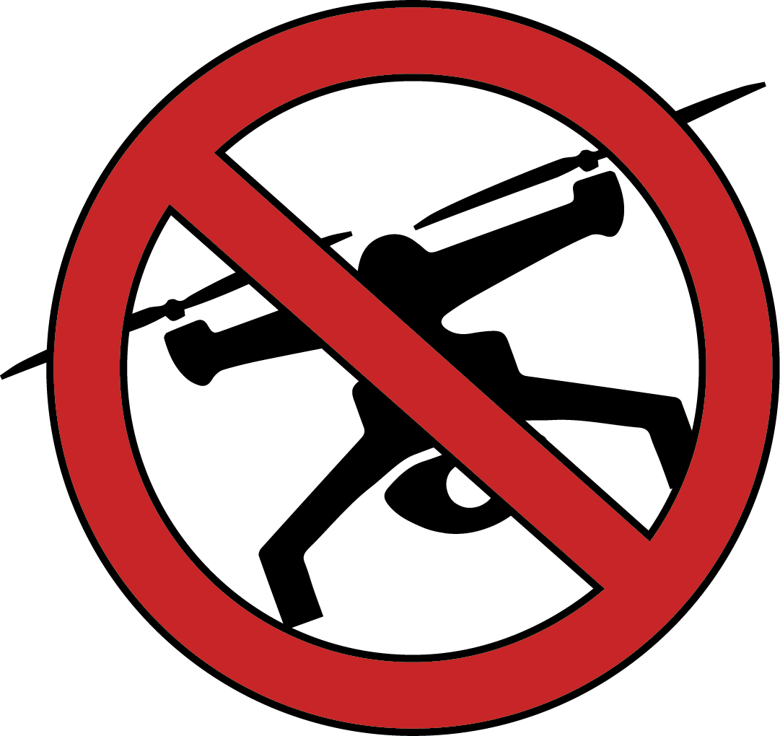
Flying drones near wildfires could
cause injury or death to firefighters.
Drones hamper firefighter’s ability
to protect lives, property and
natural resources
Contact your nearest land management
agency to learn more about drone use on public lands.
Learn more at: knowbeforeyoufly.org
Pacific Northwest
Wildfire Coordinating
Group
2015_08_23drones.pptx

Slide 3
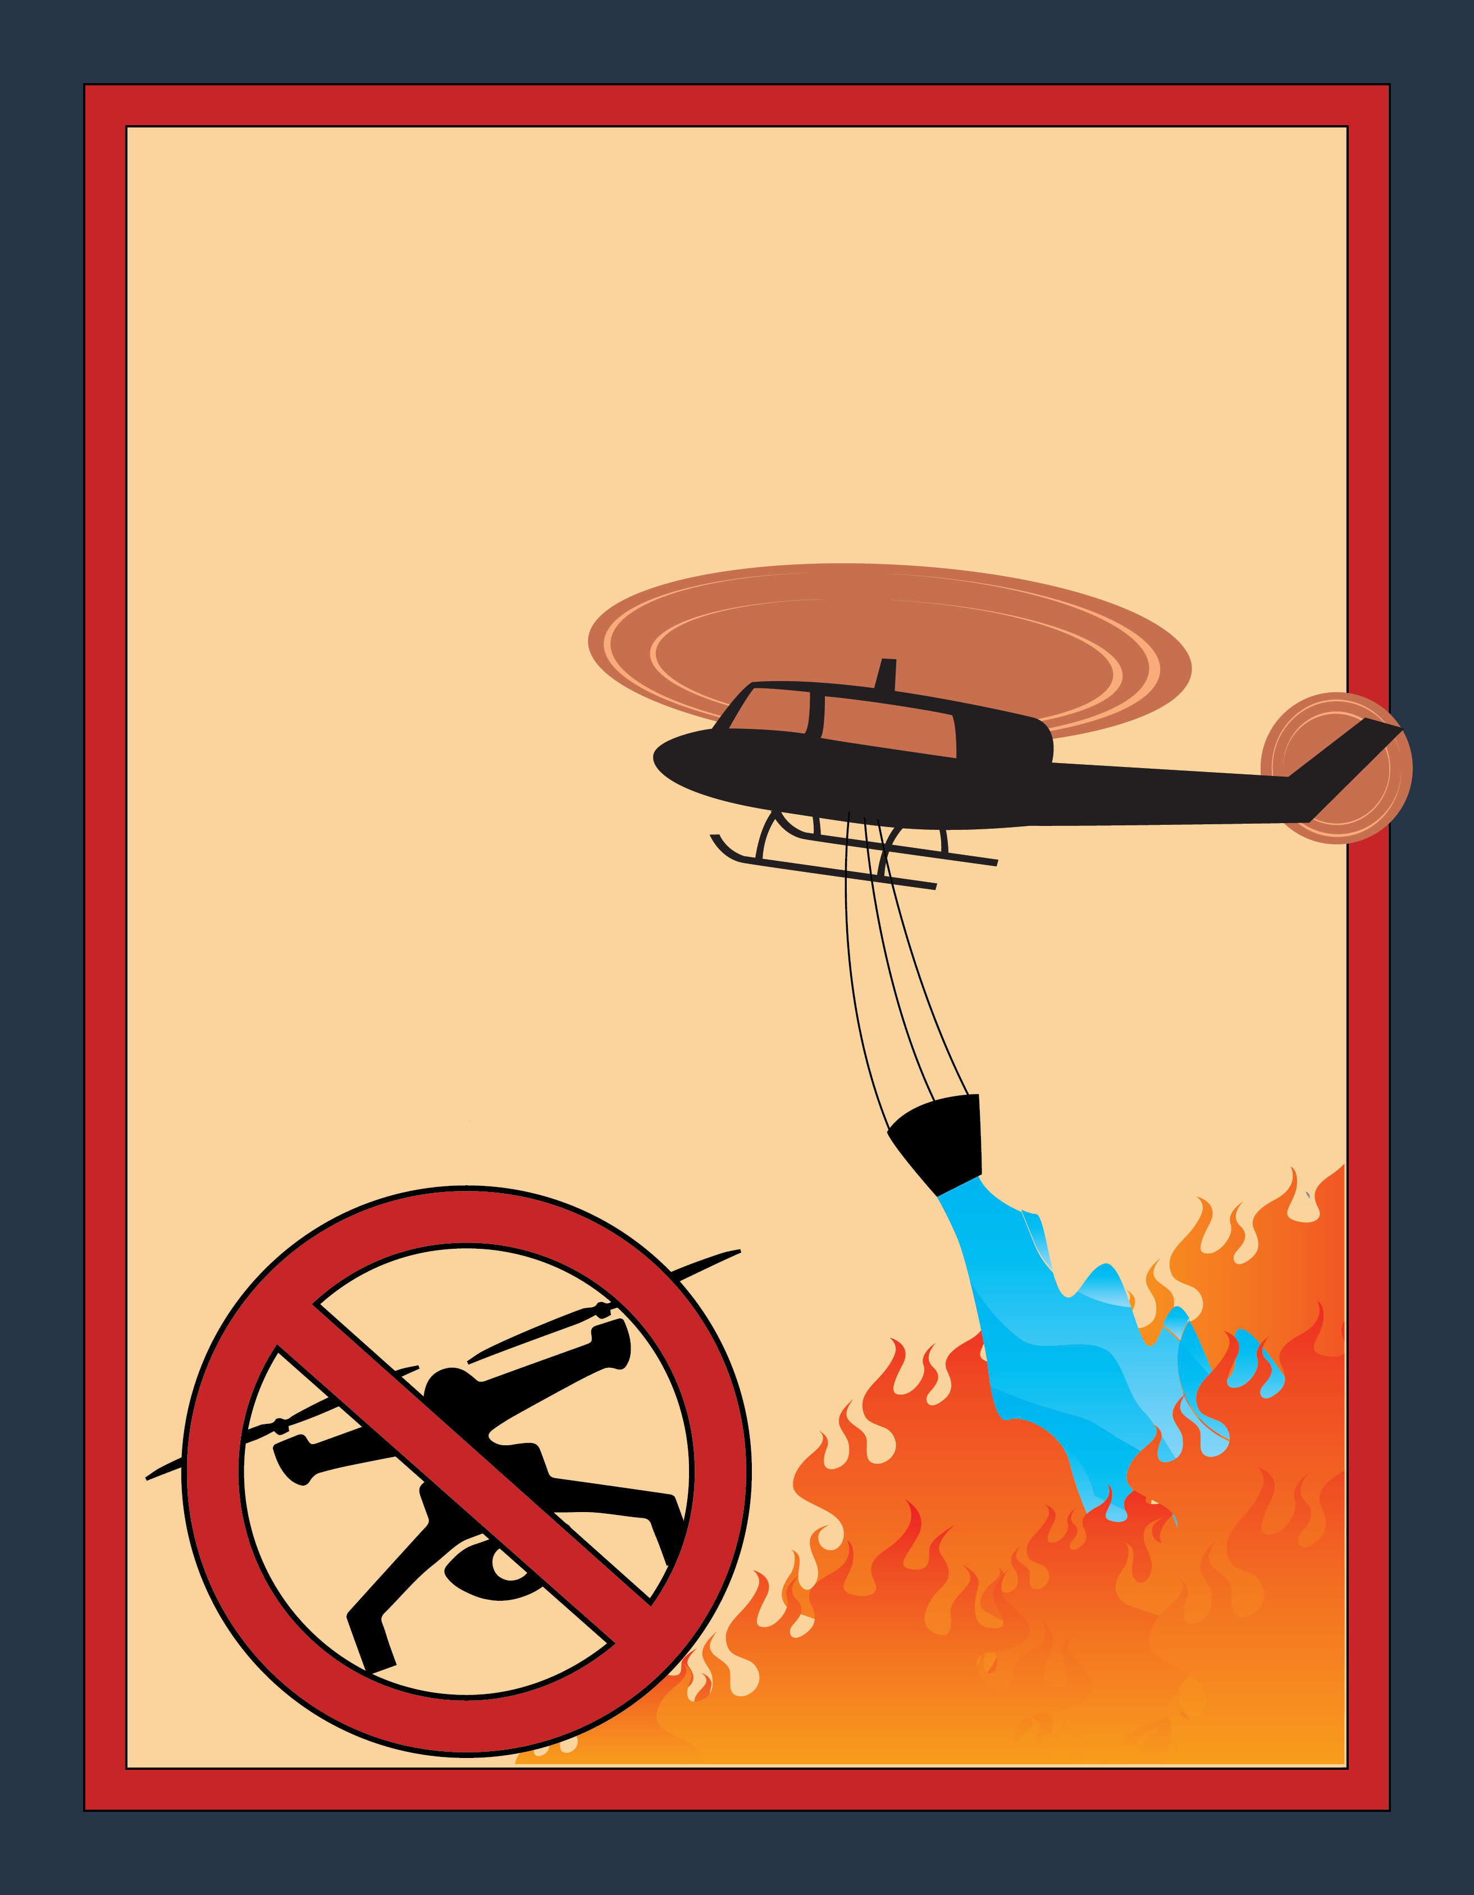
Flying hobby drones
near wildfires could
cause injury or death to
firefighters.
Drones hamper firefighters’
ability to protect lives,
property and natural resources.
Contact your nearest land management agency to learn more about drone use on public lands.
Learn more at: knowbeforeyoufly.org
Pacific Northwest
Wildfire Coordinating Group
2015_08_23drones.pptx

Slide 4
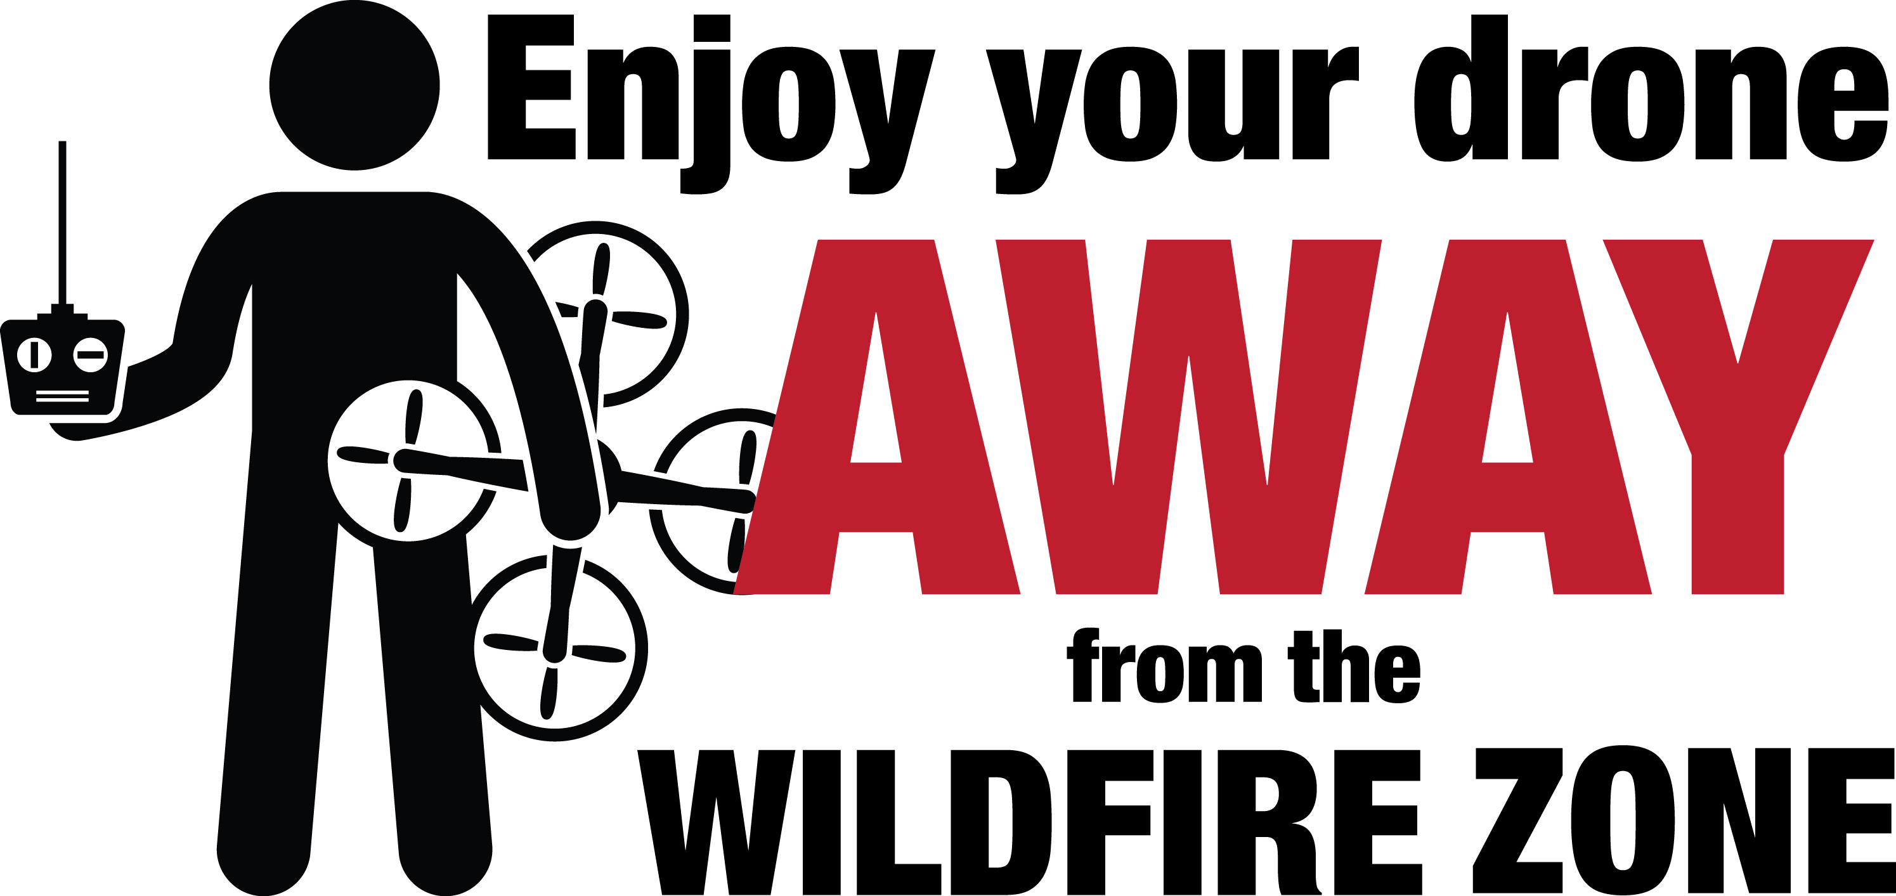
Flying hobby drones near wildfires could cause injury or death to firefighters. Drones hamper firefighters’ ability to protect lives, property and natural resources.
Aerial firefighting may be suspended until unauthorized drones leave the area. This could result in a larger wildfire..
Contact your nearest land management agency to learn
more about drone use on
public lands.
Pacific Northwest
Wildfire Coordinating Group
Learn more at: knowbeforeyoufly.org
2015_08_23drones.pptx

