Slide 1
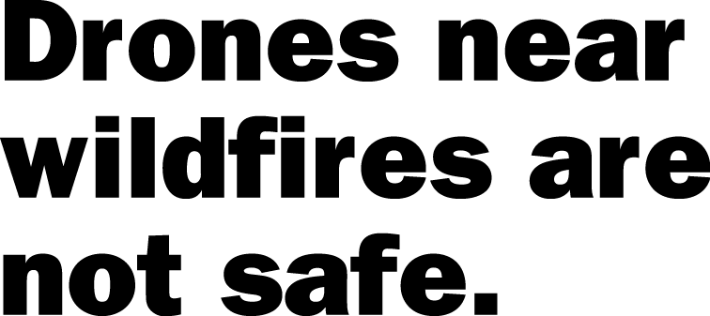
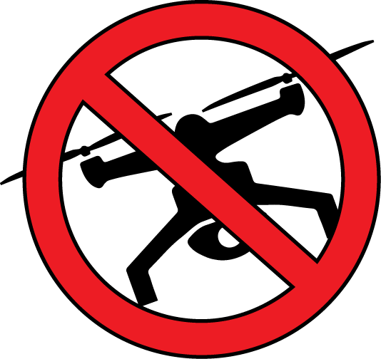
Flying hobby drones near wildfires could cause injury or death to firefighters.
Drones hamper firefighters’ ability to protect lives, property and natural resources.
Aerial firefighting may be suspended until unauthorized drones leave the area. This could result in a larger wildfire.
Contact your nearest land management agency to learn more about drone use on public lands.
Learn more at: knowbeforeyoufly.org
Insert agency
logo
Name and Contact Information for agency goes here.
Notes:
This 8.x11 flyer can be edited, so you can change the text if needed, or change the logo and contact information.

Slide 2
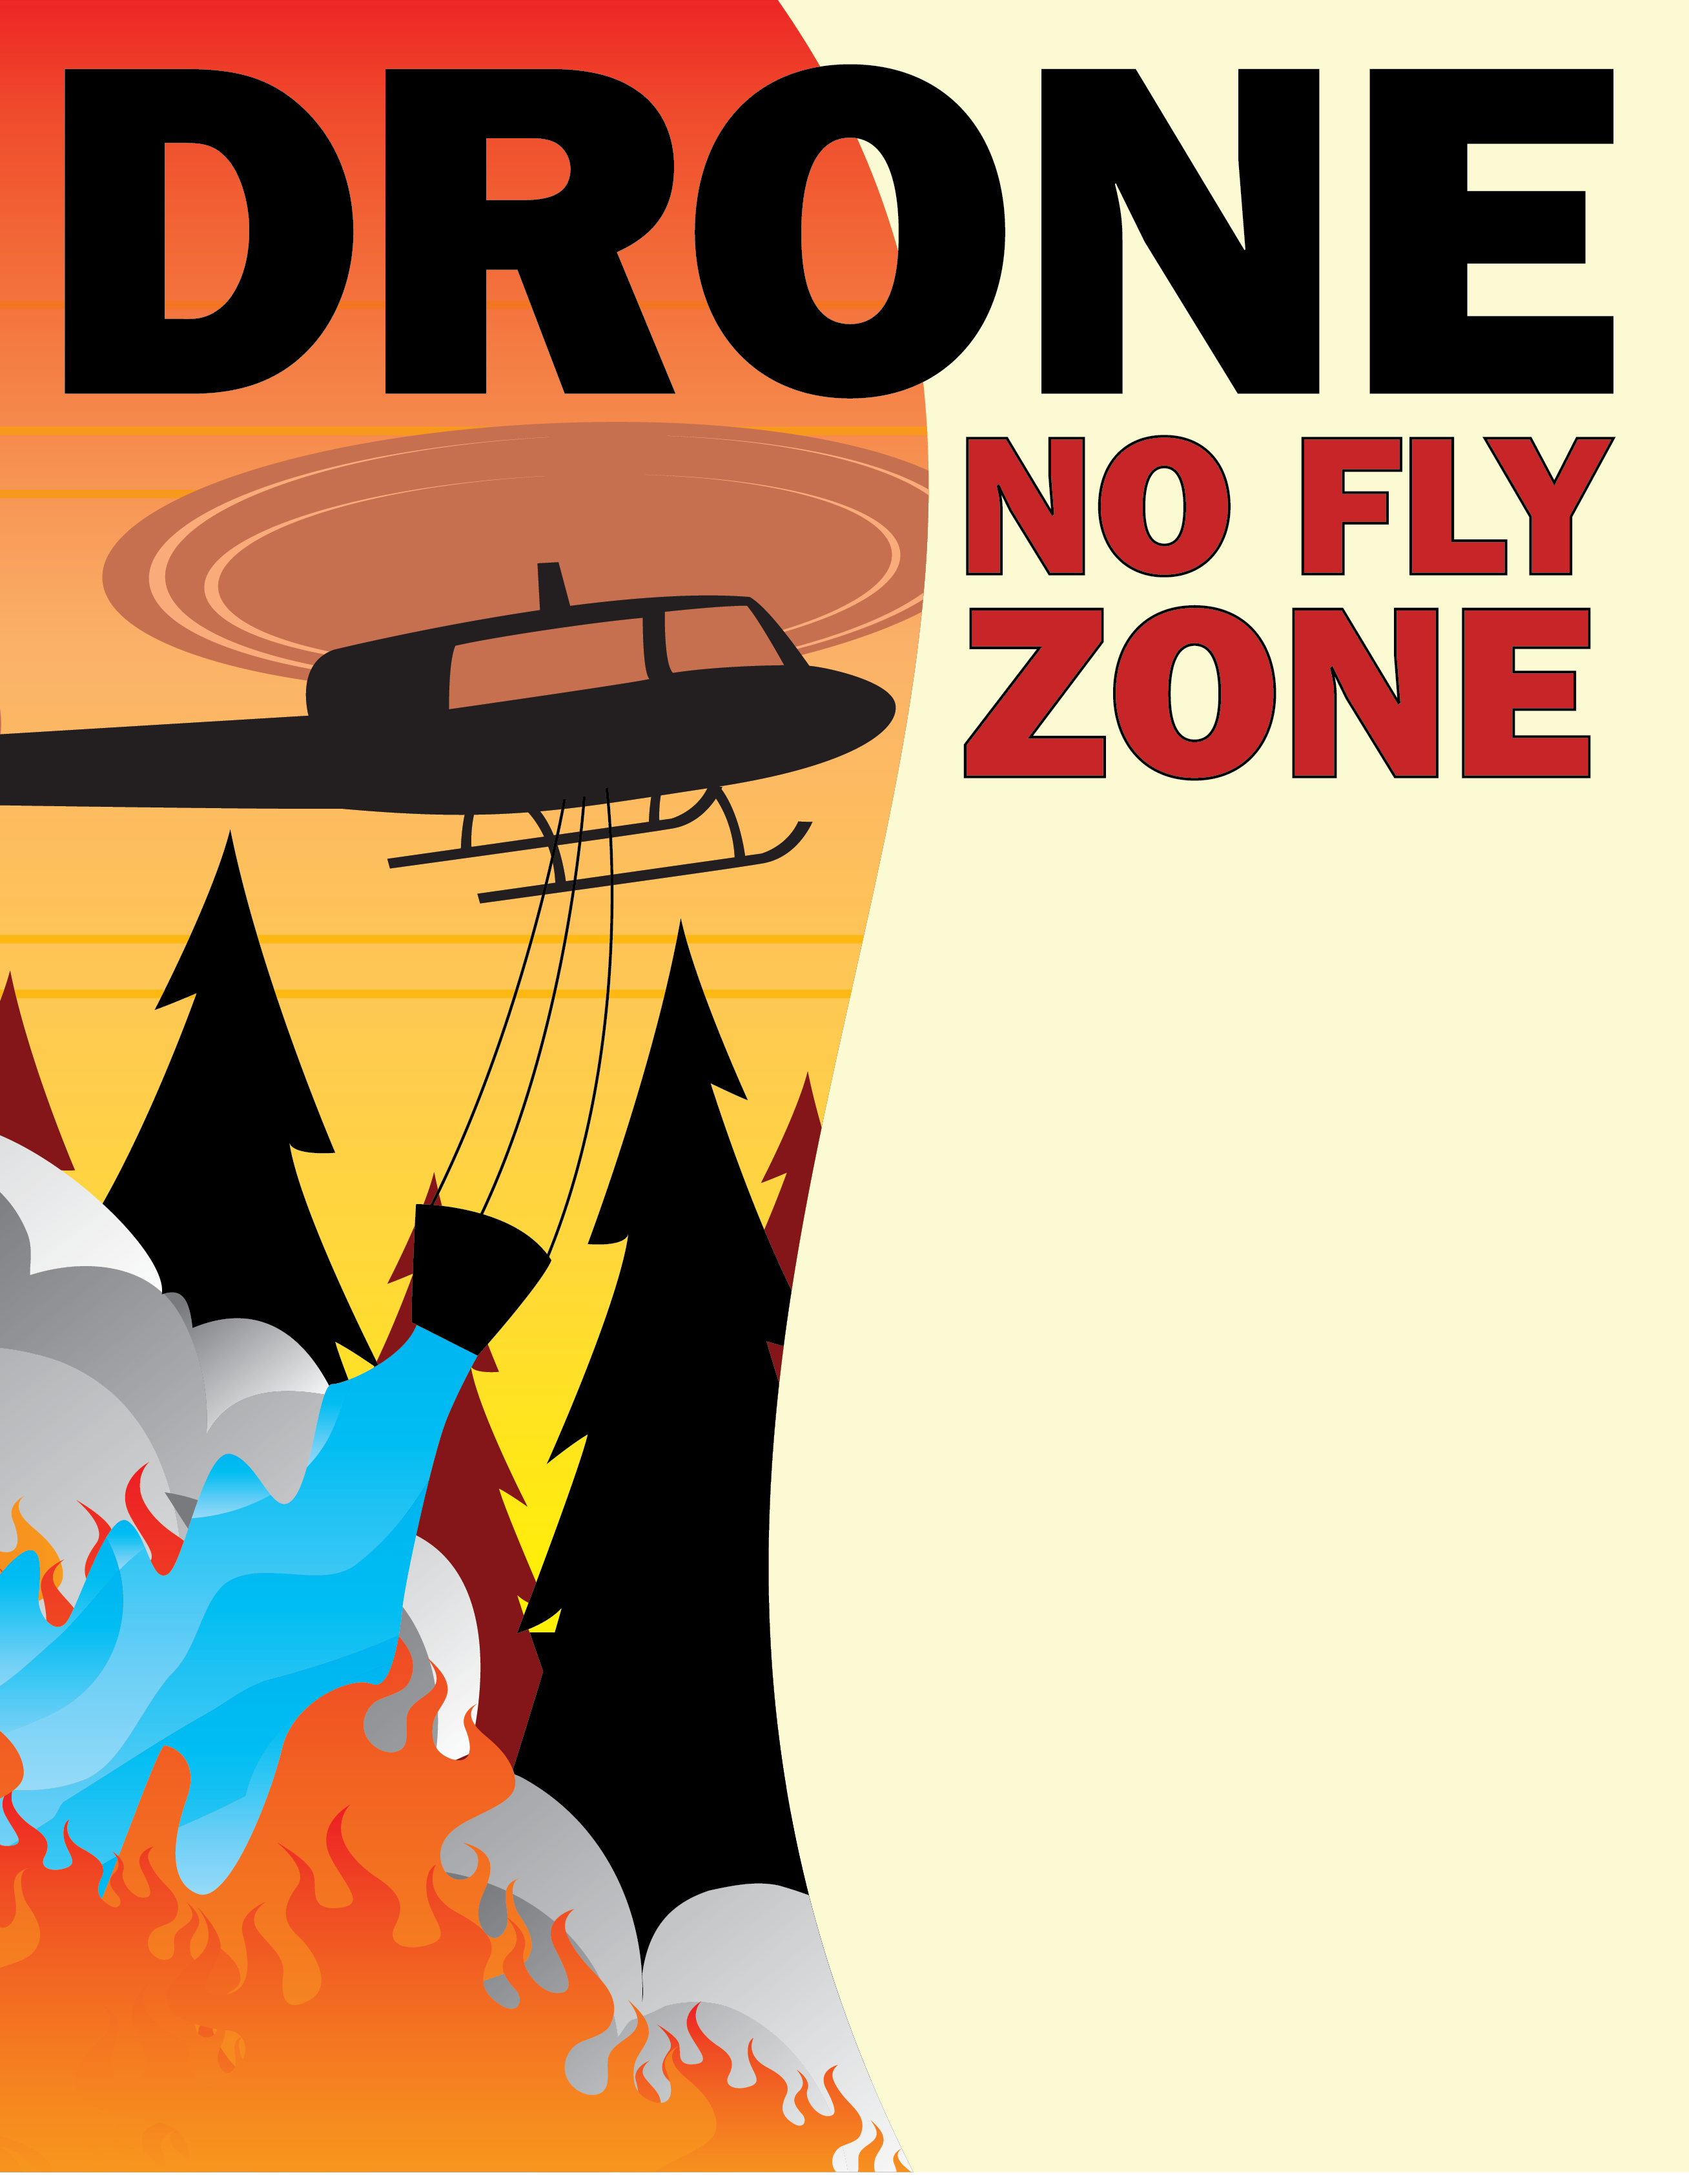
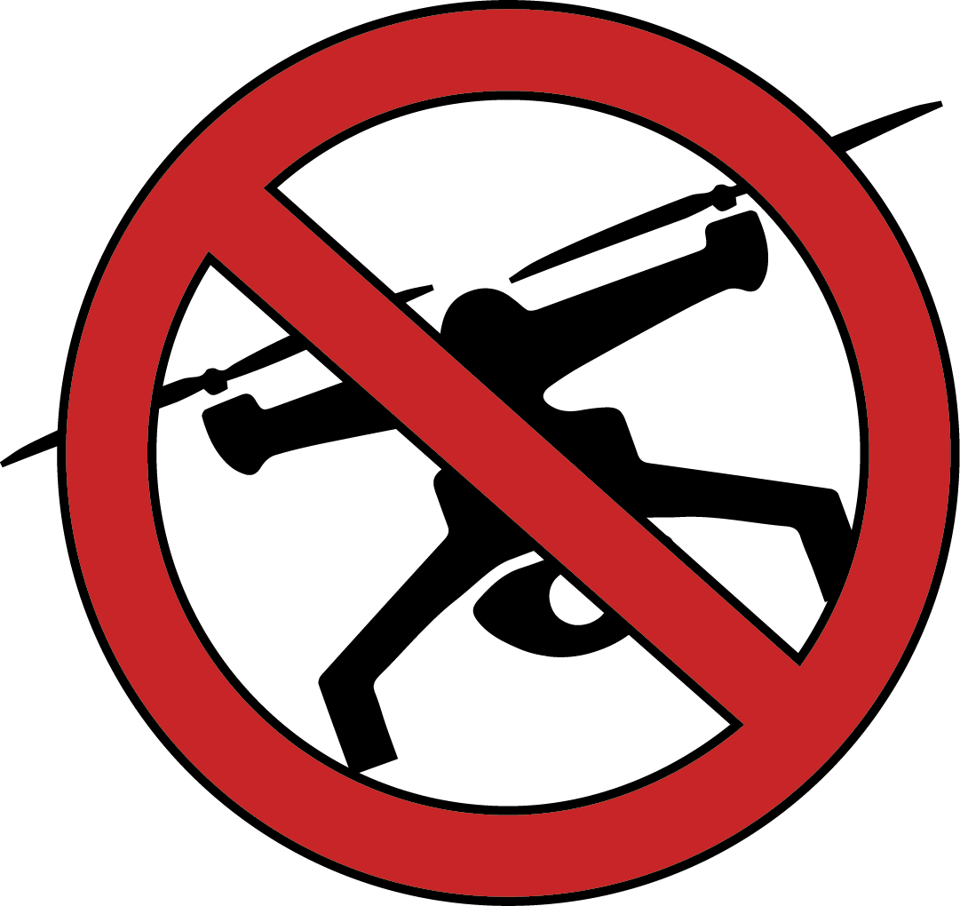
Flying drones near wildfires could
cause injury or death to firefighters.
Drones hamper firefighter’s ability
to protect lives, property and
natural resources
Contact your nearest land management
agency to learn more about drone use on public lands.
Learn more at: knowbeforeyoufly.org
Insert agency
logo
Name and Contact Information for agency goes here.

Slide 3
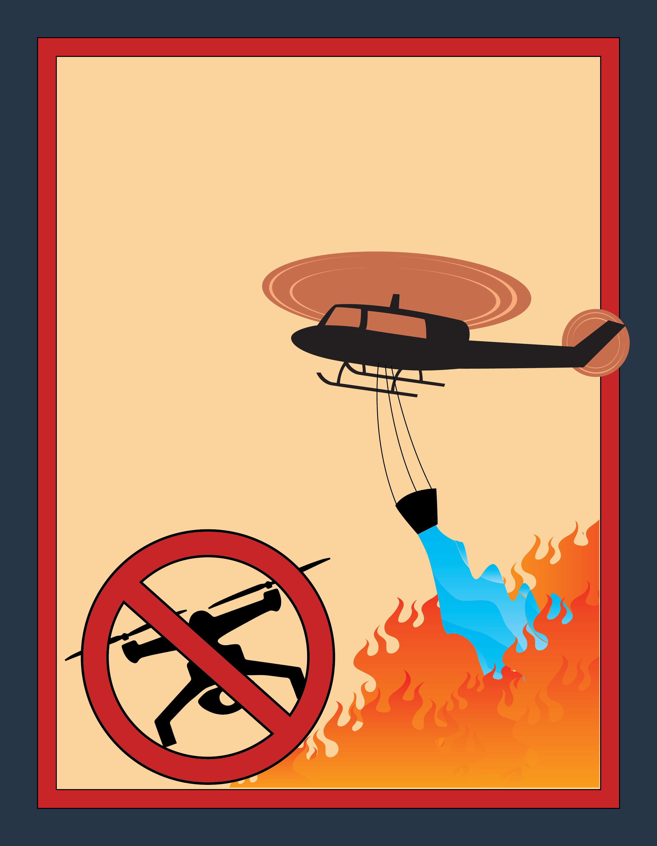
Flying hobby drones
near wildfires could
cause injury or death to
firefighters.
Drones hamper firefighters’
ability to protect lives,
property and natural resources.
Contact your nearest land management agency to learn more about drone use on public lands.
Learn more at: knowbeforeyoufly.org
Name and Contact Information for agency goes here.
Insert agency
logo

Slide 4
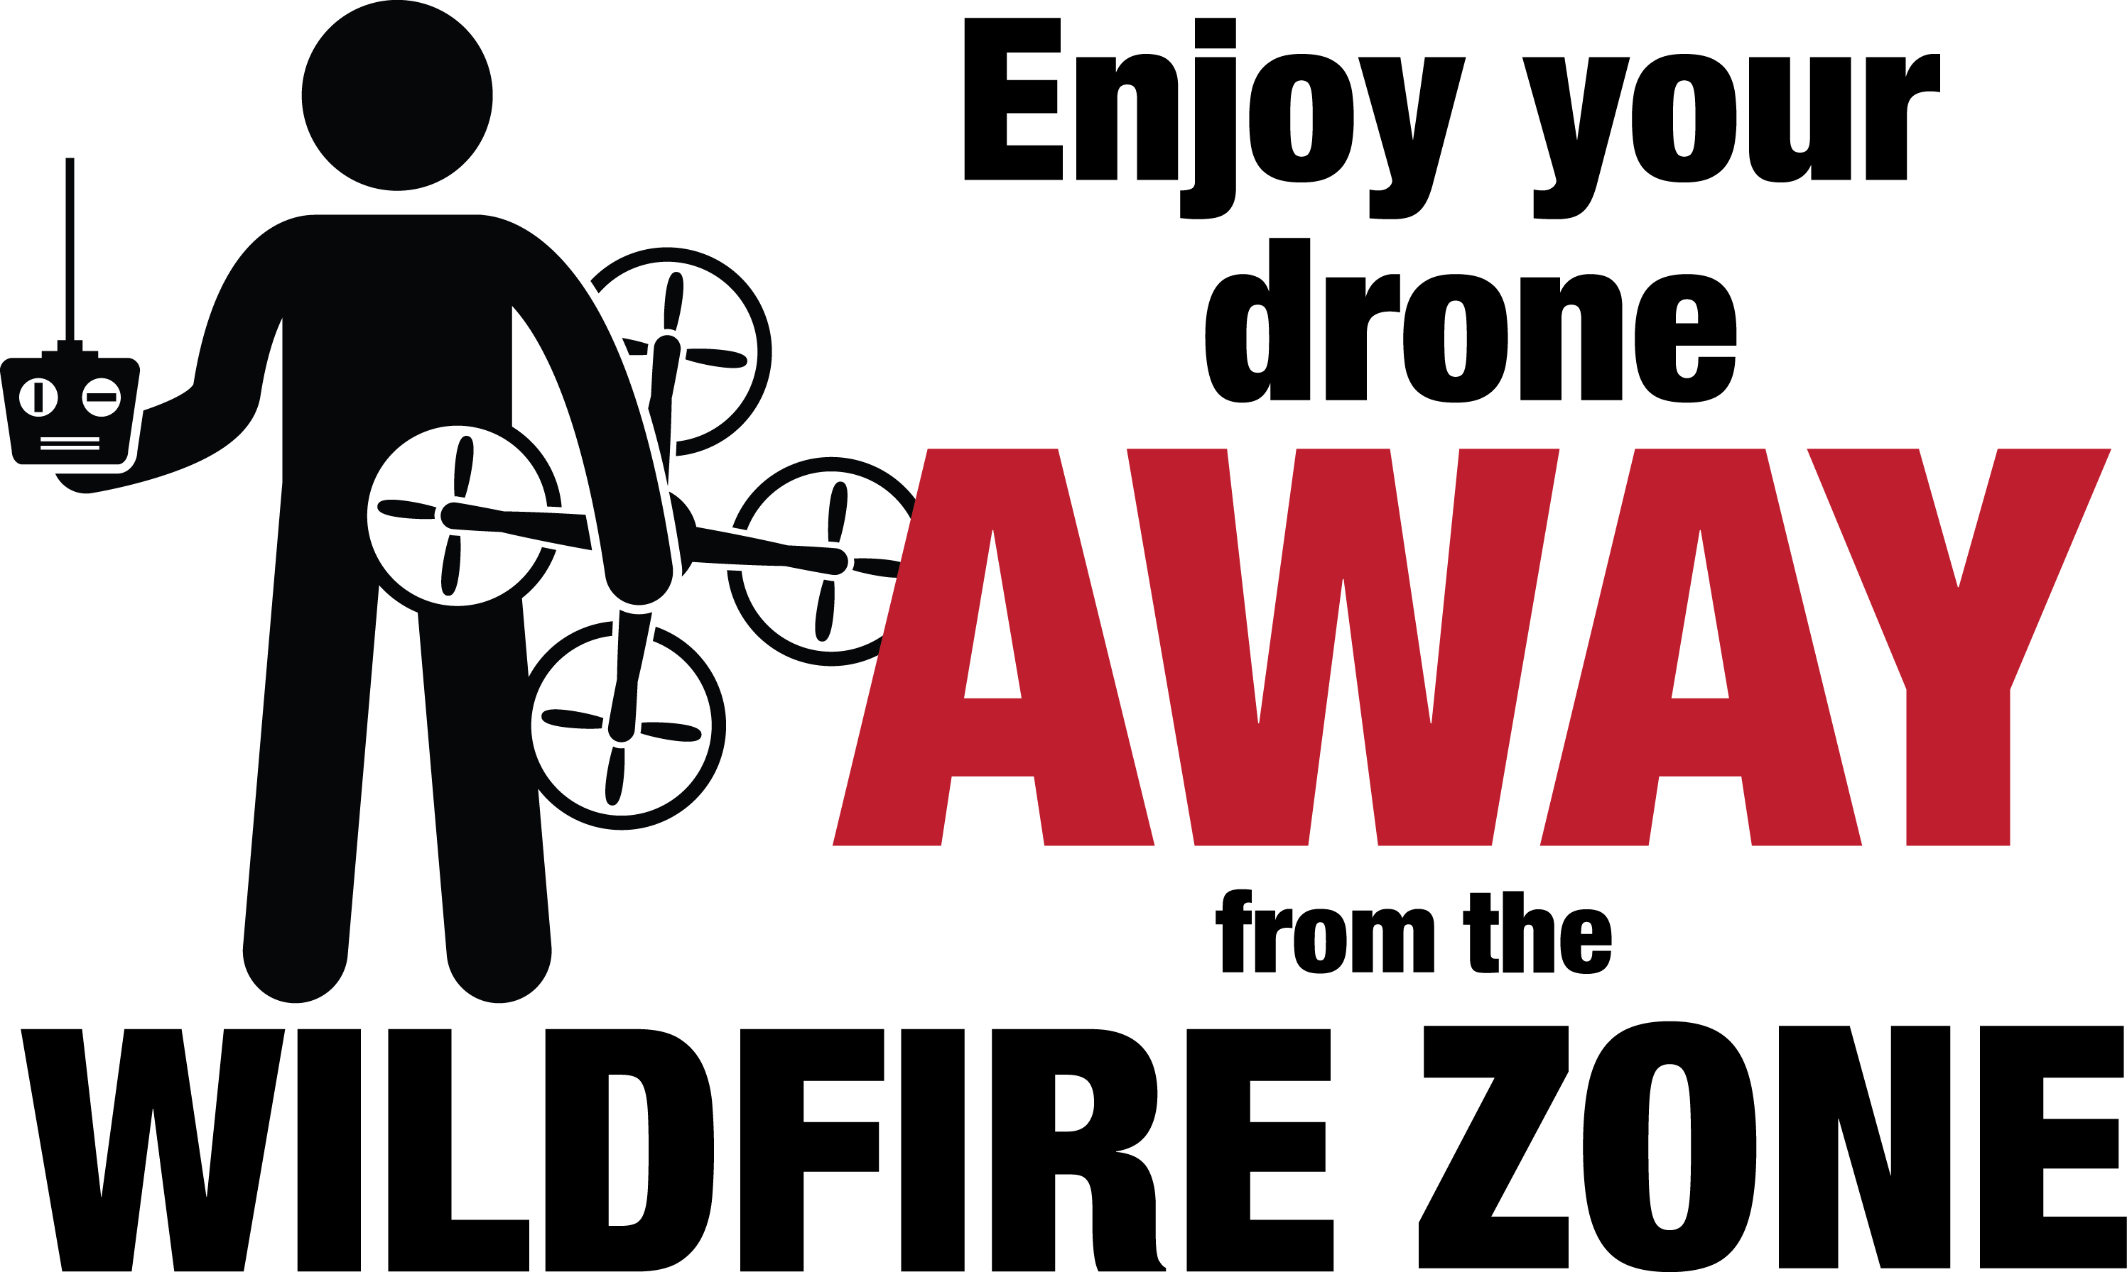
Flying hobby drones near wildfires could cause injury or death to firefighters. Drones hamper firefighters’ ability to protect lives, property and natural resources.
Aerial firefighting may be suspended until unauthorized drones leave the area. This could result in a larger wildfire.
Contact your nearest land management
agency to learn more about drone
use on public lands.
Insert agency
logo
Name and Contact Information for agency goes here.
Learn more at: knowbeforeyoufly.org

