Slide 1
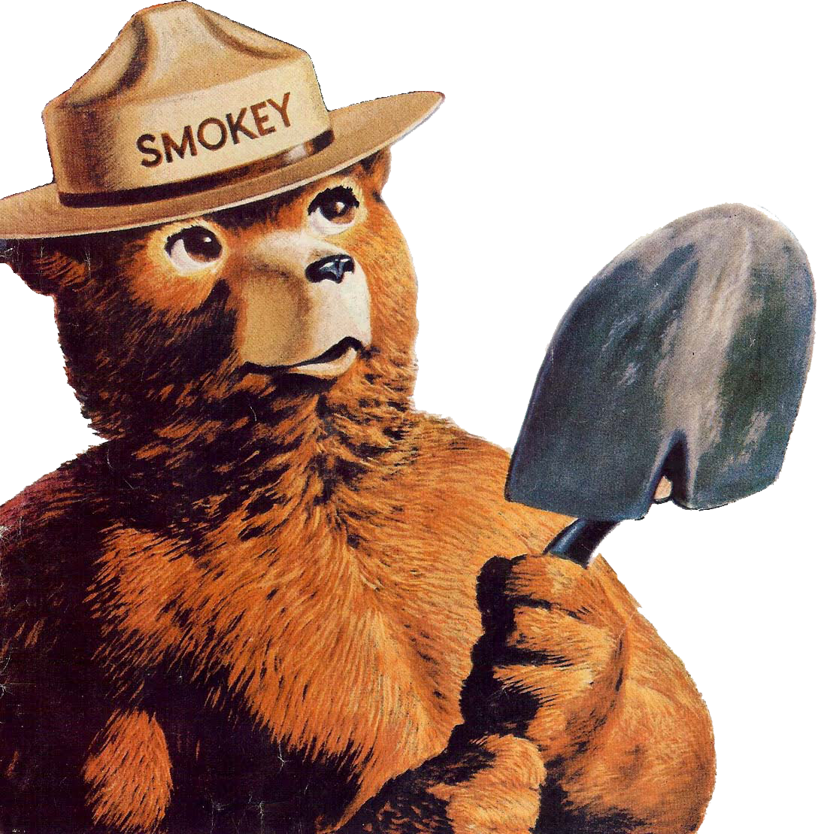
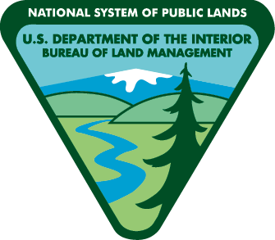
Checking for and fixing fire hazards will reduce the chance of starting a wildfire. Check equipment for:
• any build up of crop residue around the engine, exhaust system, belts and chains;
• damaged exhaust system components;
• worn or badly frayed drive belts;
• broken or exposed electrical wiring;
• the odor of burning electrical wiring;
• worn or mis-aligned moving parts, which can indicate the lack of lubricant; and
• signs of leaking fluids, oil and fuel.
Spokane Office
1103 N Fancher Road
Spokane, WA 99212
509-536-1200
Wenatchee Office
915 N. Walla Walla
Wenatchee, WA 98801
509-665-2100
Only you can prevent wildfires!

