Slide 1
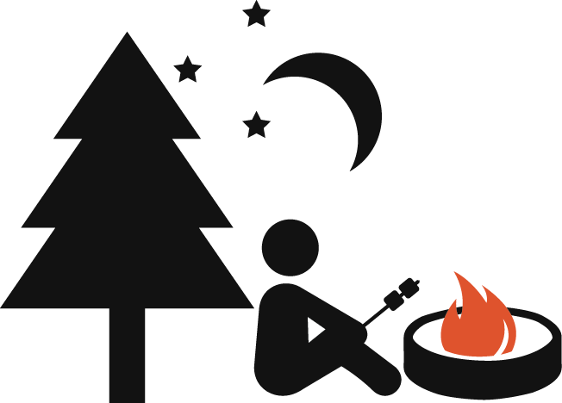
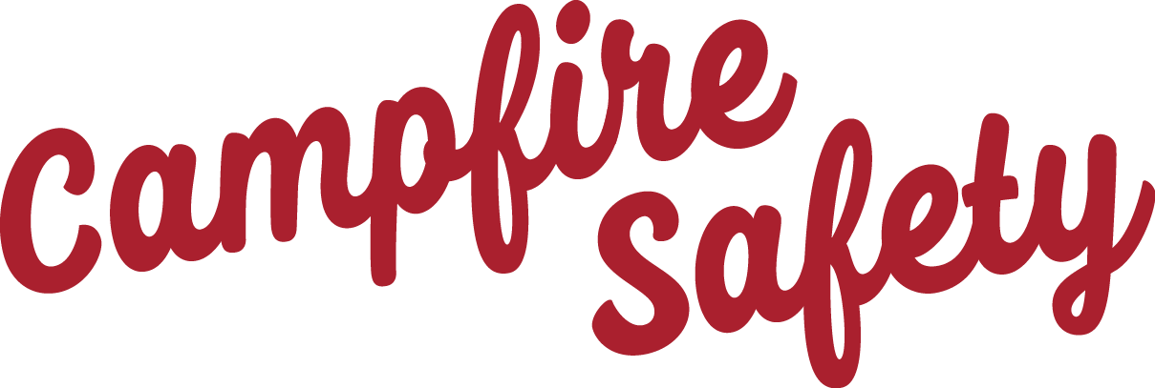
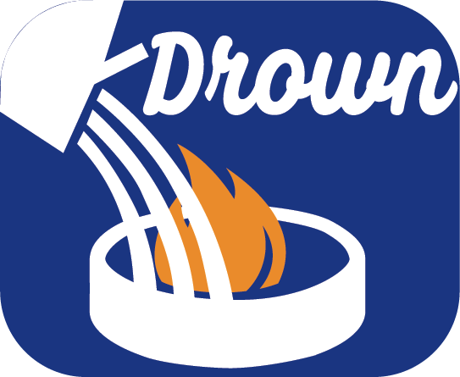
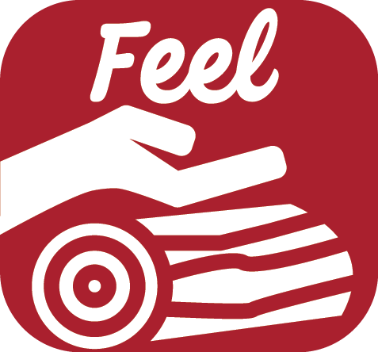
Make sure your campfire is DEAD OUT!
Make sure your campfire is DEAD OUT!
Drown the campfire ashes with lots of water.
Stir, add more water and stir again. Be sure all burned material is out cold.
Feel materials with your bare hand. If it is too hot to touch, it’s too hot to leave.
Drown the campfire ashes with lots of water.
Stir, add more water and stir again. Be sure all burned material is out cold.
Feel materials with your bare hand. If it is too hot to touch, it’s too hot to leave.
Make sure your campfire is DEAD OUT!
Make sure your campfire is DEAD OUT!
Drown the campfire ashes with lots of water.
Stir, add more water and stir again. Be sure all burned material is out cold.
Feel materials with your bare hand. If it is too hot to touch, it’s too hot to leave.
Drown the campfire ashes with lots of water.
Stir, add more water and stir again. Be sure all burned material is out cold.
Feel materials with your bare hand. If it is too hot to touch, it’s too hot to leave.

Slide 2
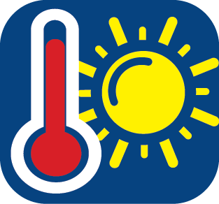
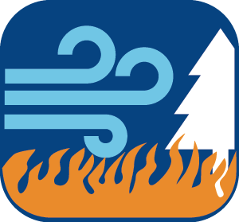
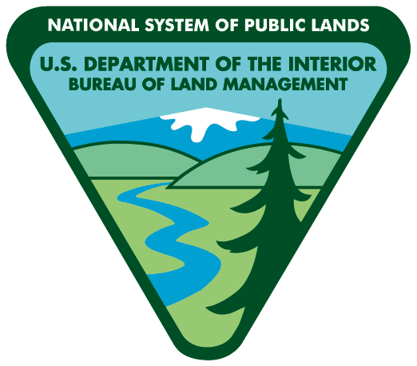
When it gets hot, vegetation like leaves and grass dry out .
When it’s hot, dry and windy, check local offices, bulletin boards and websites for current fire restrictions.
When it gets hot, vegetation like leaves and grass dry out .
When it’s hot, dry and windy, check local offices, bulletin boards and websites for current fire restrictions.
Low humidity and lack of rain will make vegetation more flammable.
Low humidity and lack of rain will make vegetation more flammable.
Consider campfire alternatives
when fire danger is high.
Consider campfire alternatives
when fire danger is high.
Wind spreads flames faster. A small fire can spread quickly.
Wind spreads flames faster. A small fire can spread quickly.
Wenatchee
Office
509-665-2100
Spokane
Office
509-536-1200
Wenatchee
Office
509-665-2100
Spokane
Office
509-536-1200
www.blm.gov/or/districts/spokane/
www.blm.gov/or/districts/spokane/
When it gets hot, vegetation like leaves and grass dry out .
When it’s hot, dry and windy, check local offices, bulletin boards and websites for current fire restrictions.
When it gets hot, vegetation like leaves and grass dry out .
When it’s hot, dry and windy, check local offices, bulletin boards and websites for current fire restrictions.
Low humidity and lack of rain will make vegetation more flammable.
Low humidity and lack of rain will make vegetation more flammable.
Consider campfire alternatives
when fire danger is high.
Consider campfire alternatives
when fire danger is high.
Wind spreads flames faster. A small fire can spread quickly.
Wind spreads flames faster. A small fire can spread quickly.
Wenatchee
Office
509-665-2100
Spokane
Office
509-536-1200
Wenatchee
Office
509-665-2100
Spokane
Office
509-536-1200
www.blm.gov/or/districts/spokane/
www.blm.gov/or/districts/spokane/

