Slide 1
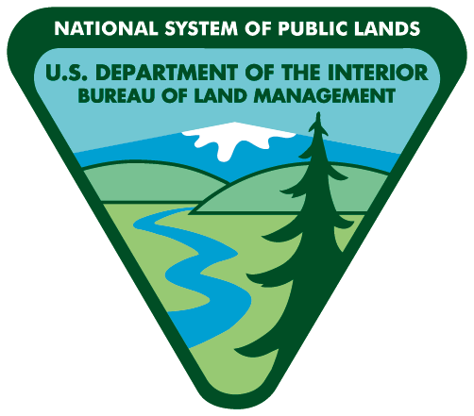
The Bureau of Land Management, Spokane District has issued a fire restrictions order on BLM lands in eastern Washington in the following counties: Adams, Asotin, Benton, Chelan, Columbia, Douglas, Ferry, Franklin, Garfield, Grant, Kittitas, Klickitat, Lincoln, Okanogan, Pend Oreille, Spokane, Stevens, Walla Walla, Whitman, and Yakima.
Follow these
restrictions:
SHOOTING
PROHIBITED: Exploding targets (including Tannerite), tracer ammunition and incendiary devices (including fireworks).
Exploding Targets Tracer Rounds Fireworks
CAMPFIRES
PROHIBITED: Building, maintaining, attending or using a fire, campfire or stove fire, including charcoal briquette fire.
PERMITTED: You can have a campfire (including charcoal briquette fire) within BLM-provided steel rings at improved campgrounds at the Yakima River Canyon, Coffeepot, Chopaka, Washburn, Pacific Lake and Twin Lakes sites.
SMOKING
PROHIBITED: Smoking while traveling in timber, brush or grass areas
PERMITTED: You can smoke in vehicles on roads, or cleared areas at least 3 feet in diameter, or on boats on rivers and or lakes.
VEHICLES
PROHIBITED: Operating any type of motorized vehicle off developed roadways.
PERMITTED: You must park your vehicle off roadways, in an area barren of flammable materials.
Spokane Office
1103 N. Fancher Rd.
Spokane, WA 99212
509-536-1200
Wenatchee Office
915 N. Walla Walla
Wenatchee, WA 98801
509-665-2100
For your help
in preventing wildfires.
Restrictions pursuant to 43 C.F.R. 9212, on file at the Spokane District Bureau of Land Management.

