Slide 1
FIRE DANGER!
FIRE DANGER!
FIRE DANGER!
The Bureau of Land Management, Spokane District has issued a fire restrictions order on BLM lands in eastern Washington in these counties: Adams, Asotin, Benton, Chelan, Columbia, Douglas, Ferry, Franklin, Garfield, Grant, Kittitas, Klickitat, Lincoln, Okanogan,
Pend Oreille, Spokane, Stevens, Walla
Walla, Whitman, and Yakima.
The Bureau of Land Management, Spokane District has issued a fire restrictions order on BLM lands in eastern Washington in these counties: Adams, Asotin, Benton, Chelan, Columbia, Douglas, Ferry, Franklin, Garfield, Grant, Kittitas, Klickitat, Lincoln, Okanogan,
Pend Oreille, Spokane, Stevens, Walla
Walla, Whitman, and Yakima.
The Bureau of Land Management, Spokane District has issued a fire restrictions order on BLM lands in eastern Washington in these counties: Adams, Asotin, Benton, Chelan, Columbia, Douglas, Ferry, Franklin, Garfield, Grant, Kittitas, Klickitat, Lincoln, Okanogan,
Pend Oreille, Spokane, Stevens, Walla
Walla, Whitman, and Yakima.
Follow
these restrictions.
Follow
these restrictions.
Follow
these restrictions.
SHOOTING
SHOOTING
SHOOTING
PROHIBITED: Exploding targets (including Tannerite), tracer ammunition and incendiary devices (including fireworks).
PROHIBITED: Exploding targets (including Tannerite), tracer ammunition and incendiary devices (including fireworks).
PROHIBITED: Exploding targets (including Tannerite), tracer ammunition and incendiary devices (including fireworks).
Exploding
Targets
Tracer
Ammunition
Fireworks
Exploding
Targets
Tracer
Ammunition
Fireworks
Exploding
Targets
Tracer
Ammunition
Fireworks
CAMPFIRES
CAMPFIRES
CAMPFIRES
PROHIBITED: Building, maintaining, attending or using a fire, campfire or stove fire, including charcoal briquette fire. You can have a campfire (including charcoal briquette fire) within BLM-provided steel rings at improved campgrounds at the Yakima River Canyon, Coffeepot, Chopaka, Washburn, Pacific Lake and Twin Lakes sites.
PROHIBITED: Building, maintaining, attending or using a fire, campfire or stove fire, including charcoal briquette fire. You can have a campfire (including charcoal briquette fire) within BLM-provided steel rings at improved campgrounds at the Yakima River Canyon, Coffeepot, Chopaka, Washburn, Pacific Lake and Twin Lakes sites.
PROHIBITED: Building, maintaining, attending or using a fire, campfire or stove fire, including charcoal briquette fire. You can have a campfire (including charcoal briquette fire) within BLM-provided steel rings at improved campgrounds at the Yakima River Canyon, Coffeepot, Chopaka, Washburn, Pacific Lake and Twin Lakes sites.

Slide 2
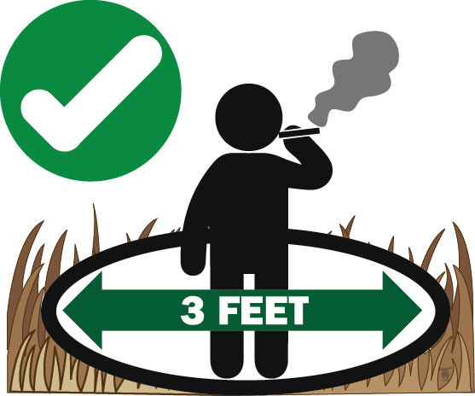
SMOKING
SMOKING
SMOKING
PROHIBITED: Smoking
while traveling in
timber, brush or grass
areas, except in vehicles
on roads, or cleared areas at
least 3 feet in diameter, or on boats on rivers and or lakes.
PROHIBITED: Smoking
while traveling in
timber, brush or grass
areas, except in vehicles
on roads, or cleared areas at
least 3 feet in diameter, or on boats on rivers and or lakes.
PROHIBITED: Smoking
while traveling in
timber, brush or grass
areas, except in vehicles
on roads, or cleared areas at
least 3 feet in diameter, or on boats on rivers and or lakes.
VEHICLES
VEHICLES
VEHICLES
PROHIBITED: Operating any
type of motorized vehicle off developed roadways.
PROHIBITED: Operating any
type of motorized vehicle off developed roadways.
PROHIBITED: Operating any
type of motorized vehicle off developed roadways.
Parking of vehicles off roadways must be done in an area barren of flammable materials.
Parking of vehicles off roadways must be done in an area barren of flammable materials.
Parking of vehicles off roadways must be done in an area barren of flammable materials.
Thank you for your help in preventing wildfires!
Thank you for your help in preventing wildfires!
Thank you for your help in preventing wildfires!
Spokane Office
1103 N. Fancher Rd.
Spokane, WA 99212
509-536-1200
Wenatchee Office
915 N. Walla Walla
Wenatchee, WA 98801
509-665-2100
Spokane Office
1103 N. Fancher Rd.
Spokane, WA 99212
509-536-1200
Wenatchee Office
915 N. Walla Walla
Wenatchee, WA 98801
509-665-2100
Spokane Office
1103 N. Fancher Rd.
Spokane, WA 99212
509-536-1200
Wenatchee Office
915 N. Walla Walla
Wenatchee, WA 98801
509-665-2100
Restrictions pursuant to 43 C.F.R. 9212, on file at the Spokane District Bureau of Land Management.
Restrictions pursuant to 43 C.F.R. 9212, on file at the Spokane District Bureau of Land Management.
Restrictions pursuant to 43 C.F.R. 9212, on file at the Spokane District Bureau of Land Management.

