Slide 1
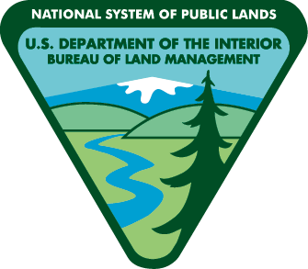
Check your surroundings when shooting on public lands. Bullet fragments can get hot enough to start a fire in dry grass on hot, windy days.
Place your targets on dirt or gravel.
Shoot in areas free of dry vegetation and loose rocks. Avoid shooting on hot, windy days. Know your target and what is beyond.
Use safe targets.
Shooting at steel targets or rocks may throw sparks into the nearby vegetation. Use paper or wooden targets. Exploding targets are prohibited.
Ammunition type matters.
Steel core and solid copper ammunition have the highest potential to start fires. Lead core bullets are less likely to ignite surrounding vegetation. Incendiary and tracer ammunition are prohibited.
Spokane Office
1103 N Fancher Road
Spokane, WA 99212
509-536-1200
Wenatchee Office
915 N. Walla Walla
Wenatchee, WA 98801
509-665-2100
Fire restriction order 43 C.F.R. 9212, on file at Spokane District Bureau of Land Management.

