Slide 1
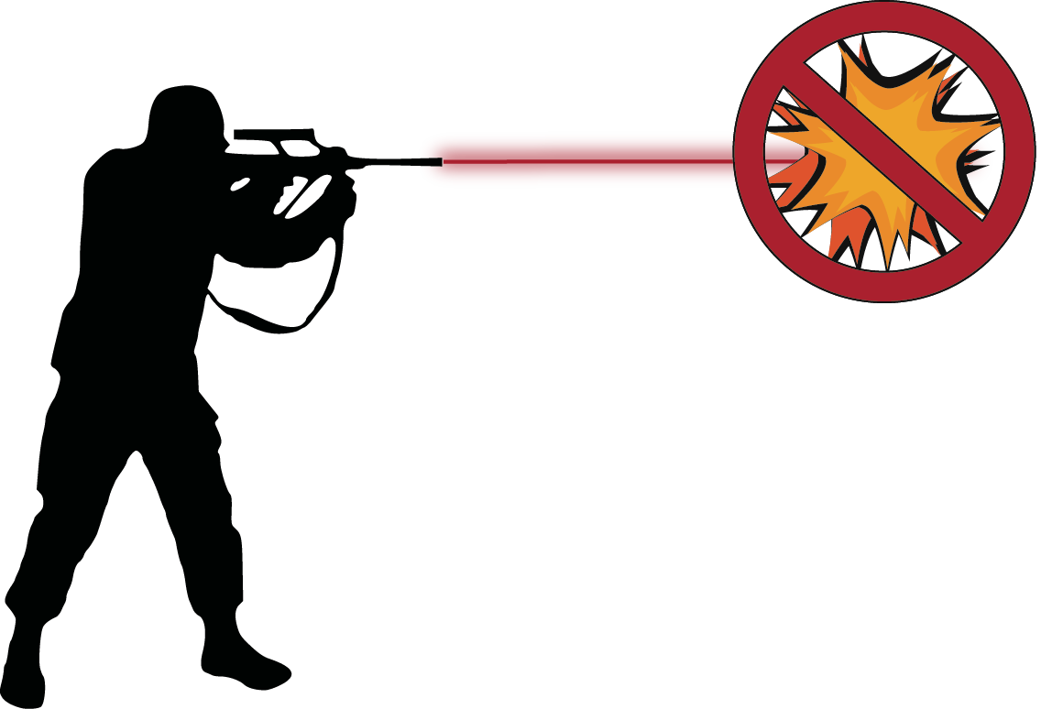
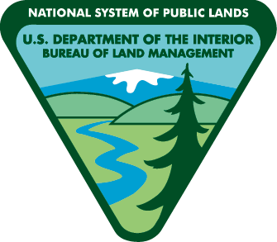
Tracer rounds, exploding targets and fireworks.
Check with public land agencies for current fire restrictions.
Know your target and what is beyond. Pick an area free of loose rocks and dry grass.
Be prepared to put out a fire. Take a shovel, fire extinguisher and a bucket of water.
Spokane Office
1103 N Fancher Road
Spokane, WA 99212
509-536-1200
Wenatchee Office
915 N. Walla Walla
Wenatchee, WA 98801
509-665-2100
Fire restriction order 43 C.F.R. 9212, on file at Spokane District Bureau of Land Management.

