Slide 1
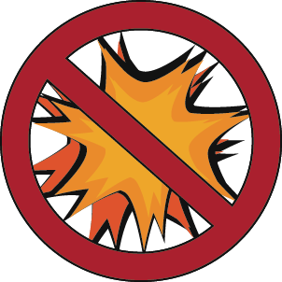
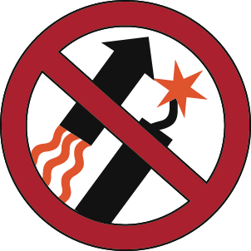
FIRE DANGER!
Wildfires caused by target shooting in dry grasses have steadily increased. You can help prevent these fires.
• Keep your target area free of dry vegetation.
• Minimize the use of ammunition containing steel.
• Avoid shooting under hot, dry and windy conditions.
PROHIBITED:
Exploding
Targets
Fireworks
Tracer
Rounds
Spokane Office
1103 N Fancher Road
Spokane, WA 99212
509-536-1200
Wenatchee Office
915 N. Walla Walla
Wenatchee, WA 98801
509-665-2100
Fire restriction order 43 C.F.R. 9212, on file at Spokane District Bureau of Land Management.

