Slide 1
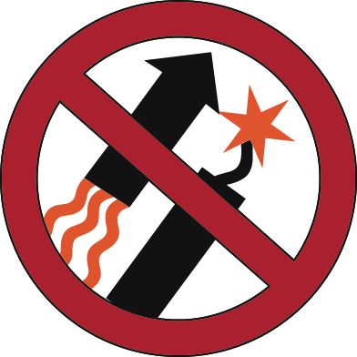
Check the weather.
Be prepared to put out a fire.
Avoid shooting on hot, dry and windy days.
Have a bucket of water, a shovel and a fire extinguisher ready.
Report fires by calling 911.
Put targets on dirt or gravel.
Report location, what is in danger, and stay on the phone.
Avoid shooting into dry grass and rocks that might cause sparks.
Exploding
Targets
Tracer
Rounds
Fireworks
For your help in preventing wildfires.
Spokane Office
1103 N. Fancher Rd.
Spokane, WA 99212
509-536-1200
Wenatchee Office
915 N. Walla Walla
Wenatchee, WA 98801
509-665-2100
Restrictions pursuant to 43 C.F.R. 9212, on file at the Spokane District Bureau of Land Management.

