Slide 1
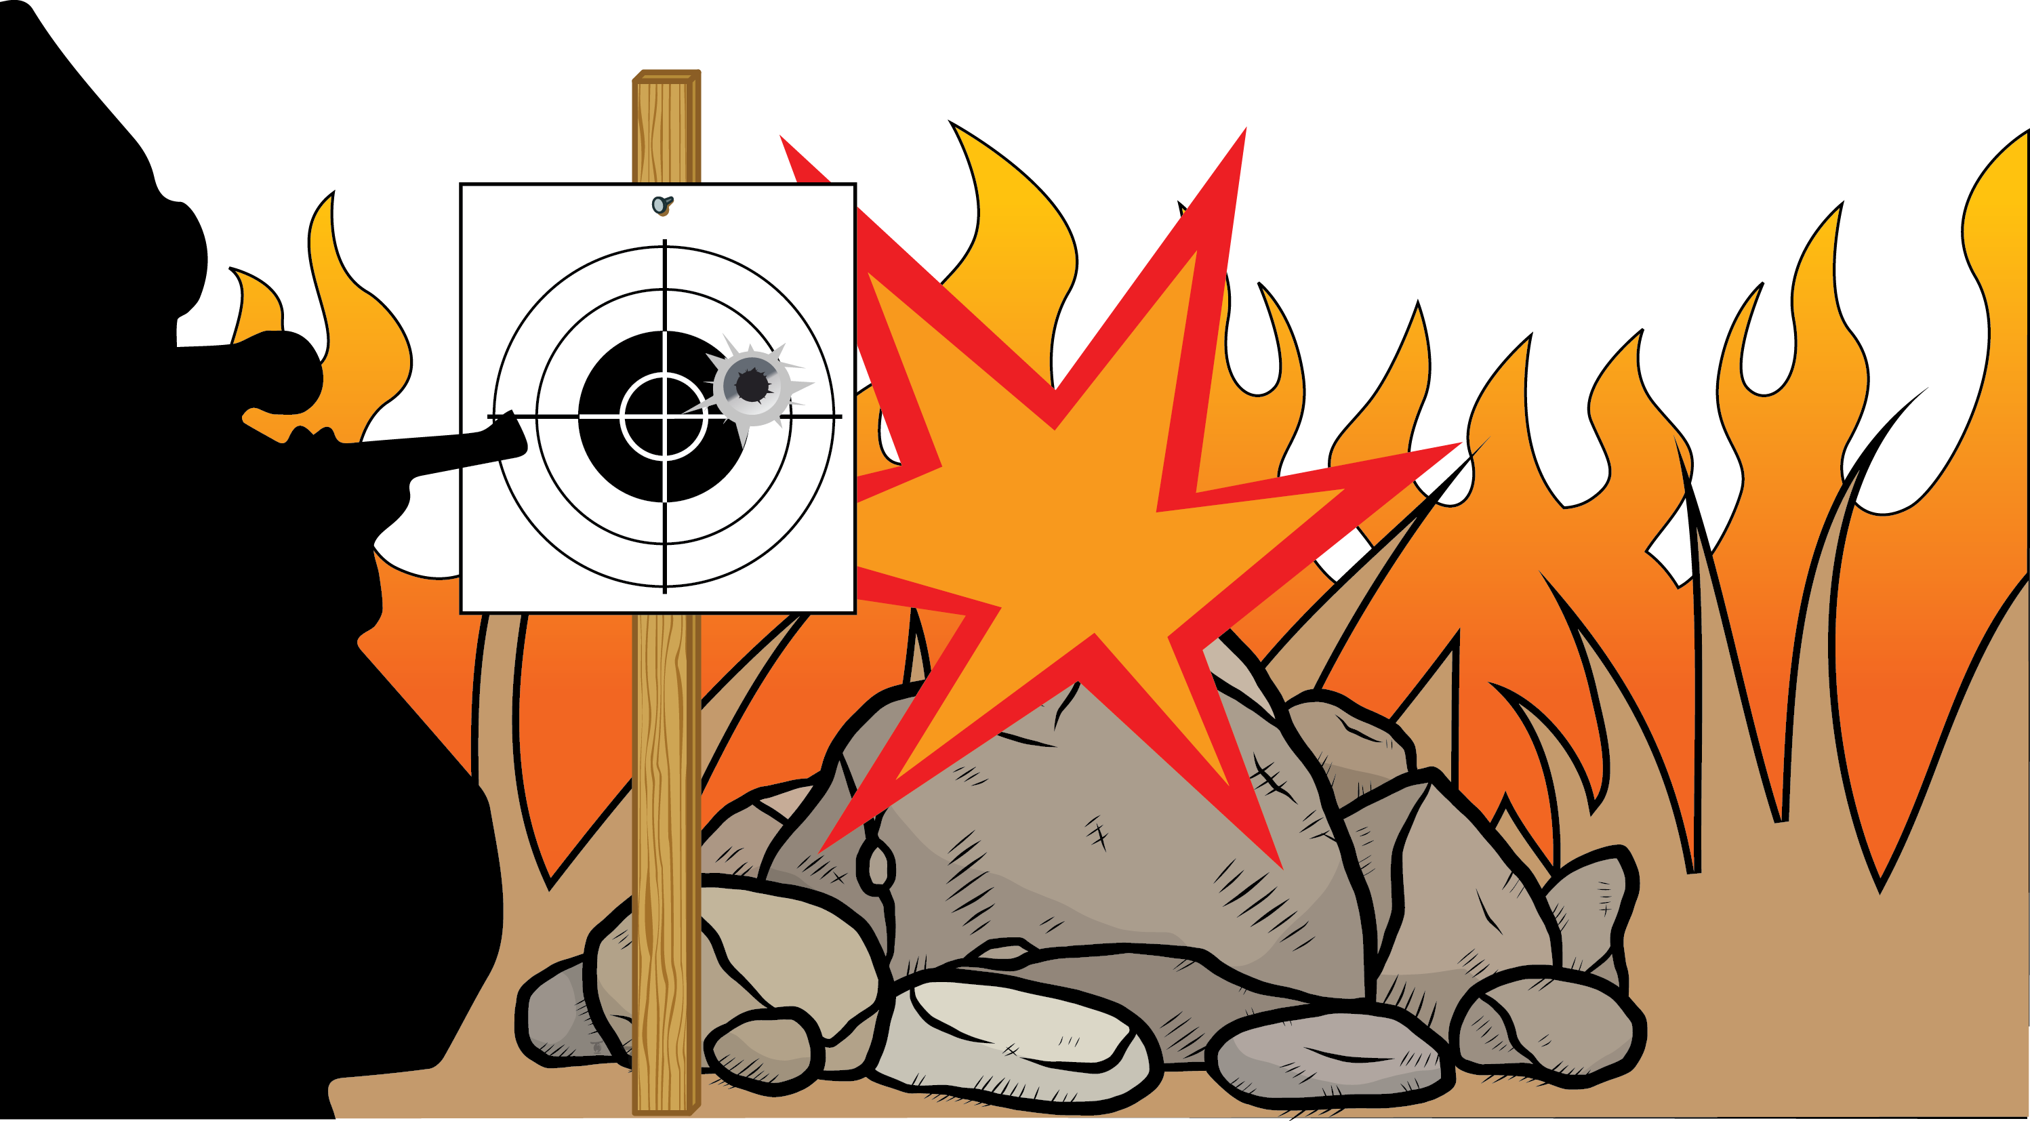
Prevent Wildfires
While Target Shooting.
Exploding targets, tracer rounds and fireworks are prohibited on public lands.
Spokane Office
1103 N. Fancher Rd.
Spokane, WA 99212
509-536-1200
Wenatchee Office
915 N. Walla Walla
Wenatchee, WA 98801
509-665-2100
Avoid shooting into dry grass and rocks that might cause sparks.
Restrictions pursuant to 43 C.F.R. 9212, on file at the Spokane District Bureau of Land Management.

