Slide 1
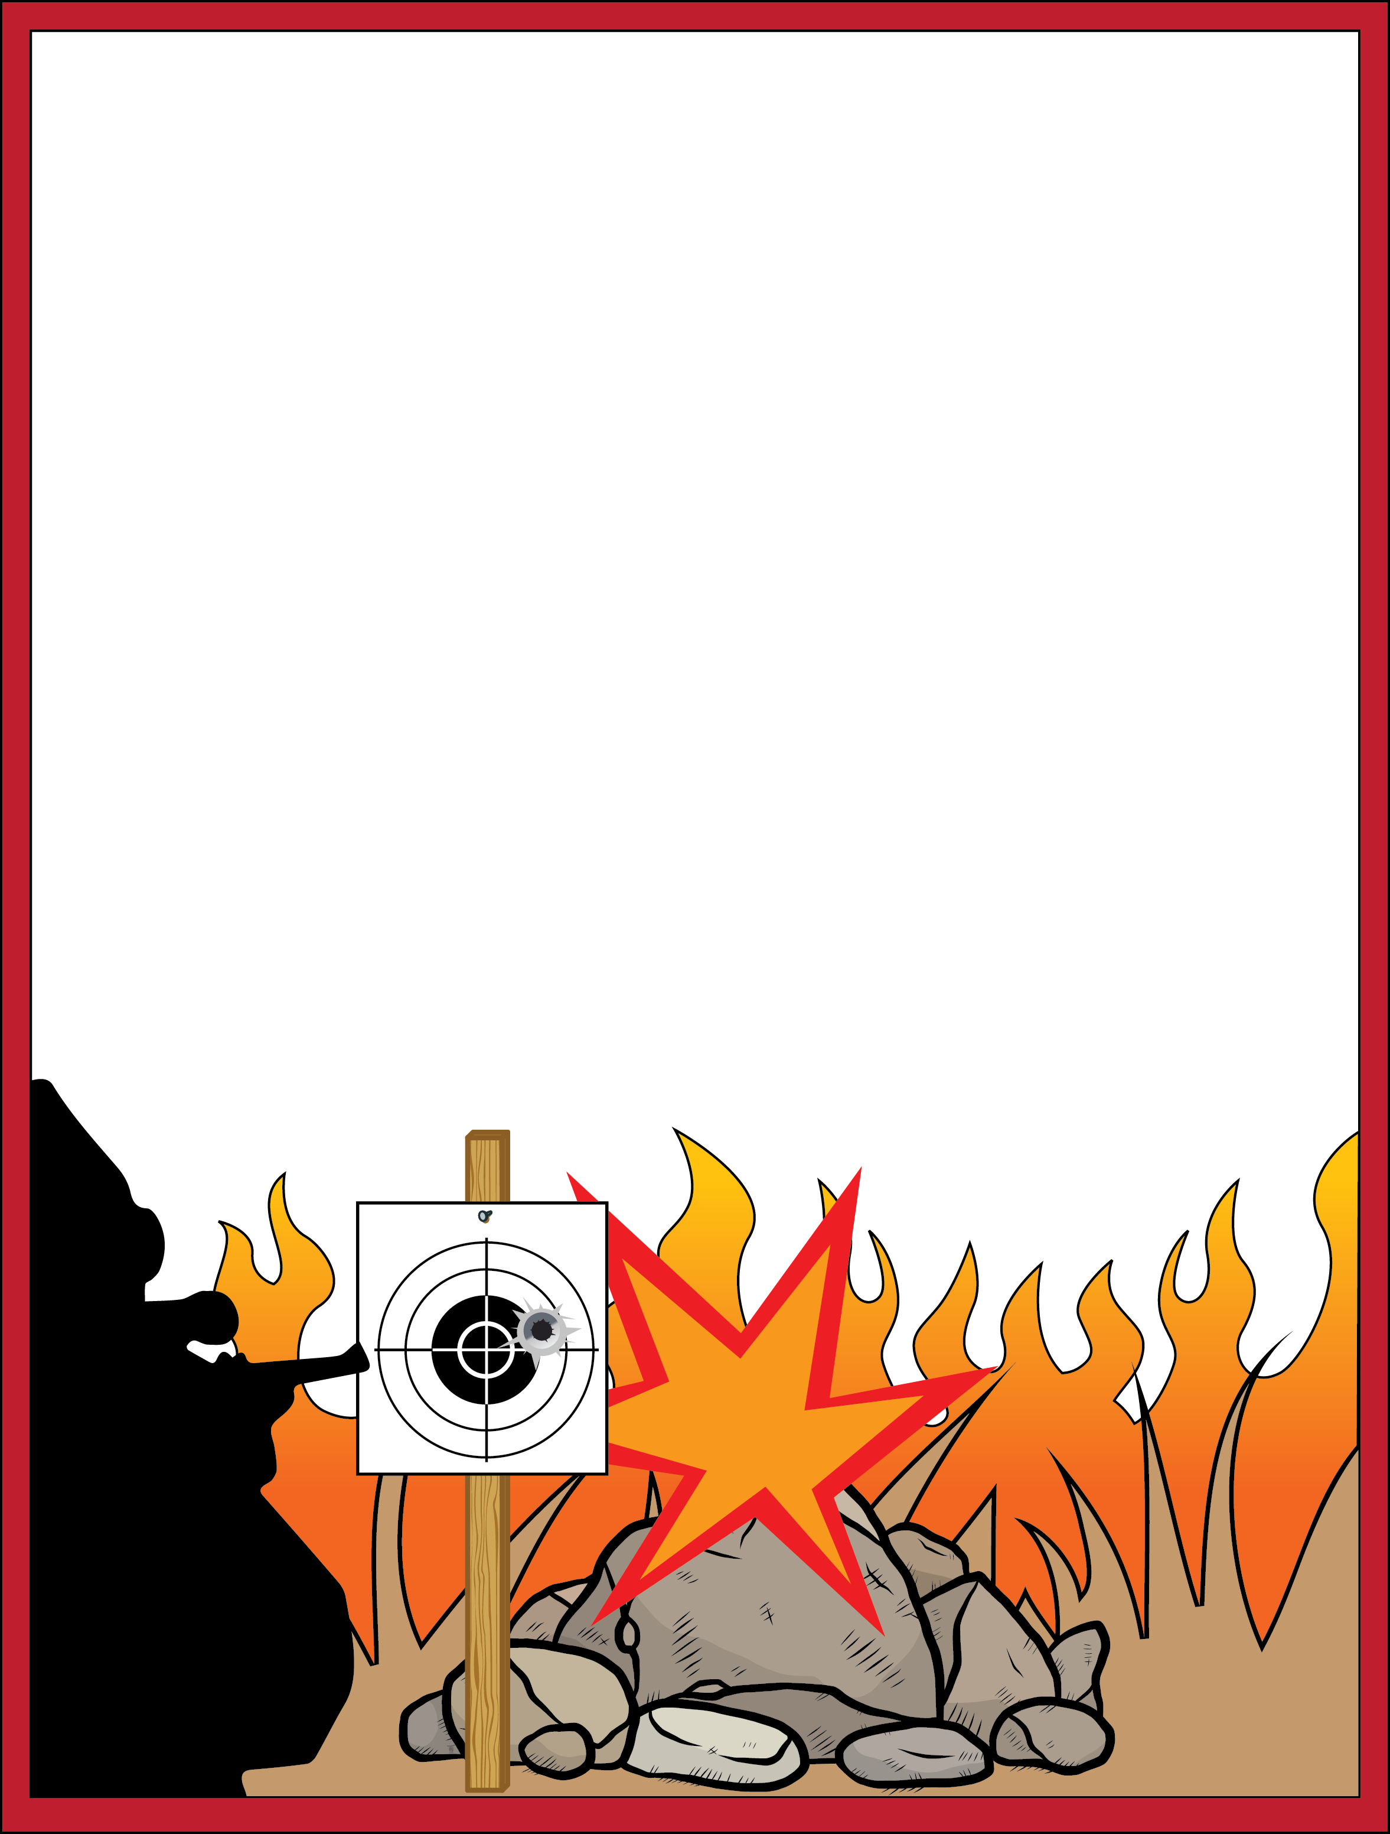
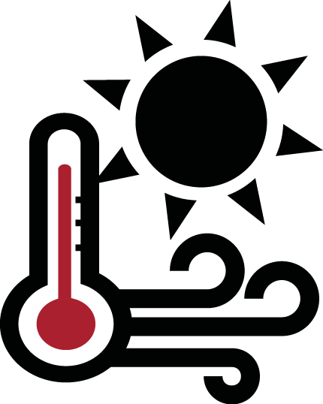
Prevent Wildfires
While Target Shooting.
Check the weather.
Be prepared to put out a fire.
Avoid shooting on hot, dry and windy days. Watch for fire danger ratings and red flag warnings.
Take a fire extinguisher, a bucket of water and a shovel.
Know your
ammo.
Put targets on dirt or gravel.
Ammunition with steel-core components can spark a wildfire.
Avoid shooting into dry grass and rocks that might cause sparks.
Exploding targets, tracer rounds and fireworks are prohibited on public lands.
Spokane Office
1103 N. Fancher Rd.
Spokane, WA 99212
509-536-1200
Wenatchee Office
915 N. Walla Walla
Wenatchee, WA 98801
509-665-2100
Restrictions pursuant to 43 C.F.R. 9212, on file at the Spokane District Bureau of Land Management.

