Slide 1
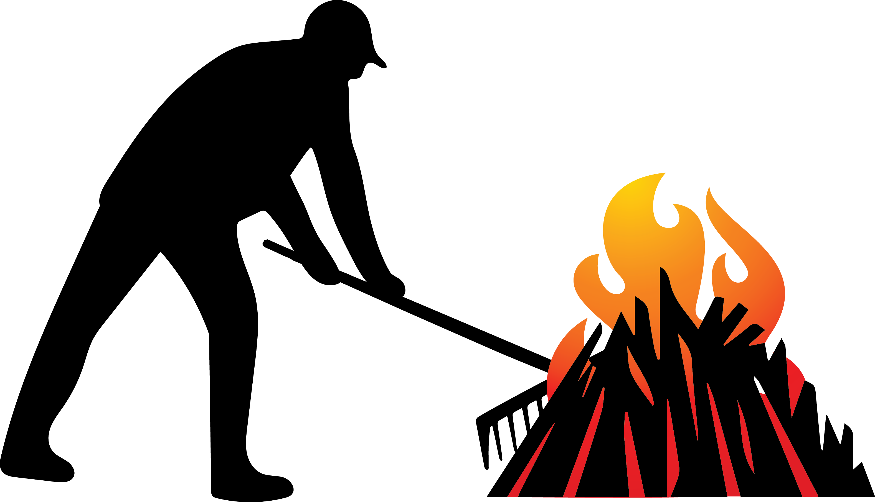
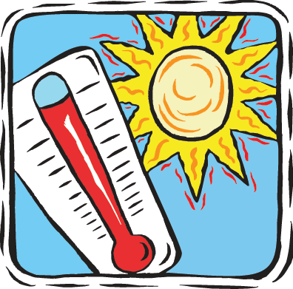
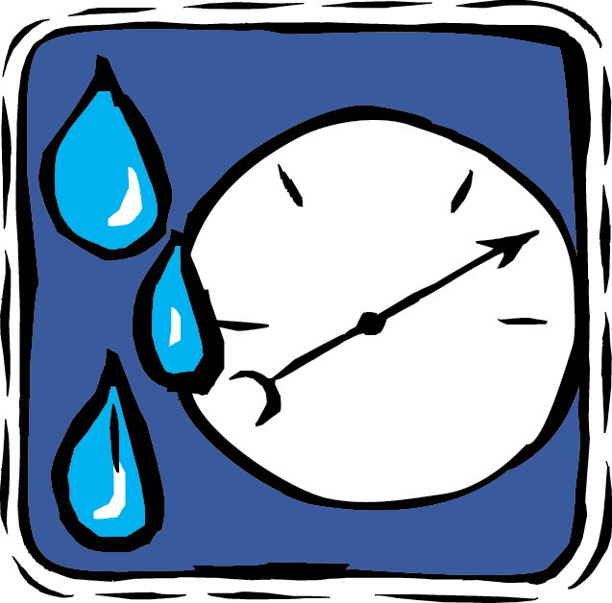
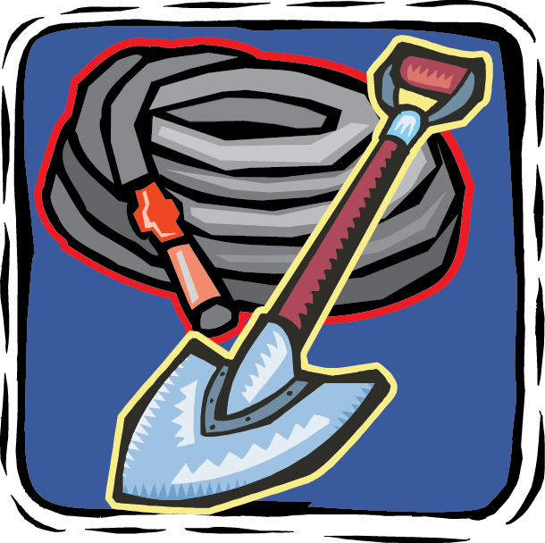
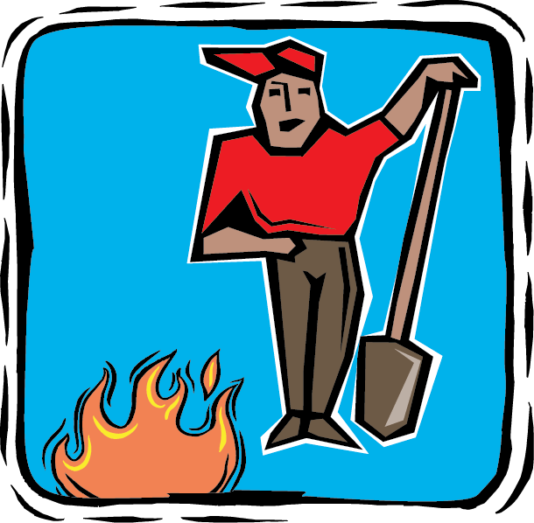
Burn permits are free and required for any burning outside city limits statewide.
www.pnwfac.org
Call your local fire department for local burning regulations.
Avoid burning on hot, dry, days, when a fire can easily get out of control.
Burn when the humidity is higher and the winds are calmer.
Clear vegetation for 10 feet around your burn pile. Keep your burn pile small.
Be prepared. Have a source of water and a shovel nearby.
Never leave your burn pile. Stay until it is completely out.
2015_08_19burnpiletips.pptx
Notes:
Be sure to change the burn permit and restriction information to match your agency/area policy, but remember to keep it very short and easy to read. You can also switch out logos and contact information. Logos are in the art_boards folder, in the agencylogos.pptx file. Always clear products you make with Public Affairs, Fire, Resource Specialists, Law Enforcement, Forest Supervisor, and cooperating agencies etc. to make sure they are correct.

Slide 2
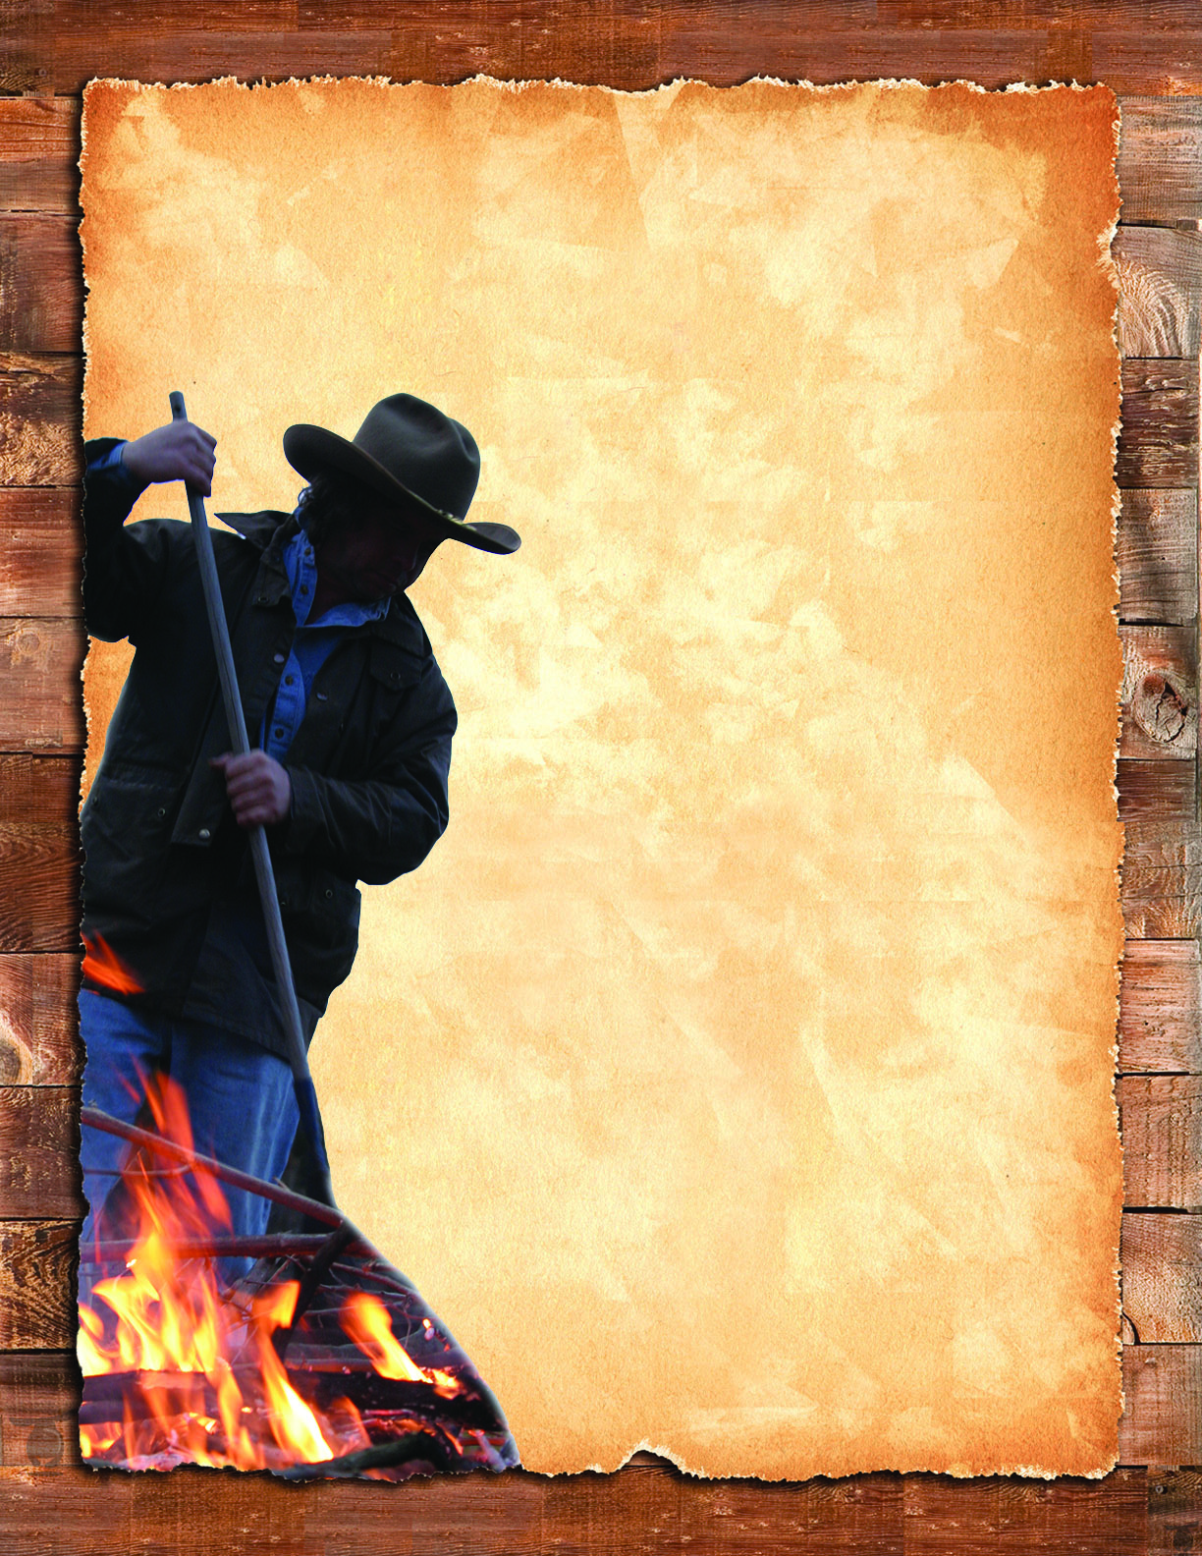
Call before you burn. Fire officials may designate certain days for burning based on weather and wind conditions.
Clear a 10-foot radius around your pile free of dead leaf litter and grass. Keep your burn small.
If it’s too hot to touch then it’s too hot leave. Make sure your debris burn is dead out before leaving.
Always have water and fire tools on site for quick suppression.
www.pnwfac.org
2015_08_19burnpiletips.pptx

Slide 3
Burn permits are free and required for any burning outside city limits statewide. Always check with local agencies for burn restrictions.
Call your local fire department for local burning regulations.
Avoid burning on hot, dry, days, when a fire can easily get out of control.
Burn when the humidity is higher and the winds are calmer.
Clear vegetation for 10 feet around your burn pile. Keep your burn pile small.
Be prepared. Have a source of water and a shovel nearby.
Never leave your burn pile. Stay until it is completely out.
2015_08_19burnpiletips.pptx
www.pnwfac.org
Notes:
Be sure to change the burn permit and restriction information to match your agency/area policy, but remember to keep it very short and easy to read. You can also switch out logos and contact information. Logos are in the art_boards folder, in the agencylogos.pptx file. Always clear products you make with Public Affairs, Fire, Resource Specialists, Law Enforcement, Forest Supervisor, and cooperating agencies etc. to make sure they are correct.

Slide 4
Call before you burn. Fire officials may designate certain days for burning based on weather and wind conditions.
Clear a 10-foot radius around your pile free of dead leaf litter and grass. Keep your burn small.
If it’s too hot to touch then it’s too hot leave. Make sure your debris burn is dead out before leaving.
Always have water and fire tools on site for quick suppression.
www.pnwfac.org
2015_08_19burnpiletips.pptx

Slide 5
Call before you burn. Fire officials may designate certain days for burning based on weather and wind conditions.
Clear a 10-foot radius around your pile free of dead leaf litter and grass. Please keep your burn small.
If it’s too hot to touch then it’s too hot leave. Make sure your debris burn is dead out before leaving.
Always have water and fire tools on site for quick suppression.
www.pnwfac.org
2015_08_19burnpiletips.pptx

