Slide 1
Spring on the Olympic Peninsula this year is the driest since 1895! That’s 130 years!
One inch of rain will protect the forest from wildfire for about 3 days! We need rain!
The forest looks green, but has only ½ of the moisture it should have, it’s a dry green, please be careful!
Snowpack on the mountains was less than 5% of average and melted off 4 month earlier than normal.
Spring on the Olympic Peninsula this year is the driest since 1895! That’s 130 years!
One inch of rain will protect the forest from wildfire for about 3 days! We need rain!
The forest looks green, but has only ½ of the moisture it should have, it’s a dry green, please be careful!
Snowpack on the mountains was less than 5% of average and melted off 4 month earlier than normal.
Spring on the Olympic Peninsula this year is the driest since 1895! That’s 130 years!
One inch of rain will protect the forest from wildfire for about 3 days! We need rain!
The forest looks green, but has only ½ of the moisture it should have, it’s a dry green, please be careful!
Snowpack on the mountains was less than 5% of average and melted off 4 month earlier than normal.
Spring on the Olympic Peninsula this year is the driest since 1895! That’s 130 years!
One inch of rain will protect the forest from wildfire for about 3 days! We need rain!
The forest looks green, but has only ½ of the moisture it should have, it’s a dry green, please be careful!
Snowpack on the mountains was less than 5% of average and melted off 4 month earlier than normal.
Notes:
This is a contact card that you can use to inform people of drought conditions. Agency logos can be changed; open the folder art_didyouknow and open the agencylogos.pptx file, copy, paste and resize your logo. Text and symbols can be switched based on most common fire causes. Please remember that you will probably have exceptions on wording… so the text can be changed to meet specific wording on orders. This product is printed front to back on the short edge.

Slide 2
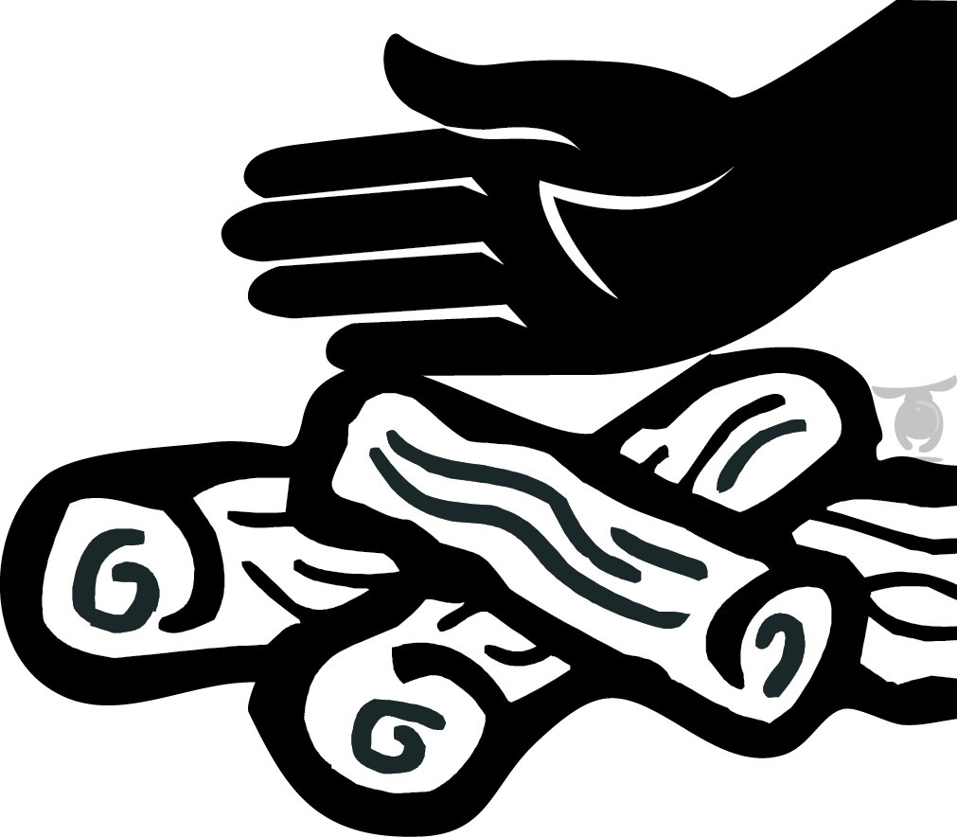
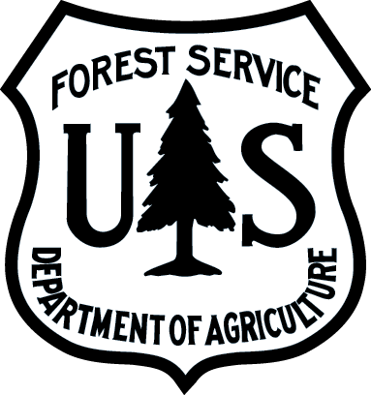
Now is not the time to take chances!
If it’s too hot to touch
Obey fire restrictions and encourage others to do the same.
If fires are allowed: Never leave fires or hot coals unattended. Before leaving, DROWN, STIR and carefully FEEL for heat.
Keep vehicles properly maintained with approved, clean spark arrestors. Stay on designated roads.
Fireworks are prohibited on public lands. Enjoy fireworks at sponsored local community events instead.
Make sure trailer chains are not dragging and creating a spark.
Avoid parking on or driving over dry, flammable vegetation.
When shooting: Know your target and what is beyond. Avoid dry grass. Use an established range when fire danger is high.
Use an ashtray. Do not discard smoking materials out your window or into dry grass.
Make sure your fire is dead out. Coals left burning can restart and spread.
Learn about fire restrictions at:
firerestrictions.us
Olympic National Forest
Olympic
National Forest
It’s too hot to leave!
2015_08_08didyouknowcard.pptx
LEARN
Check local offices, bulletin boards, websites and visitor centers for current fire restrictions.
DROWN
Drown the campfire ashes with lots of water. Don’t take chances–use a lot!
STIR
Stir the remains, add more water and stir again. Be sure all burned material has been put out cold.
FEEL
Feel materials with your bare hand. If it is hot to touch, it’s too hot to leave!
A backpacking stove is a great alternate source for cooking.
Use lanterns for light in place of a campfire.
The stars and darkness are a fun change from a campfire.
Learn more at Olympic National Forest: www.fs.usda.gov/olympic
Learn more at Olympic National Forest: www.fs.usda.gov/olympic
Notes:
You may want to change/switch out the back tips based on restrictions; if campfires are prohibited then “campfire safety” and “too hot to leave” might not be appropriate. Be sure to change the Agency name, logo and website address.

