Slide 1
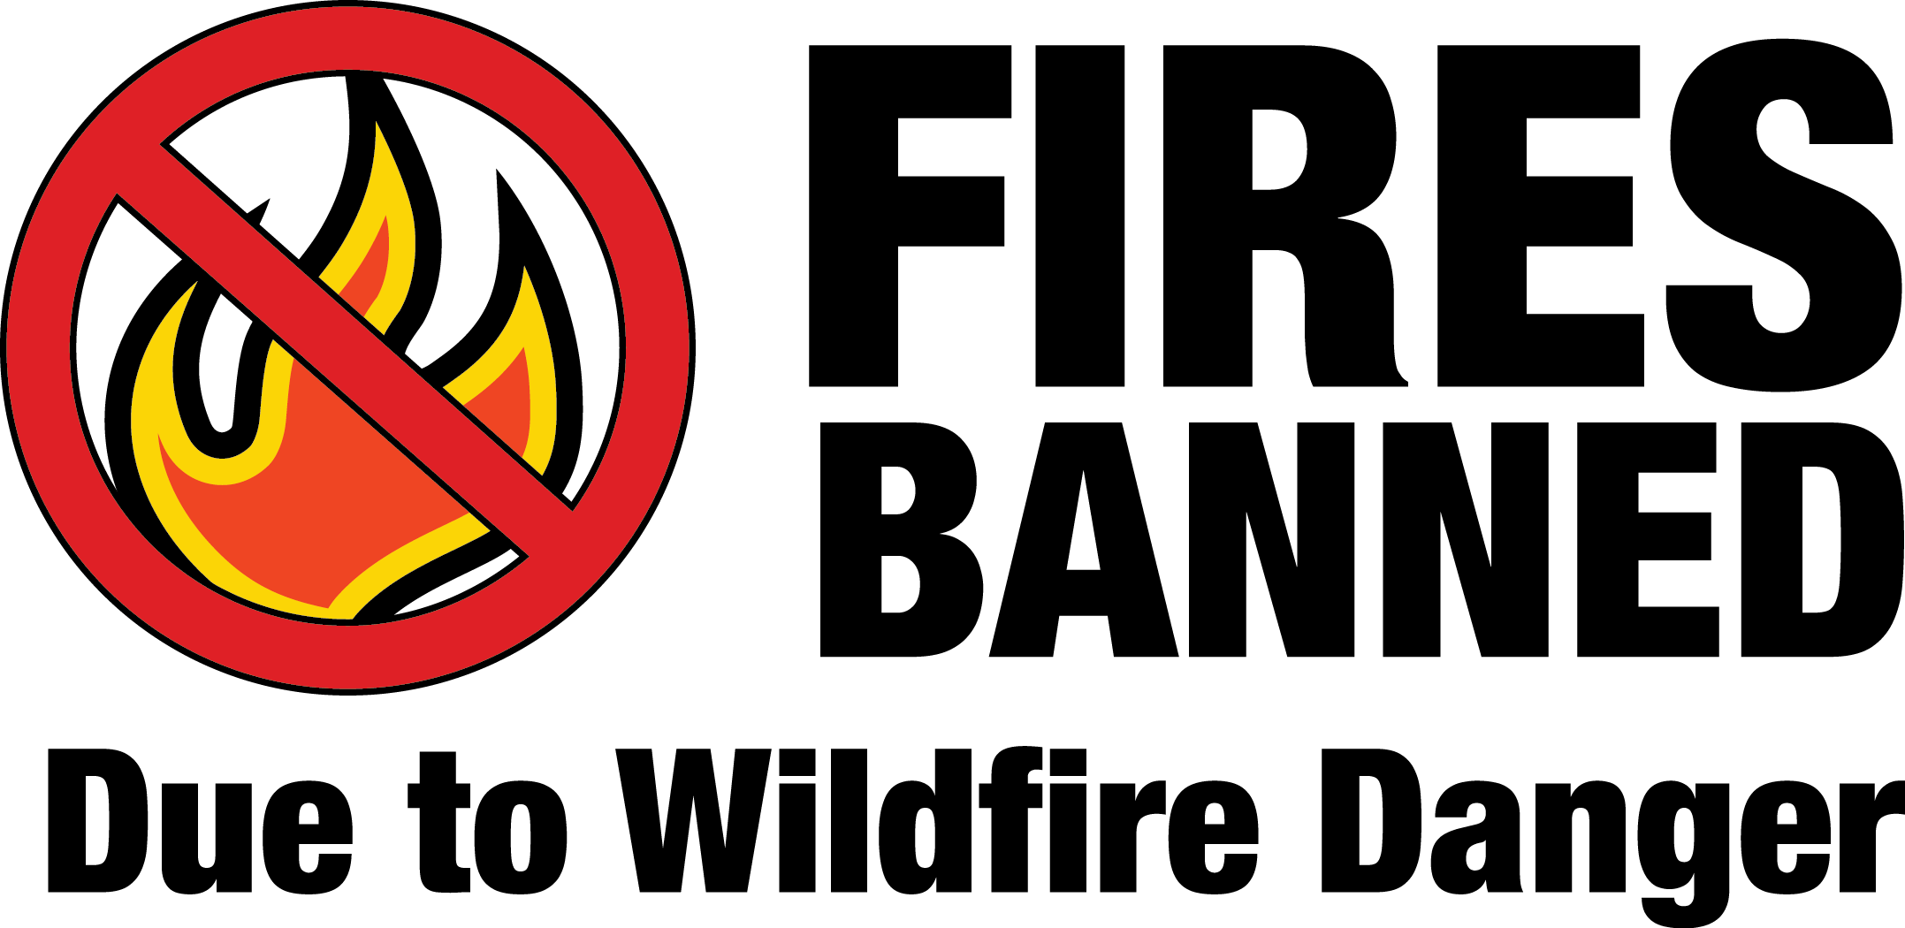
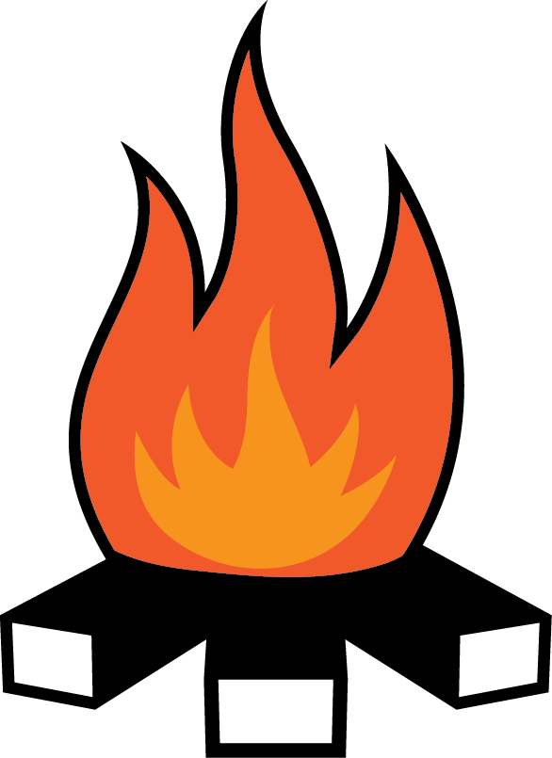
Campfires are only allowed in established metal fire rings within developed areas such as campgrounds.
No open fires are allowed in dispersed, backcounty areas.
Pressurized gas stoves and space heating devices that can be quickly turned off are allowed.
Wood and charcoal fires, charcoal grills, and portable braziers are prohibited.
Portable stoves and lanterns using liquid petroleum fuels.
Fires are prohibited in rock fire pits and rock fire rings.
2015_08_21firesbannedletter.pptx
Learn more at firerestrictions.us
United States Department of Agriculture
Forest Service
USDA is an equal opportunity provider, employer, and lender.
Olympic National Forest Supervisor's Office
1835 Black Lk Blvd SW (360) 956-2402
Olympia, WA 98512 TTD (360) 956-2401
Notes:
You can change the artwork for what is prohibited/permitted by deleting what is there, and relacing it with art from the restrictart.pptx file; just copy and paste. Since each Supervisor’s Order is different (dependent on Stage or IFPL), images might be different and the text will need to be changed to match the order. Check with the PAO for clarification in wording to make it simple yet accurate. Agency logos and addresses can be changed; open the art_firesbanned folder then open the agencylogos.pptx. Copy and paste your logo into this file, resize and add your contact information.

