Slide 1



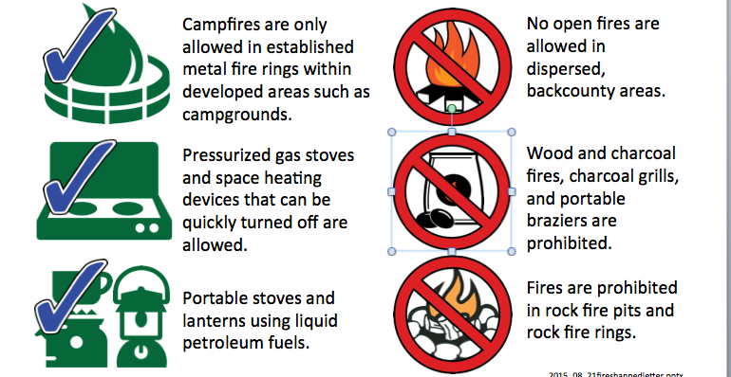



How to Use These Graphics
These graphics can be copied and pasted to customize restriction posters and flyers. It is assumed that the user will have basic operational familiarity with editing Powerpoint files; like how to copy, paste, move and resize graphics, and basic text formatting.
1.
Select a graphic from the following pages. You’ll see a blue box around it with handles when selected. From your menu bar: Edit>Copy or keyboard, ctrl C.
2.
Open the restriction file you want to edit. Do a File>Save As and give it a new name, so you do not overwrite your template. Then select the graphic you want to replace and delete it.
3.
Now you have a blank space to put in the new graphic that you copied. Edit>Paste or from keyboard, ctrl V. If needed, resize the graphic by selecting a corner and dragging it to the right size.
4.
Now you need to place the red “Do Not” circle over the graphic. Go back to restriction graphics page, select the red circle, From your menu bar: Edit>Copy or keyboard, ctrl C. GO back to your document, Edit>Paste or from keyboard, ctrl V. Move the red circle so it covers the other graphic.
5.
Sometimes the circle will need to be moved to the front. Select the circle, then from the menu bar choose Arrange> Bring to Front.
6.
When re-sizing graphics, always grab the corner, not the side, so it is proportional when resized.
Do not distort when resizing – don’t use the side handle.
Grab the corner to resize.
7.
Now you can edit the text. Select the text and type in or paste the new text. (Edit>Paste Special>Unformatted text allows you to copy it from another location, then when it’s pasted it uses the existing formatting). Try to keep it the same size as the other text items. It looks neater, more consistent and easier to read.
8.
Readability and accessibility standards need to be followed, so follow these tips:
Do not use red or orange text on a dark background; there is not enough contrast. Do not use yellow text on a white background.
Do not use special effects like drop shadows and glows.
Do not use a textured background – it makes text hard to read.
Do not use ornate fonts – they affect readabilty, and do not transfer if you send file to someone who does not have that font. Stick to common system fonts.

Slide 2





































Slide 3
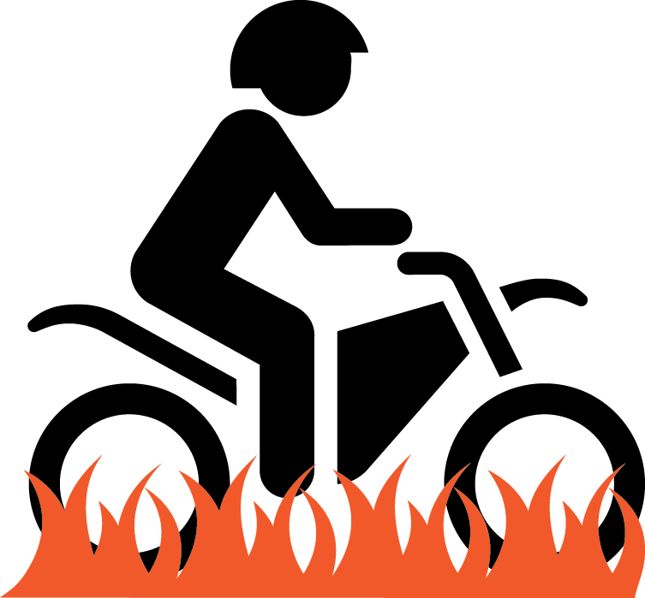





























Slide 4








