Slide 1
Possessing, discharging and/or using fireworks are prohibited on public lands.
Only You Can Prevent Wildfires.
2015_08_20fireworks.pptx
Notes:
You can change the wording based on your agency’s restrictions. Wording on explosives could also be added. Agency logos and addresses can be changed; open the art_fireworks folder then open the agencylogos.pptx. Copy and paste your logo into this file, resize and add your contact information.

Slide 2
Possessing, discharging and/or using fireworks are prohibited on public lands.
Only You Can
Prevent Wildfires.
2015_08_20fireworks.pptx

Slide 3
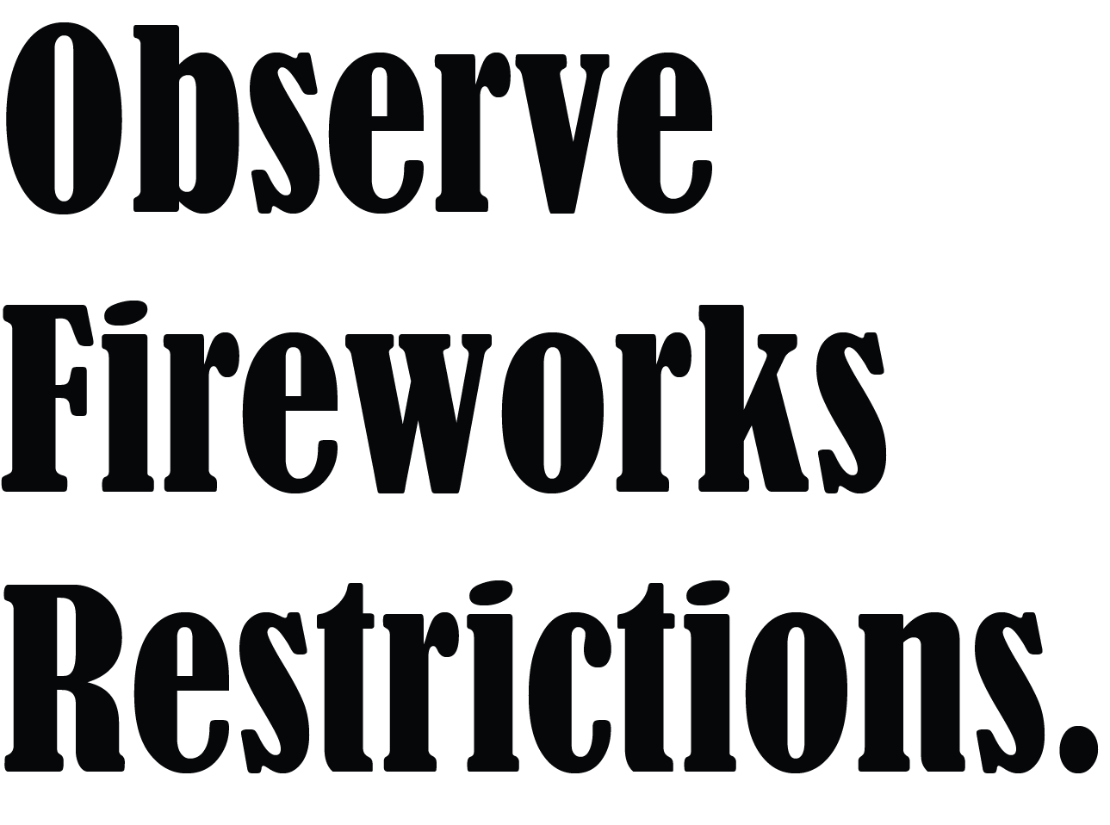
2015_08_20fireworks.pptx

Slide 4
2015_08_20fireworks.pptx

