Slide 1
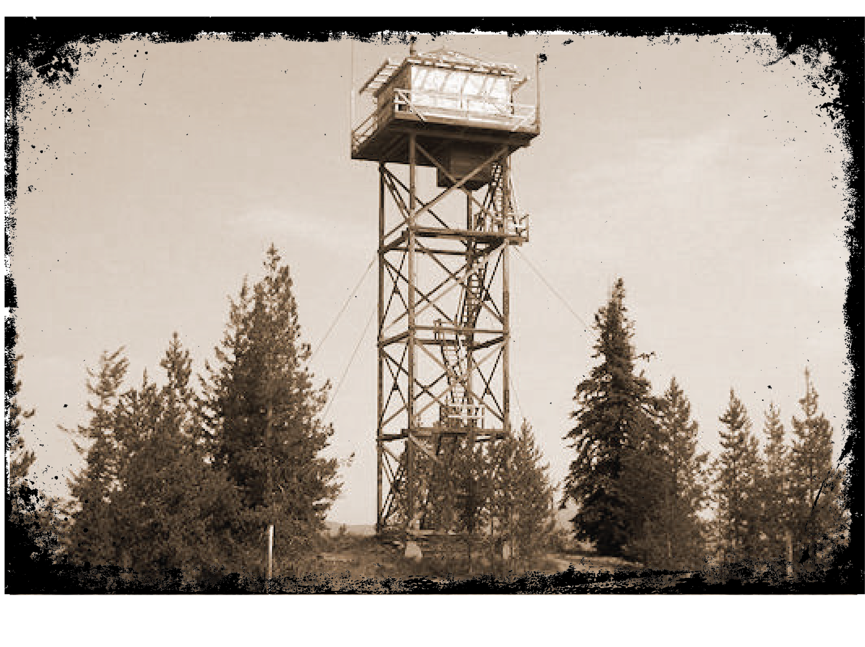
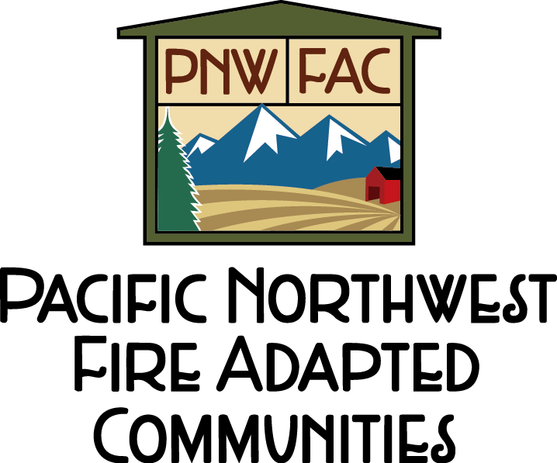
Together we can protect our memories of people, places and events from wildfires.
Visit www.pnwfac.org
2015_08_19preservepast.pptx
Notes:
Use this poster in areas where wildfires might threaten historic areas valued by the public. Delete this photo and insert local historic site photo. Change the text and add your agency’s logo by going to the art_heritage folder, and opening the agencylogos.pptx file, then copy and paste your logo into this document. Resize the photo and add your contact information.

Slide 2
Together we can protect our memories of people, places and events from wildfires.
Visit www.pnwfac.org
2015_08_19preservepast.pptx

