Slide 1
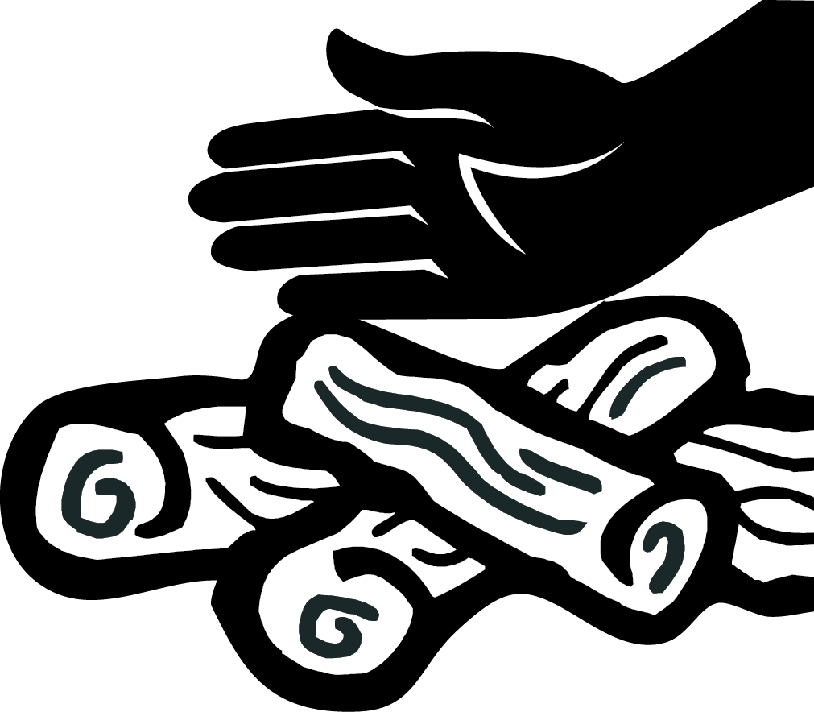
¡Ahora no es el momento de arriesgarse!
¡Si está demasiado caliente para tocar,
Obedezca las restricciones de fuego y aliente a los demás a que hagan lo mismo.
Asegúrese de que su fuego esté apagado por completo. Las brasas que se dejan encendidas pueden reavivarse y propagarse.
Obtenga información sobre restricciones de fuego en:
firerestrictions.us
Si se autoriza encender fuego: nunca deje el fuego o las brasas encendidas sin atender. Antes de marcharse, AHOGUE, MEZCLE y SIENTA cuidadosamente el calor.
Realíceles un mantenimiento adecuado a los vehículos con parachispas aprobados y limpios. Manténgase sobre las carreteras y/o carriles designados.
Los fuegos artificiales están prohibidos en terrenos públicos. En cambio, disfrute de los fuegos artificiales en eventos comunitarios locales patrocinados.
Los fuegos artificiales están prohibidos en terrenos públicos. En cambio, disfrute de los fuegos artificiales en eventos comunitarios locales patrocinados.
Asegúrese de que las cadenas del tráiler no estén arrastrando ni produciendo chispas.
Evite estacionar o conducir sobre vegetación seca e inflamable.
Cuando dispare: conozca su objetivo y lo que se encuentra detrás. Seleccione un área sin vegetación. Utilice un rango establecido cuando el peligro de incendio sea alto.
Olympic
National Forest
está demasiando caliente para abandonarlo!
Olympic
National Forest
2015_08_21SPpatrolcard.pptx
Seguridad de
las fogatas
Alternativas de fogatas
OBTENGA INFORMACIÓN
Revise las oficinas locales, los tableros de información, los sitios web y los centros para visitantes para conocer las restricciones de fuego actuales.
AHOGUE
Ahogue las cenizas de la fogata con mucha agua. No se arriesgue, ¡use mucha cantidad!
MEZCLE
Mezcle los restos, agregue más agua y vuelva a mezclar. Asegúrese de que todo el material quemado haya quedado frío.
SIENTA
Sienta los materiales con la mano desnuda. ¡Si está demasiado caliente para tocar, está demasiando caliente para abandonarlo!
Una estufa de campaña es una fuente alternativa excelente para cocinar.
Lleve algunas velas. Utilícelas en lugar de hacer una fogata.
Las estrellas y la oscuridad son una alternativa divertida en comparación con una fogata.
Obtenga más información en : www.fs.usda.gov/olympic
Obtenga más información en : www.fs.usda.gov/olympic

Slide 2
As of today’s date, _________, our public lands are under fire restrictions. Restrictions are subject to change. Violators can be fined and/or face imprisonment. We have observed the following violations:
As of today’s date, _________, our public lands are under fire restrictions. Restrictions are subject to change. Violators can be fined and/or face imprisonment. We have observed the following violations:
Fire outside an agency-designated recreation site
Smoking when not surrounded by 3 feet of cleared ground
Fire outside concrete or metal ring at an agency-designated recreation site
Use and or possession of fireworks on public lands
Unsafe shooting practices or shooting in violation of restrictions.
Charcoal briquettes used in grills outside of agency-designated recreation sites
Other:
Igniting, building, maintaining, attending or using a fire on public lands when restrictions are in effect
Smoking outside an enclosed vehicle or building
Operating motorized vehicles off of designated roads and trails
Operating a chainsaw outside hours listed in restrictions
Operating an internal combustion engine without a working spark arrestor
Fire outside an agency-designated recreation site
Smoking when not surrounded by 3 feet of cleared ground
Fire outside concrete or metal ring at an agency-designated recreation site
Use and or possession of fireworks on public lands
Unsafe shooting practices or shooting in violation of restrictions.
Charcoal briquettes used in grills outside of agency-designated recreation sites
Other:
Igniting, building, maintaining, attending or using a fire on public lands when restrictions are in effect
Smoking outside an enclosed vehicle or building
Operating motorized vehicles off of designated roads and trails
Operating a chainsaw outside hours listed in restrictions
Operating an internal combustion engine without a working spark arrestor
As of today’s date, _________, our public lands are under fire restrictions. Restrictions are subject to change. Violators can be fined and/or face imprisonment. We have observed the following violations:
As of today’s date, _________, our public lands are under fire restrictions. Restrictions are subject to change. Violators can be fined and/or face imprisonment. We have observed the following violations:
Fire outside an agency-designated recreation site
Smoking when not surrounded by 3 feet of cleared ground
Fire outside concrete or metal ring at an agency-designated recreation site
Use and or possession of fireworks on public lands
Unsafe shooting practices or shooting in violation of restrictions.
Charcoal briquettes used in grills outside of agency-designated recreation sites
Other:
Igniting, building, maintaining, attending or using a fire on public lands when restrictions are in effect
Smoking outside an enclosed vehicle or building
Operating motorized vehicles off of designated roads and trails
Operating a chainsaw outside hours listed in restrictions
Operating an internal combustion engine without a working spark arrestor
Fire outside an agency-designated recreation site
Smoking when not surrounded by 3 feet of cleared ground
Fire outside concrete or metal ring at an agency-designated recreation site
Use and or possession of fireworks on public lands
Unsafe shooting practices or shooting in violation of restrictions.
Charcoal briquettes used in grills outside of agency-designated recreation sites
Other:
Igniting, building, maintaining, attending or using a fire on public lands when restrictions are in effect
Smoking outside an enclosed vehicle or building
Operating motorized vehicles off of designated roads and trails
Operating a chainsaw outside hours listed in restrictions
Operating an internal combustion engine without a working spark arrestor
Notes:
This is a contact card that LEOs and other agency field personnel can use to inform people of violations of restrictions, in lieu of a ticket* or when visitors are not on site. Agency logo can be changed; open the art_patrolcard folder, then open the agencylogos.pptx file and copy/paste your agency’s logo. The text and symbols can be switched based on most common fire causes. Please remember that you will probably have exceptions on wording… so the text can be changed to meet specific wording on orders.
* If restrictions have been enacted but signs and flyers have not yet been posted… ie the visitor says “I did not know” or “I did not see a sign”.
These should be printed on bright cardstock (Astrobright yellow or green)

