Slide 1
As of today’s date, _________, our public lands are under fire restrictions. Restrictions are subject to change. Violators can be fined and/or face imprisonment. We have observed the following violations:
As of today’s date, _________, our public lands are under fire restrictions. Restrictions are subject to change. Violators can be fined and/or face imprisonment. We have observed the following violations:
Fire outside an agency-designated recreation site
Smoking when not surrounded by 3 feet of cleared ground
Fire outside concrete or metal ring at an agency-designated recreation site
Use and or possession of fireworks on public lands
Unsafe shooting practices or shooting in violation of restrictions.
Charcoal briquettes used in grills outside of agency-designated recreation sites
Other:
Igniting, building, maintaining, attending or using a fire on public lands when restrictions are in effect
Smoking outside an enclosed vehicle or building
Operating motorized vehicles off of designated roads and trails
Operating a chainsaw outside hours listed in restrictions
Operating an internal combustion engine without a working spark arrestor
Fire outside an agency-designated recreation site
Smoking when not surrounded by 3 feet of cleared ground
Fire outside concrete or metal ring at an agency-designated recreation site
Use and or possession of fireworks on public lands
Unsafe shooting practices or shooting in violation of restrictions.
Charcoal briquettes used in grills outside of agency-designated recreation sites
Other:
Igniting, building, maintaining, attending or using a fire on public lands when restrictions are in effect
Smoking outside an enclosed vehicle or building
Operating motorized vehicles off of designated roads and trails
Operating a chainsaw outside hours listed in restrictions
Operating an internal combustion engine without a working spark arrestor
2015_08_21patrolcard.pptx
As of today’s date, _________, our public lands are under fire restrictions. Restrictions are subject to change. Violators can be fined and/or face imprisonment. We have observed the following violations:
As of today’s date, _________, our public lands are under fire restrictions. Restrictions are subject to change. Violators can be fined and/or face imprisonment. We have observed the following violations:
Fire outside an agency-designated recreation site
Smoking when not surrounded by 3 feet of cleared ground
Fire outside concrete or metal ring at an agency-designated recreation site
Use and or possession of fireworks on public lands
Unsafe shooting practices or shooting in violation of restrictions.
Charcoal briquettes used in grills outside of agency-designated recreation sites
Other:
Igniting, building, maintaining, attending or using a fire on public lands when restrictions are in effect
Smoking outside an enclosed vehicle or building
Operating motorized vehicles off of designated roads and trails
Operating a chainsaw outside hours listed in restrictions
Operating an internal combustion engine without a working spark arrestor
Fire outside an agency-designated recreation site
Smoking when not surrounded by 3 feet of cleared ground
Fire outside concrete or metal ring at an agency-designated recreation site
Use and or possession of fireworks on public lands
Unsafe shooting practices or shooting in violation of restrictions.
Charcoal briquettes used in grills outside of agency-designated recreation sites
Other:
Igniting, building, maintaining, attending or using a fire on public lands when restrictions are in effect
Smoking outside an enclosed vehicle or building
Operating motorized vehicles off of designated roads and trails
Operating a chainsaw outside hours listed in restrictions
Operating an internal combustion engine without a working spark arrestor
Notes:
This is a contact card that LEOs and other agency field personnel can use to inform people of violations of restrictions, in lieu of a ticket* or when visitors are not on site. Agency logo can be changed; open the art_patrolcard folder, then open the agencylogos.pptx file and copy/paste your agency’s logo. The text and symbols can be switched based on most common fire causes. Please remember that you will probably have exceptions on wording… so the text can be changed to meet specific wording on orders.
* If restrictions have been enacted but signs and flyers have not yet been posted… ie the visitor says “I did not know” or “I did not see a sign”.
These should be printed on bright cardstock (Astrobright yellow or green)

Slide 2
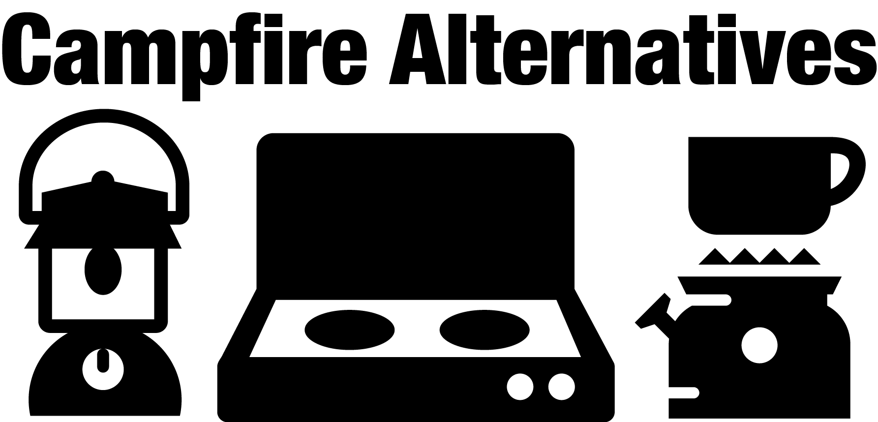
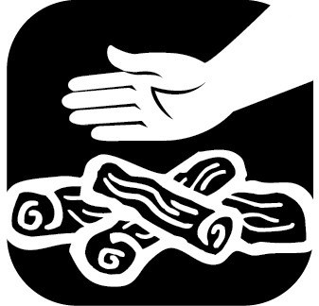
Now is not the time to take chances!
If it’s too hot to touch
Obey fire restrictions and encourage others to do the same.
If fires are allowed: Never leave fires or hot coals unattended. Before leaving, DROWN, STIR and carefully FEEL for heat.
Keep vehicles properly maintained with approved, clean spark arrestors. Stay on designated roads and/or trails.
Fireworks are prohibited on public lands. Enjoy fireworks at sponsored local community events instead.
Make sure trailer chains are not dragging and creating a spark.
Avoid parking on or driving over dry, flammable vegetation.
When shooting: Know your target and what is beyond. Select an area free of vegetation.
Use an ashtray. Do not discard smoking materials out your window or into dry grass.
Make sure your fire is dead out. Coals left burning can restart and spread.
Learn about fire restrictions at:
www.firerestrictions.us
(Name) National Forest
(name)
National Forest
It’s too hot to leave!
2015_08_21patrolcard.pptx
LEARN
Check local offices, bulletin boards, websites and visitor centers for current fire restrictions.
DROWN
Drown the campfire ashes with lots of water. Don’t take chances–use a lot!
STIR
Stir the remains, add more water and stir again. Be sure all burned material has been put out cold.
FEEL
Feel materials with your bare hand. If it is hot to touch, it’s too hot to leave!
A backpacking stove is a great alternate source for cooking.
Use lanterns for light in place of a campfire.
The stars and darkness are a fun change from a campfire.
Learn more at (name) National Forest: www.fs.usda.gov/name
Learn more at (name) National Forest: www.fs.usda.gov/name

