Slide 1
Set an example and encourage others to protect our public lands from wildfires.
Check restrictions and closures. Are campfires allowed?
Check weather conditions and forecast.
Don’t smoke, park, drive or shoot near dry grass.
2015_08_19respectlands.pptx
Notes:
The text is editable, so you can change the wording if you want to add more specific fire tips based on fire cause, or what restriction level you are in (ie campfires). You can also switch out logos and contact information. Logos are in the art_target folder, in the agencylogos.pptx file. You can copy and paste them into this file and add your agency contact information. Always clear products you make with Public Affairs, Fire, Resource Specialists, Law Enforcement, Forest Supervisor etc. to make sure they are correct.

Slide 2
Set an example and encourage others to protect our public lands from wildfires.
Check restrictions and closures. Are campfires allowed?
Make sure your campfire is DEAD OUT.
Check weather conditions and forecast.
Don’t smoke, park or near dry grass.
2015_08_19respectlands.pptx

Slide 3
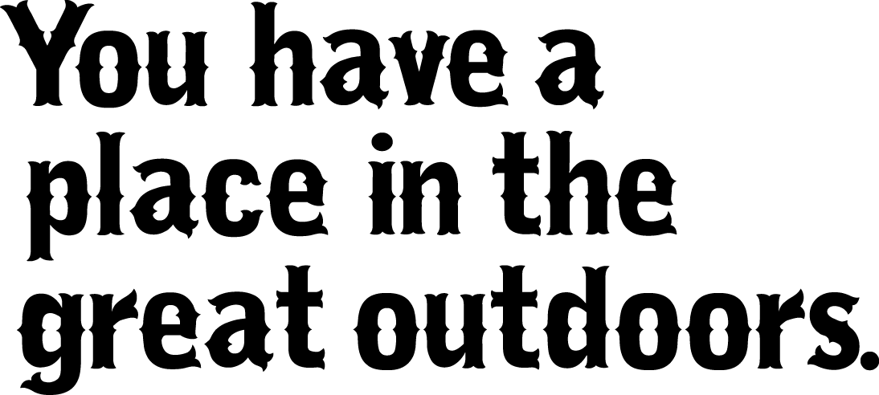
Conserving recreation access and opportunities starts with you. Help protect our public lands from wildfires.
Check restrictions and closures. Are campfires allowed?
Check weather conditions and forecast.
If fire danger is high, consider a campfire alternative for cooking.
Don’t smoke, park or near dry grass.
2015_08_19respectlands.pptx

