Slide 1
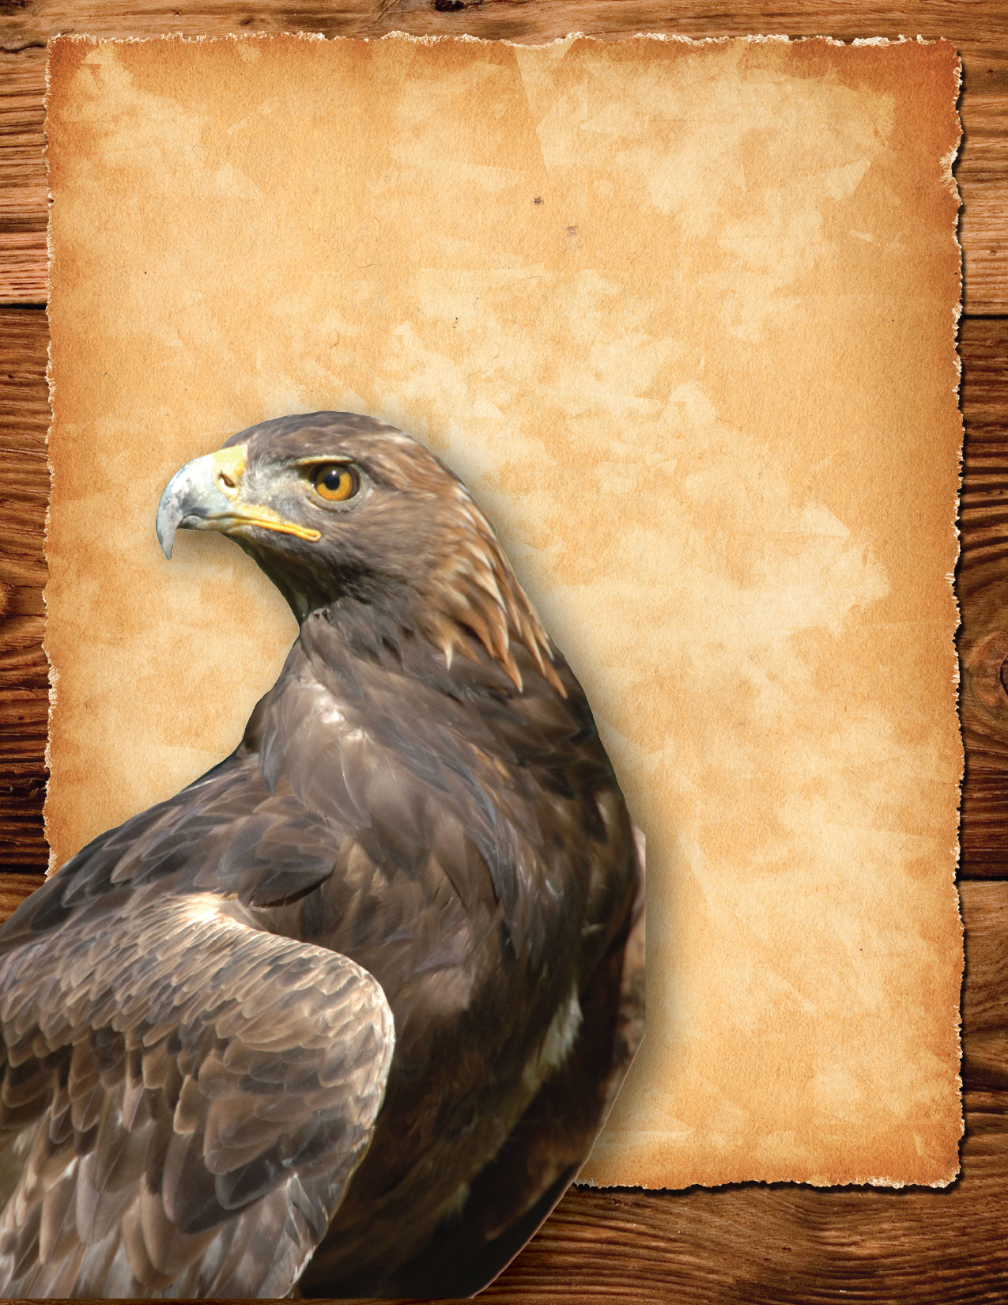
Desirable sagebrush provides habitat for the sagebrush lizard, greater sage-grouse, golden eagle, pygmy rabbit, mule deer, pronghorn, elk and other native species.
Wildfires kill sagebrush and cheatgrass takes its place.
Cheatgrass displaces native plant species that provide habitat for wildlife.
Golden Eagle
www.pnwfac.org

Slide 2
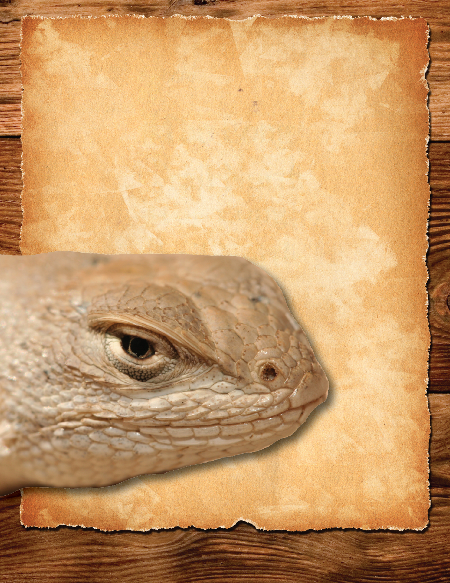
Desirable sagebrush provides habitat for the sagebrush lizard, greater sage-grouse, golden eagle, pygmy rabbit, mule deer, pronghorn, elk and other native species.
Wildfires kill sagebrush and cheatgrass takes its place.
Cheatgrass displaces native plant species that provide habitat for wildlife.
Sagebrush lizard
www.pnwfac.org

Slide 3
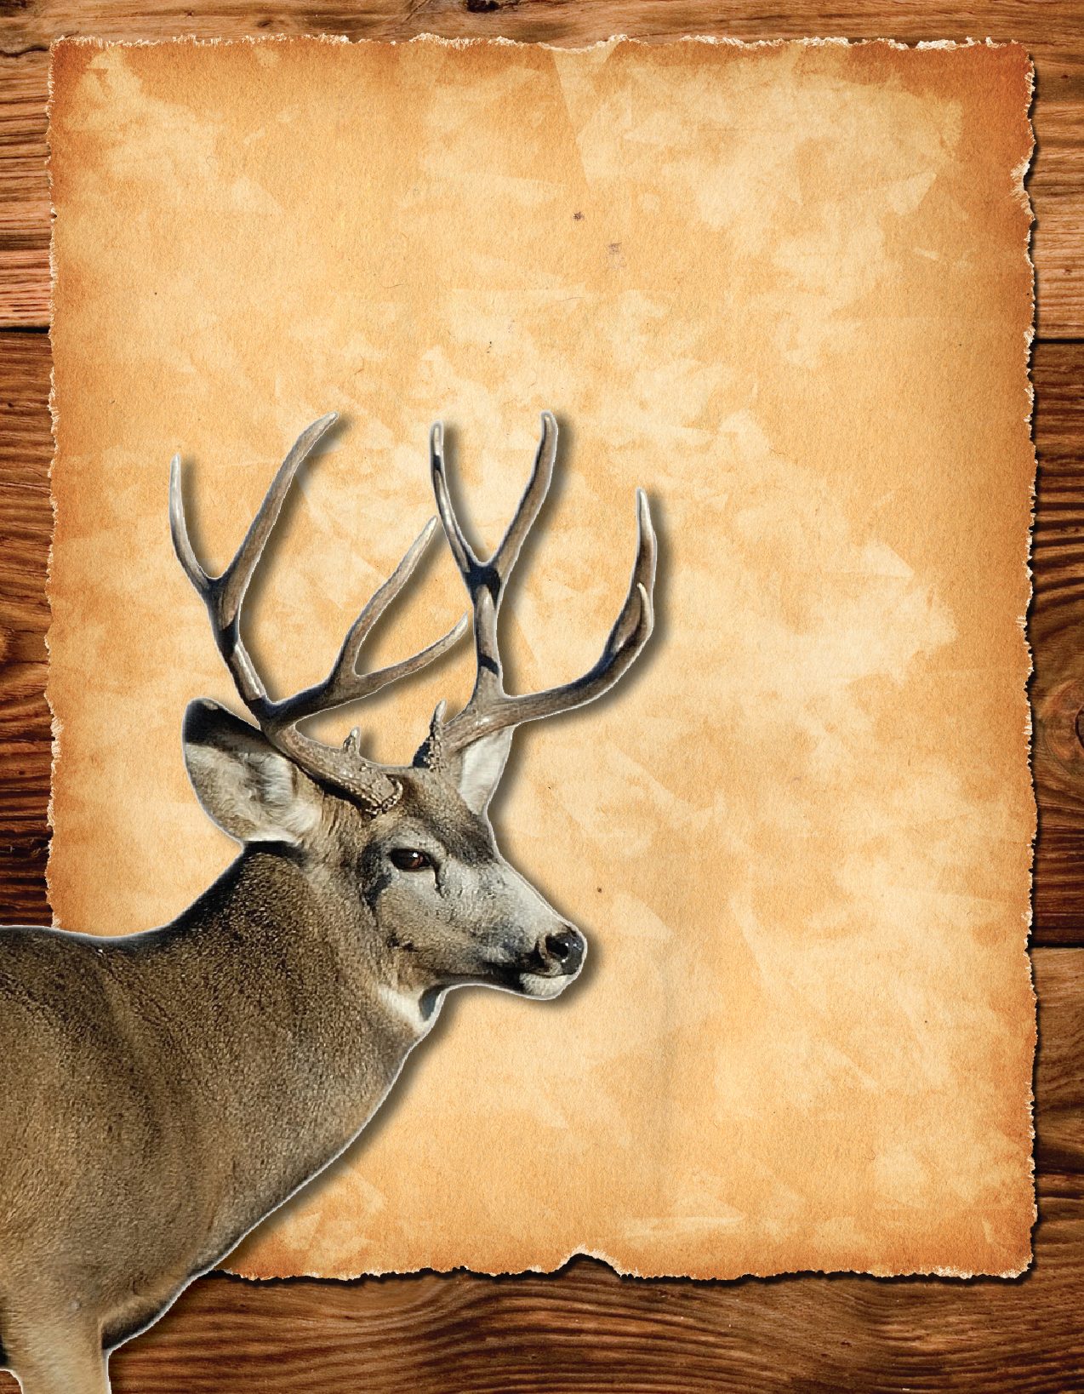
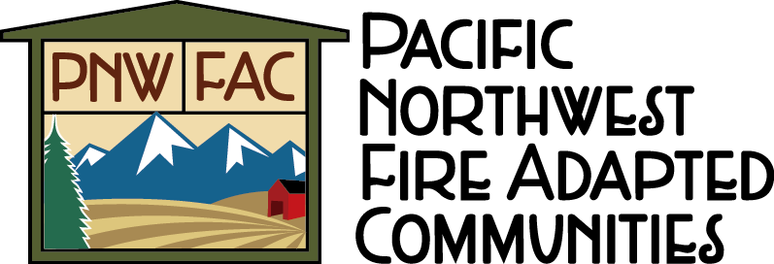
Desirable sagebrush provides habitat for the sagebrush lizard, greater sage-grouse, golden eagle, pygmy rabbit, mule deer, pronghorn, elk and other native species.
Wildfires kill sagebrush and cheatgrass takes its place.
Cheatgrass displaces native plant species that provide habitat for wildlife.
Mule deer
www.pnwfac.org

Slide 4
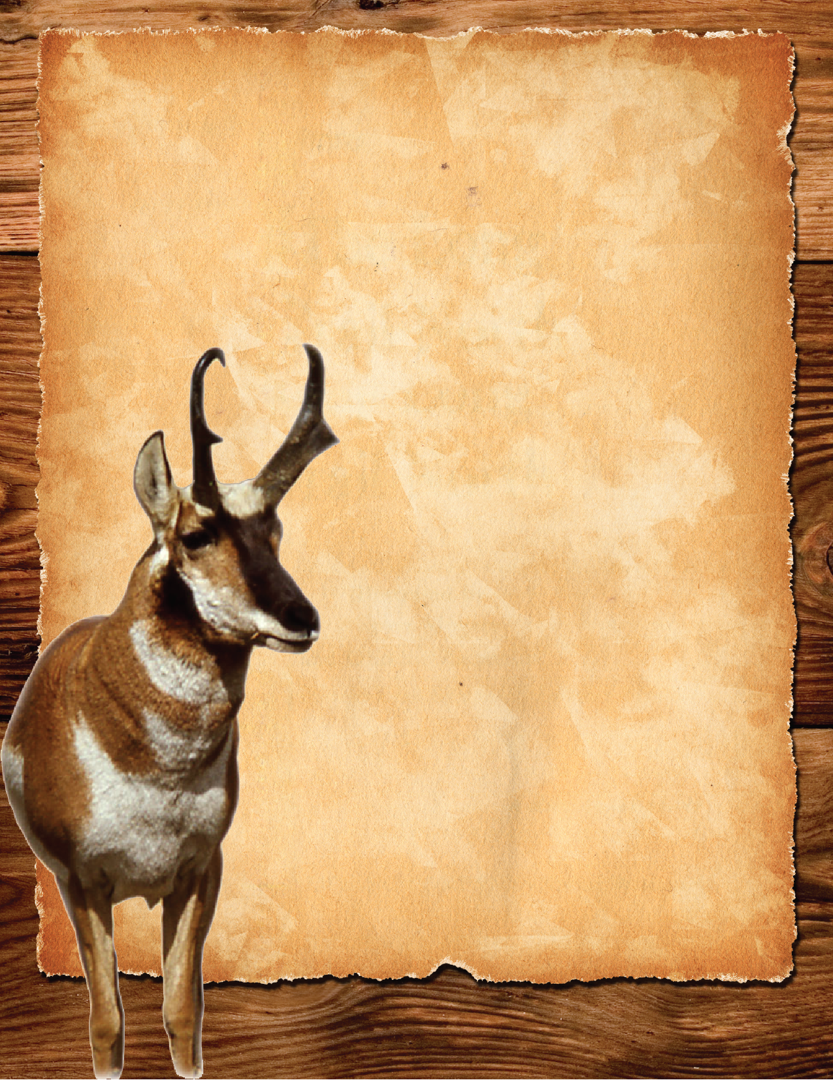
Pronghorn
Desirable sagebrush provides habitat for the sagebrush lizard, greater sage-grouse, golden eagle, pygmy rabbit, mule deer, pronghorn, elk and other native species.
Wildfires kill sagebrush and cheatgrass takes its place.
Cheatgrass displaces native plant species that provide habitat for wildlife.
www.pnwfac.org

Slide 5
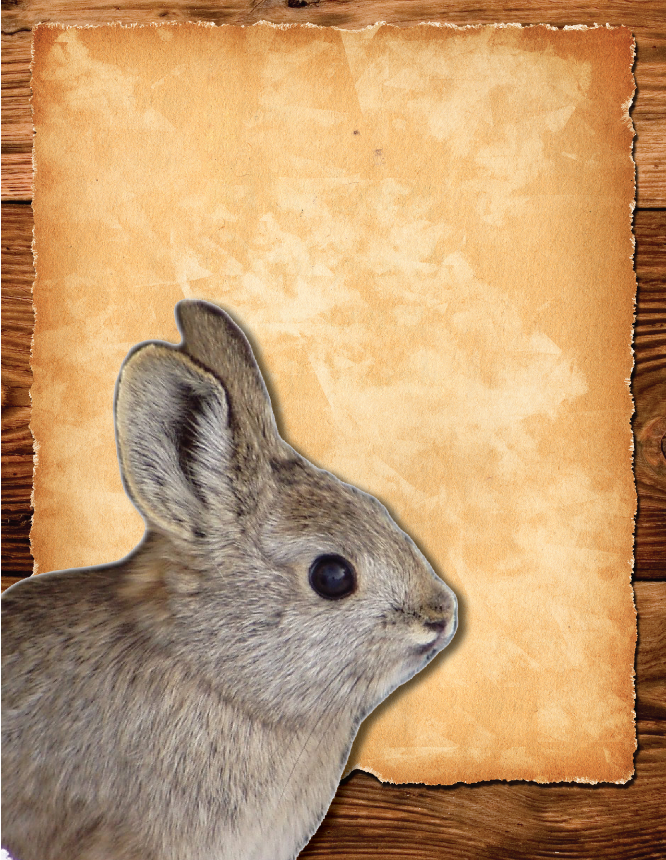
Desirable sagebrush provides habitat for the sagebrush lizard, greater sage-grouse, golden eagle, pygmy rabbit, mule deer, pronghorn, elk and other native species.
Wildfires kill sagebrush and cheatgrass takes its place.
Cheatgrass displaces native plant species that provide habitat for wildlife.
Pygmy rabbit
www.pnwfac.org

Slide 6
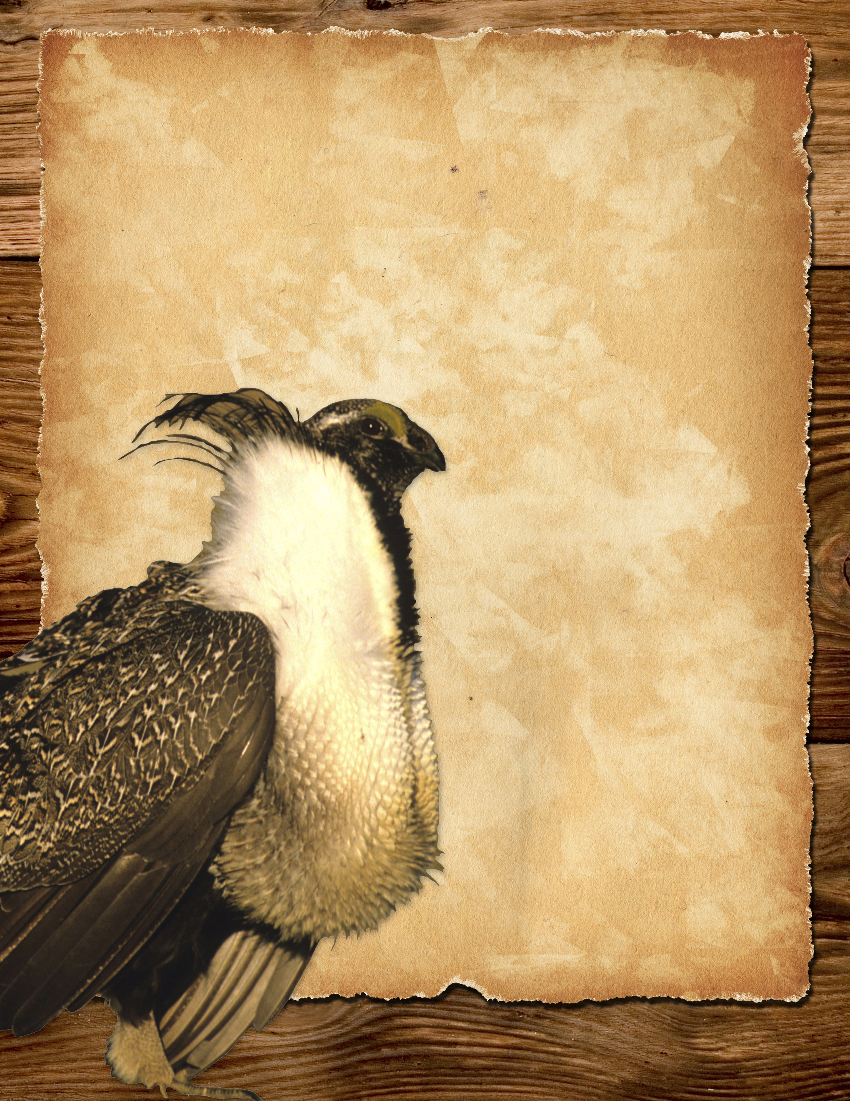
Desirable sagebrush provides habitat for the sagebrush lizard, greater sage-grouse, golden eagle, pygmy rabbit, mule deer, pronghorn, elk and other native species.
Wildfires kill sagebrush and cheatgrass takes its place.
Cheatgrass displaces native plant species that provide habitat for wildlife.
Greater
sage-grouse
www.pnwfac.org

