Slide 1
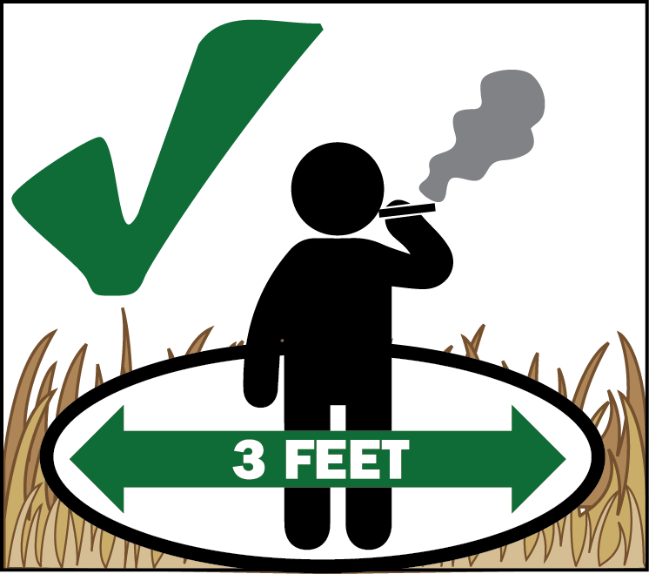
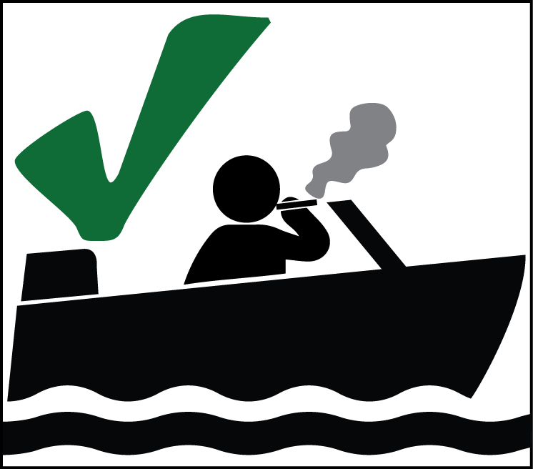
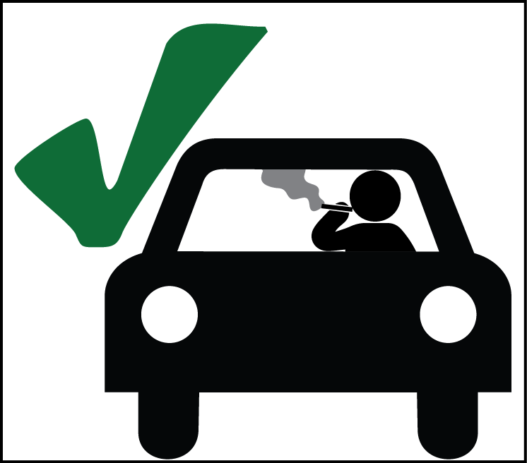
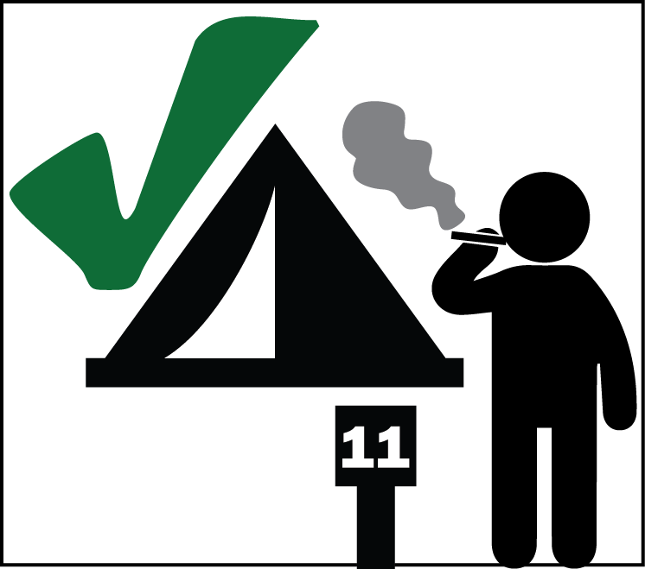
On National Forest Lands
Smoking is prohibited due to high fire danger. Even though there are exceptions, extreme care must be taken with all smoking materials.
Clear an area at least 3 feet in diameter down to bare dirt.
Extinguish all smoking materials dead out before leaving the cleared area.
Always use your ash tray when smoking in your vehicle.
Do not smoke while walking.
You can smoke in enclosed vehicle or building, in a designated campground, in boats on lakes and rivers, or while stopped in an area at least 3 feet in diameter that is clear of all flammable material.
National Forests, National Parks and state lands might have different restrictions based on fire danger for that area. These restrictions are subject to change based on current conditions. Always check with with your local land management agency when planning your trip outdoors!
2015_08_28smokingbannedletter.pptx
Learn more at fs.usda.gov/forestname
United States Department of Agriculture
Forest Service
USDA is an equal opportunity provider, employer, and lender.
(Name) National Forest Supervisor's Office
Street Address Office Phone
City, State, Zip TTD phone
Notes:
Since each Supervisor’s Order is different (dependent on Stage or IFPL), images might be different and the text will need to be changed to match the order. Check with the PAO for clarification in wording to make it simple yet accurate. Agency logos and addresses can be changed; open the art_firesbanned folder then open the agencylogos.pptx. Copy and paste your logo into this file, resize and add your contact information.

