Slide 1
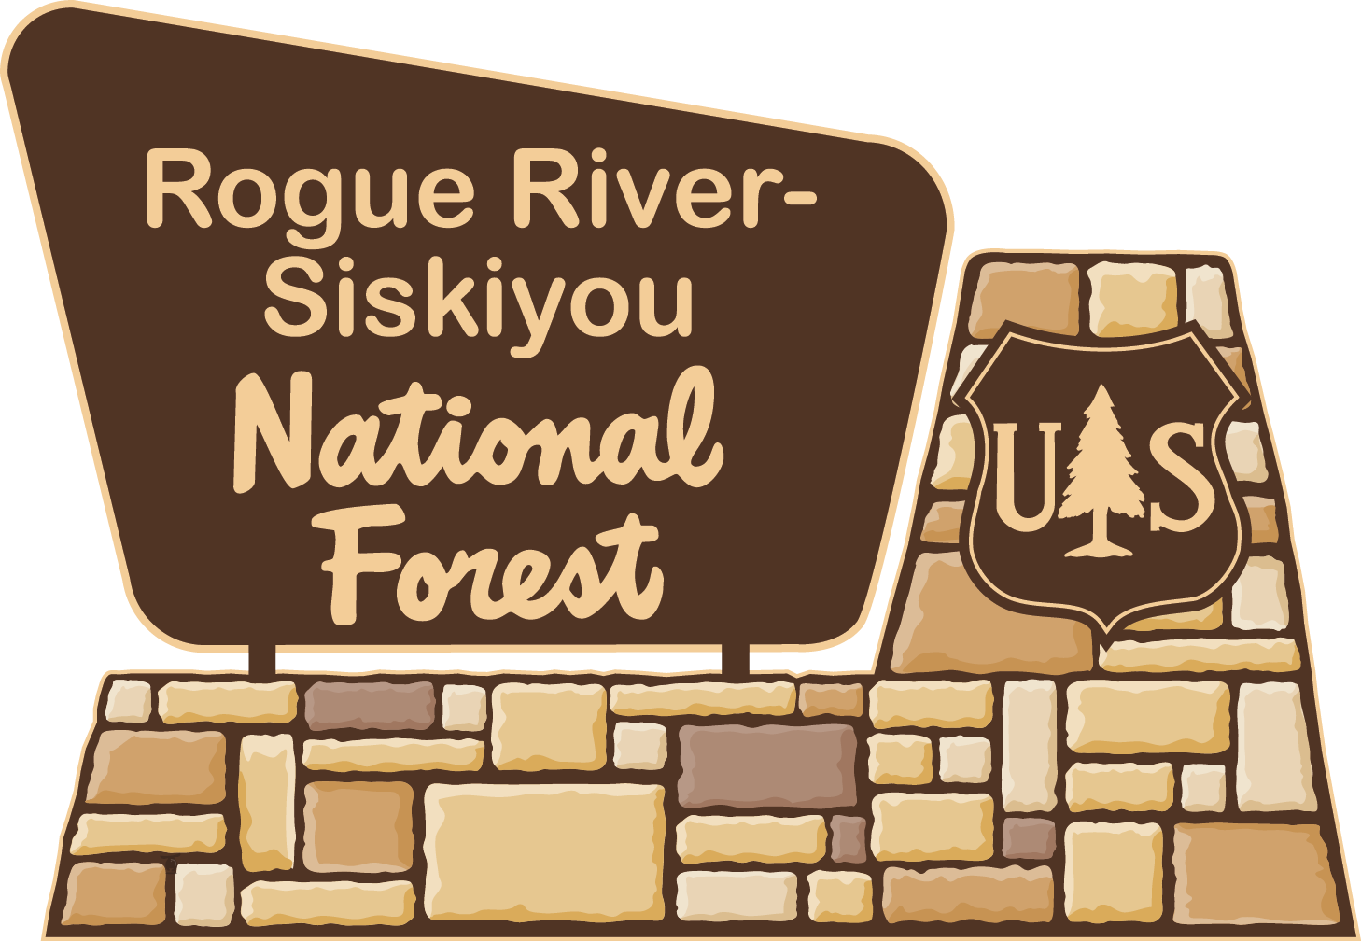
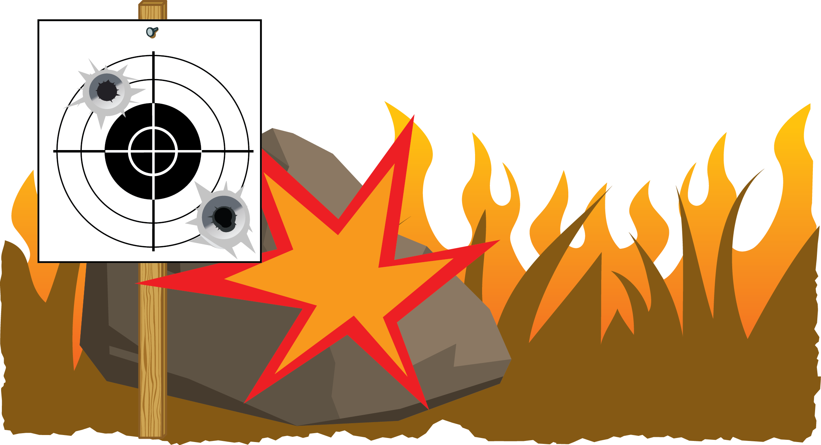
Bring a shovel and water or fire extinguisher to put out a fire.
Place your targets on dirt or gravel, away from grass.
If fire danger is high, consider shooting at an established outdoor or indoor range.
Don’t shoot with steel core ammo.
Exploding targets and tracer ammunition are Illegal during fire season.
Don’t shoot trash like TVs or other appliances.
Don’t smoke or park near dry grass.
Rogue River-Siskiyou
National Forest
3040 Biddle Road
Medford, OR
541-618-2200
pnwfac.org
2015_07_20shootdrygrassbarn.pptx
Notes:
The text is editable, so you can change the wording if regulations change especially concerning the exploring target, steel core ammo and tracer ammunition Make sure the bulets line up if you revise the text. You can also switch out logos and contact information

Slide 2
Bring a shovel and water or fire extinguisher to put out a fire.
Place your targets on dirt or gravel, away from grass.
If fire danger is high, consider shooting at an established outdoor or indoor range.
Don’t shoot with steel core ammo.
Exploding targets and tracer ammunition are Illegal during fire season.
Don’t shoot trash like TVs or other appliances.
Don’t smoke or park near dry grass.
Oregon Department of Forestry
503-945-7200
www.oregon.gov/ODF
pnwfac.org
2015_07_20shootdrygrassbarn.pptx
Notes:
The text is editable, so you can change the wording if regulations change especially concerning the exploring target, steel core ammo and tracer ammunition Make sure the bullets line up if you revise the text. You can also switch out logos and contact information. Logos are in the art_target folder, in the agencylogos.ppts file. You can also Insert>Photos>Picture from File and navigate to the art_target folder. Always clear products you make with Public Affairs, Fire, Resource Specialists, Law Enforcement, Forest Supervisor etc. to make sure they are correct.

Slide 3
Bring a shovel and water or fire extinguisher to put out a fire.
Place your targets on dirt or gravel, away from grass.
If fire danger is high, consider shooting at an established outdoor or indoor range.
Don’t shoot with steel core ammo.
Exploding targets and tracer ammunition are Illegal during fire season.
Don’t shoot trash like TVs or other appliances.
Don’t smoke or park near dry grass.
Washington State Department
of Natural Resources
(360) 902-1000
www.dnr.wa.gov
pnwfac.org
2015_07_20shootdrygrassbarn.pptx
Notes:
The text is editable, so you can change the wording if regulations change especially concerning the exploring target, steel core ammo and tracer ammunition Make sure the bulets line up if you revise the text. You can also switch out logos and contact information

Slide 4
Bring a shovel and water or fire extinguisher to put out a fire.
Place your targets on dirt or gravel, away from grass.
If fire danger is high, consider shooting at an established outdoor or indoor range.
Don’t shoot with steel core ammo.
Exploding targets, tracer ammo and incendiary ammo are illegal on public lands.
Don’t shoot trash like TVs or other appliances.
Don’t smoke or park near dry grass.
2015_07_20shootdrygrassbarn.pptx
Notes:
The text is editable, so you can change the wording if regulations change especially concerning the exploring target, steel core ammo and tracer ammunition. Make sure the bulets line up if you revise the text. You can also switch out logos and contact information.

Slide 5
Bring a shovel and water or fire extinguisher to put out a fire.
Place your targets on dirt or gravel, away from grass.
If fire danger is high, consider shooting at an established outdoor or indoor range.
Don’t shoot with steel core ammo.
Exploding targets, tracer ammo and incendiary ammo are illegal on public lands.
Don’t shoot trash like TVs or other appliances.
Don’t smoke or park near dry grass.
Bureau of Land Management
1220 S.W. 3rd Avenue
Portland, OR 97204
503-808-6001
www.blm.gov
pnwfac.org
2015_07_20shootdrygrassbarn.pptx
Notes:
The text is editable, so you can change the wording if regulations change especially concerning the exploring target, steel core ammo and tracer ammunition Make sure the bulets line up if you revise the text. You can also switch out logos and contact information.

Slide 6
Bring a shovel and water or fire extinguisher to put out a fire.
Place your targets on dirt or gravel, away from grass.
If fire danger is high, consider shooting at an established outdoor or indoor range.
Don’t shoot with steel core ammo.
Exploding targets, tracer ammo and incendiary ammo are illegal on public lands.
Don’t shoot trash like TVs or other appliances.
Don’t smoke or park near dry grass.
pnwfac.org
2015_07_20shootdrygrassbarn.pptx
Notes:
The text is editable, so you can change the wording if regulations change especially concerning the exploring target, steel core ammo and tracer ammunition Make sure the bulets line up if you revise the text. You can also switch out logos and contact information.

Slide 7
Bring a shovel and water or fire extinguisher to put out a fire.
Place your targets on dirt or gravel, away from grass.
If fire danger is high, consider shooting at an established outdoor or indoor range.
Don’t shoot with steel core ammo.
Exploding targets, tracer ammo and incendiary ammo are illegal on public lands.
Don’t shoot trash like TVs or other appliances.
Don’t smoke or park near dry grass.
pnwfac.org
2015_07_20shootdrygrassbarn.pptx
Notes:
The text is editable, so you can change the wording if regulations change especially concerning the exploring target, steel core ammo and tracer ammunition Make sure the bulets line up if you revise the text. You can also switch out logos and contact information.

