Slide 1
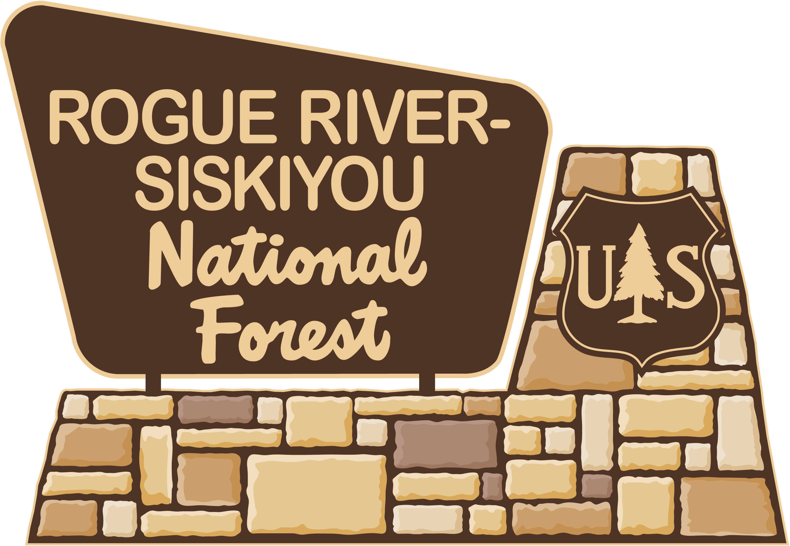
The Forest Service fully recognizes hunting and target shooting as valid uses of National Forest System lands. Help protect the reputation of responsible hunters and shooters by obeying restrictions. The use of explosives are banned on national forests in Oregon and Washington.
The following are prohibited:
• Explosives • Exploding targets
• Fireworks • Tracer bullets
• Incendiary ammunition
Rogue River-Siskiyou National Forest
3040 Biddle Road | Medford, OR 97504
(541) 618-2200
www.fs.usda.gov/rogue-siskiyou/
2015_08_29target11x17.pptx
2015_08_20targetprohibited.pptx

Slide 2
The Forest Service fully recognizes hunting and target shooting as valid uses of National Forest System lands. Help protect the reputation of responsible hunters and shooters by obeying restrictions. The use of explosives are banned on national forests in Oregon and Washington.
The following are prohibited:
• Explosives • Exploding targets
• Fireworks • Tracer bullets
• Incendiary ammunition
Rogue River-Siskiyou National Forest
3040 Biddle Road | Medford, OR 97504
(541) 618-2200
www.fs.usda.gov/rogue-siskiyou/
2015_08_29target11x17.pptx

