Slide 1
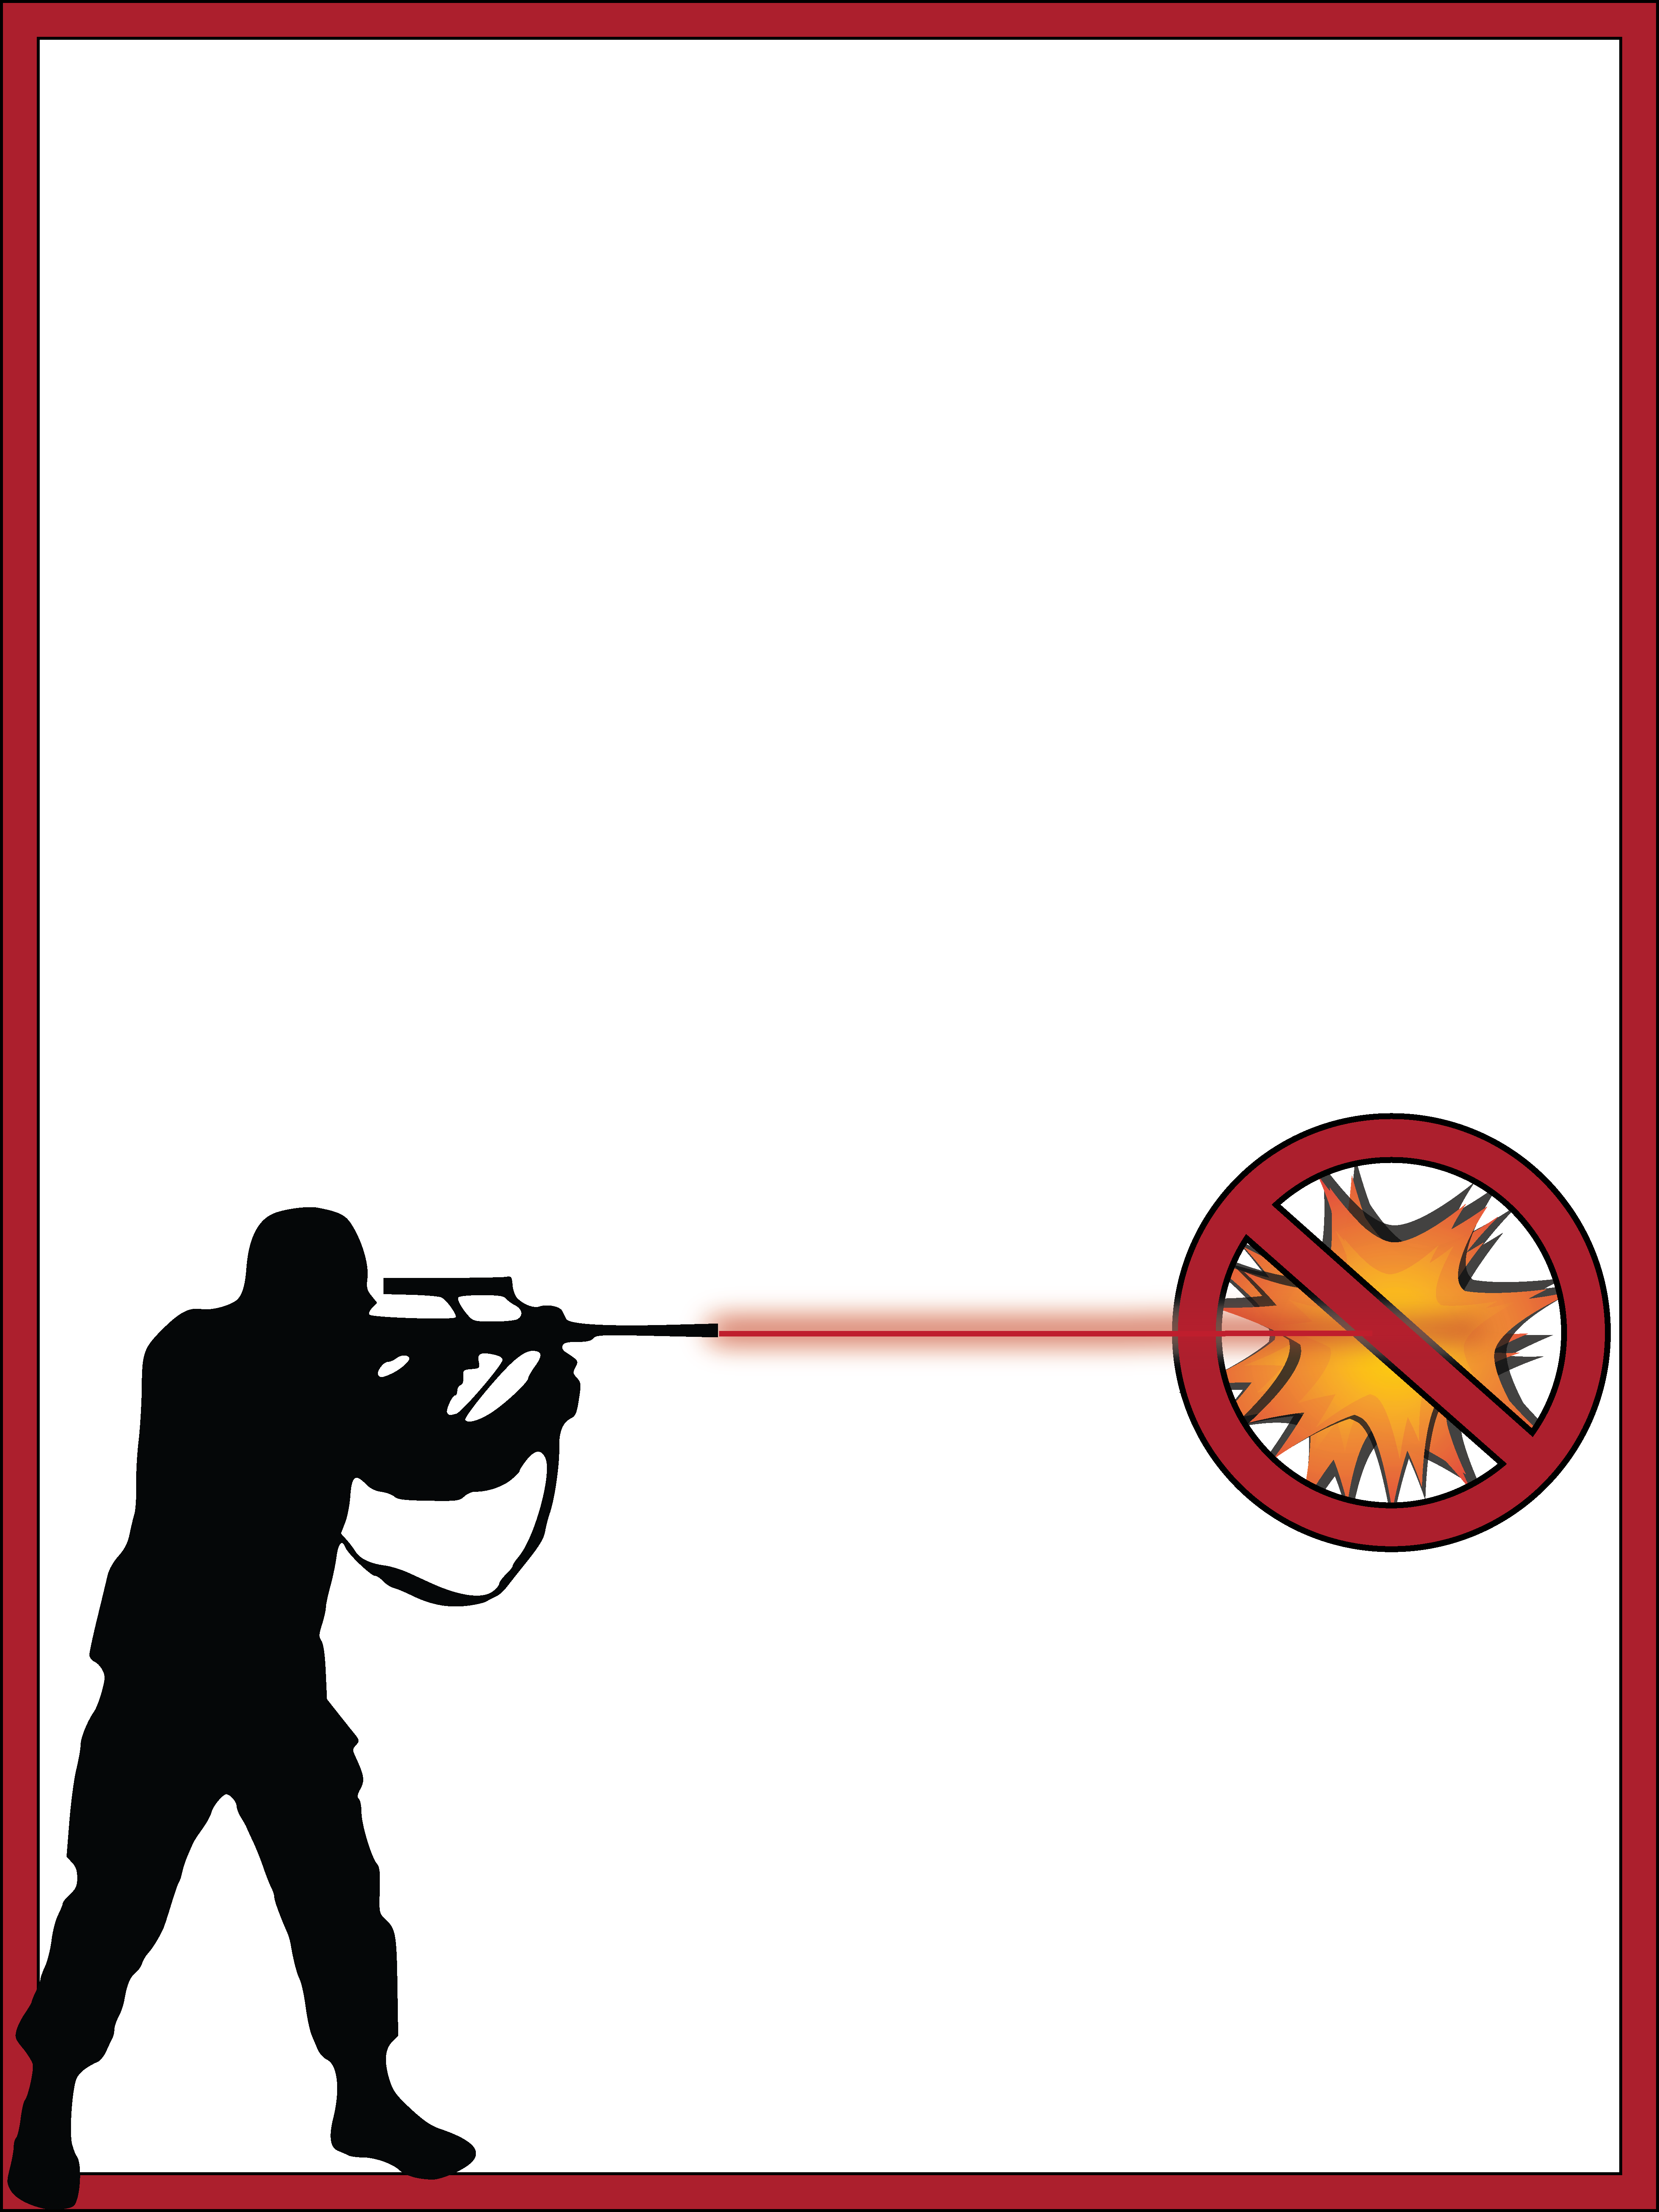
On National Forest lands in Oregon and Washington
The use of explosives are banned on national forests in Oregon and Washington.
Explosives cause wildfires -- high temperatures and often flames are generated when they explode.
The following are prohibited:
Explosives
Fireworks
Exploding targets
Tracer bullets
Incendiary ammunition
The Forest Service fully recognizes hunting and target shooting as valid uses of National Forest System lands. Please enjoy your sport responsibly.
2015_08_20targetprohibited.pptx

Slide 2
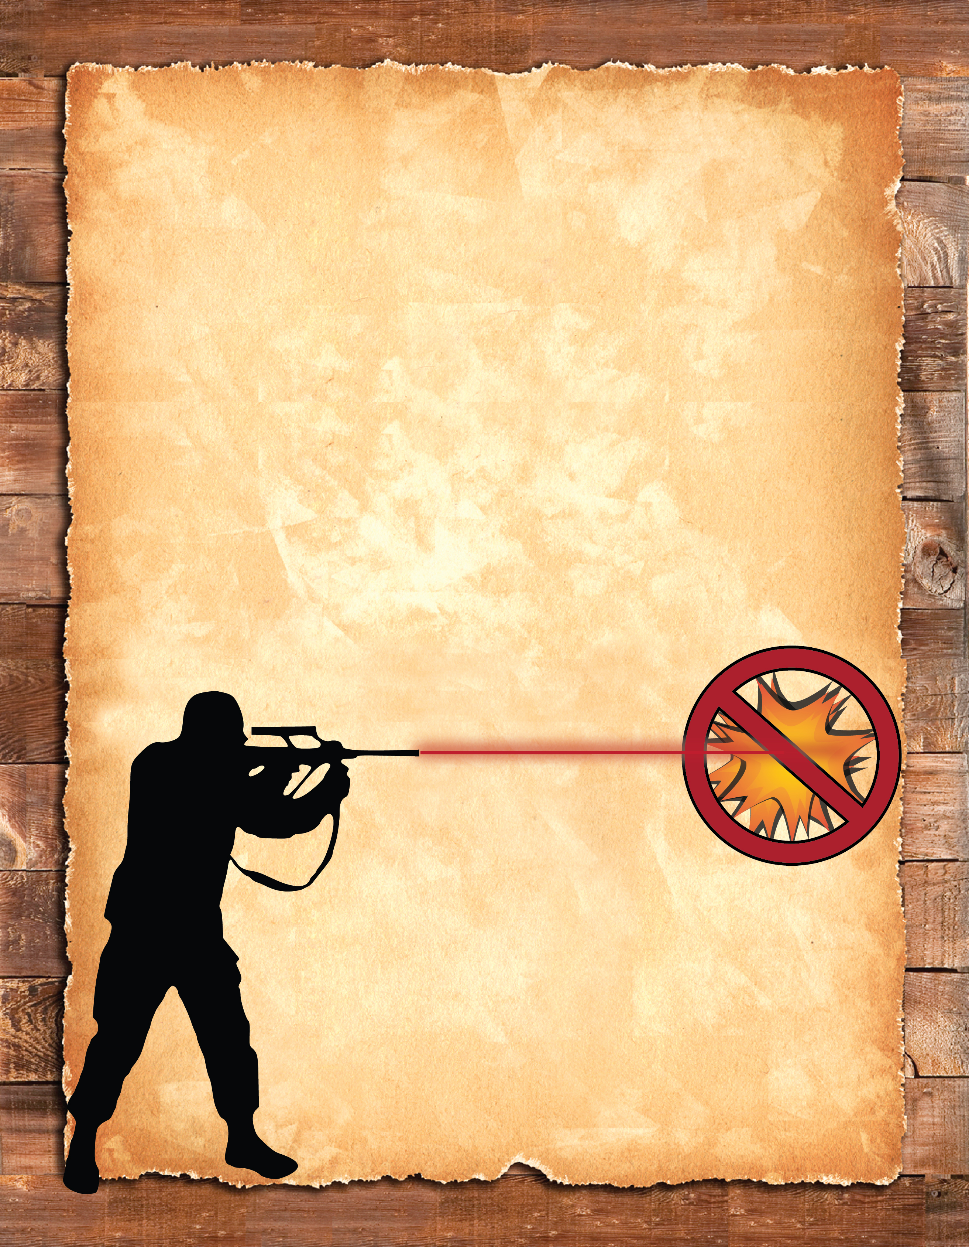
On National Forest lands in Oregon and Washington
The use of explosives are banned on national forests in Oregon and Washington.
Explosives cause wildfires -- high temperatures and often flames are generated when they explode.
The following are prohibited:
Explosives
Fireworks
Exploding targets
Tracer bullets
Incendiary ammunition
The Forest Service fully recognizes hunting and target shooting as valid uses of National Forest System lands. Please enjoy your sport responsibly.
2015_08_20targetprohibited.pptx

