Slide 1
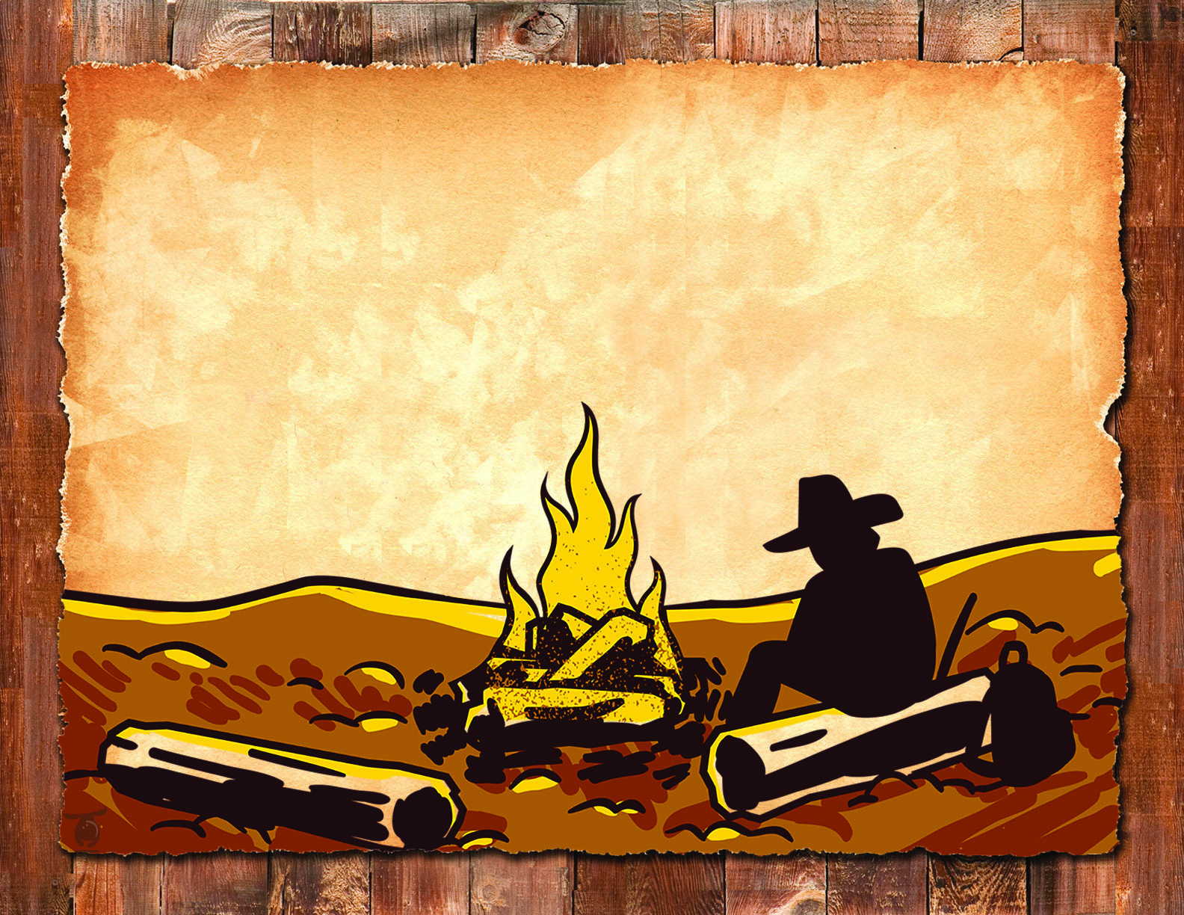
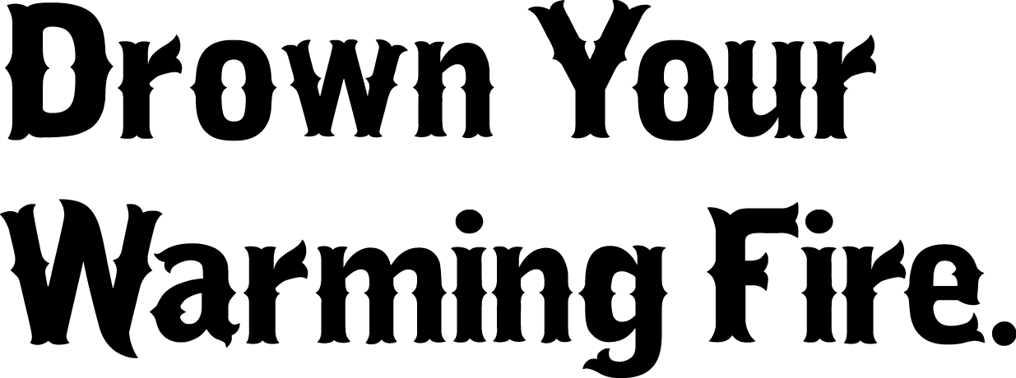
Obey fire restrictions.
Never leave a fire unattended.
Douse your fire before leaving.
2015_08_21drownwarming.pptx
Notes:
The text is editable, so you can change the wording if regulations or tips change. Make sure the bullets line up if you revise the text. You can also switch out logos and contact information. Logos are in the art_warming folder, in the agencylogos.pptx file; you can copy, paste and resize to fit, then add contact information. Always clear products you make with Public Affairs, Fire, Resource Specialists, Law Enforcement, Forest Supervisor etc. to make sure they are correct.

Slide 2
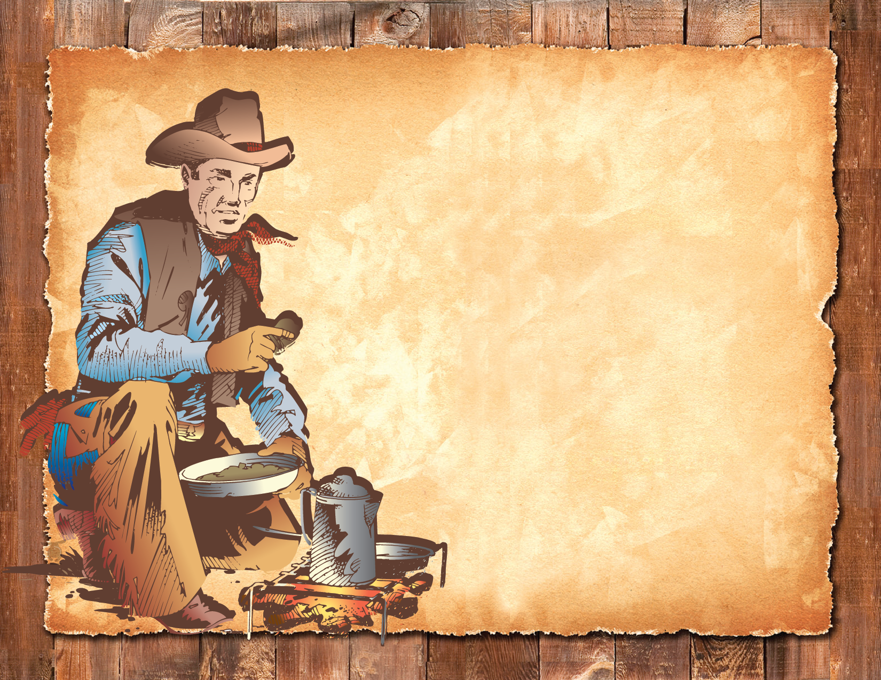
Obey fire restrictions.
Never leave a fire unattended.
Douse your fire before leaving.
2015_08_21drownwarming.pptx

