Slide 1
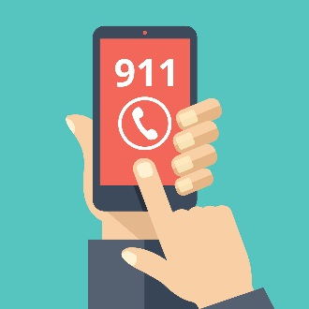
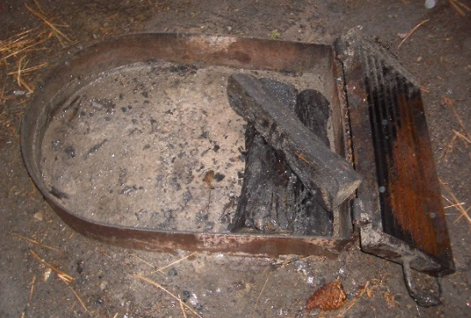
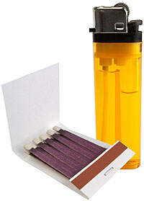
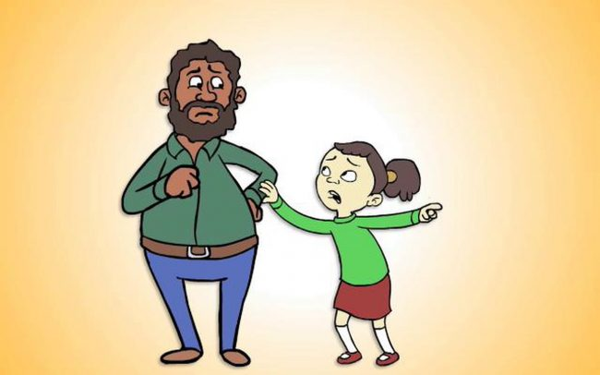
Fire safe friends never play with what?
GET SAFE
then
DIAL 911
What should you do if you see other children misusing matches and lighters?
When it is
DEAD-OUT
Do you ever leave any fire unattended?
Matches and lighters
When is it safe to leave any fire?
What should you do if you see a bad fire?
Tell an adult

