Slide 1
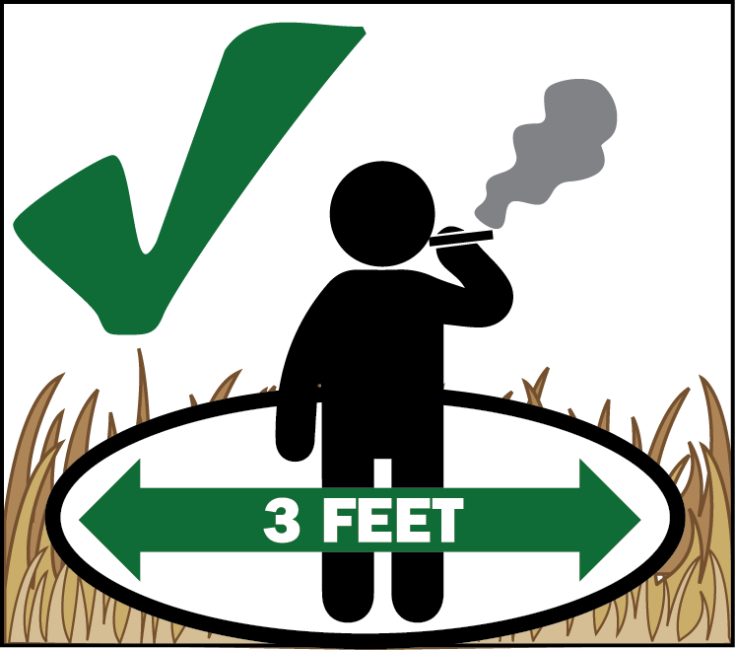
Tiv thaiv qhov chaw nyob ntawm hom nceb matsutake kom txhob kub hnyiab!
Tiv thaiv txoj kev tau mus yos de nceb!
Pev cov hav ntoo yog qhov chaw nyob rau hom nceb matsutake, uas muaj nqis nyob thoob ntiaj teb vim nws tsw ib tus ntxhiab txawv rau neeg nyiam. Vim tus xwm txheej hluav taws kub hnyiab, koj yuav tsum txuag zoo heev kom txhob kub hnyiab kis toj kis pes thaum nyob hauv hav ntoo.
TXHOB RAUV TAWS
vim kub hnyiab kis toj kis pes yog ib qho xwm txheej loj
Tas nrho cov qhov cub rauv taws nyob cuab lug yog txwv tsis pub rauv nyob rau ntawm lub hav ntoo Deschutes National Forest. Nws yeej tsis muaj qhov pub rauv taws ntawm cov chaw uas cia rau sawv daws mus pw ua si hauv hav zoov li.
PUB UA TAU
TXWV TSIS PUB
Haus luam yeeb
Rauv taws ntawm chaw mus pw ua si hav zoov
Rauv taws nte kom sov
Rauv taws ua zaub ua mov noj
Rauv cov qhov cub rau roj (propane) uas nqa tau mus los
Rauv thee
Cov qhov cub rauv taws
Cov qhov cub ci nqaij
Koj haus tau luam yeeb hauv ib lub tsheb los yog hauv ib lub tsev uas kaw qhov rooj qhov rai, hauv ib qhov chaw mus pw ua si tom hav zoov uas luag cia rau haus luam yeeb, hauv ib lub nkoj, ntawm ntug pa dej thiab hav dej, los yog thaum nres rau ntawm ib qhov chaw uas deb tsawg kawg 3 feet ib puag ncig uas tsis muaj tej khoom txais tau hluav taws nyob ntawd.
Hmong
Crescent Ranger District Office
136471 Hwy 97 North
Crescent, OR 97733
541-433-3200
www.fs.usda.gov/deschutes

