Slide 1
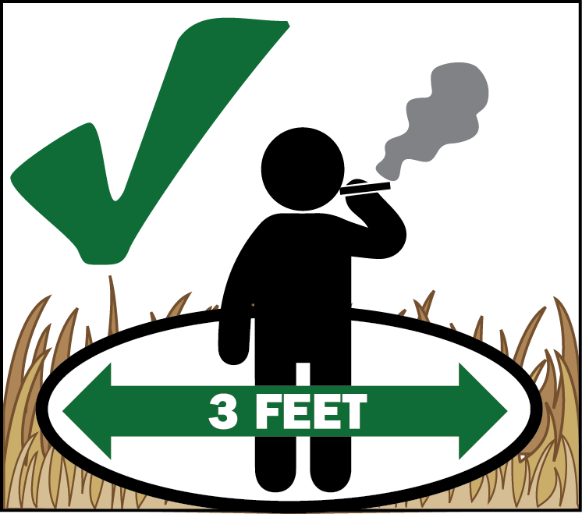
Beu jienv matsutake coutv nyei dorngx nqaeqv jienv lomc zangc douz! Beu jienv bun mbuo haih duqv siou cun-gaeng!
Mbuo nyei maaih ndiangx nyei gemh lomc se matsutake cuotv nyei dorngx, maaih jaax-zinh yiem lungh ndiev weic zuqc lengc jeiv kuv haic.
Douz se maaih hiuang-orqv nyei, meih a’zuqc beu jienv nqaeqv coutv lomc zangc douz yiem maaih ndiangx camv nyei gemh lomc.
MAIV BUN BUOV DOUZ
weic zuqc lomc zangc douz maaih hiuang-orqv
Yietc zungv ga’nyiec maengx nyei douz se maiv maaih doz-leiz longc yiem Deschutes Guoc Jaac nyei Lomc. Maiv maaih haih dauh cih cuotv duqv longc douz, yiem liepc daih nyei camp caux camp maaih zipv kaeqv mienh nyei ziouv yaac zeiz.
NQOI NZUIH BUN NYEI
MAIV MAAIH DOZ LEIZ
Buov in mbiaatc
Buov douz yiem camp
Buov douz siouv
Buov douz zouv nyanc hopv
Bouv qiex nyei youh longc zoux camp nyei douz
Taanx nyei douz
Bouv ndiangx nyei douz louh
Ndiangx nyei douz louh fai sioux orv nyei douz louh
Crescent Ranger District Office
136471 Hwy 97 North
Crescent, OR 97733
541-433-3200
www.fs.usda.gov/deschutes
Meih haih duqv buov in mbiaatc yiem gu’nyuoz guon jienv nyei cie fai biauv, yiem nuqv cuotv daaih nyei camp ndau-beih, yiem nzangv yiem domh njaangh fai ndoqv, caux yiem dorngx buo norm zaux-benv gaatv jiex guinh mbu’ndongx nyei jauv maiv maaih haih zieqc douz nyei ga’naaiv. Mien

