Slide 1
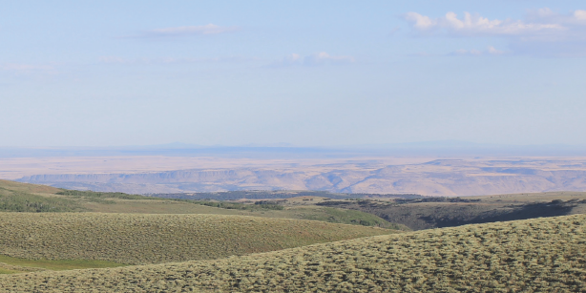
Notes:
Billboards typically have different dimensions/proportions based on location and company. This PowerPoint version is just to give you an idea of how it can look. The background landscape is low-resolution just to show how it will look… you will need to find a hi-res version for production by sign company. Most billboard companies have specific file formats (Like Adobe Illustrator) and cannot accept PowerPoint files for final output. SInce this is a billboard, graphic elements are kept deliberately simple; background elements that look great on your computer or when printed out small on an office laser printer will not be visually effective on a billboard. These were analysed using Outdoor Advertising Association of America’s Creative Testing Tool to make sure they worked well.

Slide 2
About Boards and Signs
The audience for outdoor signing is mobile. This fast pace lifestyle of your audience reduces the time you have to reach them with your message to only a few seconds. If you edit this sign, below are some tips to help you meet this challenge.
THE MESSAGE
Express the most important idea concisely.
Use short copy lines. Seven words or less.
Make sure the logo is legible.
COLORS
Use bold colors. Being subtle from 600 feet does not work.
Forget about white space. It does not apply in outdoor like in print.
Use contrasting colors, they read better from a distance.
FONTS
Use bold, non-serif fonts.
Avoid decorative, italic or thin serif fonts.
IMAGES
Choose images with simple backgrounds.
Avoid using landscapes or complex scenes.
CONTEXT
Follow agency guidelines for font size based on sign location and viewing distance. (FS Sign Manual)

