Slide 1
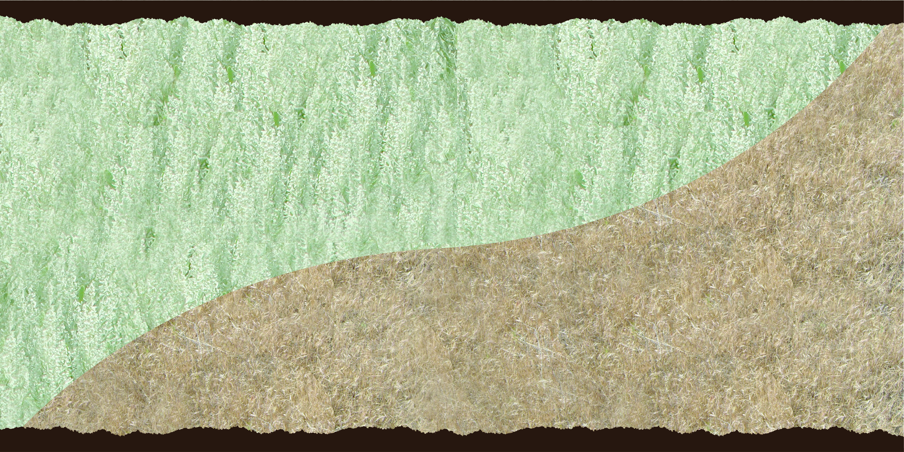
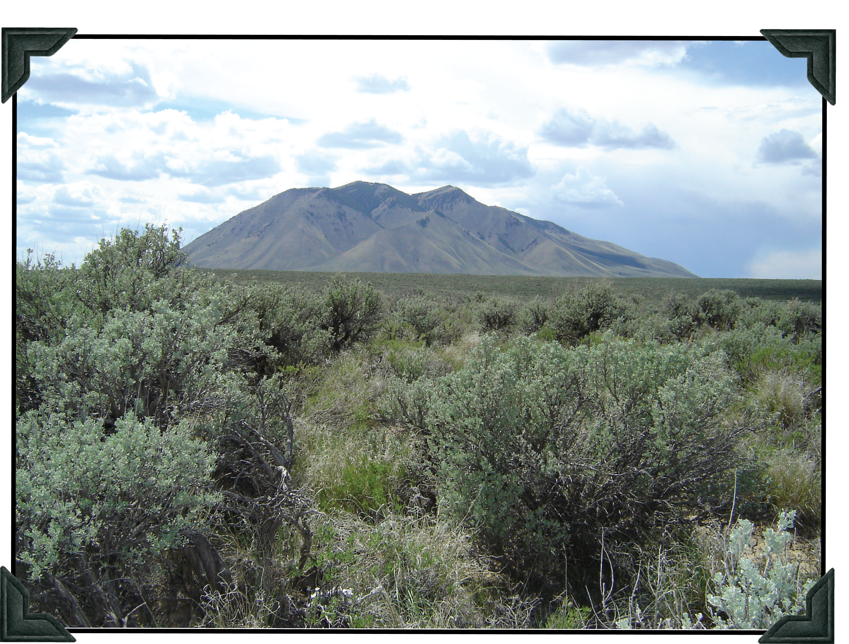
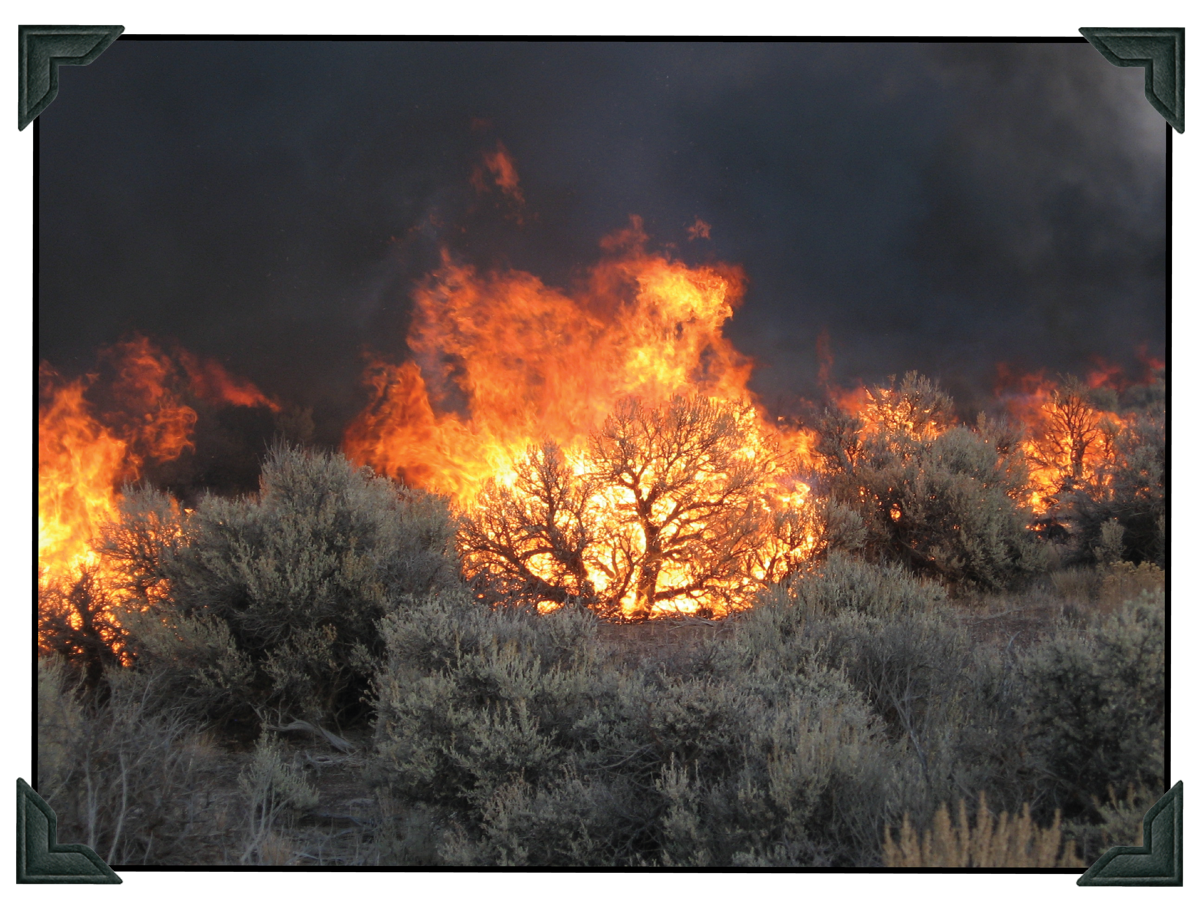
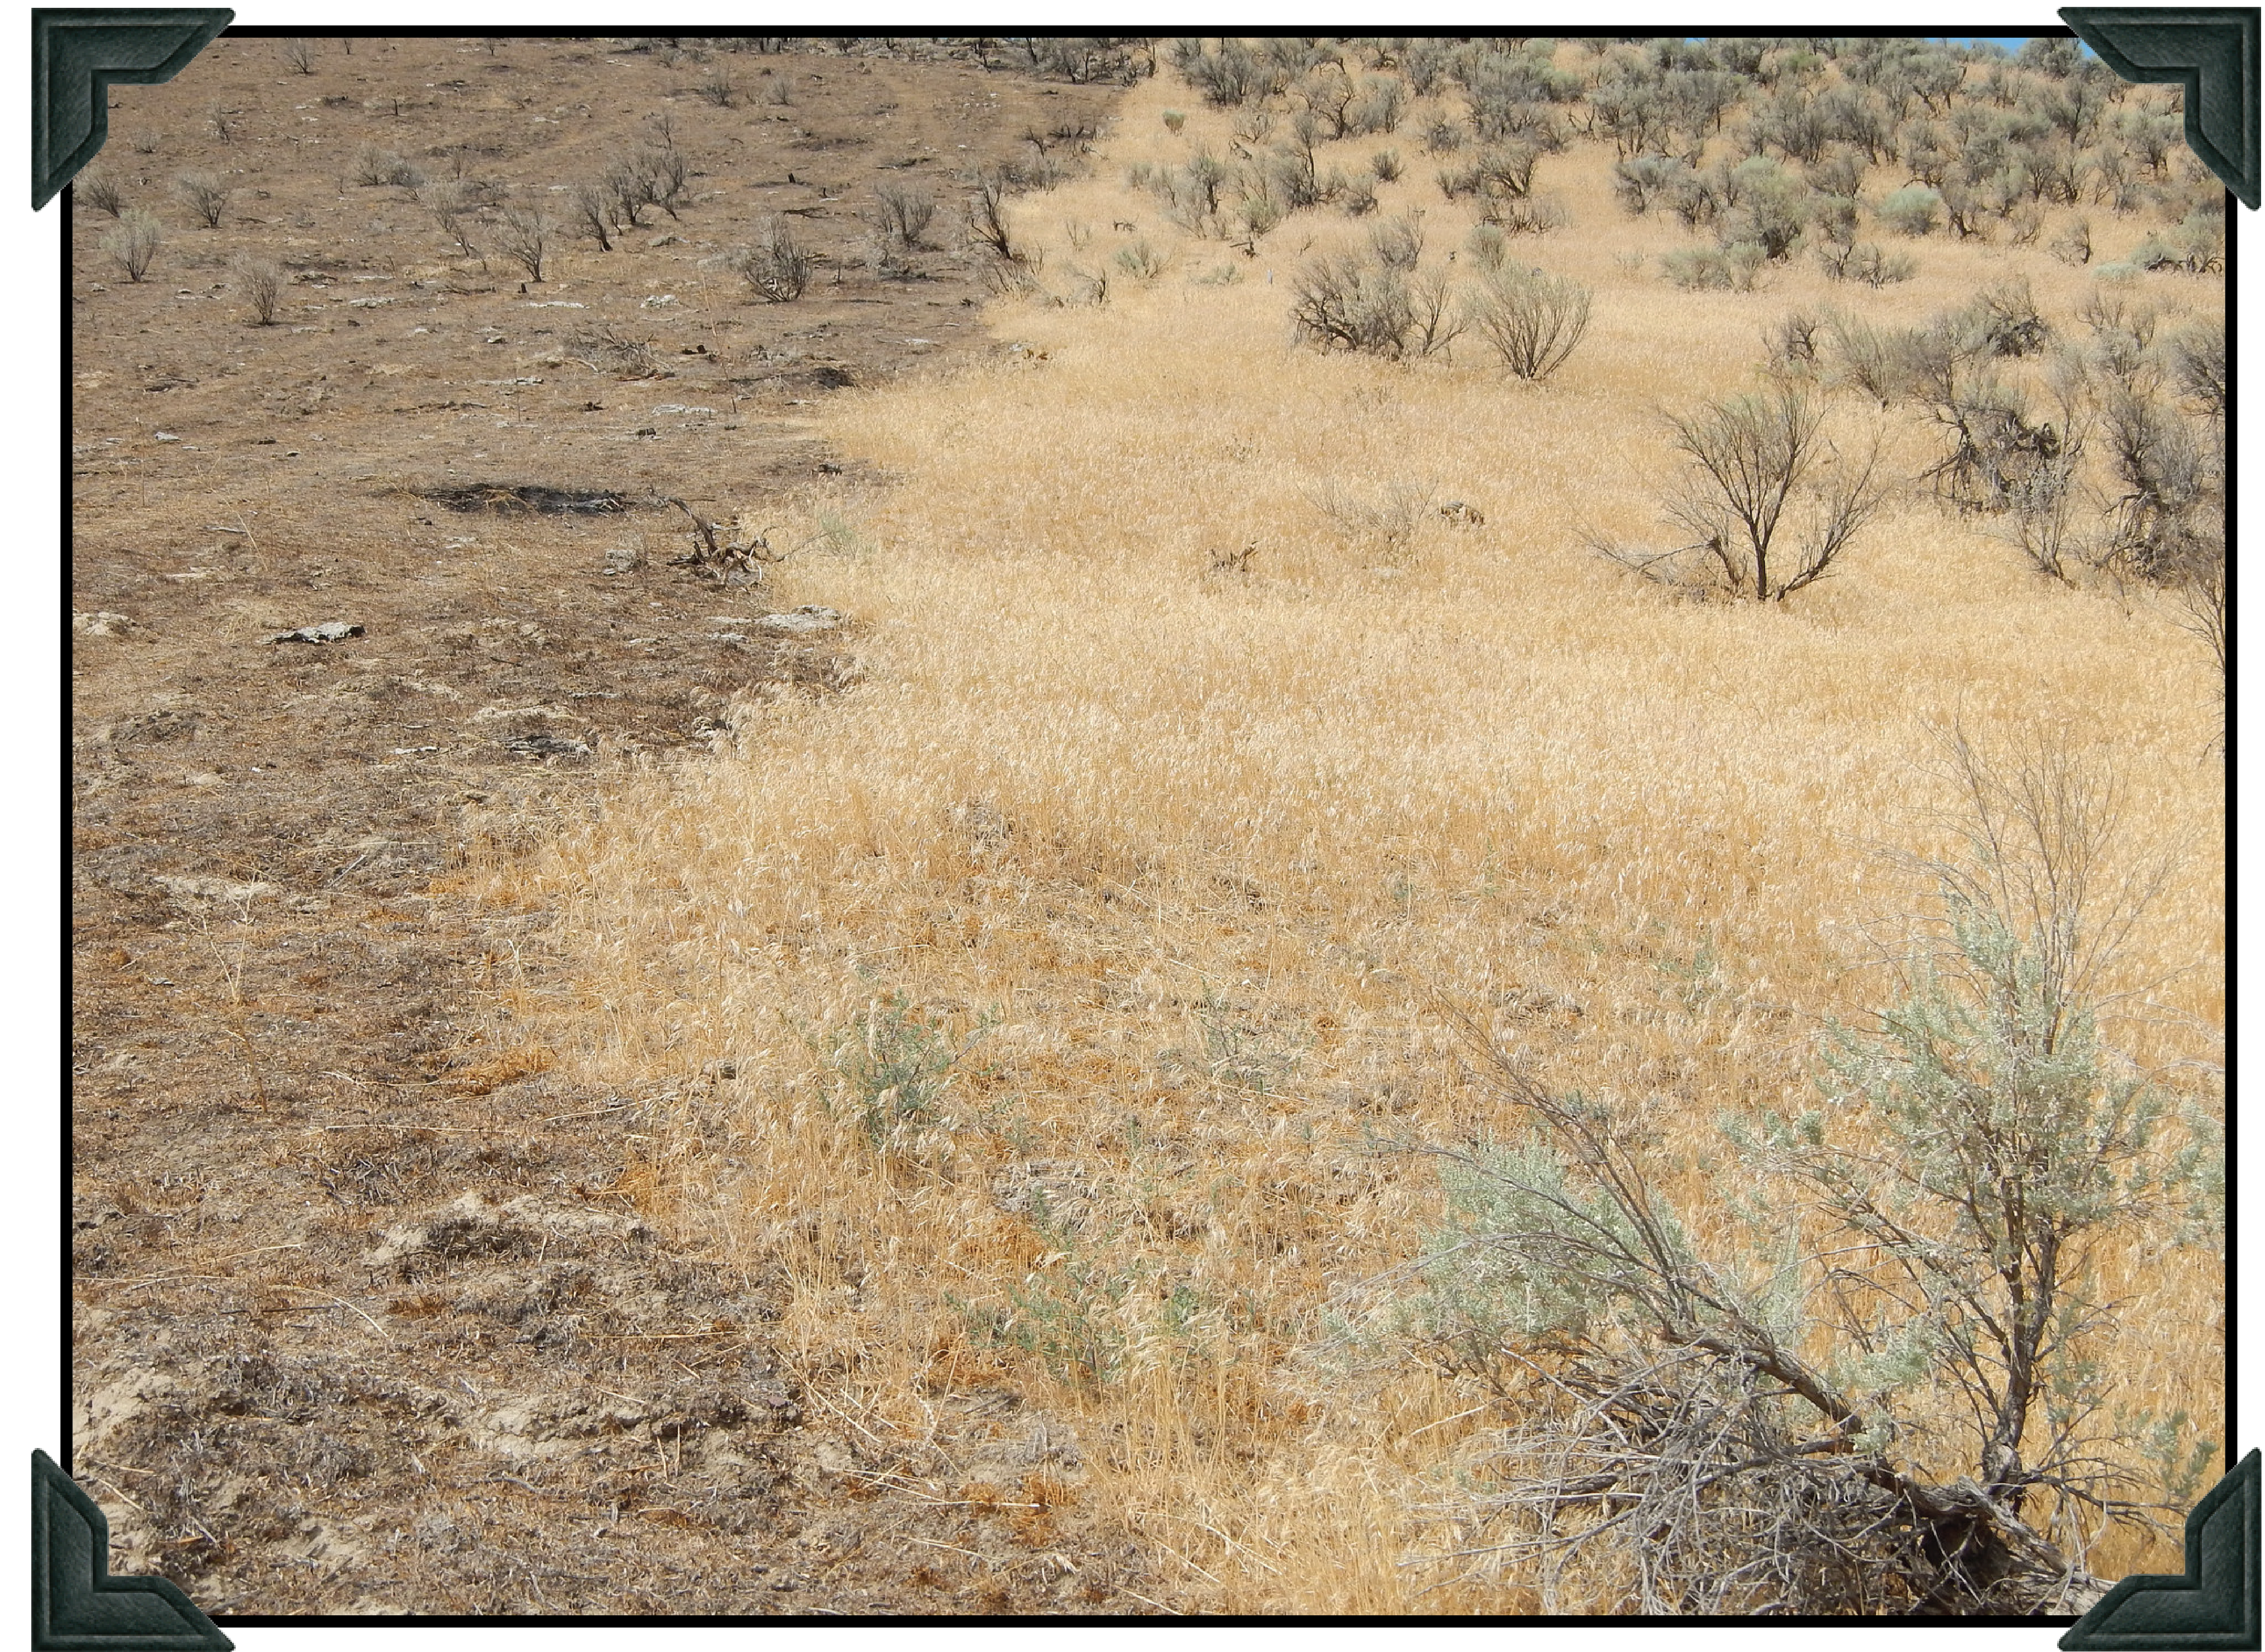
Cheatgrass displaces
native plant species that
provide habitat for wildlife.
Desirable sagebrush provides habitat for the Greater Sage-
Grouse and other native species.
Fire kills sagebrush
and cheatgrass
takes its place.
2015_08_22stopinvasivedisplay.pptx

