Slide 1
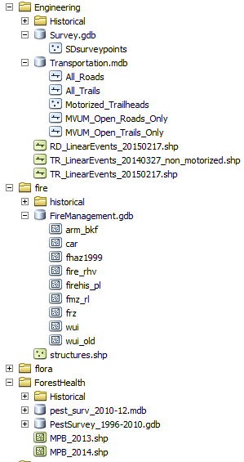
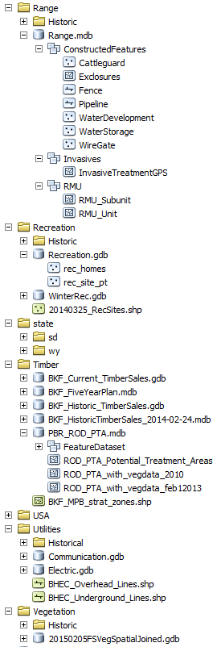
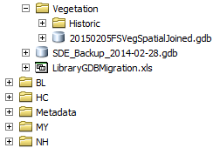
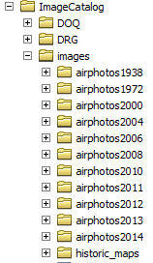
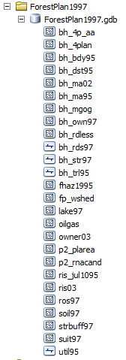
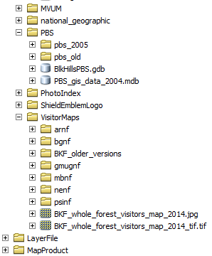
Below is the ArcCatalog view of GIS and other data in our T:drive library, T:\FS\Reference\GIS\r02_bkf
There is a spreadsheet “GIS_data_layers_listing_Tdrive_library_20150729.xls” that gives more detail on the data.
July 29, 2015
CHECK’EM OUT

