Slide 1
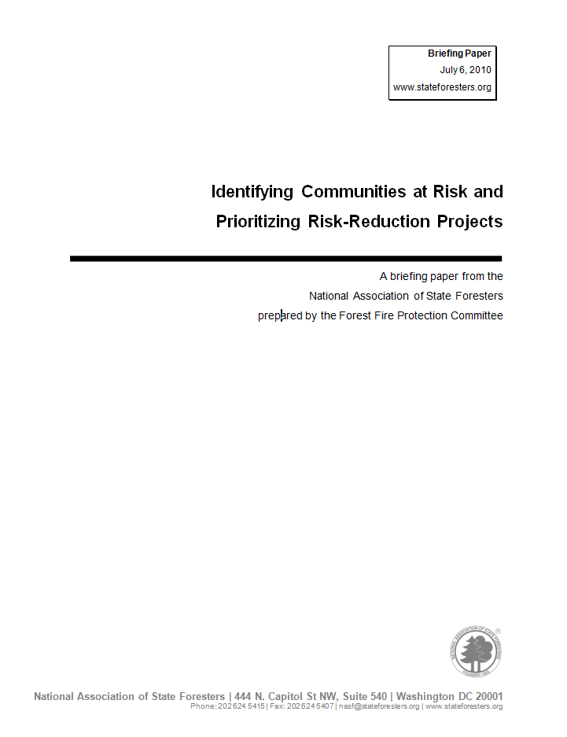
Developing a Common Strategy to Identify Communities at Risk and Prioritize Risk Reduction Projects - An Initial Review by SGSF GIS Task Force
SGSF GIS Annual Meeting
Asheville, North Carolina
November 3, 2010
Curt Stripling, Sue Leverette, Roy Boggs

Slide 2
Objectives
Initial review and discussion will focus primarily on the first two commitments and expectations outlined in the briefing paper - Identification and Prioritization
Review history and purpose for identifying and communities at risk
Identify and review current issues
Discuss future strategies for identifying communities at risk or alternately landscapes of similar risk
Identify action items

Slide 3
History and Purpose for Identifying Communities at Risk
Federal Register –
Cohesive Strategy – “assessing the level of risk to communities”
National Fire Plan -
SGSF Briefing Paper – “ Each state will determine how many communities are at risk or alternately identify landscapes of similar risk and will establish methodology for assessing community risk.’

Slide 4
# 1 - Identification
“Each state will determine how many communities are at risk or alternately identify landscapes of similar risk and will establish methodology for assessing community risk. Statewide Forest Resource Assessments will also aid in determining priority areas of wildfire risk. To determine communities at risk, each state should:
Include all lands and all ownerships
Use a collaborative process that is consistent with the complexity of land ownership patterns, resource management issues, and the number of interested stakeholders
Report the number of communities at risk on a gradient scale of low, moderate, and high”

Slide 5
# 2 - Prioritization
“NASF strongly promotes Community Wildfire Protection Planning and encourages each state to prioritize community wildfire risk reduction projects based on nationally publicized risk-assessment methods and on community, state, or regional risk assessments. The intent of the risk assessment process is to compare relative risk to communities from wildfire within a state, not to compare wildfire risk to communities between or among states.”
“Using available mitigation plans, CWPPs, or another similar analysis process, federal, state and local agencies and tribes will each annually examine the lands under its own ownership or jurisdiction and, with the involvement of all interested parties, identify high priority areas for conducting fuels reduction, ecosystem restoration, and other projects that have the potential to reduce the risk to a specific community or communities.”

Slide 6
Current Issues Related to Identifying, Mapping and Rating Communities at Risk
text

